Slide 1
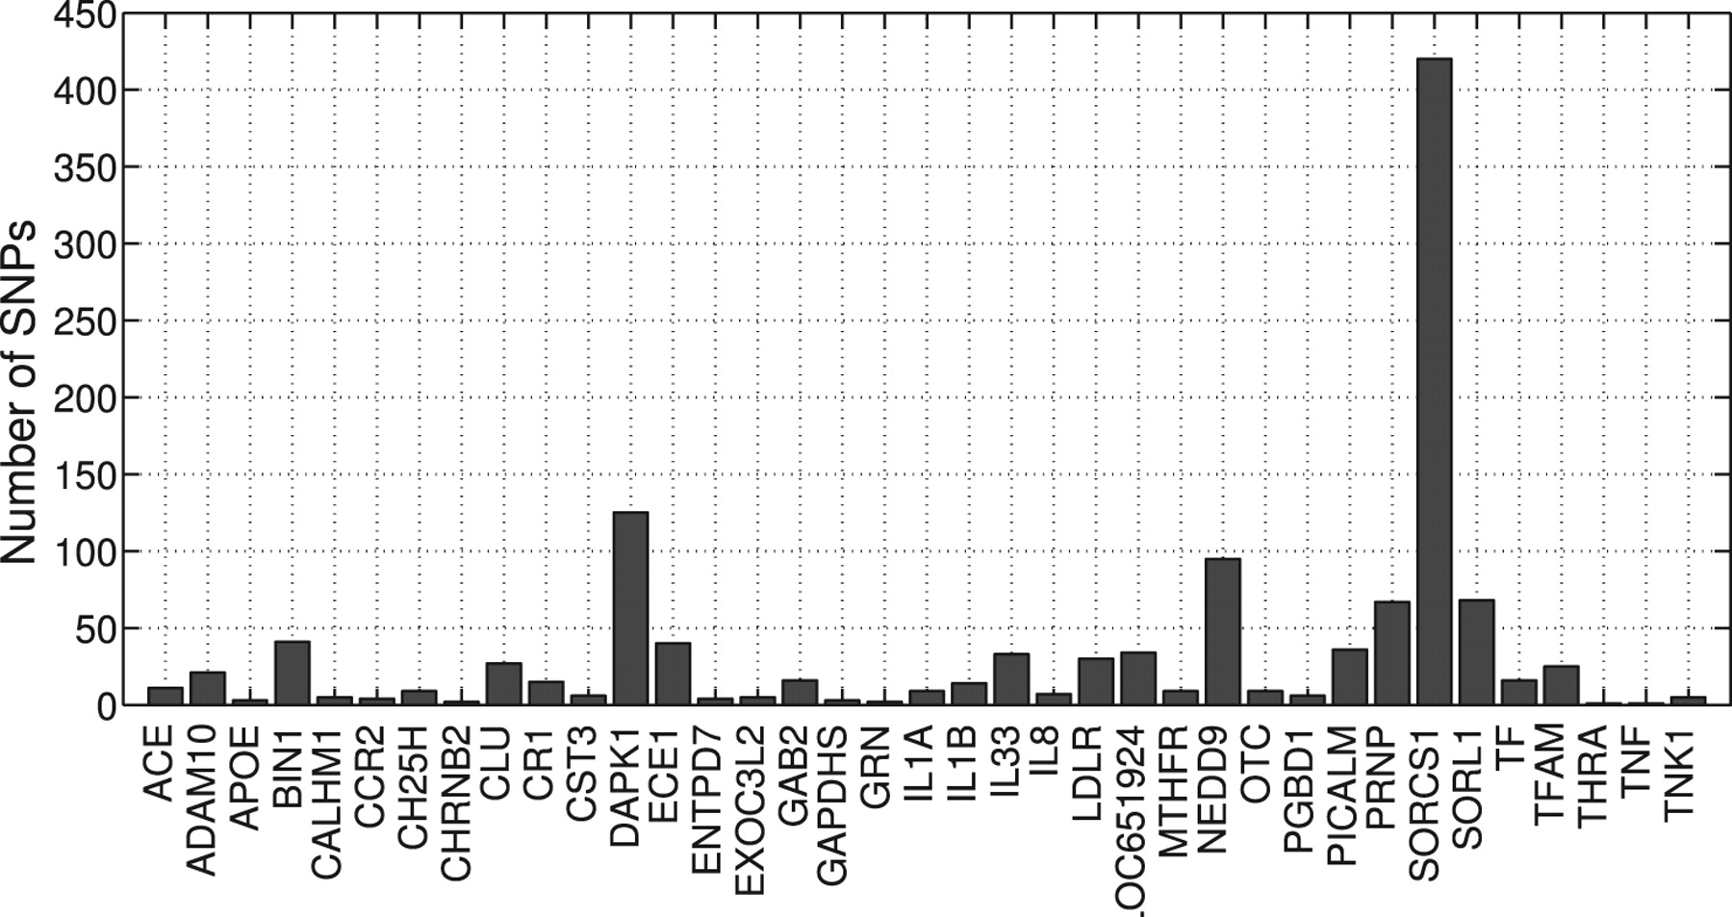
Fig. 1. Top 37 AD risk factor genes used in this study and the numbers of their SNPs.
Notes:
Fig. 1. Top 37 AD risk factor genes used in this study and the numbers of their SNPs.
Unless provided in the caption above, the following copyright applies to the content of this slide: © The Author 2011. Published by Oxford University Press. All rights reserved. For Permissions, please email: journals.permissions@oup.com

Slide 2
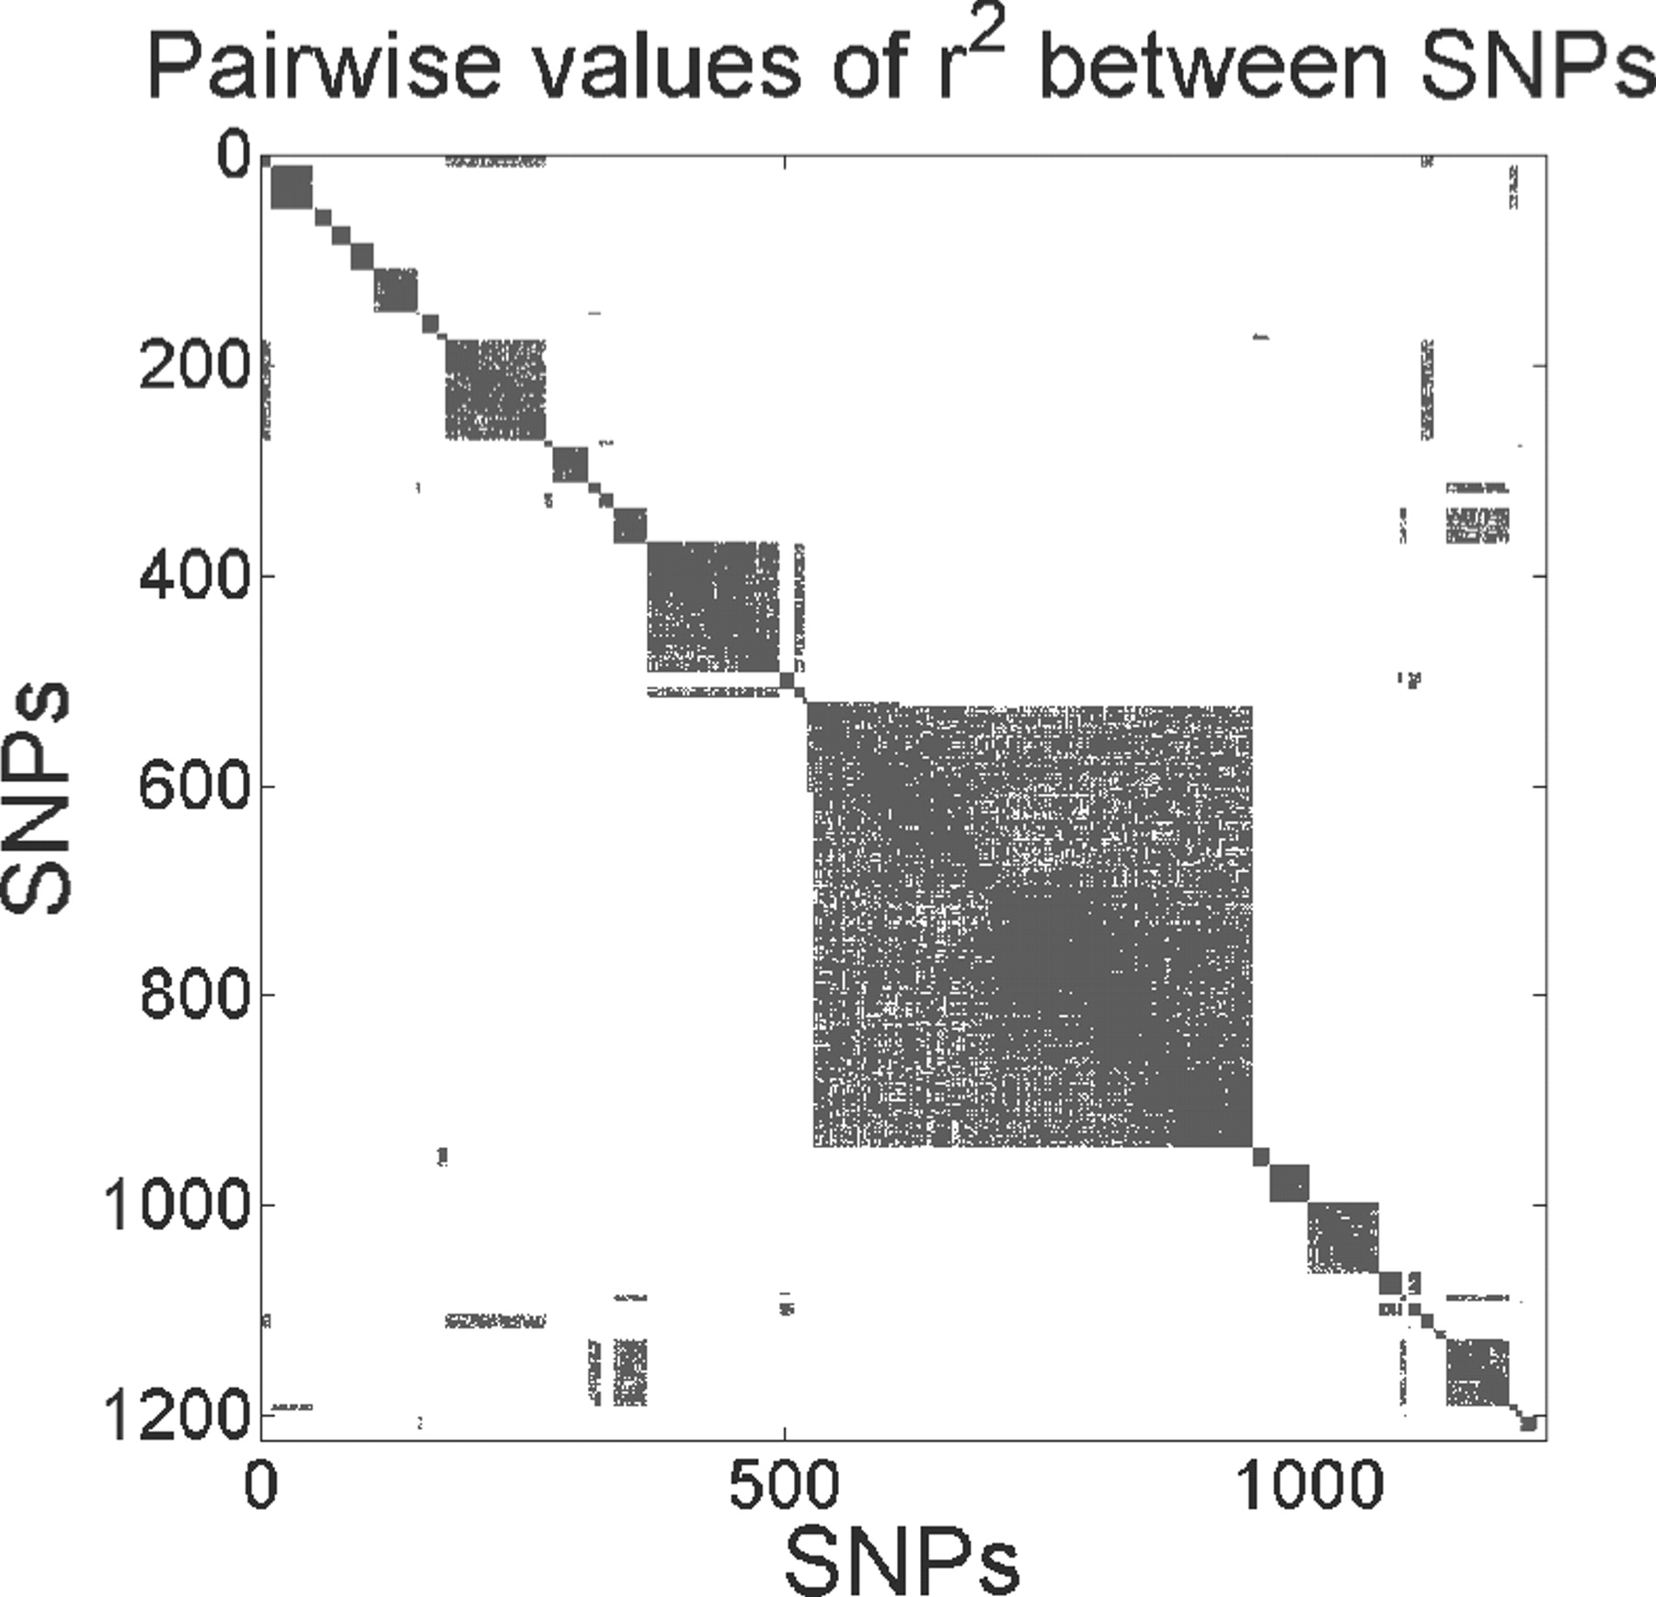
Fig. 2. Pairwise LD correlation coefficients (r²>0.2 in blue) among the 1224 SNPs used in this study. The ...
Notes:
Fig. 2. Pairwise LD correlation coefficients (r2>0.2 in blue) among the 1224 SNPs used in this study. The SNPs clearly form groups.
Unless provided in the caption above, the following copyright applies to the content of this slide: © The Author 2011. Published by Oxford University Press. All rights reserved. For Permissions, please email: journals.permissions@oup.com

Slide 3
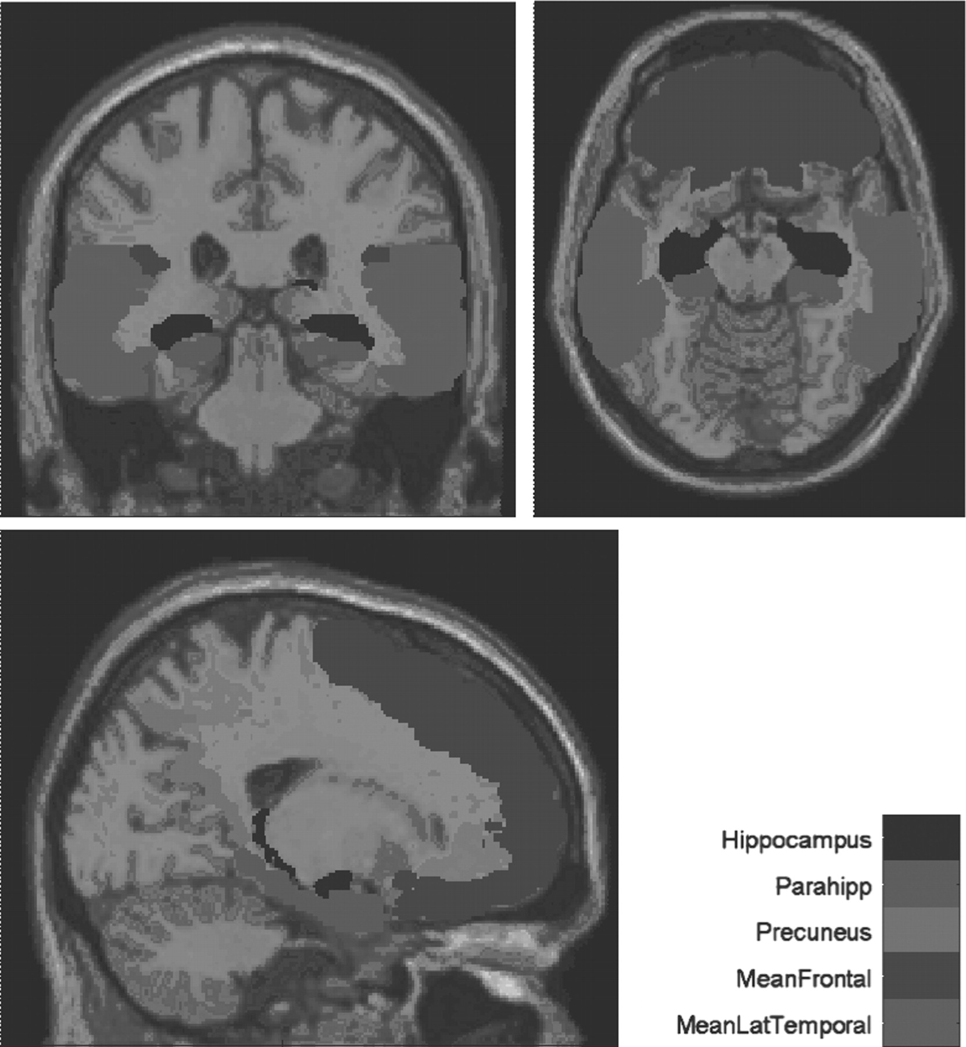
Fig. 3. VBM ROIs used in this study are mapped onto a brain.
Notes:
Fig. 3. VBM ROIs used in this study are mapped onto a brain.
Unless provided in the caption above, the following copyright applies to the content of this slide: © The Author 2011. Published by Oxford University Press. All rights reserved. For Permissions, please email: journals.permissions@oup.com

Slide 4
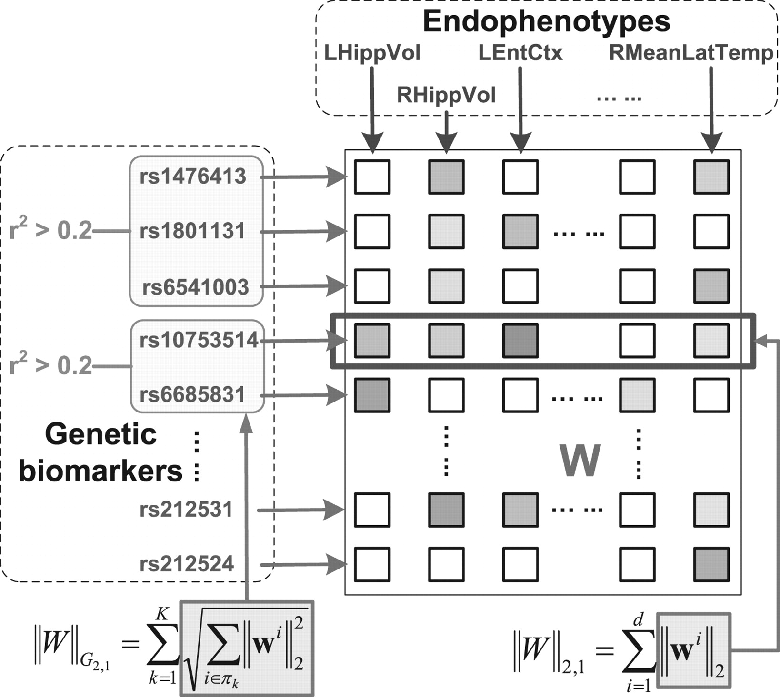
Fig. 4. Illustration of the proposed G-SMuRFS method. We incorporate the group structural information of the genetic ...
Notes:
Fig. 4. Illustration of the proposed G-SMuRFS method. We incorporate the group structural information of the genetic markers through a new group ℓ2,1-norm regularization (‖W‖G2,1), and enforce ℓ2,1-norm regularization (‖W‖G2,1) to jointly select prominent SNPs across all endophenotypes.
Unless provided in the caption above, the following copyright applies to the content of this slide: © The Author 2011. Published by Oxford University Press. All rights reserved. For Permissions, please email: journals.permissions@oup.com

Slide 5
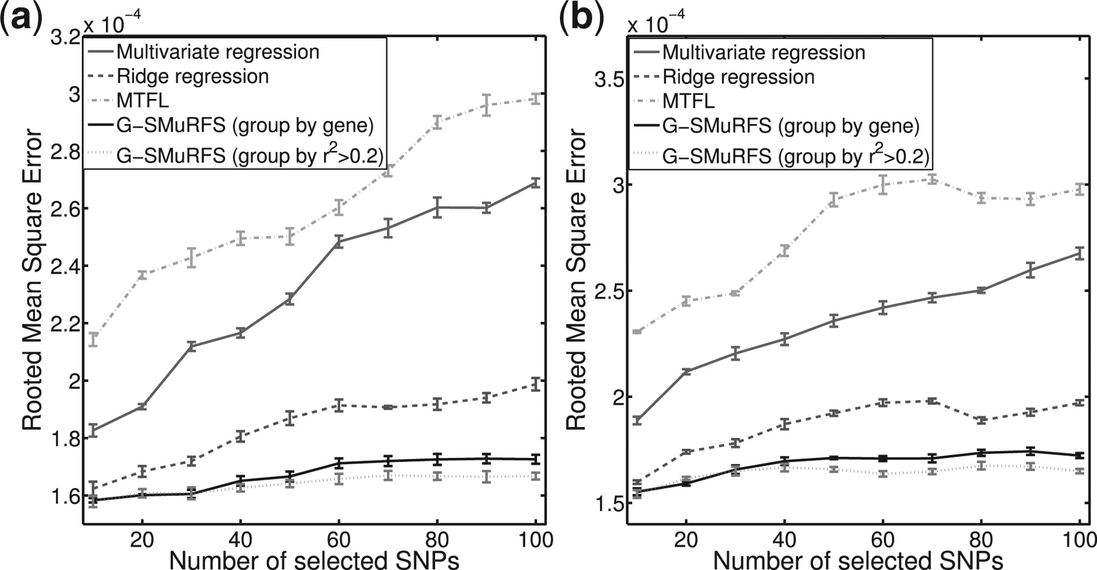
Fig. 5. Performance comparison: The mean and SD of the root mean square errors (RMSEs) obtained from five ...
Notes:
Fig. 5. Performance comparison: The mean and SD of the root mean square errors (RMSEs) obtained from five cross-validation trials in each experiment are plotted, where each error bar indicates ±1 SD. (a) FreeSurfer imaging phenotypes; (b) VBM imaging phenotypes.
Unless provided in the caption above, the following copyright applies to the content of this slide: © The Author 2011. Published by Oxford University Press. All rights reserved. For Permissions, please email: journals.permissions@oup.com

Slide 6
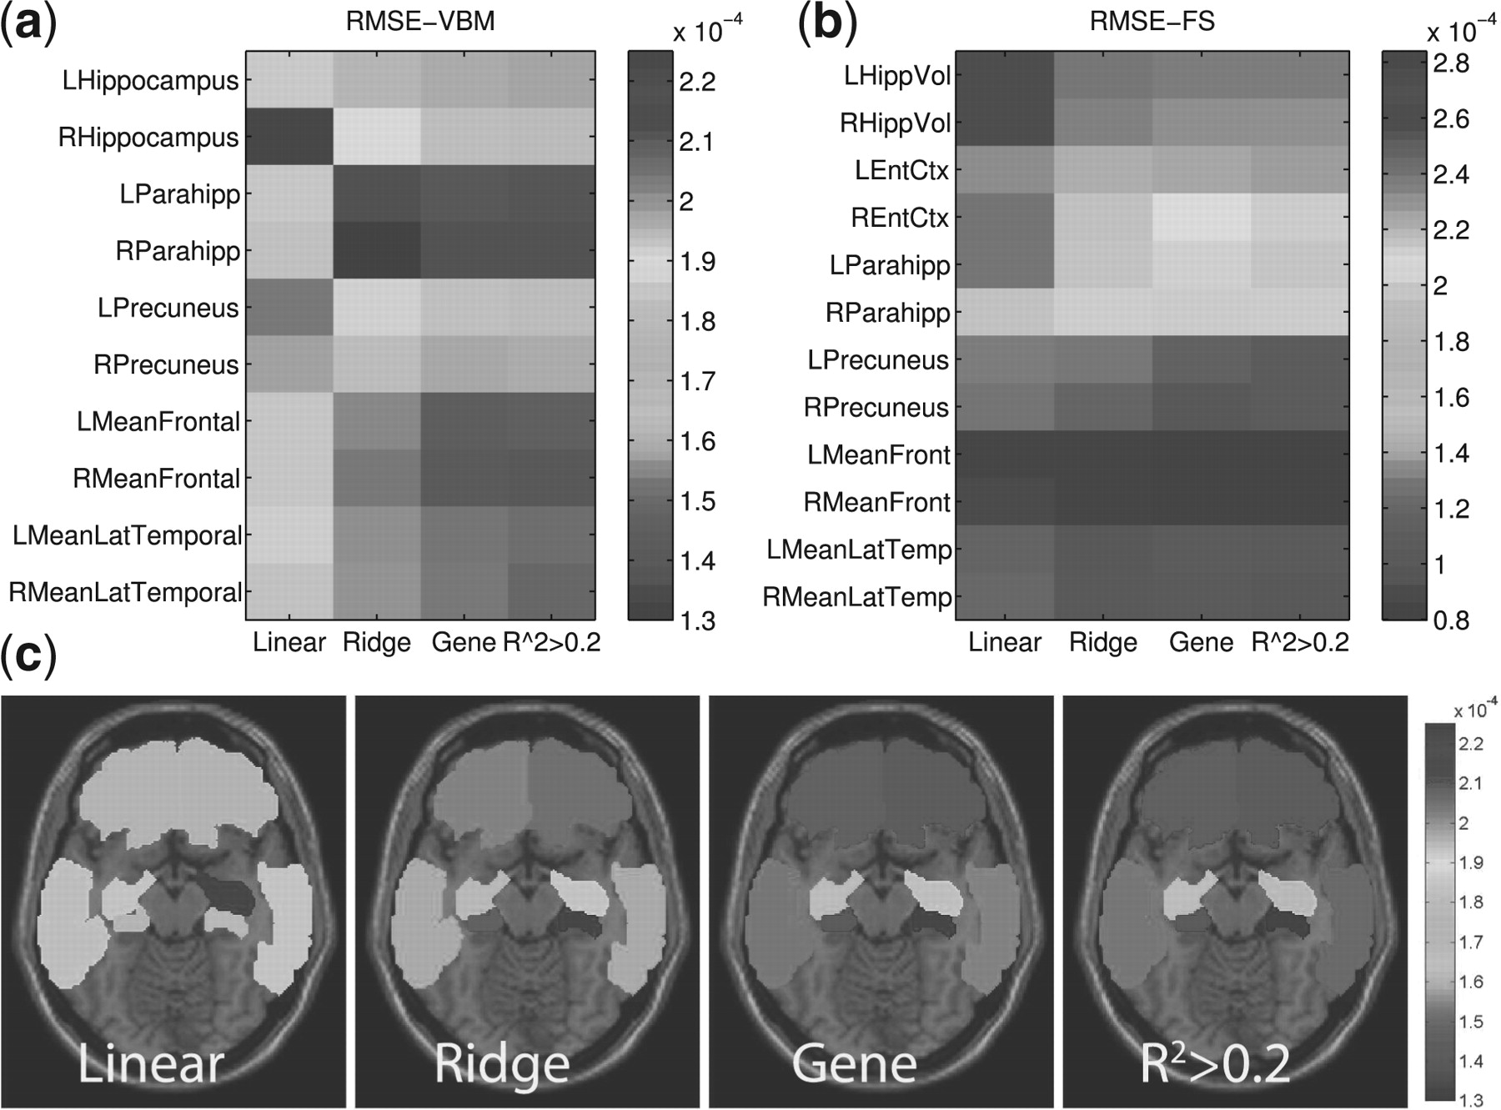
Fig. 6. (a and b) Show the heat maps of RMSEs for predicting VBM (a) and FreeSurfer (b) measures using LR, RR, our ...
Notes:
Fig. 6. (a and b) Show the heat maps of RMSEs for predicting VBM (a) and FreeSurfer (b) measures using LR, RR, our G-SMuRFS method with SNPs grouped by gene and G-SMuRFS with SNPs grouped by r2>0.2, where top 10 SNPs were used in our G-SMuRFS methods. In (c), RMSEs for predicting VBM measures using four methods are mapped onto the brain volume.
Unless provided in the caption above, the following copyright applies to the content of this slide: © The Author 2011. Published by Oxford University Press. All rights reserved. For Permissions, please email: journals.permissions@oup.com

Slide 7
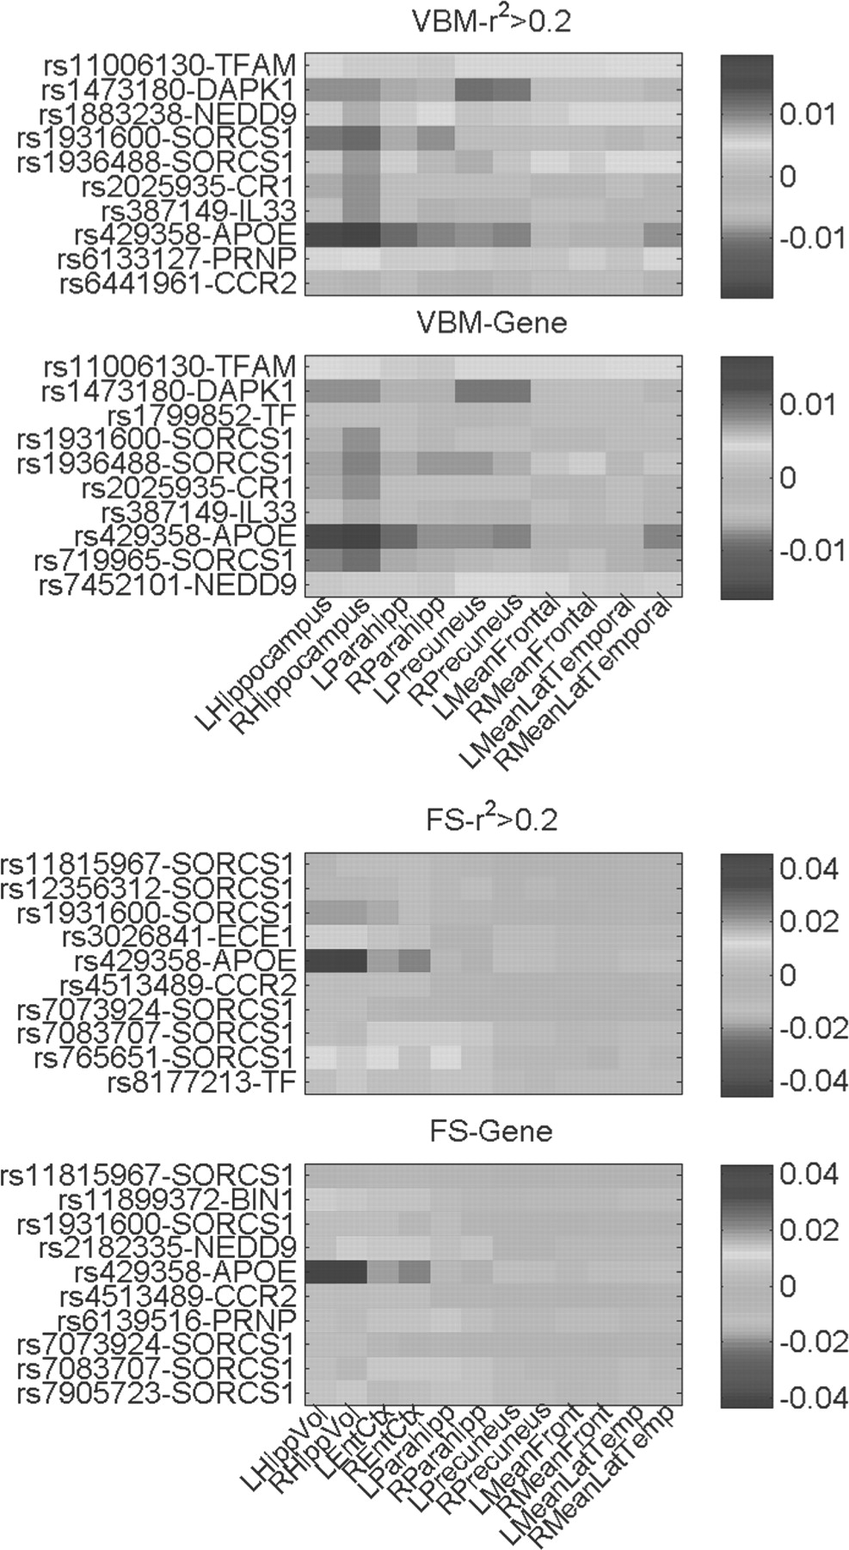
Fig. 7. Regression coefficients are visualized for top 10 selected SNPs in each of the four experiments (from top to ...
Notes:
Fig. 7. Regression coefficients are visualized for top 10 selected SNPs in each of the four experiments (from top to bottom): (i) group by r2>0.2, regression on VBM measures; (ii) group by gene, regression on VBM measures; (iii) group by r2>0.2, regression on FreeSurfer measures; and (iv) group by gene, regression on FreeSurfer measures.
Unless provided in the caption above, the following copyright applies to the content of this slide: © The Author 2011. Published by Oxford University Press. All rights reserved. For Permissions, please email: journals.permissions@oup.com

Slide 8
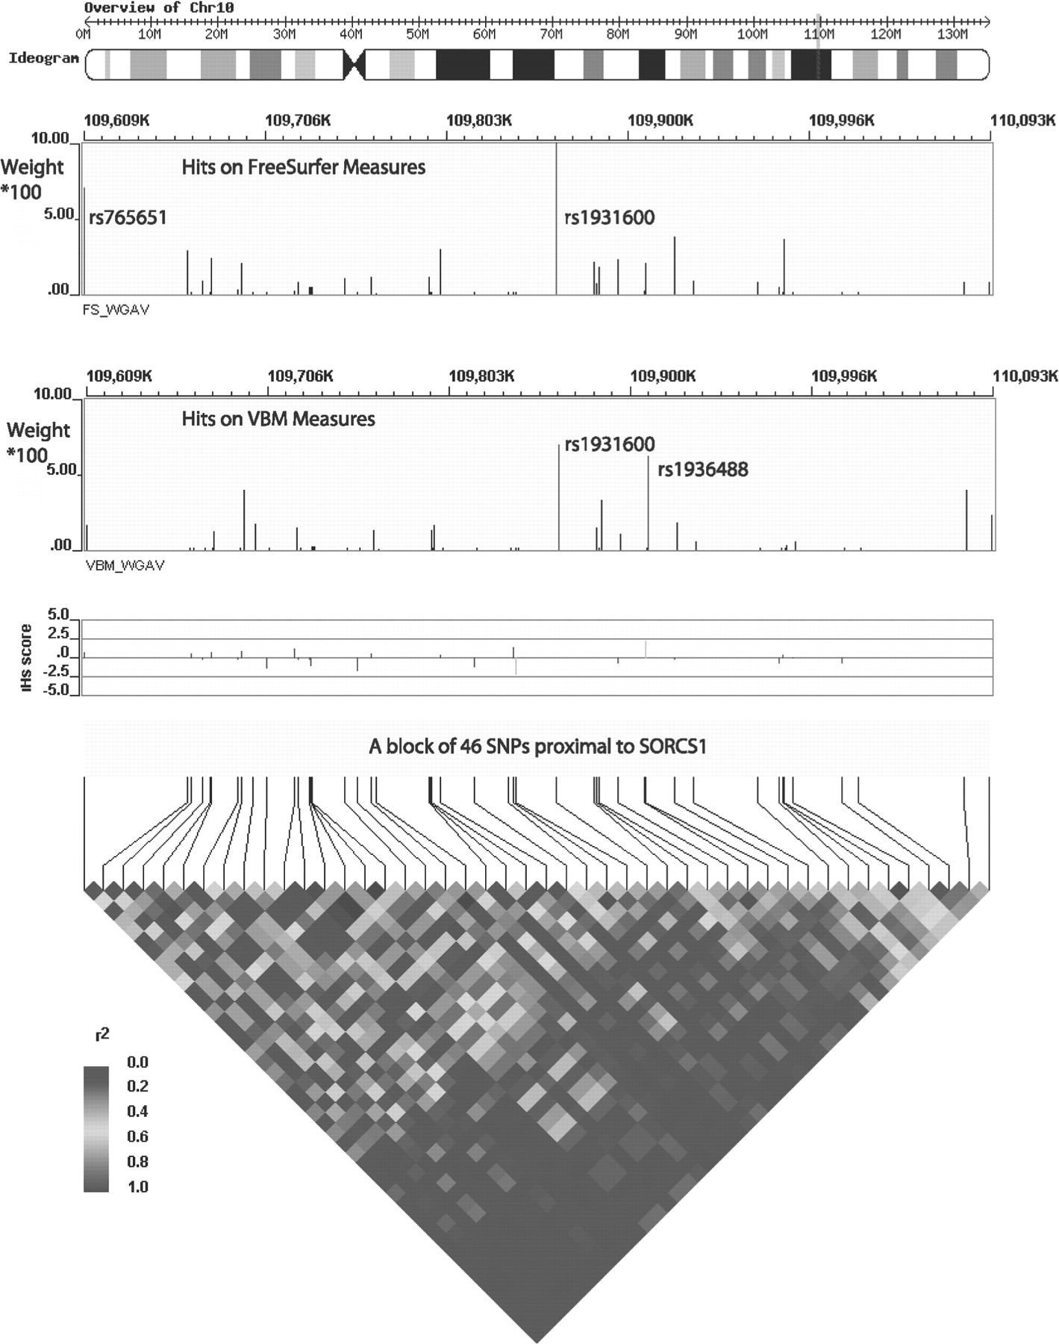
Fig. 8. Pair-wise LD in a group of 46 SNPs proximal to SORCS1. Numerical values r² of the LD maps are ...
Notes:
Fig. 8. Pair-wise LD in a group of 46 SNPs proximal to SORCS1. Numerical values r2 of the LD maps are determined by Haploview and visualized with WGAViewer. The top panel is the ideogram of the chromosome and the vertical red line represents the relative location of the locus of interest. In the second panel, regression coefficients*100 is plotted for each SNP for the FreeSurfer data, where two top hits rs765651 and rs1931600 are labeled with red lines. In the third panel, regression coefficients*100 is plotted for each SNP for the VBM data, where two top hits rs1931600 and rs1936488 are labeled with red lines. The fourth panel shows the recent selection score (Voight et al., 2006). The bottom figure demonstrates the LD pattern among 46 SNPs.
Unless provided in the caption above, the following copyright applies to the content of this slide: © The Author 2011. Published by Oxford University Press. All rights reserved. For Permissions, please email: journals.permissions@oup.com

