Slide 1
Fig. 1. While 80% of websites reported the scent of the odorous house ant as “rotten coconut” (a), most participants ...
Notes:
Fig. 1. While 80% of websites reported the scent of the odorous house ant as “rotten coconut” (a), most participants in the smell test chose “blue cheese” (b). Results are based on data collected from 53 Web sites and 143 participants from North Carolina's BugFest.
Unless provided in the caption above, the following copyright applies to the content of this slide: © The Authors 2015. Published by Oxford University Press on behalf of Entomological Society of America. All rights reserved. For Permissions, please email: journals.permissions@oup.com

Slide 2
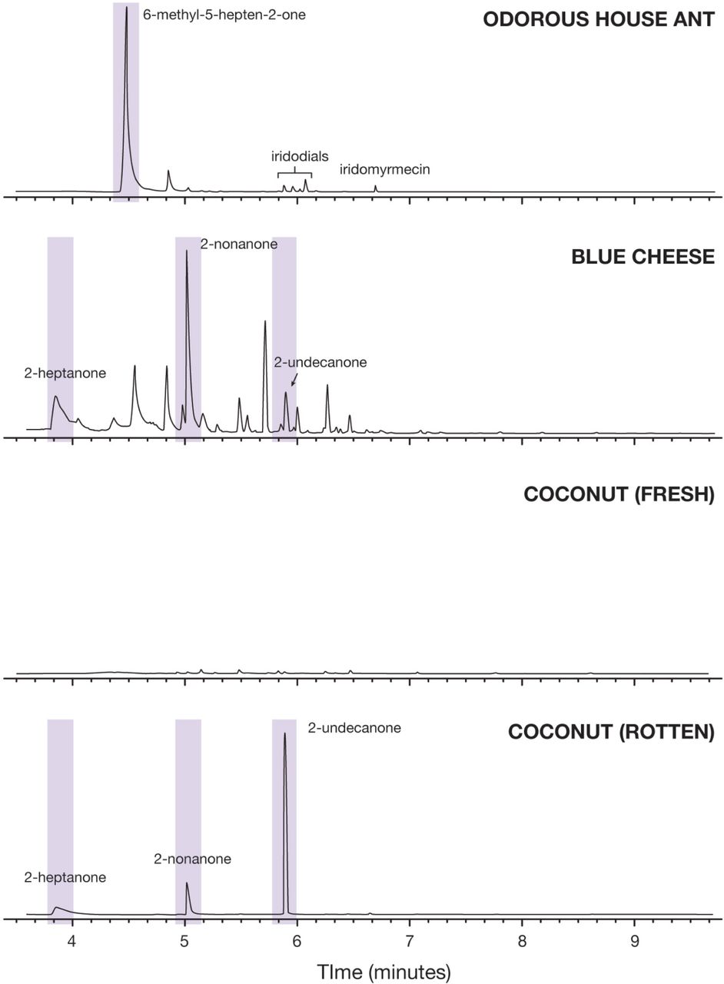
Fig. 2. Each peak from the gas chromatographs above corresponds with a specific chemical compound, and the size of ...
Notes:
Fig. 2. Each peak from the gas chromatographs above corresponds with a specific chemical compound, and the size of the peak represents the relative abundance of that compound. Methyl ketones (shaded) were present in the odorous house ant, blue cheese, and rotten coconut, but fresh coconut had no prominent compounds.
Unless provided in the caption above, the following copyright applies to the content of this slide: © The Authors 2015. Published by Oxford University Press on behalf of Entomological Society of America. All rights reserved. For Permissions, please email: journals.permissions@oup.com

