Slide 1
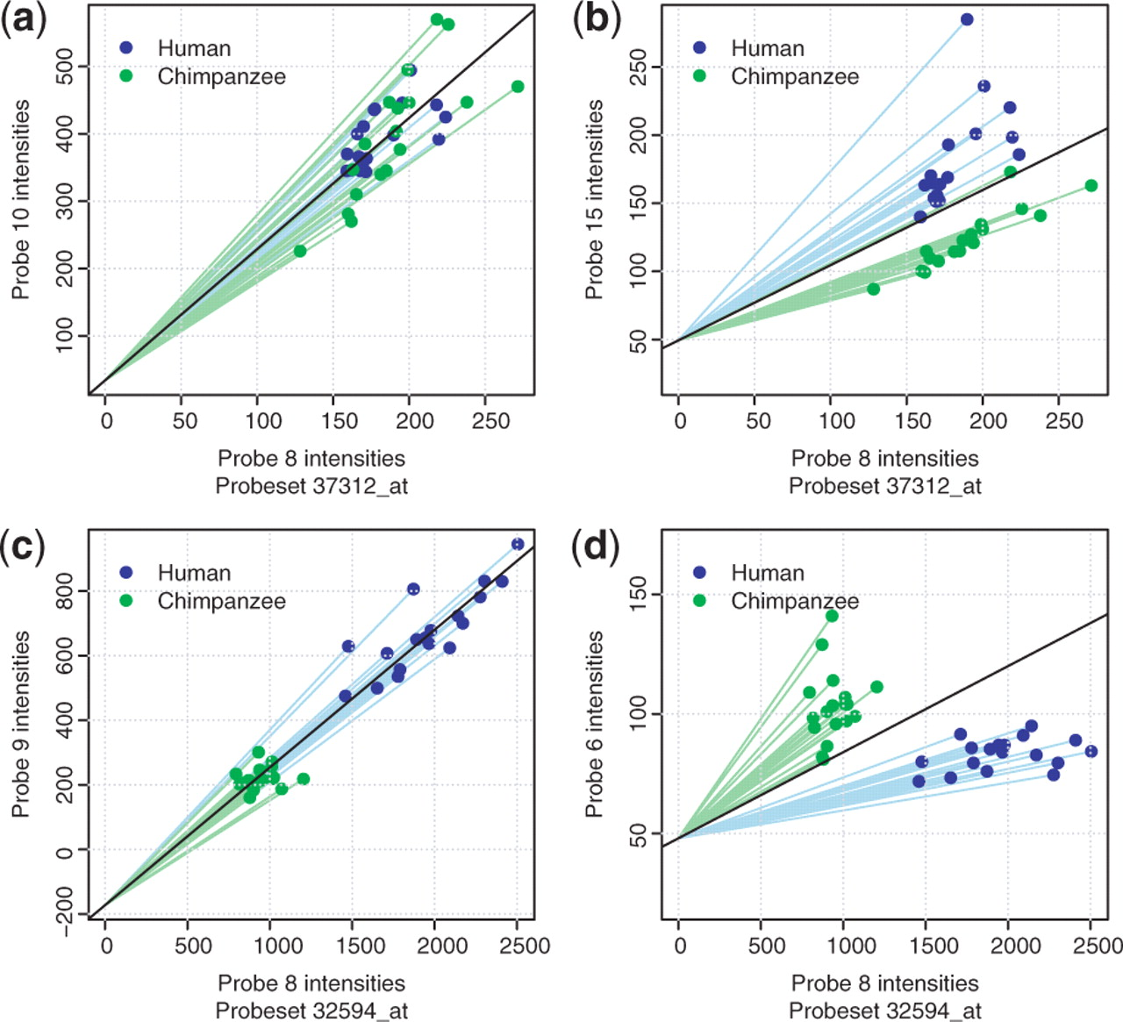
Fig. 1. Comparison of fluorescence level between two probes that measure the same mRNA target molecule—belonging to ...
Notes:
Fig. 1. Comparison of fluorescence level between two probes that measure the same mRNA target molecule—belonging to the same probeset. Each dot represents a sample—humans (blue) and chimpanzee (green). On the left, (a) and (c) relative fluorescence level when there is no sequence difference between humans and chimpanzees in either probe. In this case the relationship of fluorescence level between probes is expected to be linear. On the right, (b) and (d) probe comparison for the same probesets, but the probe on the y-axis has a sequence difference. On top, for probeset 37312_at, there is no detectable expression difference between humans and chimpanzees, on the bottom, for probeset 32594_at there is a difference. Our method performs a t-test of the slopes to each point (green and blue lines), assuming that the intercept is taken from all points (black line).
Unless provided in the caption above, the following copyright applies to the content of this slide: © The Author 2009. Published by Oxford University Press. All rights reserved. For Permissions, please email: journals.permissions@oxfordjournals.org

Slide 2
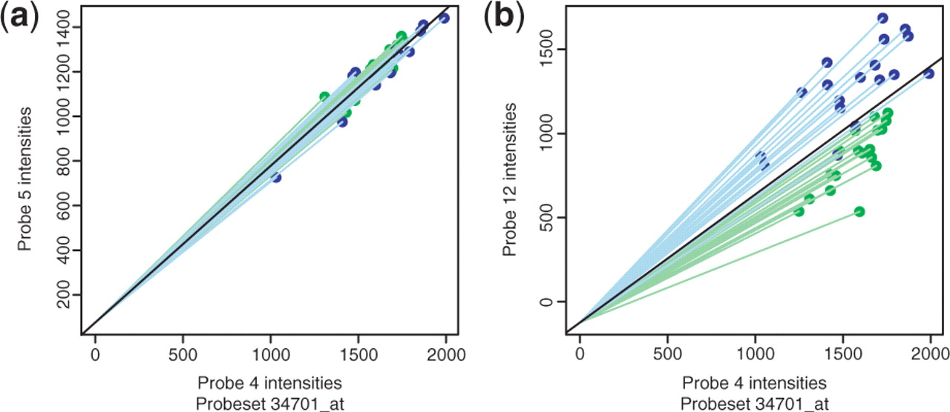
Fig. 2. An example of a BAD probe not detected by a sequence-derived mask based on human and chimpanzee data, in ...
Notes:
Fig. 2. An example of a BAD probe not detected by a sequence-derived mask based on human and chimpanzee data, in probeset 34701_at measuring expression of gene DLG4 (post-synaptic density protein 95). (a) Probe 5 versus probe 4: no BADs between the species can be seen. (b) Probe 5 versus probe 12: even though none of the probes have a sequence difference between species, it is clear that probe 12 displays a difference between the species that is not the result of a difference in the expression level of DLG4. This probe could cause a spurious expression difference between the species.
Unless provided in the caption above, the following copyright applies to the content of this slide: © The Author 2009. Published by Oxford University Press. All rights reserved. For Permissions, please email: journals.permissions@oxfordjournals.org

Slide 3
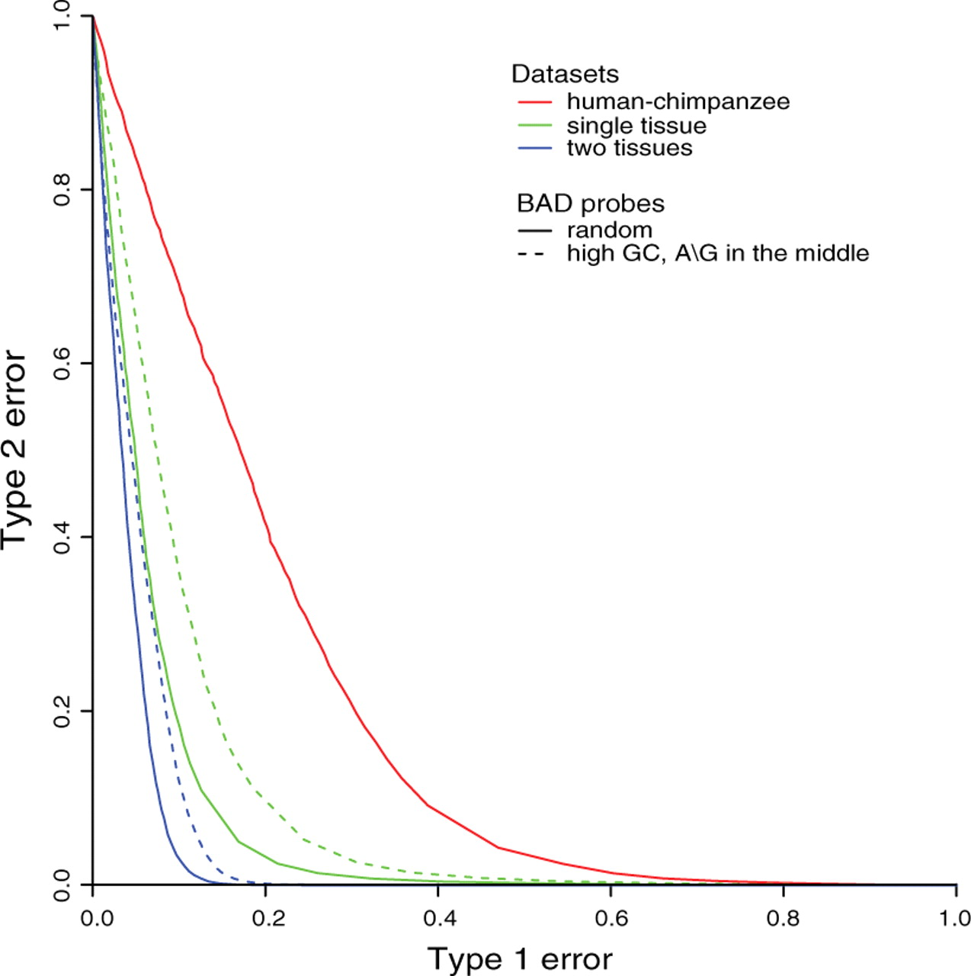
Fig. 3. Power of detecting sequence differences using an expression-based mask. The x-axis, type 1 error, refers to ...
Notes:
Fig. 3. Power of detecting sequence differences using an expression-based mask. The x-axis, type 1 error, refers to the fraction of probes without a sequence difference, that are still detected as BAD by the method. The y-axis, type 2 error, refers to the fraction of probes with a sequence difference that are not detected as BAD by the method. Shown are power curves for detecting BAD probes for the human–chimpanzee dataset, and for the two simulated datasets. Dashed lines are simulated datasets in which only the probes that were the most difficult to detect as BAD were used (highest GC content among probes with an A/G in the middle of the probe).
Unless provided in the caption above, the following copyright applies to the content of this slide: © The Author 2009. Published by Oxford University Press. All rights reserved. For Permissions, please email: journals.permissions@oxfordjournals.org

Slide 4
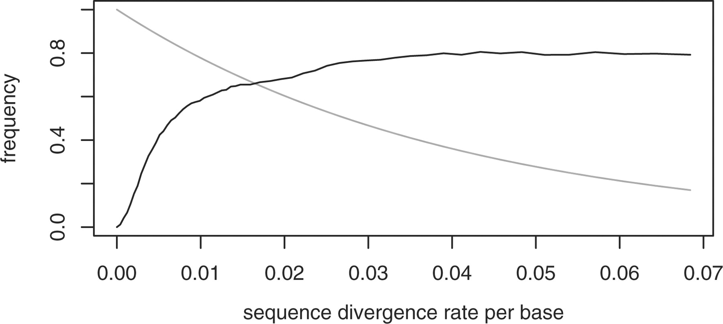
Fig. 4. Black: rate at which probesets gain spurious expression differences versus sequence divergence rate per base. ...
Notes:
Fig. 4. Black: rate at which probesets gain spurious expression differences versus sequence divergence rate per base. In the single-tissue dataset, we flipped a number of probes equivalent to the sequence divergence rate shown on the x-axis (per base). Then we measured what fraction of probesets showing no difference in the original dataset show an expression difference after flipping (t-test P-value <0.05). Notice that in this plot, we first applied flipping only to high GC, middle C/T probes, but as those ran out to all probes. Red (grey): fraction of probes without a sequence difference versus divergence rate per base.
Unless provided in the caption above, the following copyright applies to the content of this slide: © The Author 2009. Published by Oxford University Press. All rights reserved. For Permissions, please email: journals.permissions@oxfordjournals.org

Slide 5
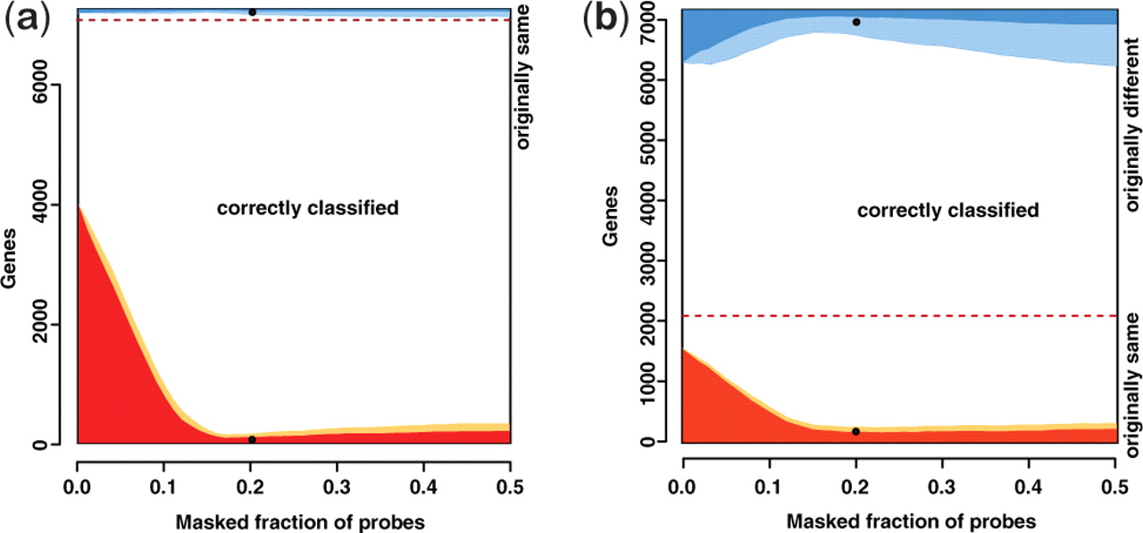
Fig. 5. Detecting differential expression with masked datasets. The y-axis represents all genes. Above the dashed ...
Notes:
Fig. 5. Detecting differential expression with masked datasets. The y-axis represents all genes. Above the dashed line are differentially expressed genes, below are non-differentially expressed—in the original dataset. The x-axis represents the fraction of genes removed by masks with different cutoffs. The white area represents correctly classified genes. The shaded area, above the dashed line, represents misclassified genes—genes that were originally different, but after masking are classified as not differently expressed. The shaded area below the dashed line represents genes that were originally not different, and after masking are classified as different. In both the cases, we distinguish those genes where the misclassification occurred already after flipping (dark shaded), and those where the misclassification was only introduced after masking, and did not occur after just flipping (light shaded). Black dots: perfect mask—exactly those probes are removed to which sequence differences were introduced. (a) Single-tissue dataset with 20% of probes simulated as BAD. (b) Two-tissue dataset with 20% of probes simulated as BAD.
Unless provided in the caption above, the following copyright applies to the content of this slide: © The Author 2009. Published by Oxford University Press. All rights reserved. For Permissions, please email: journals.permissions@oxfordjournals.org

