Slide 1
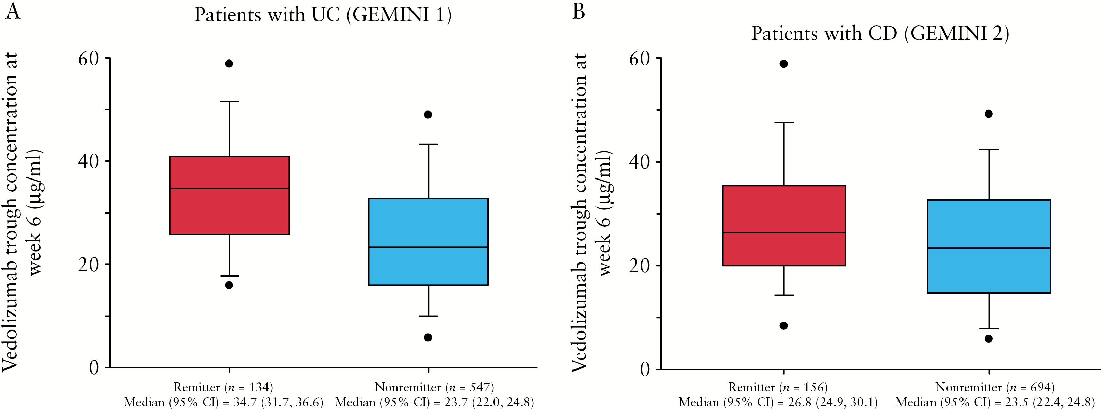
Figure 1. Vedolizumab measured trough serum concentration by clinical remission status at Week 6 in patients with UC ...
Notes:
Figure 1. Vedolizumab measured trough serum concentration by clinical remission status at Week 6 in patients with UC [GEMINI 1] and patients with CD [GEMINI 2]. Horizontal lines represent median values; lower and upper boundaries of boxes represent the 25th and 75th percentiles, respectively; whiskers [error bars] represent highest and lowest points within 1.5 × interquartile range; and individual points represent outliers. CD, Crohn’s disease; UC, ulcerative colitis.
Unless provided in the caption above, the following copyright applies to the content of this slide: Copyright © 2017 European Crohn’s and Colitis Organisation (ECCO). Published by Oxford University Press. All rights reserved. For permissions, please email: journals.permissions@oup.com

Slide 2
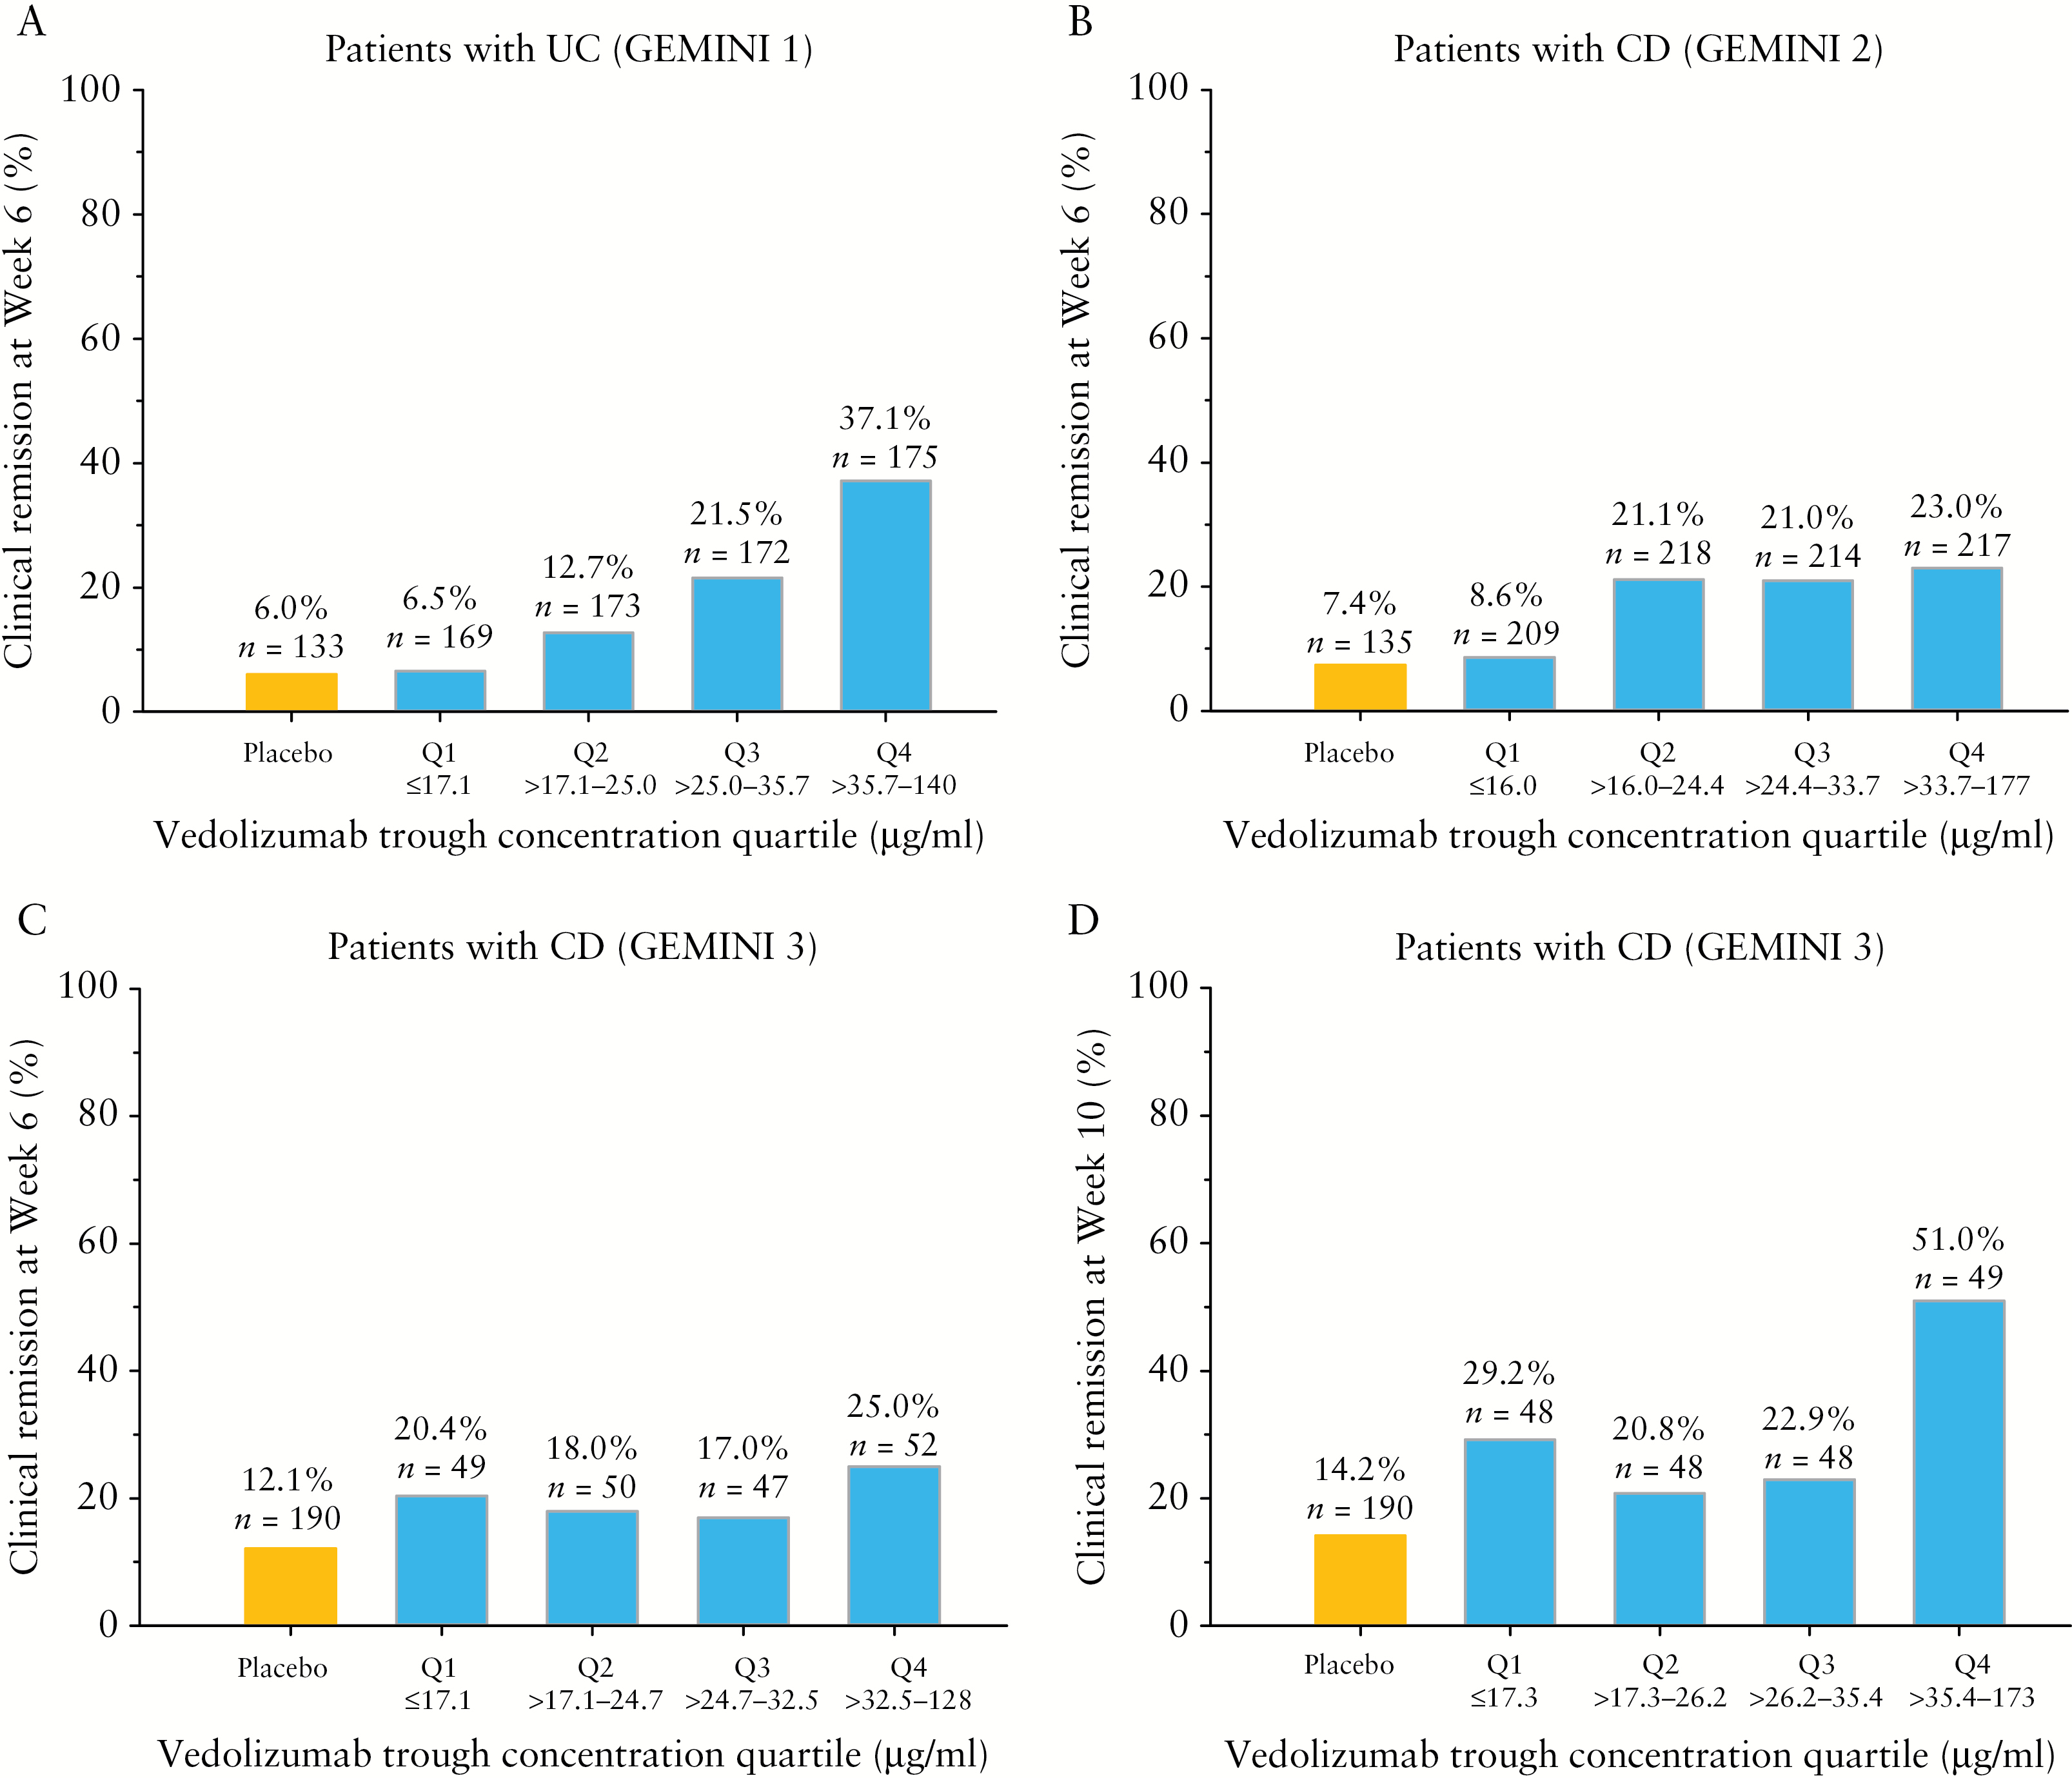
Figure 2. Percentage of patients with clinical remission by vedolizumab trough concentration quartile at Week 6 or Week ...
Notes:
Figure 2. Percentage of patients with clinical remission by vedolizumab trough concentration quartile at Week 6 or Week 10 in patients with UC [GEMINI 1] and patients with CD [GEMINI 2 and GEMINI 3]. Data for placebo-treated patients are shown for reference. CD, Crohn’s disease; Q, quartile; UC, ulcerative colitis.
Unless provided in the caption above, the following copyright applies to the content of this slide: Copyright © 2017 European Crohn’s and Colitis Organisation (ECCO). Published by Oxford University Press. All rights reserved. For permissions, please email: journals.permissions@oup.com

Slide 3
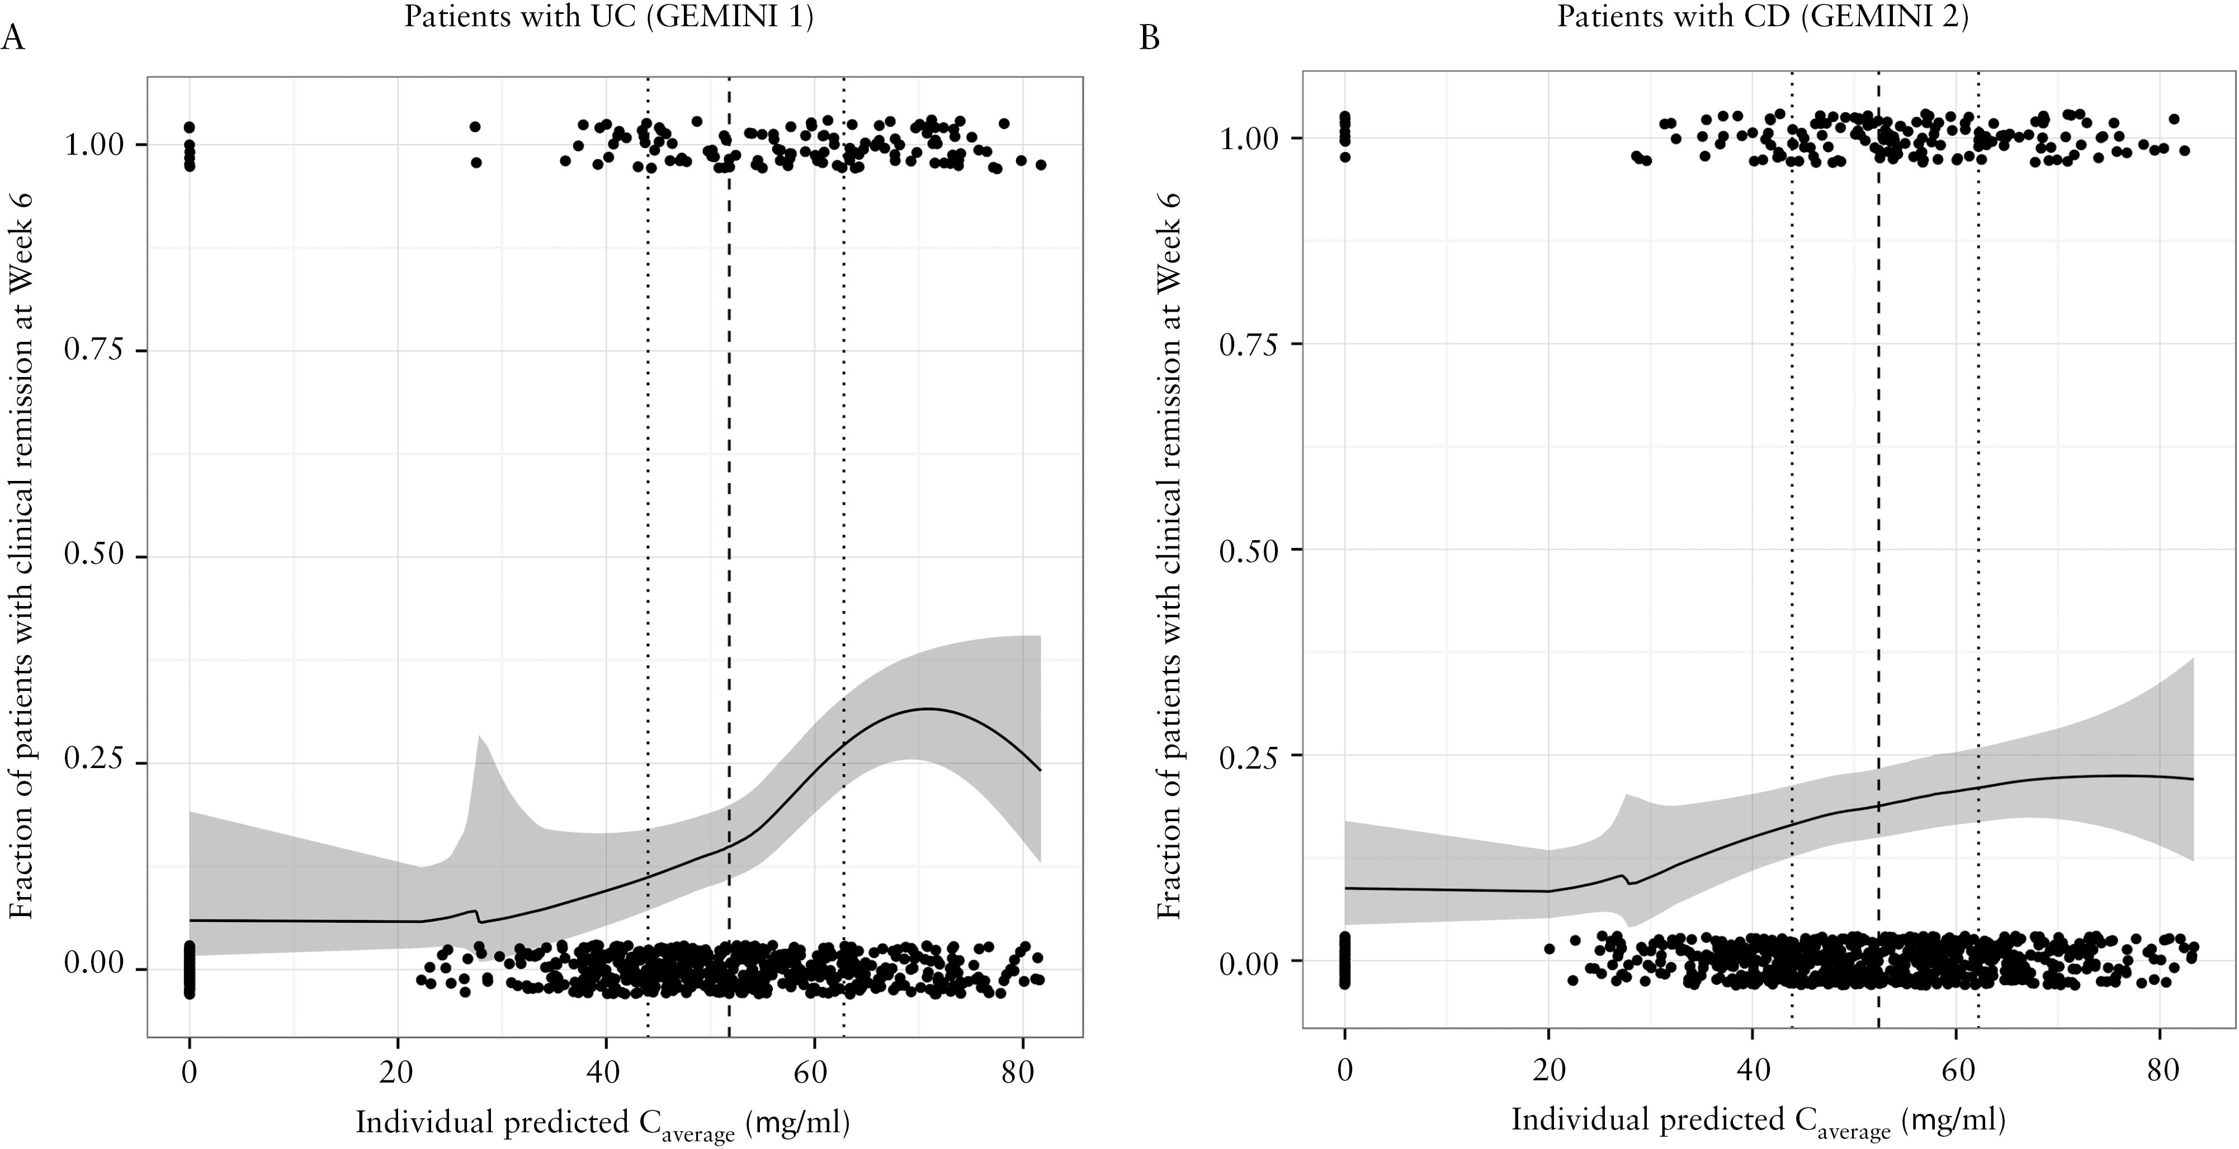
Figure 3. Fraction of patients with clinical remission at Week 6 versus individual predicted cumulative ...
Notes:
Figure 3. Fraction of patients with clinical remission at Week 6 versus individual predicted cumulative Caverage in patients with UC [GEMINI 1] and patients with CD [GEMINI 2]. The solid lines are local regression smooths; the shaded area represents the 95% CIs; and the vertical dashed lines represent the quartiles of individual predicted cumulative Caverage values. Caverage, average concentration through Week 6. CD, Crohn’s disease; UC, ulcerative colitis; CI, confidence interval.
Unless provided in the caption above, the following copyright applies to the content of this slide: Copyright © 2017 European Crohn’s and Colitis Organisation (ECCO). Published by Oxford University Press. All rights reserved. For permissions, please email: journals.permissions@oup.com

Slide 4
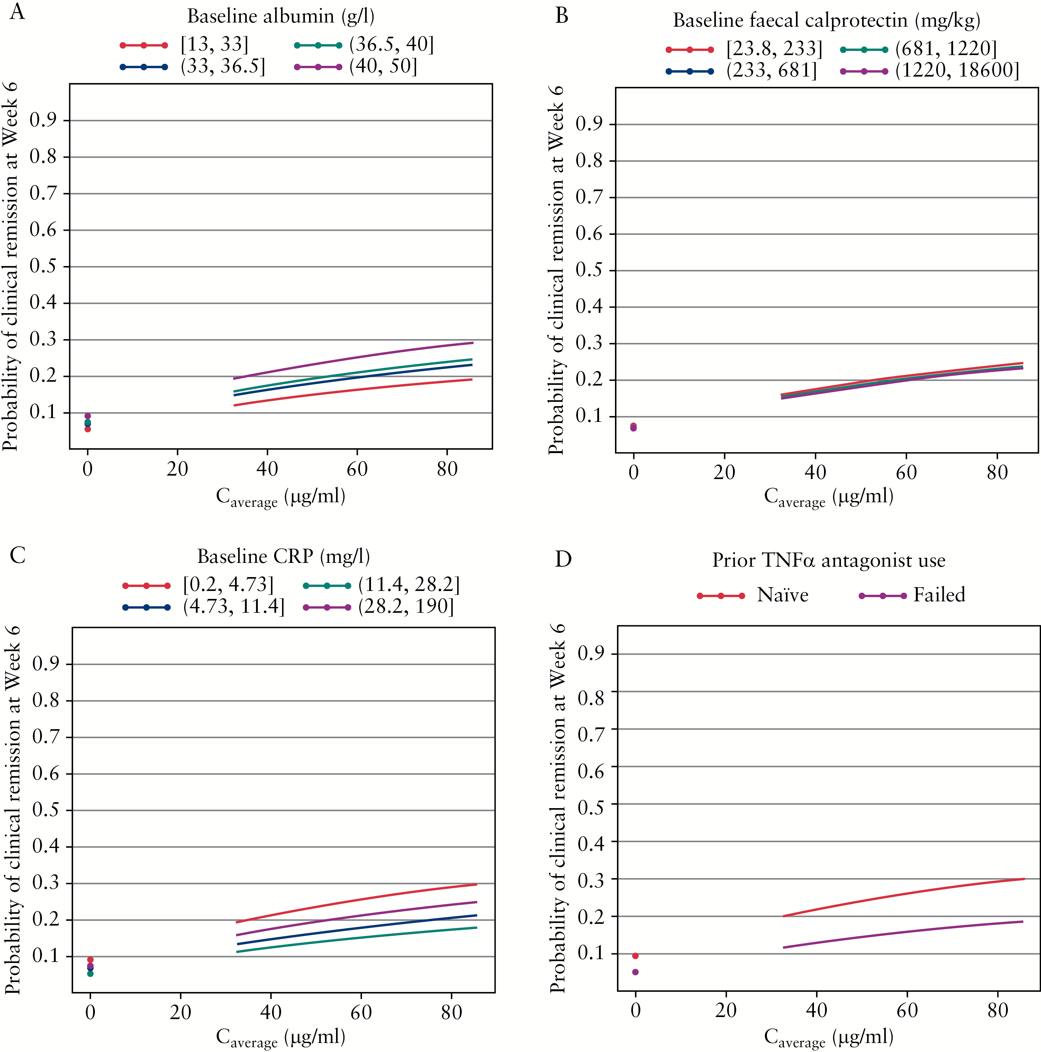
Figure 5. Model-predicted average exposure–efficacy relationship for clinical remission at Week 6 in patients with CD ...
Notes:
Figure 5. Model-predicted average exposure–efficacy relationship for clinical remission at Week 6 in patients with CD [GEMINI 2] by baseline albumin, faecal calprotectin and CRP concentration quartiles, and previous TNFα antagonist use. Caverage, average concentration through Week 6. CD, Crohn’s disease; CRP, C-reactive protein; TNFα, tumour necrosis factor-α; UC, ulcerative colitis.
Unless provided in the caption above, the following copyright applies to the content of this slide: Copyright © 2017 European Crohn’s and Colitis Organisation (ECCO). Published by Oxford University Press. All rights reserved. For permissions, please email: journals.permissions@oup.com

Slide 5
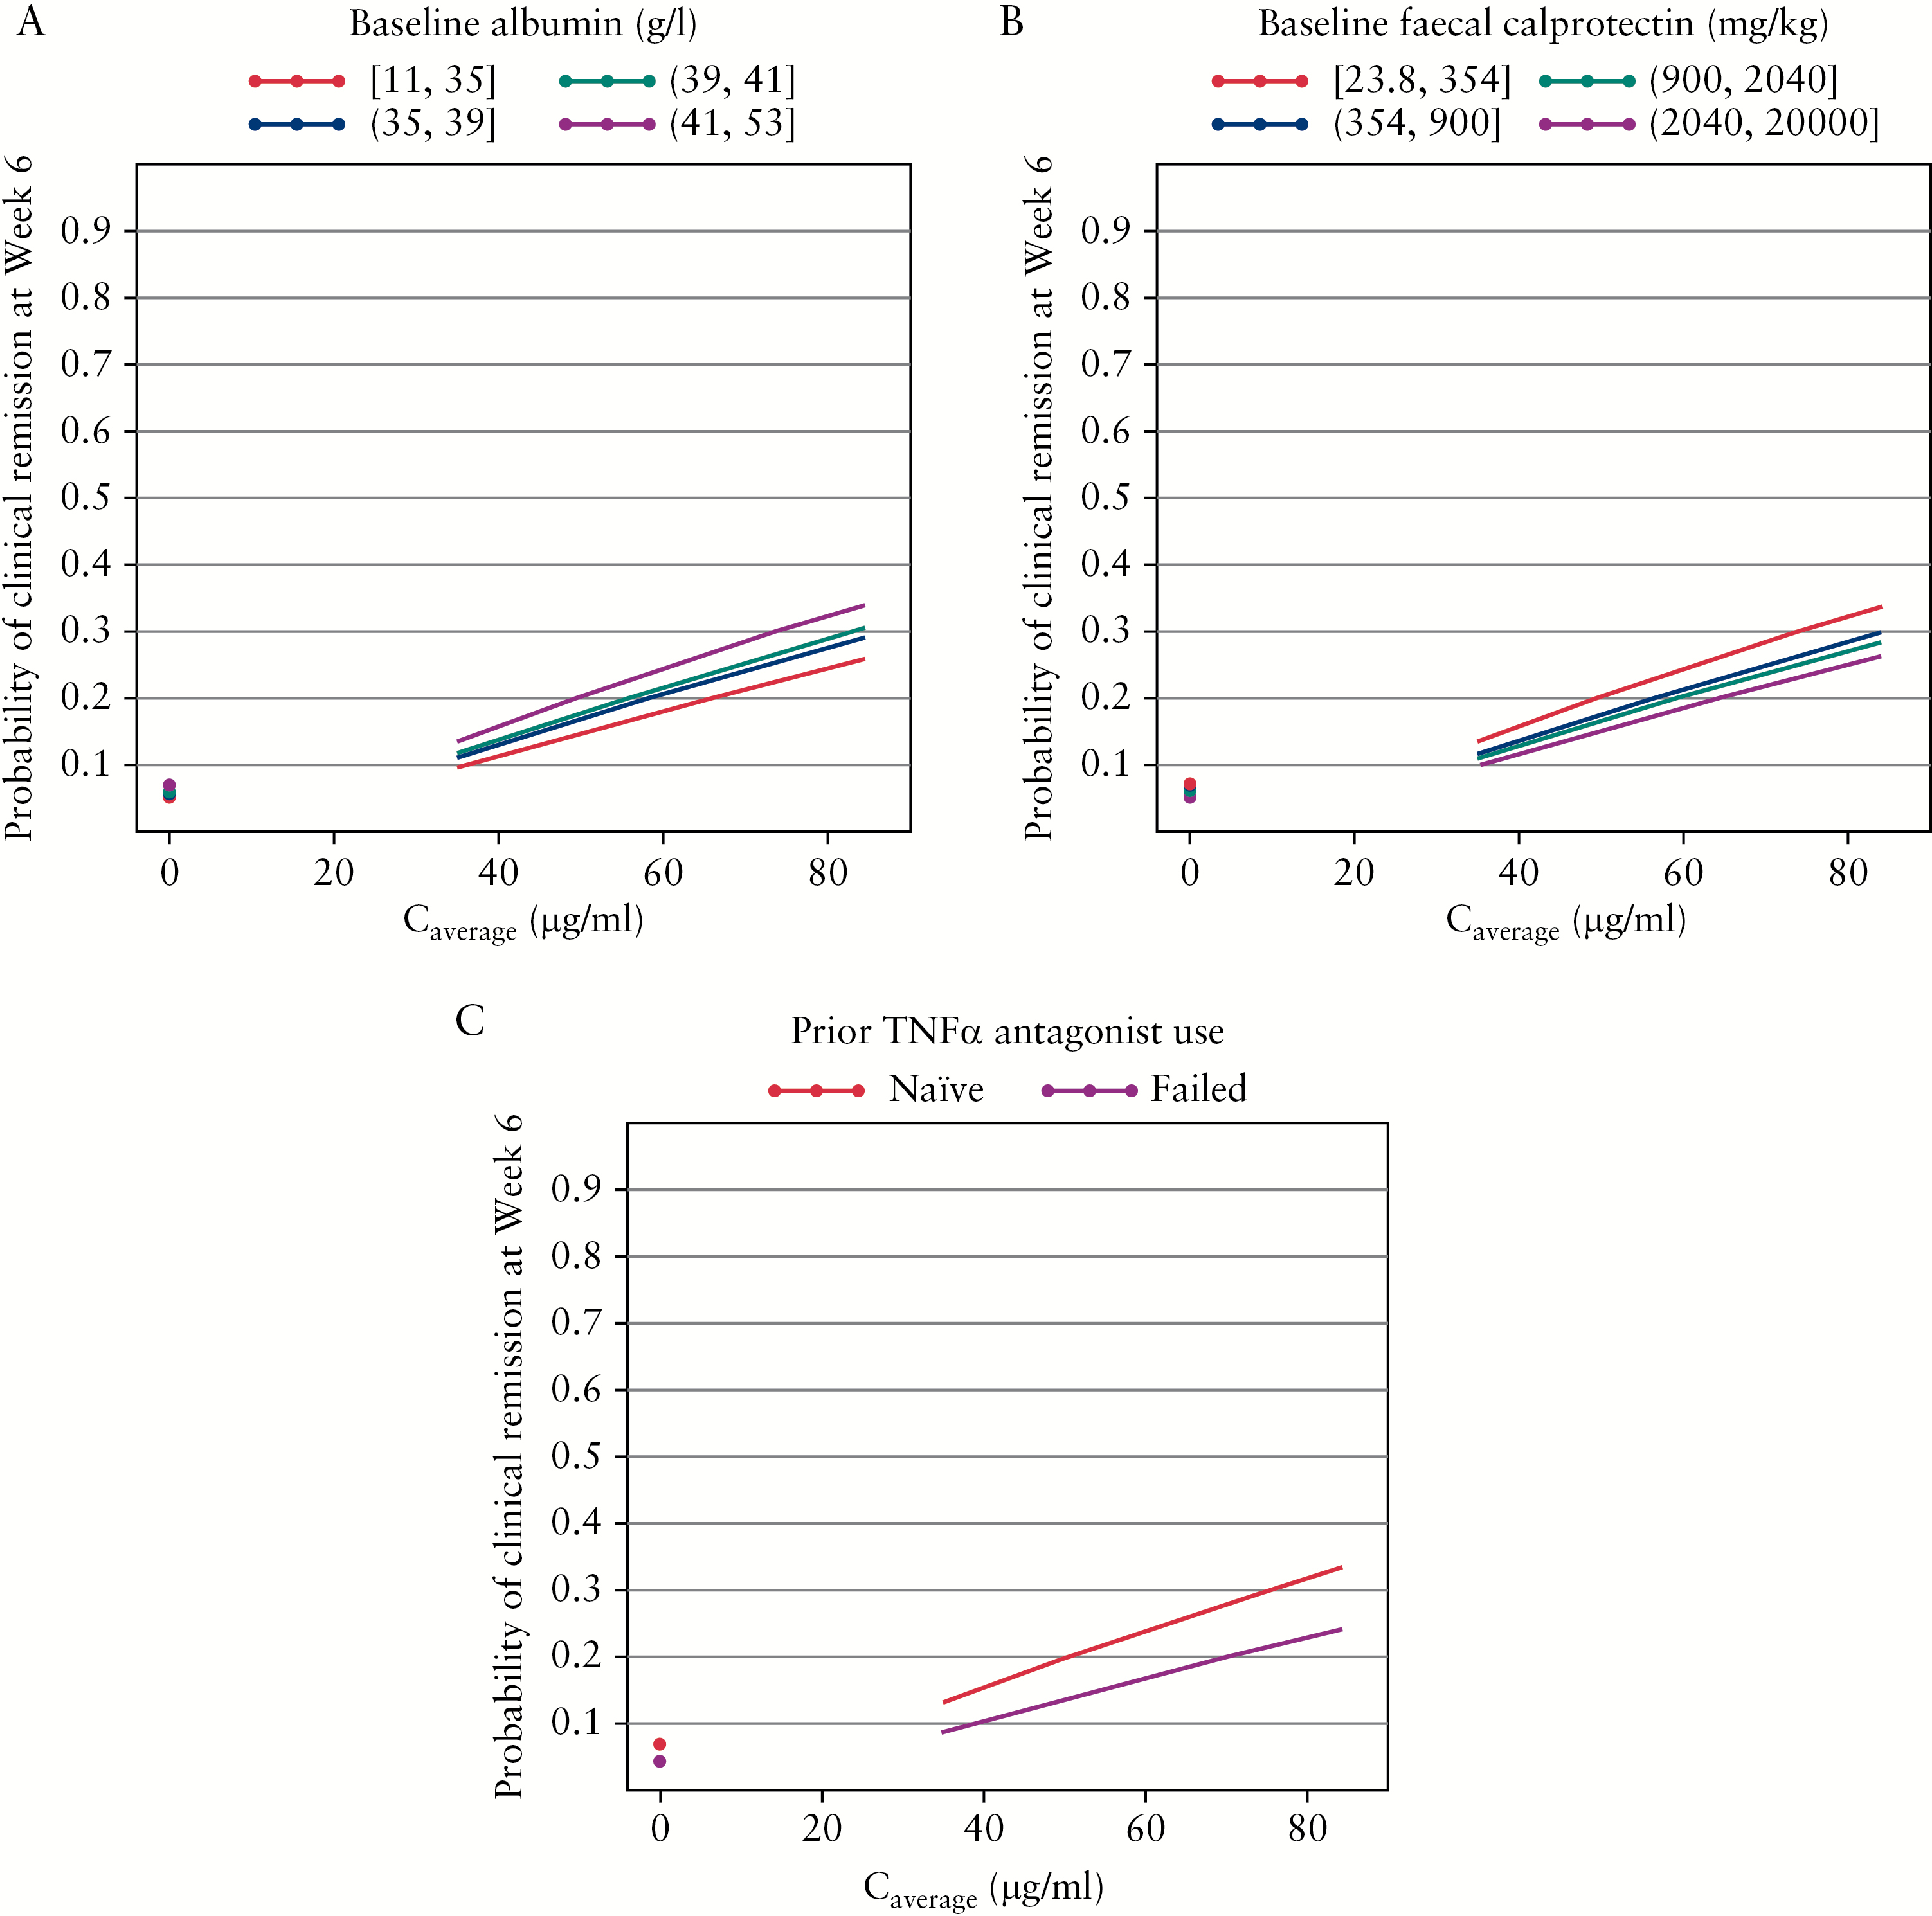
Figure 4. Model-predicted average exposure–efficacy relationship for clinical remission at Week 6 in patients with UC ...
Notes:
Figure 4. Model-predicted average exposure–efficacy relationship for clinical remission at Week 6 in patients with UC [GEMINI 1] by baseline albumin and faecal calprotectin concentration quartiles and previous TNFα antagonist use. Caverage, average concentration through Week 6. CD, Crohn’s disease; TNFα, tumour necrosis factor-α; UC, ulcerative colitis.
Unless provided in the caption above, the following copyright applies to the content of this slide: Copyright © 2017 European Crohn’s and Colitis Organisation (ECCO). Published by Oxford University Press. All rights reserved. For permissions, please email: journals.permissions@oup.com

