Slide 1
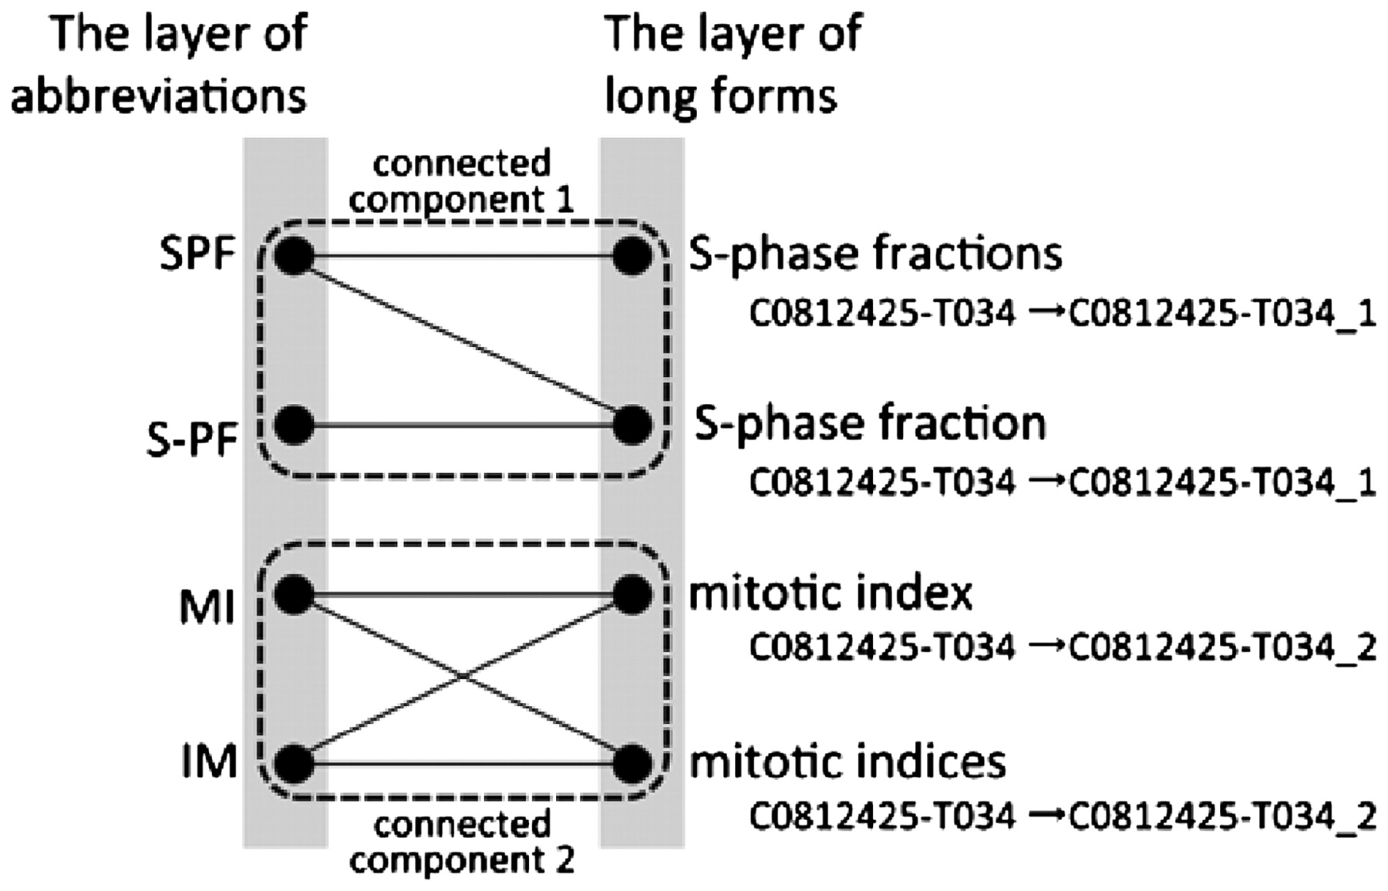
Figure 1. A part of a bipartite graph used in Allie. GENA gives the concept ID ‘C0812425-T034’ to ‘S-phase fractions’, ...
Notes:
Figure 1. A part of a bipartite graph used in Allie. GENA gives the concept ID ‘C0812425-T034’ to ‘S-phase fractions’, ‘S-phase fraction’, ‘mitotic index’ and ‘mitotic indices’. Allie changes the ID to one that corresponds to each cluster using connected components of the graph.
Unless provided in the caption above, the following copyright applies to the content of this slide: © The Author(s) 2011. Published by Oxford University Press.This is Open Access article distributed under the terms of the Creative Commons Attribution Non-Commercial License (http://creativecommons.org/licenses/by-nc/2.5), which permits unrestricted non-commercial use, distribution, and reproduction in any medium, provided the original work is properly cited.

Slide 2
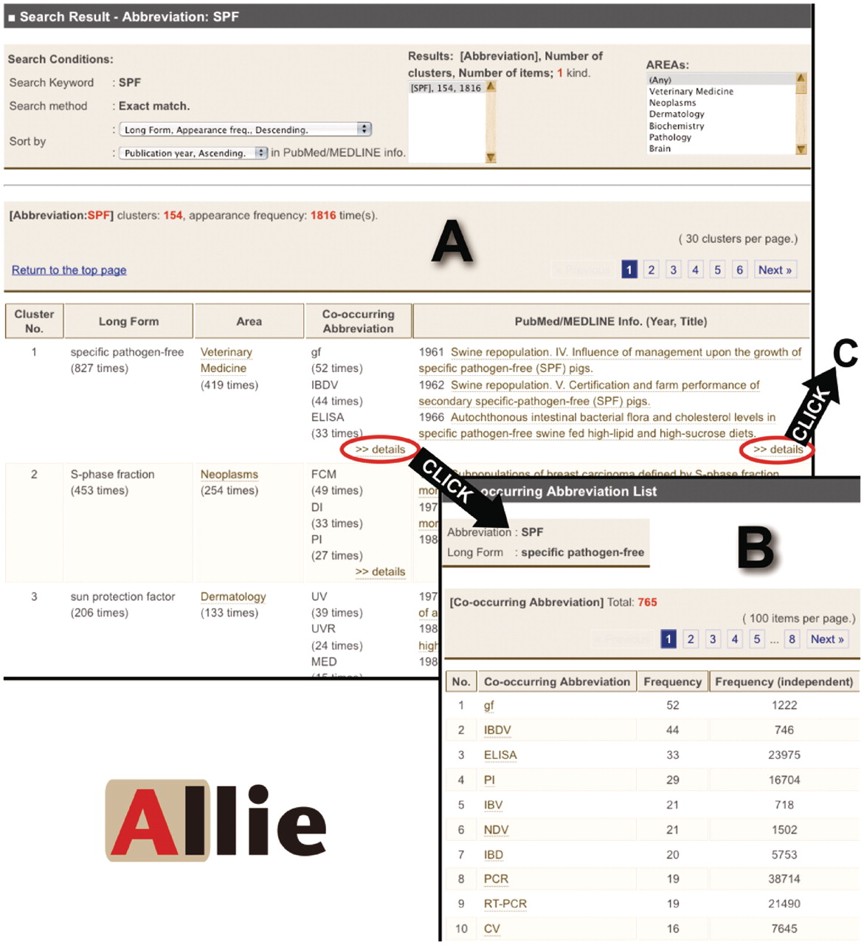
Figure 2. Images of Allie’s outputs. (A) Hit cluster-list page for the abbreviation ‘SPF’. By clicking links in the ...
Notes:
Figure 2. Images of Allie’s outputs. (A) Hit cluster-list page for the abbreviation ‘SPF’. By clicking links in the ‘Co-occurring Abbreviation’ or the ‘PubMed/MEDLINE Info.’ cells, the user can access these corresponding pages (A to B or A to C, respectively). (B) Co-occurring abbreviation page. Here, the user is provided with all the co-occurring abbreviations, and by clicking one of the listed abbreviations, one can access the hit cluster-list page. (C) PubMed/MEDLINE Information page. Here, the user is provided with all publication years, titles, and co-occurring abbreviations that appear in the titles or abstracts with the pair. Each title is anchor text that links to the corresponding PubMed page. By clicking one of the co-occurring abbreviations, the user can access the hit cluster-list page (C to D). (D) Hit cluster-list page for the abbreviation ‘BVD’.
Unless provided in the caption above, the following copyright applies to the content of this slide: © The Author(s) 2011. Published by Oxford University Press.This is Open Access article distributed under the terms of the Creative Commons Attribution Non-Commercial License (http://creativecommons.org/licenses/by-nc/2.5), which permits unrestricted non-commercial use, distribution, and reproduction in any medium, provided the original work is properly cited.

Slide 3
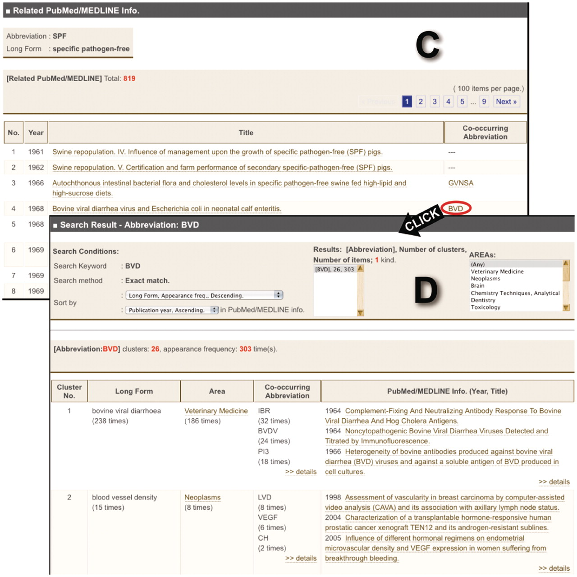
Figure 2. Images of Allie’s outputs. (A) Hit cluster-list page for the abbreviation ‘SPF’. By clicking links in the ...
Notes:
Figure 2. Images of Allie’s outputs. (A) Hit cluster-list page for the abbreviation ‘SPF’. By clicking links in the ‘Co-occurring Abbreviation’ or the ‘PubMed/MEDLINE Info.’ cells, the user can access these corresponding pages (A to B or A to C, respectively). (B) Co-occurring abbreviation page. Here, the user is provided with all the co-occurring abbreviations, and by clicking one of the listed abbreviations, one can access the hit cluster-list page. (C) PubMed/MEDLINE Information page. Here, the user is provided with all publication years, titles, and co-occurring abbreviations that appear in the titles or abstracts with the pair. Each title is anchor text that links to the corresponding PubMed page. By clicking one of the co-occurring abbreviations, the user can access the hit cluster-list page (C to D). (D) Hit cluster-list page for the abbreviation ‘BVD’.
Unless provided in the caption above, the following copyright applies to the content of this slide: © The Author(s) 2011. Published by Oxford University Press.This is Open Access article distributed under the terms of the Creative Commons Attribution Non-Commercial License (http://creativecommons.org/licenses/by-nc/2.5), which permits unrestricted non-commercial use, distribution, and reproduction in any medium, provided the original work is properly cited.

