Slide 1
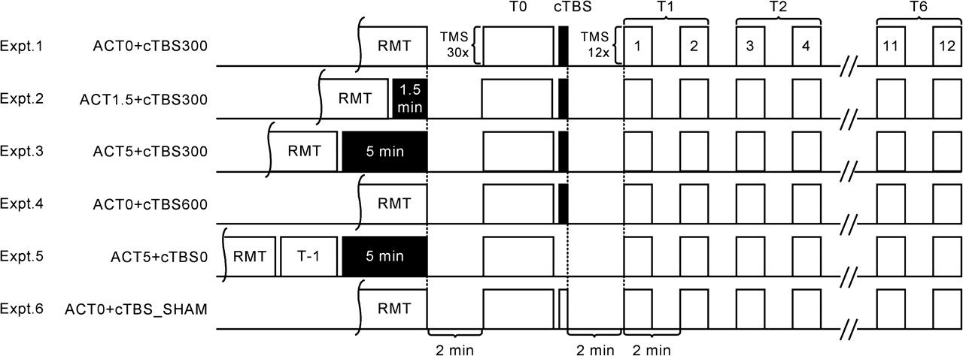
Figure 1. Schematic overview of the 6 principal interventions. After determining the stimulation intensity for evoking ...
Notes:
Figure 1. Schematic overview of the 6 principal interventions. After determining the stimulation intensity for evoking MEP amplitudes of ∼1 mV (SI1mV) and the resting MEP threshold subjects paused for 2 min, either directly or after an isometric voluntary contraction (black filled blocks) (for 1.5 or 5 min). The pre-cTBS corticospinal excitability (T0) was then established, followed by the application of cTBS. Postintervention measurements were performed in 12 blocks consisting of 12 MEP responses at SI1mV followed by 1 min of rest, up to 25-min postintervention. Two successive time points were then binned.
Unless provided in the caption above, the following copyright applies to the content of this slide: © The Author 2007. Published by Oxford University Press. All rights reserved. For permissions, please e-mail: journals.permissions@oxfordjournals.org

Slide 2
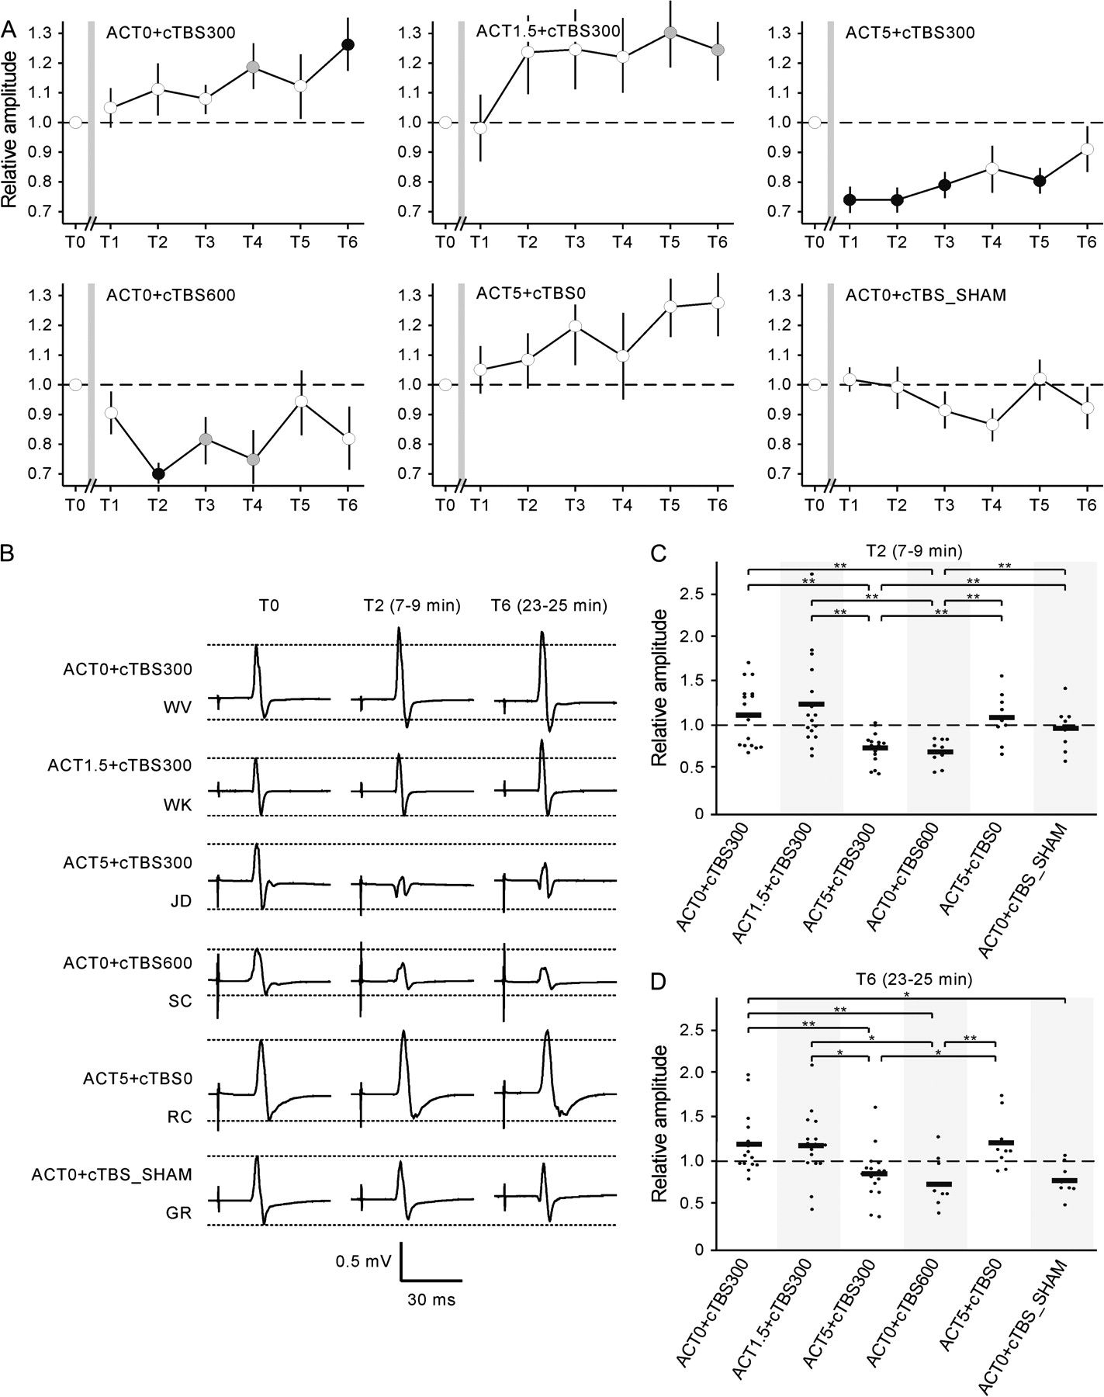
Figure 2. (A) Time course of changes in MEP responses of all 6 principal interventions normalized to pre-cTBS (T0). ...
Notes:
Figure 2. (A) Time course of changes in MEP responses of all 6 principal interventions normalized to pre-cTBS (T0). Gray filled symbols, significant differences from pre-cTBS (T0) MEP amplitudes (P < 0.05, 2-tailed t-test). Black filled symbols, significant after FDRC. Error bars, SEM. (B) Examples of averaged MEP responses of individual subjects obtained before (T0) and 7–9 min (T2) and 23–25 min (T6) postintervention. (C) Results (horizontal line, group mean) obtained at 7–9 min (T2). (D) Results (horizontal line, group mean) obtained at 23–25 min (T6). Asterisks denote significant differences after FDRC.
Unless provided in the caption above, the following copyright applies to the content of this slide: © The Author 2007. Published by Oxford University Press. All rights reserved. For permissions, please e-mail: journals.permissions@oxfordjournals.org

