Slide 1
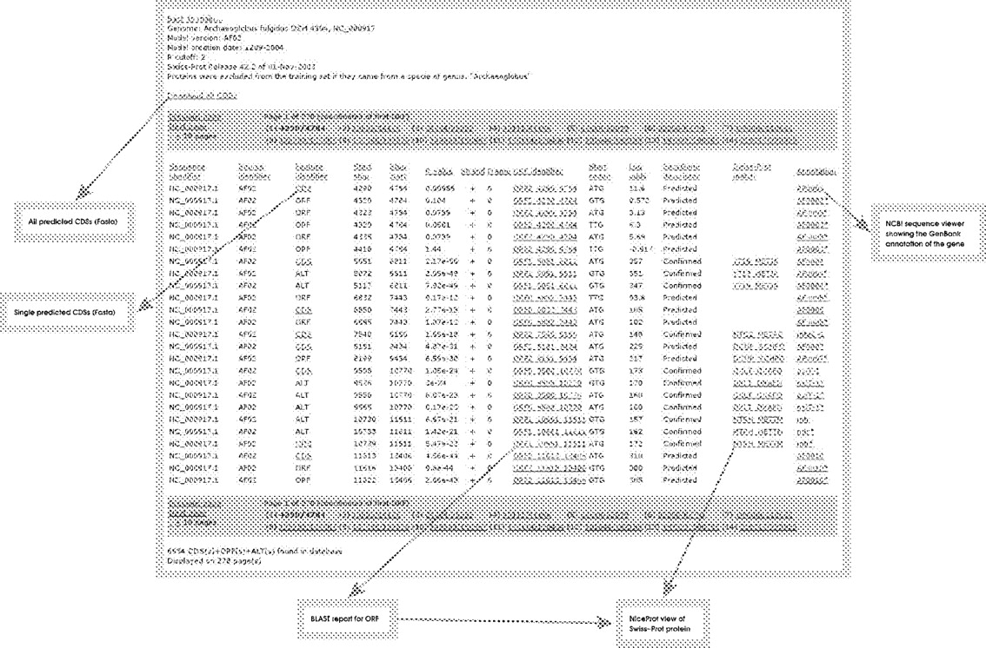
Fig. 1 The predictions for each sequence are presented on a separate page. The pages provide for easy access to the ...
Notes:
Fig. 1 The predictions for each sequence are presented on a separate page. The pages provide for easy access to the sequence of predicted CDSs and facilitate navigation to the relevant BLASTP report, Swiss-Prot data and NCBI resources. Each column is described in links on the page. The first eight columns comply with the GFF format. Columns 9–14 are an extension of the GFF commentary field. These columns contain information about the maximal ORF, the predicted start codon, the sequence log-odds score, the type of sequence, the highest scoring match in Swiss-Prot and the match to GenBank and RefSeq annotation. For further description, see the webpage.
Unless provided in the caption above, the following copyright applies to the content of this slide: © The Author 2005. Published by Oxford University Press. All rights reserved. For Permissions, please email: journals.permissions@oxfordjournals.org

Slide 2
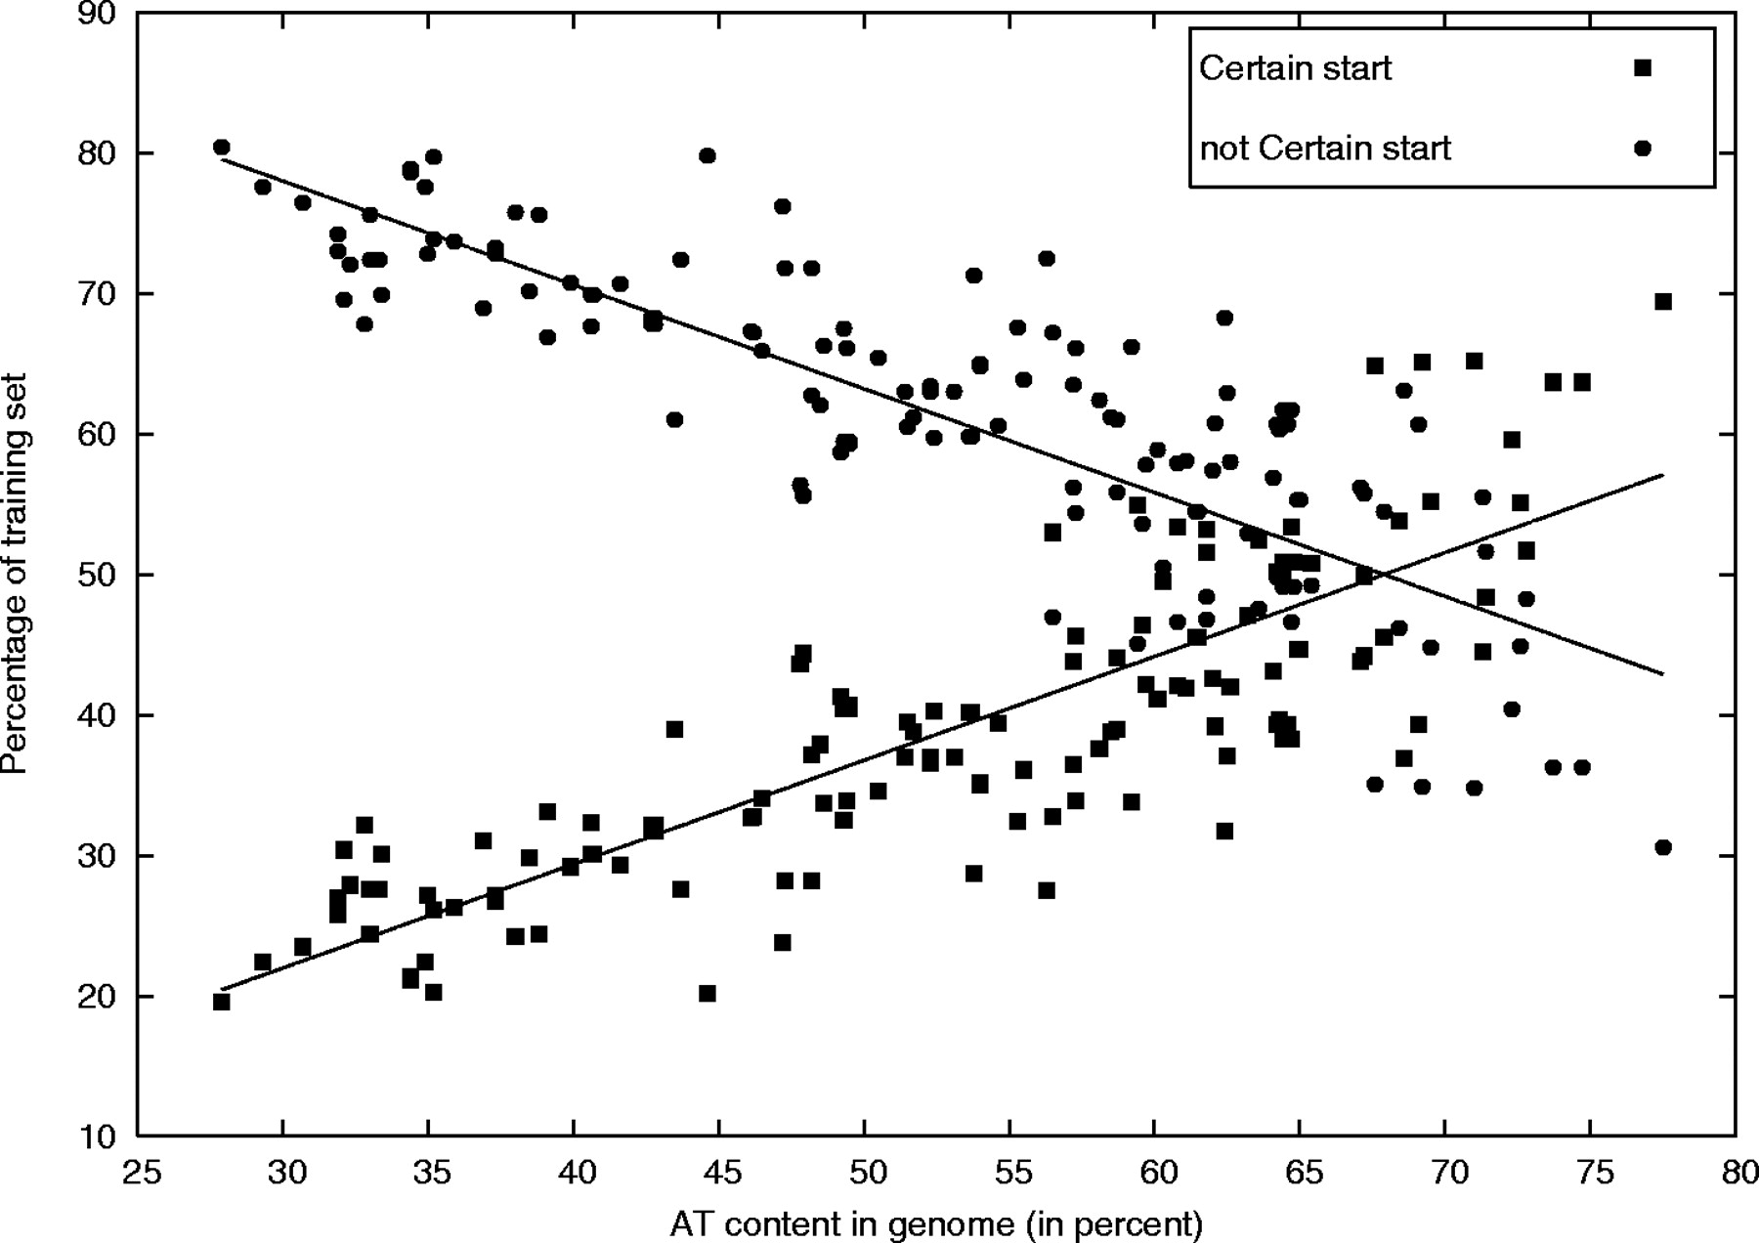
Fig. 2 The fraction of certain start genes in the training set increases in genomes with higher AT content and is ...
Notes:
Fig. 2 The fraction of certain start genes in the training set increases in genomes with higher AT content and is generally >50% when AT exceeds 67.6%.
Unless provided in the caption above, the following copyright applies to the content of this slide: © The Author 2005. Published by Oxford University Press. All rights reserved. For Permissions, please email: journals.permissions@oxfordjournals.org

Slide 3
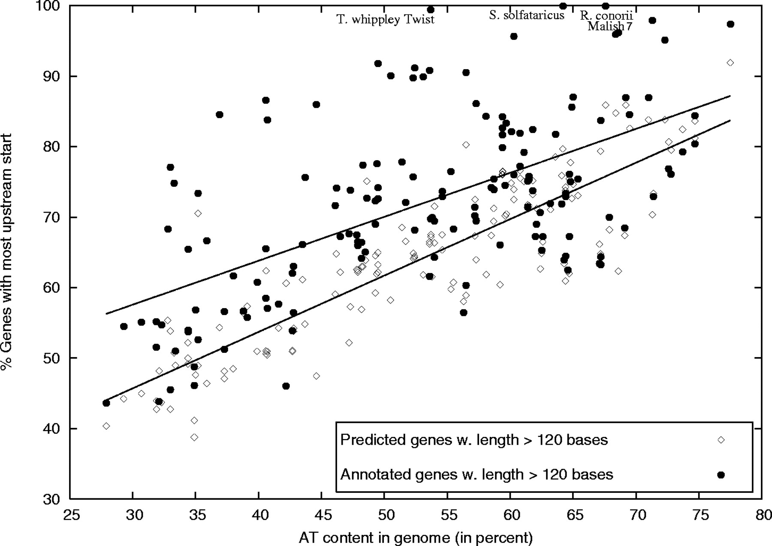
Fig. 3 There is a tendency towards annotating genes with the most upstream start codon. Particularly in GC-rich ...
Notes:
Fig. 3 There is a tendency towards annotating genes with the most upstream start codon. Particularly in GC-rich genomes this is done much more often than predicted by EasyGene.
Unless provided in the caption above, the following copyright applies to the content of this slide: © The Author 2005. Published by Oxford University Press. All rights reserved. For Permissions, please email: journals.permissions@oxfordjournals.org

Slide 4
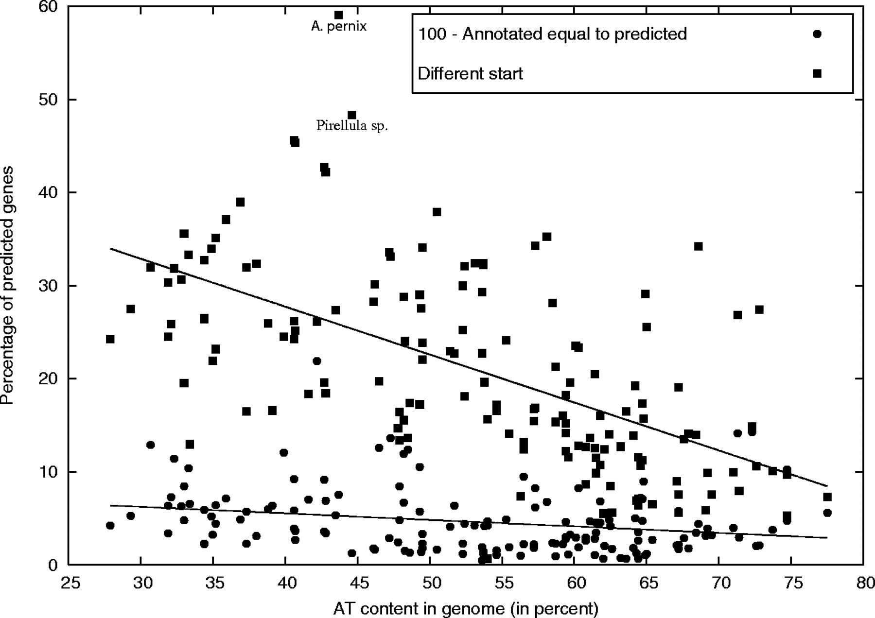
Fig. 4 The fraction of predicted genes with a start codon different from the annotated one is higher in genomes with ...
Notes:
Fig. 4 The fraction of predicted genes with a start codon different from the annotated one is higher in genomes with low AT content. The largest differences are found in A.pernix and Pirellula sp. The fraction of annotated genes equal to predicted based on stop codon comparison increases with higher AT content.
Unless provided in the caption above, the following copyright applies to the content of this slide: © The Author 2005. Published by Oxford University Press. All rights reserved. For Permissions, please email: journals.permissions@oxfordjournals.org

Slide 5
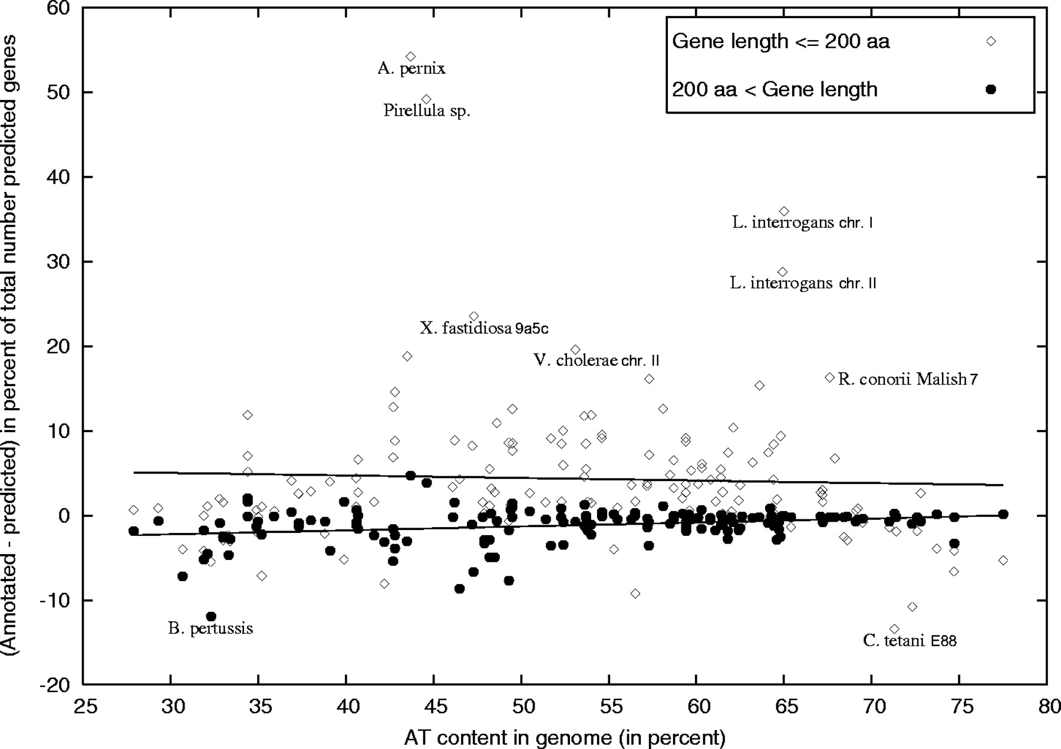
Fig. 5 In many genomes the fraction of small annotated genes is larger than the fraction of small predicted genes ...
Notes:
Fig. 5 In many genomes the fraction of small annotated genes is larger than the fraction of small predicted genes (most extreme in Pirellula sp., L.interrogans chr. I and II, and X.fastidiosa 9a5c). Fractions are with respect to all predicted genes. For a few genomes short genes could be missing from the annotation (e.g. C.tetani E88). EasyGene 1.2 generally predicts longer genes than what is annotated (B.pertussis).
Unless provided in the caption above, the following copyright applies to the content of this slide: © The Author 2005. Published by Oxford University Press. All rights reserved. For Permissions, please email: journals.permissions@oxfordjournals.org

