Slide 1
Figure 1. Study design. Subjects viewed episode of The Big Bang Theory with food and control (non-food) commercials ...
Notes:
Figure 1. Study design. Subjects viewed episode of The Big Bang Theory with food and control (non-food) commercials embedded throughout as typical commercial breaks.
Unless provided in the caption above, the following copyright applies to the content of this slide: © The Author 2015. Published by Oxford University Press. All rights reserved. For Permissions, please e-mail: journals.permissions@oup.com

Slide 2
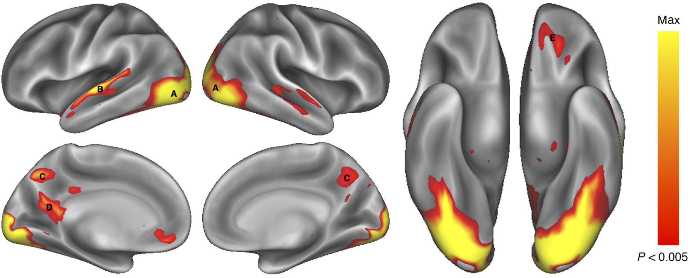
Figure 2. Brain regions showing greater activity when viewing FOOD commercials than NON-FOOD commercials. Activations ...
Notes:
Figure 2. Brain regions showing greater activity when viewing FOOD commercials than NON-FOOD commercials. Activations (P < 0.005, 173 contiguous voxels) are displayed on an inflated rendering of the cortical surface (Marcus et al. 2010; Marcus et al. 2011). Greater activation for FOOD commercials was observed in a number of occipital regions (A) extending from the occipital pole through the fusiform gyrus, the left superior and middle temporal gyrus (B), the precuneus (C and D), and the left orbital frontal cortex (E).
Unless provided in the caption above, the following copyright applies to the content of this slide: © The Author 2015. Published by Oxford University Press. All rights reserved. For Permissions, please e-mail: journals.permissions@oup.com

Slide 3
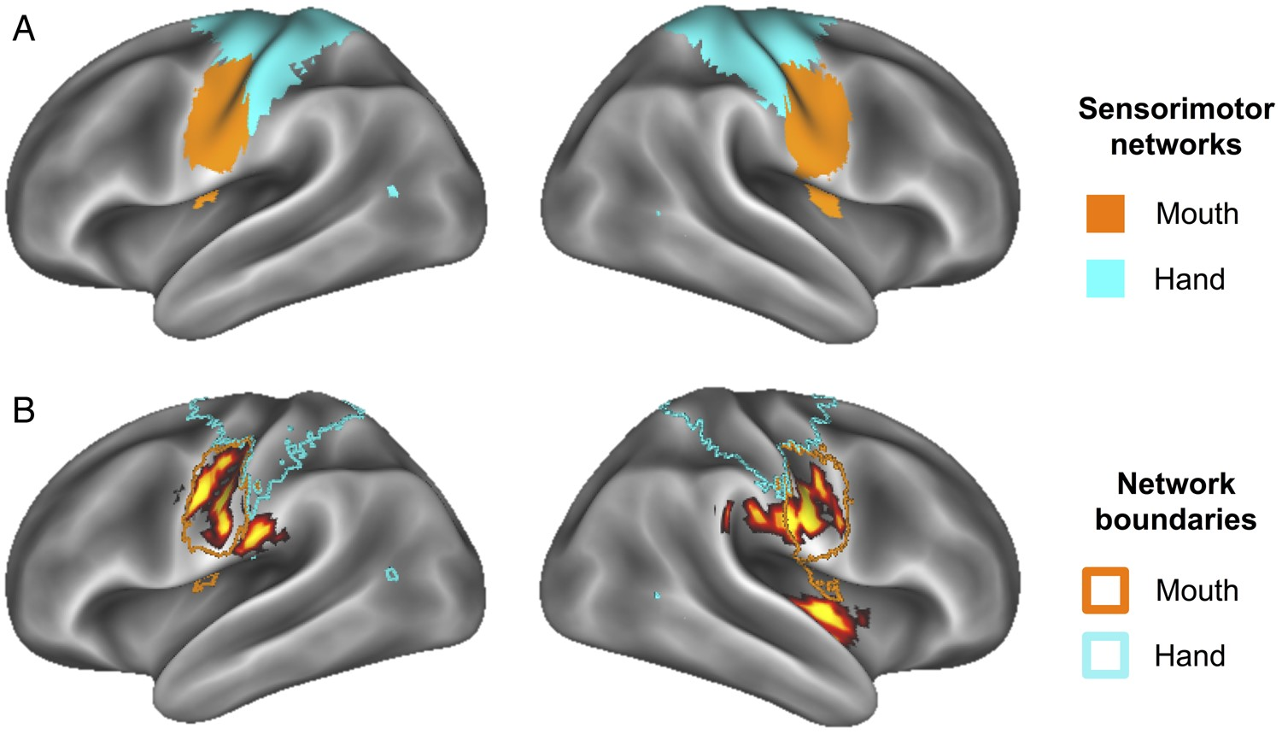
Figure 5. (A) Functionally defined sensorimotor networks via resting-state connectivity (Power et al. 2011) provide ...
Notes:
Figure 5. (A) Functionally defined sensorimotor networks via resting-state connectivity (Power et al. 2011) provide evidence for separable mouth and hand (body) subnetworks. (B) Activity from (A) overlaid on network boundaries from Power et al. (2011) demonstrates specificity of activity to “mouth” sensorimotor network.
Unless provided in the caption above, the following copyright applies to the content of this slide: © The Author 2015. Published by Oxford University Press. All rights reserved. For Permissions, please e-mail: journals.permissions@oup.com

Slide 4
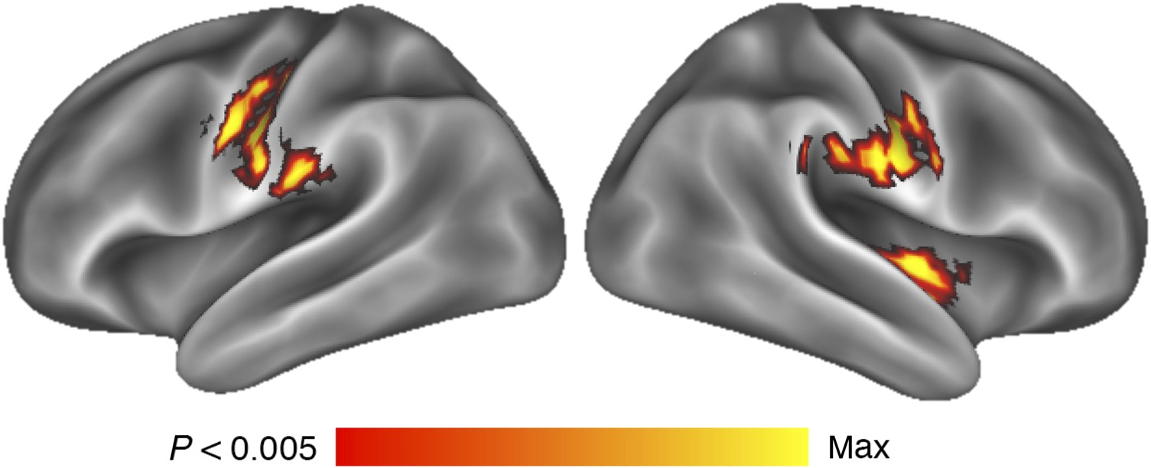
Figure 4. Whole-brain response to FOOD commercials covaried with percent body fat, accounting for age and gender. ...
Notes:
Figure 4. Whole-brain response to FOOD commercials covaried with percent body fat, accounting for age and gender. Activations are overlayed on an inflated representation of the cortical surface (Marcus et al. 2010; Marcus et al. 2011). Activations were observed in bilateral regions of sensorimotor cortices along the pre- and post-central gyri and bilateral central sulci and a region of the right insula/posterior opercula.
Unless provided in the caption above, the following copyright applies to the content of this slide: © The Author 2015. Published by Oxford University Press. All rights reserved. For Permissions, please e-mail: journals.permissions@oup.com

Slide 5
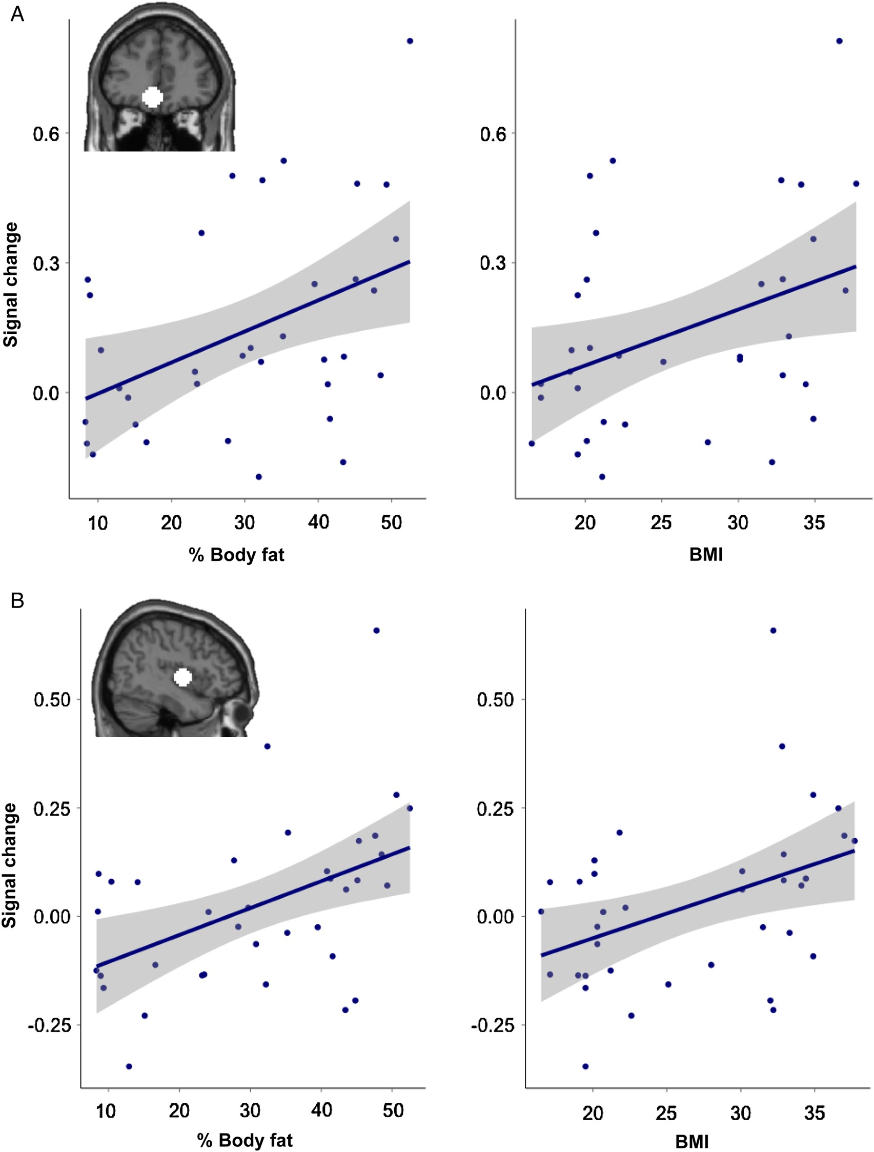
Figure 3. Regions correlating with percent body fat. (A) The magnitude of response to food commercials in a region of ...
Notes:
Figure 3. Regions correlating with percent body fat. (A) The magnitude of response to food commercials in a region of the left orbitofrontal cortex, defined by the FOOD > NON-FOOD contrast, correlated with percent body fat (r = 0.43, P < 0.01) and BMI (r = 0.38, P NON-FOOD contrast, correlated with percent body fat (r = 0.38, P < 0.05) and BMI (r = 0.41, P < 0.05).
Unless provided in the caption above, the following copyright applies to the content of this slide: © The Author 2015. Published by Oxford University Press. All rights reserved. For Permissions, please e-mail: journals.permissions@oup.com

