Slide 1
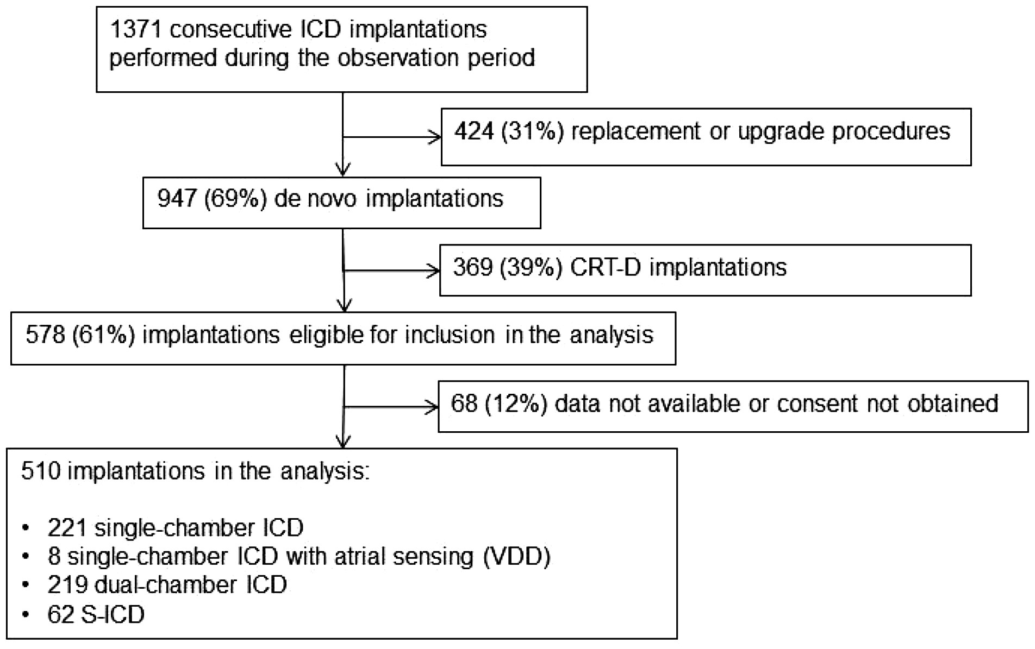
Figure 1 Diagram of the study: number of cases in analysis.
Notes:
Figure 1 Diagram of the study: number of cases in analysis.
Unless provided in the caption above, the following copyright applies to the content of this slide: © The Author 2016. Published by Oxford University Press on behalf of the European Society of Cardiology.This is an Open Access article distributed under the terms of the Creative Commons Attribution Non-Commercial License (http://creativecommons.org/licenses/by-nc/4.0/), which permits non-commercial re-use, distribution, and reproduction in any medium, provided the original work is properly cited. For commercial re-use, please contact journals.permissions@oup.com

Slide 2
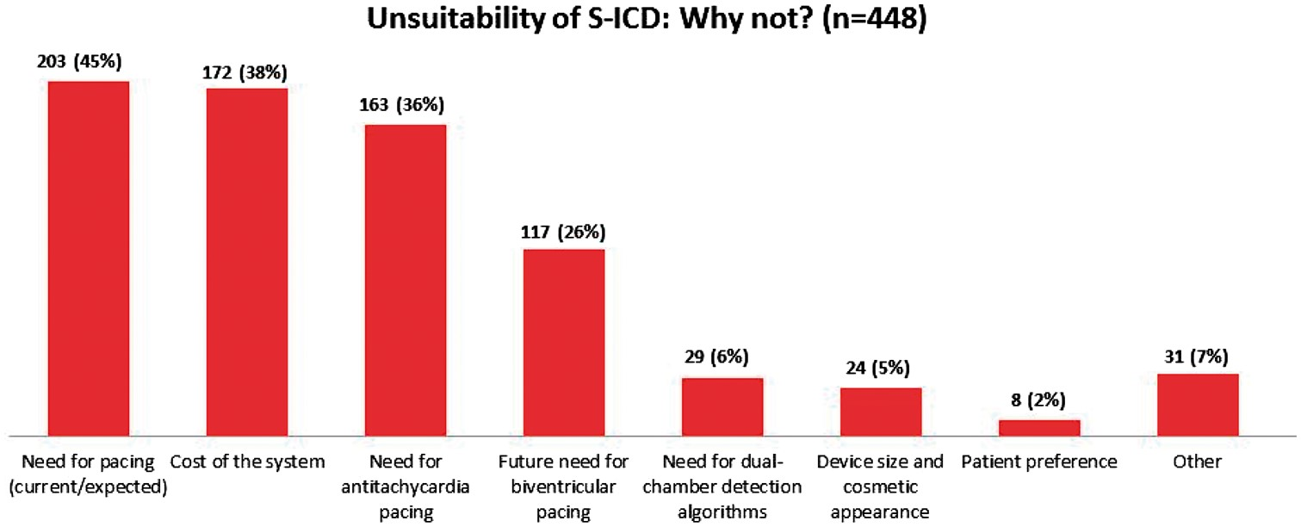
Figure 2 Factors for preferring a transvenous ICD over an S-ICD (n = 448). Multiple factors were reported per ...
Notes:
Figure 2 Factors for preferring a transvenous ICD over an S-ICD (n = 448). Multiple factors were reported per patient.
Unless provided in the caption above, the following copyright applies to the content of this slide: © The Author 2016. Published by Oxford University Press on behalf of the European Society of Cardiology.This is an Open Access article distributed under the terms of the Creative Commons Attribution Non-Commercial License (http://creativecommons.org/licenses/by-nc/4.0/), which permits non-commercial re-use, distribution, and reproduction in any medium, provided the original work is properly cited. For commercial re-use, please contact journals.permissions@oup.com

Slide 3
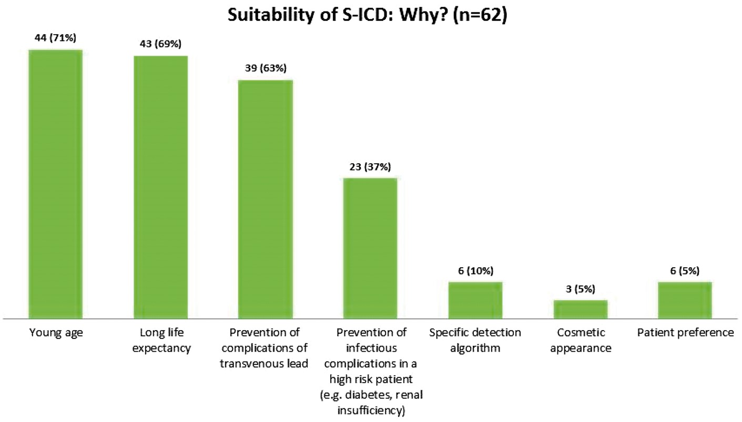
Figure 3 Factors for preferring an S-ICD over a transvenous ICD (n = 62). Multiple factors were reported per patient.
Notes:
Figure 3 Factors for preferring an S-ICD over a transvenous ICD (n = 62). Multiple factors were reported per patient.
Unless provided in the caption above, the following copyright applies to the content of this slide: © The Author 2016. Published by Oxford University Press on behalf of the European Society of Cardiology.This is an Open Access article distributed under the terms of the Creative Commons Attribution Non-Commercial License (http://creativecommons.org/licenses/by-nc/4.0/), which permits non-commercial re-use, distribution, and reproduction in any medium, provided the original work is properly cited. For commercial re-use, please contact journals.permissions@oup.com

