Slide 1
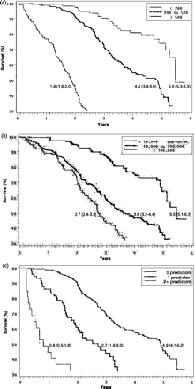
Figure 1 Survival probability for men by years since entrance into follow-up stratified by (a) CD4 count, (b) viral ...
Notes:
Figure 1 Survival probability for men by years since entrance into follow-up stratified by (a) CD4 count, (b) viral load, and (c) number of resource-limited predictors (TLC < 1200, anaemia, and low BMI)
Unless provided in the caption above, the following copyright applies to the content of this slide: Published by Oxford University Press on behalf of the International Epidemiological Association © The Author 2005; all rights reserved.

