Slide 1
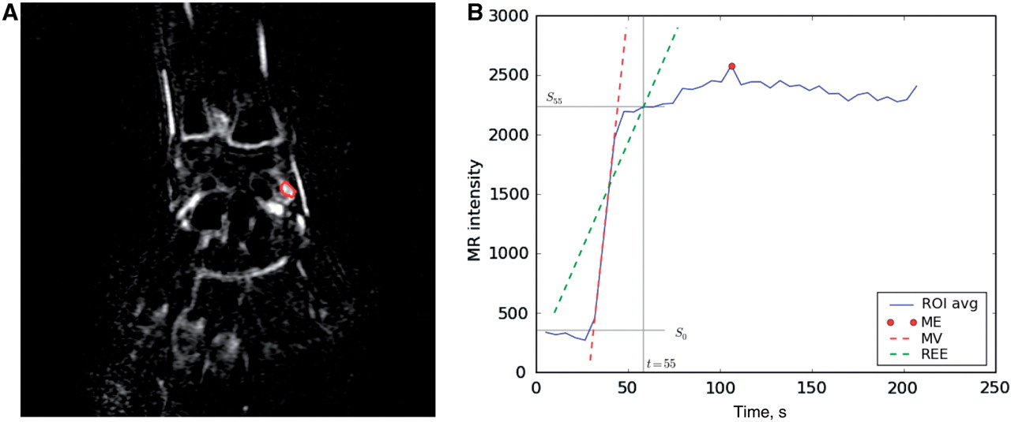
Fig. 1 (A) MIP from a wrist MRI of a JIA patient. The MIP is a static 3D image in which to each voxel is assigned ...
Notes:
Fig. 1 (A) MIP from a wrist MRI of a JIA patient. The MIP is a static 3D image in which to each voxel is assigned the maximum intensity reached during the whole acquisition. The ROI (in red) is drawn by the operator in the area of highest visual enhancement. (B) Dynamic enhancement curve following the injection of gadolinium. The curve, shown in blue, is obtained from the ROI. The ME reached during the acquisition is marked by a red circle. The MV and the REE are shown as dashed line, in red and green, respectively. The latter is defined as the curve slope in the first 55 s. S0: signal intensity before injection of Gd-DTPA; S55: signal intensity 55 s after injection. See ‘Patients and methods’ methods section for details on the computation of ME, MV and REE.
Unless provided in the caption above, the following copyright applies to the content of this slide: © The Author 2010. Published by Oxford University Press on behalf of the British Society for Rheumatology. All rights reserved. For Permissions, please email: journals.permissions@oxfordjournals.org

Slide 2
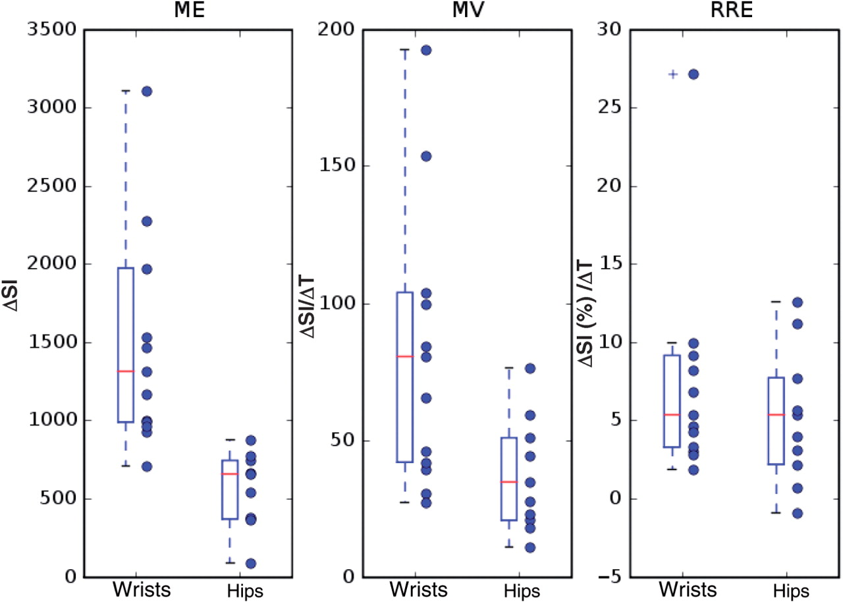
Fig. 2 Values of ME, MV and REE in patients with JIA and wrist or hip involvement. Both the individual values ...
Notes:
Fig. 2 Values of ME, MV and REE in patients with JIA and wrist or hip involvement. Both the individual values (circles) and the box plots of the three quantities are shown. In the box plots, the median values are indicated by a horizontal dash and the rectangular boxes extend from the lower to the upper quartiles. Whiskers extend from the box to show the range of the data; outliers are shown with a plus sign. SI: signal intensity; T: time (s).
Unless provided in the caption above, the following copyright applies to the content of this slide: © The Author 2010. Published by Oxford University Press on behalf of the British Society for Rheumatology. All rights reserved. For Permissions, please email: journals.permissions@oxfordjournals.org

