Slide 1
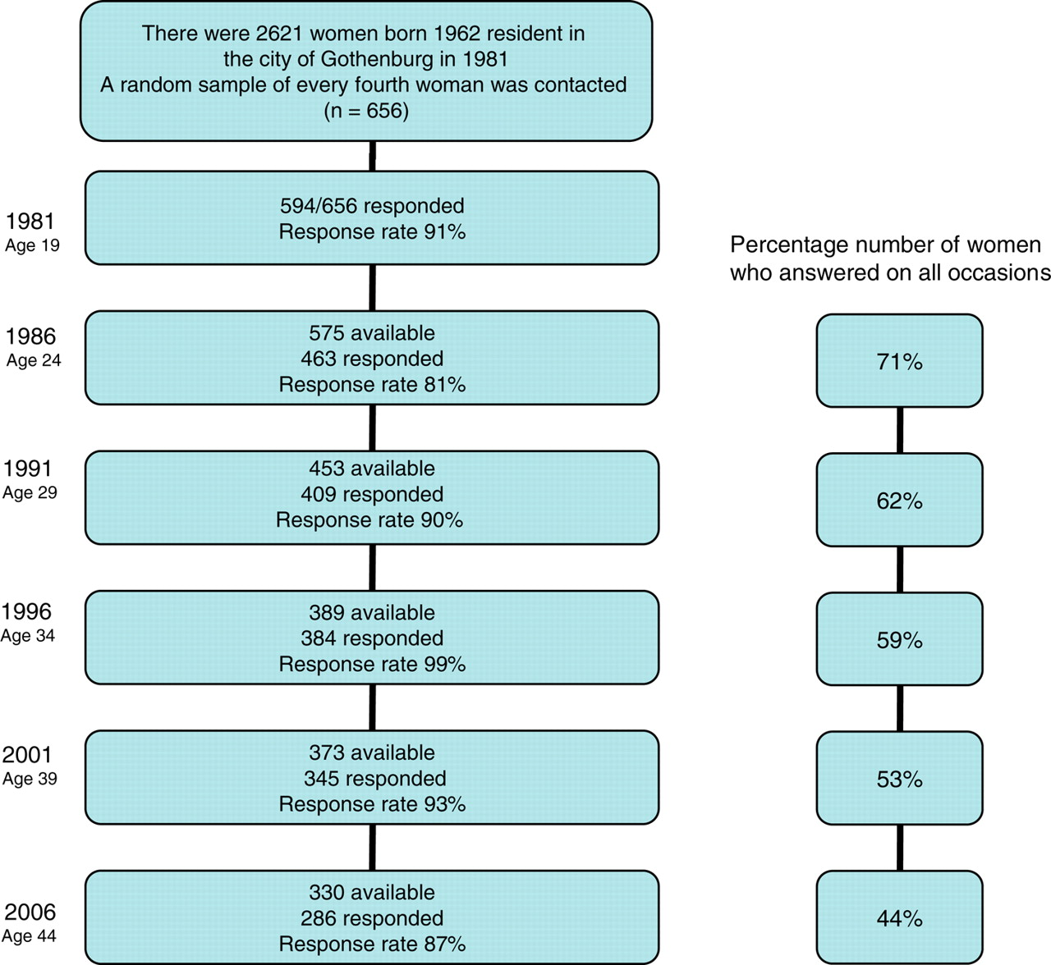
Figure 1 Flow chart illustrating the inclusion of the women and their continued participation in this longitudinal ...
Notes:
Figure 1 Flow chart illustrating the inclusion of the women and their continued participation in this longitudinal study.
Unless provided in the caption above, the following copyright applies to the content of this slide: © The Author 2010. Published by Oxford University Press on behalf of the European Society of Human Reproduction and Embryology. All rights reserved. For Permissions, please email: journals.permissions@oxfordjournals.org

Slide 2
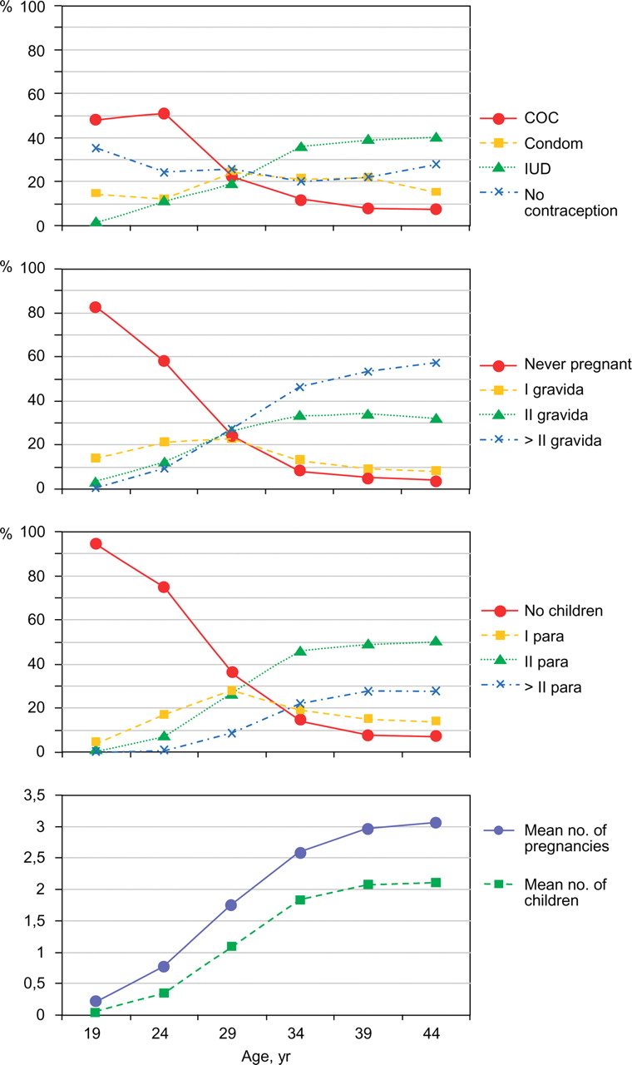
Figure 2 Contraceptive choice, number of pregnancies and births and the cumulative mean number of pregnancies and ...
Notes:
Figure 2 Contraceptive choice, number of pregnancies and births and the cumulative mean number of pregnancies and children at different ages in the same women (n = 286) followed longitudinally from 19 to 44 years of age. COC, combined oral contraceptive pill; IUD, intrauterine device.
Unless provided in the caption above, the following copyright applies to the content of this slide: © The Author 2010. Published by Oxford University Press on behalf of the European Society of Human Reproduction and Embryology. All rights reserved. For Permissions, please email: journals.permissions@oxfordjournals.org

Slide 3
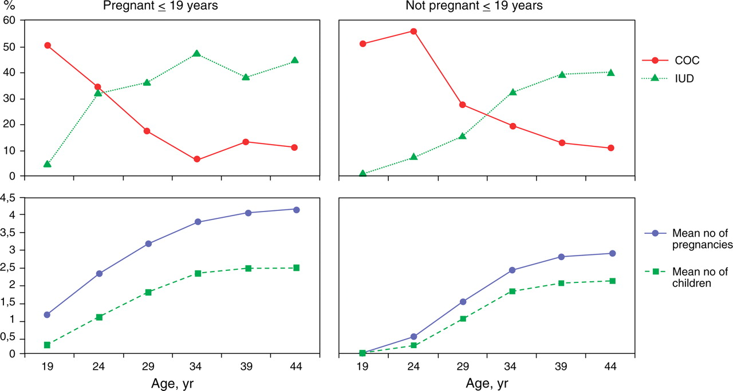
Figure 3 Comparison of the use of the COC pill or an IUD, and the cumulative mean number of pregnancies and children ...
Notes:
Figure 3 Comparison of the use of the COC pill or an IUD, and the cumulative mean number of pregnancies and children at different ages from 19 to 44 years in the women grouped according to whether the woman had been pregnant or not ≤19 years of age.
Unless provided in the caption above, the following copyright applies to the content of this slide: © The Author 2010. Published by Oxford University Press on behalf of the European Society of Human Reproduction and Embryology. All rights reserved. For Permissions, please email: journals.permissions@oxfordjournals.org

