Slide 1
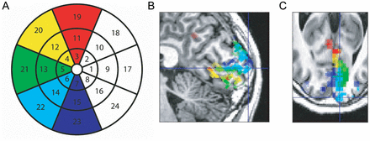
Figure 1. (A) The 24 visual field regions whose representations on the occipital cortex were mapped with multifocal ...
Notes:
Figure 1. (A) The 24 visual field regions whose representations on the occipital cortex were mapped with multifocal fMRI. The retinotopic polar angle maps of representations of these regions are shown for the participant P2 in the (B) sagittal and (C) axial planes. The cross hair in B and C indicates the approximate center of subarea 6 in V1.
Unless provided in the caption above, the following copyright applies to the content of this slide: © The Author 2013. Published by Oxford University Press. All rights reserved. For Permissions, please e-mail: journals.permissions@oup.com

Slide 2
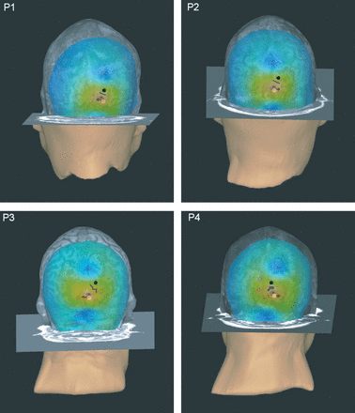
Figure 2. The E-field distribution on the cortex when the maximal E-field was directed to the approximate center of ...
Notes:
Figure 2. The E-field distribution on the cortex when the maximal E-field was directed to the approximate center of target subarea in V1 (red spot). The blue color illustrates the lowest E-field strength and the green color indicates the highest E-field strength. The yellow spot represents the location of the coil and the red arrow shows the direction of the E-field. A black spot represents the approximate center of retinotopically corresponding V2 and the gray line the border between V1 and V2 subareas. For participant P4, we stimulated V2 in the left hemisphere, retinotopically contralateral to her V1 stimulation. The approximate center of stimulated V2 subarea for P4 in the left hemisphere is shown with purple, and the center of the retinotopically corresponding V1 with orange.
Unless provided in the caption above, the following copyright applies to the content of this slide: © The Author 2013. Published by Oxford University Press. All rights reserved. For Permissions, please e-mail: journals.permissions@oup.com

Slide 3
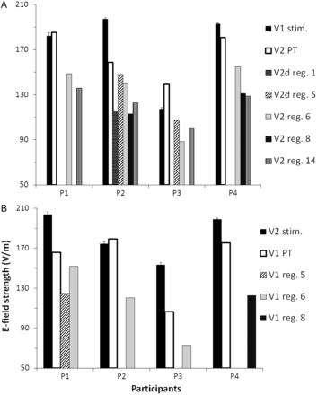
Figure 3. E-field strengths in V1 and V2 during the stimulation of V1 (A) and during the stimulation of V2 (B). The ...
Notes:
Figure 3. E-field strengths in V1 and V2 during the stimulation of V1 (A) and during the stimulation of V2 (B). The E-field strength value in the target area is the mean of E-field strengths in 50 TMS trials, including different TMS sessions. The E-field strength in subareas of the nontarget cortical area was assessed at this mean strength. These values are provided for the subareas, where the E-field strength was higher than 70% of the phosphene threshold of that area. Alternatively, in cases with no nontargeted subarea exceeding the 70% of phosphene threshold, we report the strongest nontargeted E-field strength. In comparison, the phosphene threshold (PT) bar indicates the E-field strength at the phosphene threshold in the homologous visual field region, but in the non-target area. Note that the E-field strength in the nontargeted V1 or V2 was always under the phosphene threshold, when they were not the targets. The error bars indicate the standard error of mean (SEM).
Unless provided in the caption above, the following copyright applies to the content of this slide: © The Author 2013. Published by Oxford University Press. All rights reserved. For Permissions, please e-mail: journals.permissions@oup.com

Slide 4
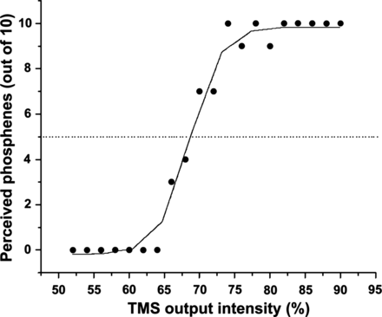
Figure 4. Example of Boltzmann fit of phosphene threshold measurement in V1 for a representative participant P1. ...
Notes:
Figure 4. Example of Boltzmann fit of phosphene threshold measurement in V1 for a representative participant P1. Stimulus intensity is shown as percentages of the maximal stimulator output. The ordinate shows the count of phosphenes perceived out of 10 delivered pulses. The threshold was defined as the half-maximal value (5/10) of the fitted function (dotted line). Measurements comprised 20 different TMS pulse intensities in steps of 2% stimulator output intervals, which were set in a pseudorandomized order.
Unless provided in the caption above, the following copyright applies to the content of this slide: © The Author 2013. Published by Oxford University Press. All rights reserved. For Permissions, please e-mail: journals.permissions@oup.com

Slide 5
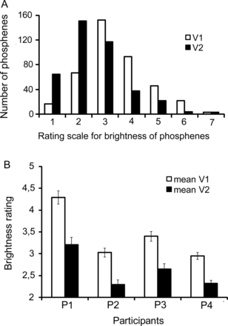
Figure 5. The subjective ratings of phosphene brightness. (A) Brightness ratings averaged across all participants. The ...
Notes:
Figure 5. The subjective ratings of phosphene brightness. (A) Brightness ratings averaged across all participants. The count of phosphenes is plotted against the subjective ratings of brightness intensity, ranging from 1 to 7. One stands for the least bright phosphenes and 7 for the brightest phosphenes. (B) Averaged brightness ratings after V1 and V2 stimulation for each participant. The error bars indicate the SEM.
Unless provided in the caption above, the following copyright applies to the content of this slide: © The Author 2013. Published by Oxford University Press. All rights reserved. For Permissions, please e-mail: journals.permissions@oup.com

Slide 6
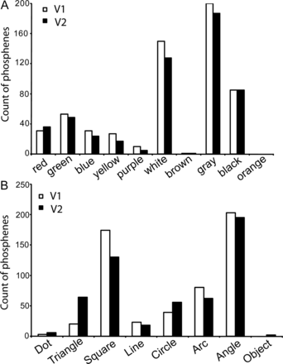
Figure 6. (A) The categories for colored percepts (n = 4). (B) The categories for different phosphene shapes.
Notes:
Figure 6. (A) The categories for colored percepts (n = 4). (B) The categories for different phosphene shapes.
Unless provided in the caption above, the following copyright applies to the content of this slide: © The Author 2013. Published by Oxford University Press. All rights reserved. For Permissions, please e-mail: journals.permissions@oup.com

