Slide 1
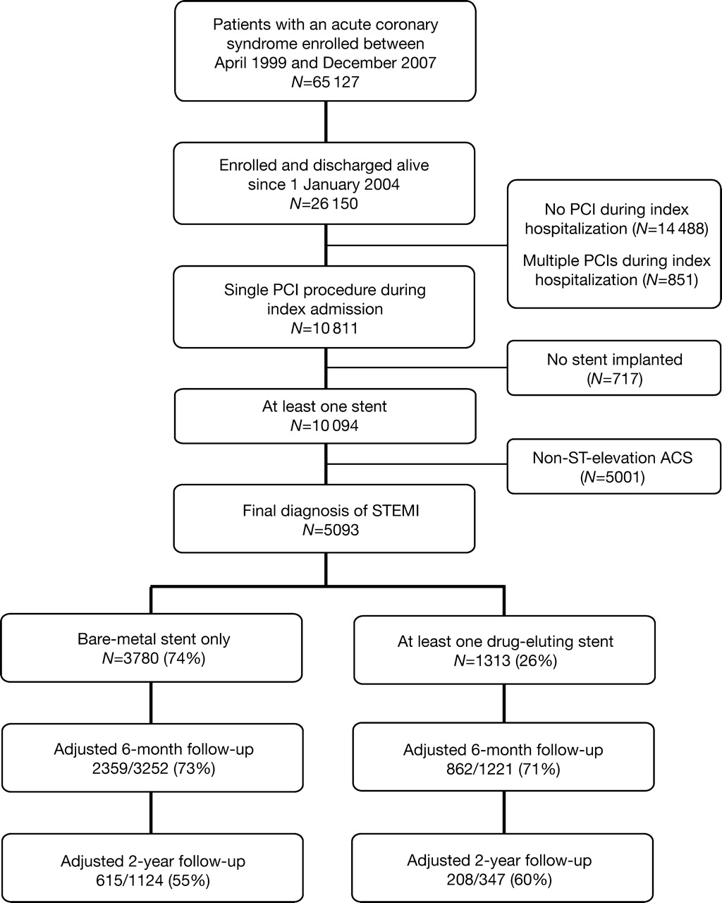
Figure 1 Flow chart of patient participation and follow-up. PCI, percutaneous coronary intervention; STEMI, ST-segment ...
Notes:
Figure 1 Flow chart of patient participation and follow-up. PCI, percutaneous coronary intervention; STEMI, ST-segment elevation myocardial infarction.
Unless provided in the caption above, the following copyright applies to the content of this slide: Published on behalf of the European Society of Cardiology. All rights reserved. © The Author 2009. For permissions please email: journals.permissions@oxfordjournals.org

Slide 2
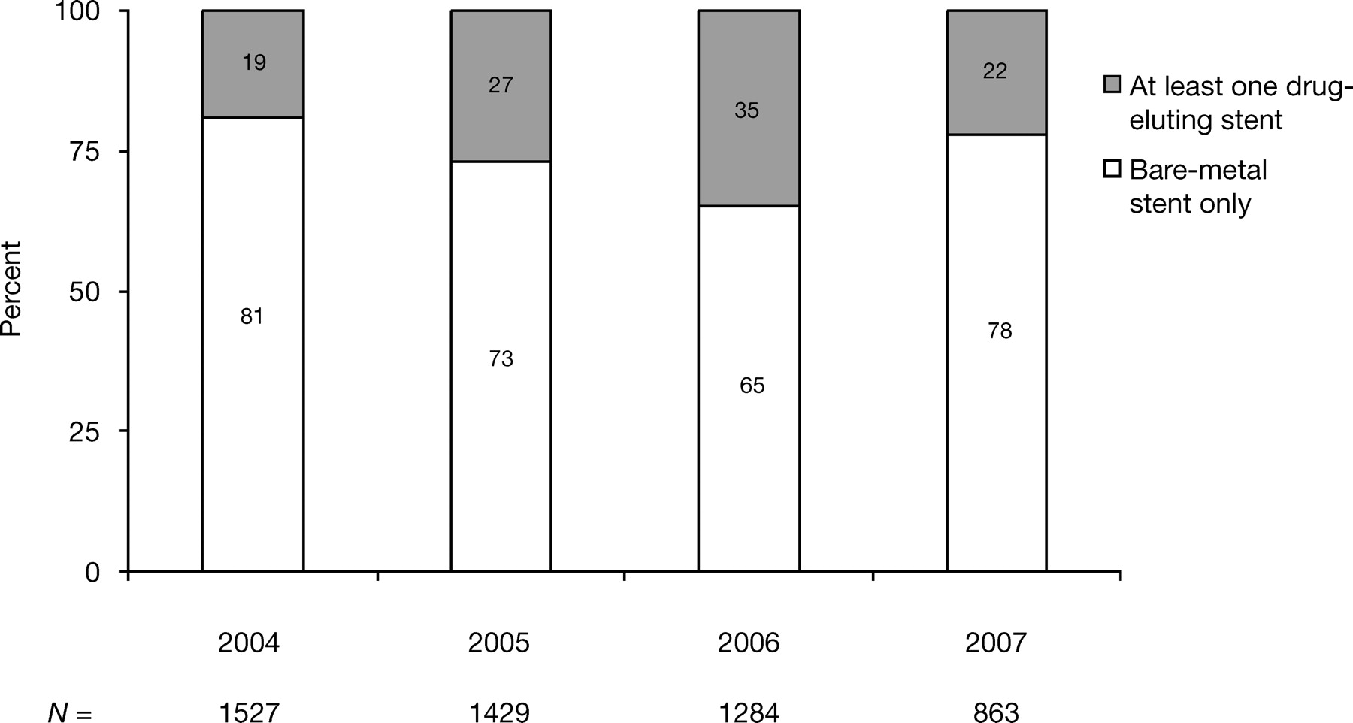
Figure 2 Proportion of drug-eluting and bare-metal stents by enrolment year ( P < 0.0001).
Notes:
Figure 2 Proportion of drug-eluting and bare-metal stents by enrolment year ( P < 0.0001).
Unless provided in the caption above, the following copyright applies to the content of this slide: Published on behalf of the European Society of Cardiology. All rights reserved. © The Author 2009. For permissions please email: journals.permissions@oxfordjournals.org

Slide 3
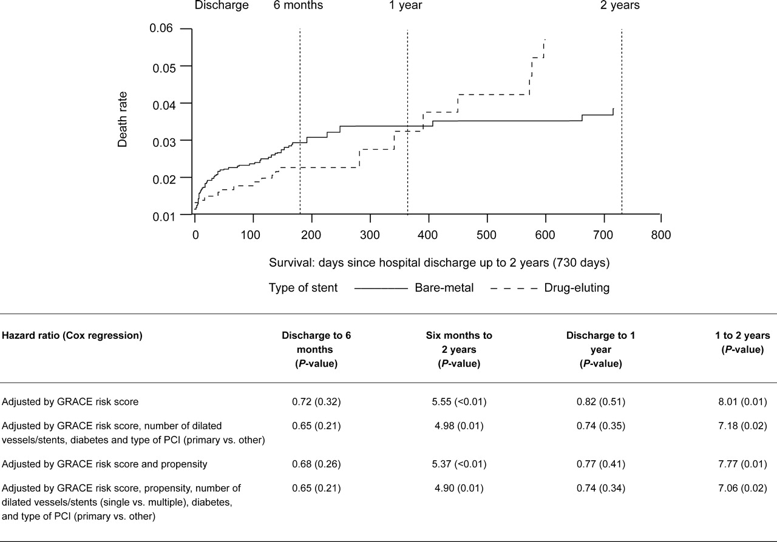
Figure 3 Landmark analysis of post-discharge survival at 6 months and at 1 year in patients with ST-segment elevation ...
Notes:
Figure 3 Landmark analysis of post-discharge survival at 6 months and at 1 year in patients with ST-segment elevation myocardial infarction treated with drug-eluting or bare-metal stents.
Unless provided in the caption above, the following copyright applies to the content of this slide: Published on behalf of the European Society of Cardiology. All rights reserved. © The Author 2009. For permissions please email: journals.permissions@oxfordjournals.org

