Slide 1
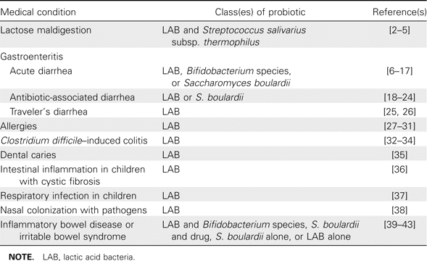
Table 1 Medical applications in humans for different classes of probiotics.
Notes:
Table 1 Medical applications in humans for different classes of probiotics.
Unless provided in the caption above, the following copyright applies to the content of this slide: © 2008 Infectious Diseases Society of America.

Slide 2
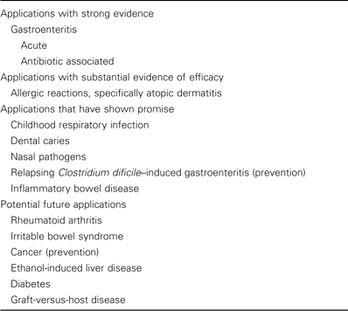
Table 2 Present and future clinical applications of probiotics, by level of evidence of efficacy.
Notes:
Table 2 Present and future clinical applications of probiotics, by level of evidence of efficacy.
Unless provided in the caption above, the following copyright applies to the content of this slide: © 2008 Infectious Diseases Society of America.

