Slide 1
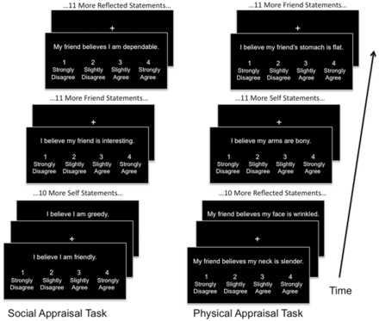
Fig. 1 Both tasks included four fMRI runs consisting of the presentations of appraisal statements with intervening ...
Notes:
Fig. 1 Both tasks included four fMRI runs consisting of the presentations of appraisal statements with intervening fixation periods. During the presentation of each statement, subjects would read and respond using a hand-held button box. Within each run, all statements for each condition (self, friend and reflected) would occur sequentially.
Unless provided in the caption above, the following copyright applies to the content of this slide: © The Author(s) (2012). Published by Oxford University Press.This is an Open Access article distributed under the terms of the Creative Commons Attribution Non-Commercial License (http://creativecommons.org/licenses/by-nc/4.0/), which permits non-commercial re-use, distribution, and reproduction in any medium, provided the original work is properly cited. For commercial re-use, please contact journals.permissions@oup.com

Slide 2
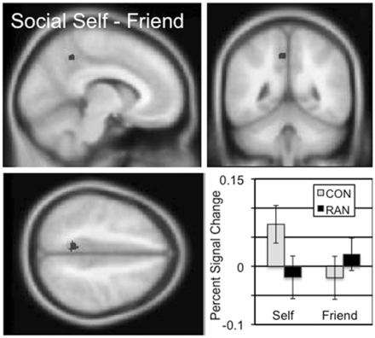
Fig. 2 The two-sample comparison of the CON and RAN groups in the social self–friend contrast (‘I am’) identified a ...
Notes:
Fig. 2 The two-sample comparison of the CON and RAN groups in the social self–friend contrast (‘I am’) identified a cluster in the precuneus with a peak t of 4.61 consisting of 43 voxels. Slices centered on MNI coordinates of the peak voxel (−8, −48, 46). The percent signal change in this cluster for the self and friend conditions is shown for the CON and RAN groups in the lower right panel.
Unless provided in the caption above, the following copyright applies to the content of this slide: © The Author(s) (2012). Published by Oxford University Press.This is an Open Access article distributed under the terms of the Creative Commons Attribution Non-Commercial License (http://creativecommons.org/licenses/by-nc/4.0/), which permits non-commercial re-use, distribution, and reproduction in any medium, provided the original work is properly cited. For commercial re-use, please contact journals.permissions@oup.com

Slide 3
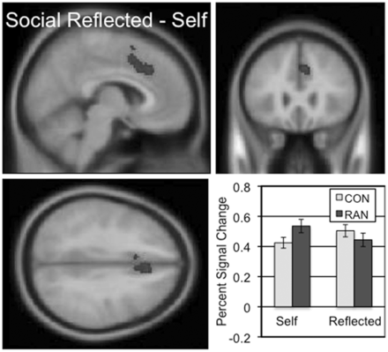
Fig. 3 The two-sample comparison of the CON and RAN groups in the social reflected–self contrast (‘Friend believes’) ...
Notes:
Fig. 3 The two-sample comparison of the CON and RAN groups in the social reflected–self contrast (‘Friend believes’) identified a cluster in the dorsal anterior cingulate and DMPFC with a peak t of 5.74 consisting of 379 voxels. Slices centered on MNI coordinates of the peak voxel (−6, 26, 36). The percent signal change in this cluster for the self and reflected conditions is shown for the CON and RAN groups in the lower right panel.
Unless provided in the caption above, the following copyright applies to the content of this slide: © The Author(s) (2012). Published by Oxford University Press.This is an Open Access article distributed under the terms of the Creative Commons Attribution Non-Commercial License (http://creativecommons.org/licenses/by-nc/4.0/), which permits non-commercial re-use, distribution, and reproduction in any medium, provided the original work is properly cited. For commercial re-use, please contact journals.permissions@oup.com

Slide 4
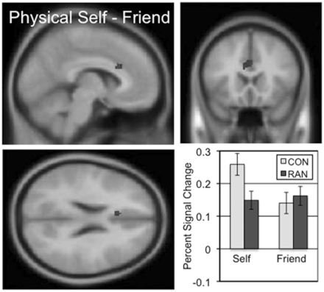
Fig. 4 The two-sample comparison of the CON and RAN groups in the physical self–friend contrast (‘I look’) ...
Notes:
Fig. 4 The two-sample comparison of the CON and RAN groups in the physical self–friend contrast (‘I look’) identified a cluster in the ventral anterior cingulate with a peak t of 4.50 consisting of 61 voxels. Slices centered on MNI coordinates of the peak voxel (−6, 20, 24). The percent signal change in this cluster for the self and friend conditions is shown for the CON and RAN groups in the lower right panel.
Unless provided in the caption above, the following copyright applies to the content of this slide: © The Author(s) (2012). Published by Oxford University Press.This is an Open Access article distributed under the terms of the Creative Commons Attribution Non-Commercial License (http://creativecommons.org/licenses/by-nc/4.0/), which permits non-commercial re-use, distribution, and reproduction in any medium, provided the original work is properly cited. For commercial re-use, please contact journals.permissions@oup.com

