Slide 1
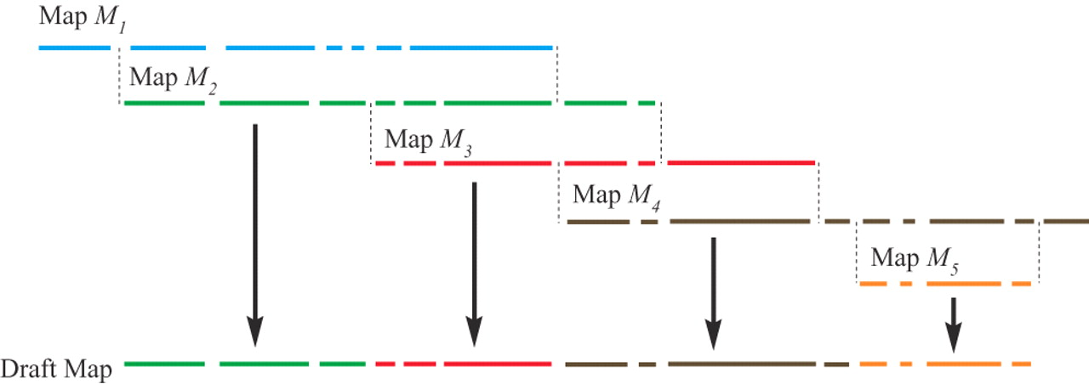
Fig. 1 Construction of draft consensus map from pairwise optical map alignments.
Notes:
Fig. 1 Construction of draft consensus map from pairwise optical map alignments.
Unless provided in the caption above, the following copyright applies to the content of this slide: © The Author 2006. Published by Oxford University Press. All rights reserved. For Permissions, please email: journals.permissions@oxfordjournals.org

Slide 2
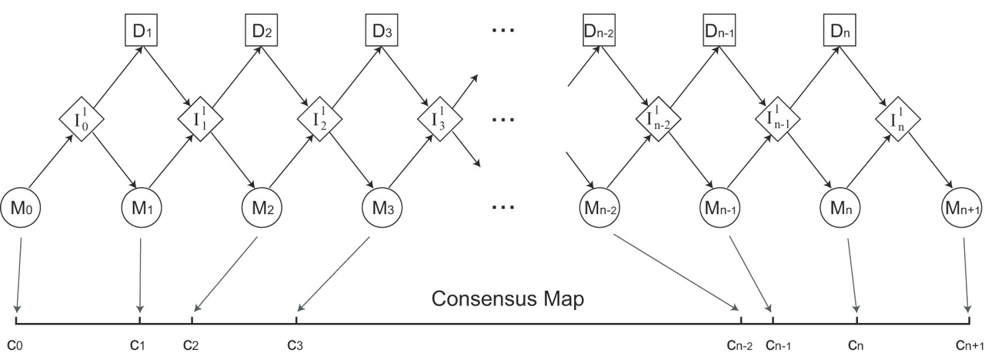
Fig. 2 HMM for physical mapping. Each restriction cut site has a group of corresponding states in the model.
Notes:
Fig. 2 HMM for physical mapping. Each restriction cut site has a group of corresponding states in the model.
Unless provided in the caption above, the following copyright applies to the content of this slide: © The Author 2006. Published by Oxford University Press. All rights reserved. For Permissions, please email: journals.permissions@oxfordjournals.org

Slide 3
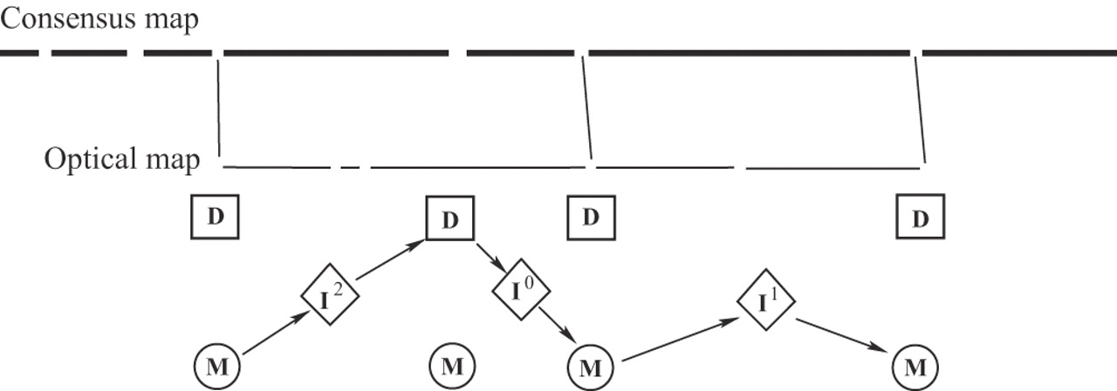
Fig. 3 Representation of optical map alignment by a path through the model states. In the top figure, only the ...
Notes:
Fig. 3 Representation of optical map alignment by a path through the model states. In the top figure, only the matching sites are connected by lines. The bottom figure shows how the corresponding alignment can be represented as a path through the model states.
Unless provided in the caption above, the following copyright applies to the content of this slide: © The Author 2006. Published by Oxford University Press. All rights reserved. For Permissions, please email: journals.permissions@oxfordjournals.org

Slide 4
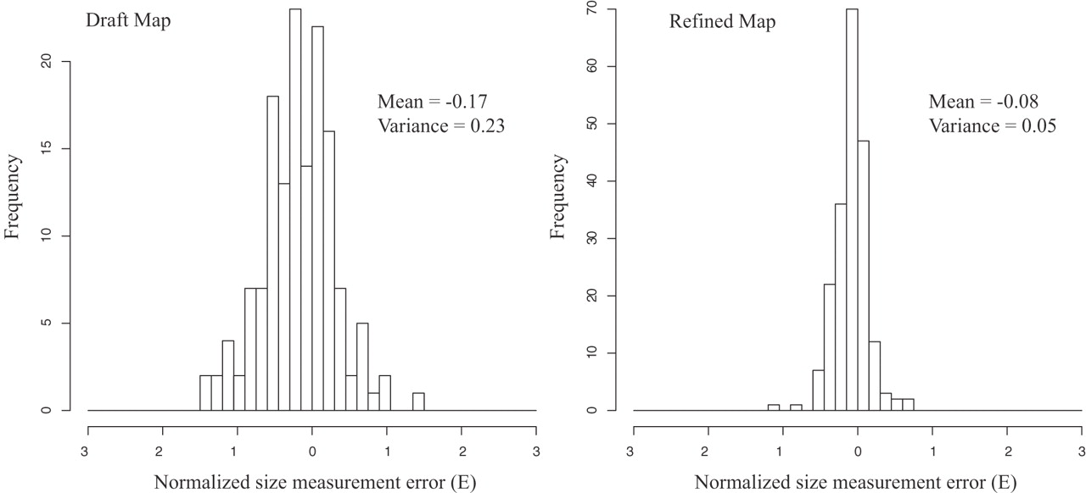
Fig. 4 Normalized size error before and after the refinement. Both graphs show histograms of normalized size error ...
Notes:
Fig. 4 Normalized size error before and after the refinement. Both graphs show histograms of normalized size error E=(X−Y)/Y, where X are sizes of fragments on consensus map and Y are their underlying counterparts of the reference map. Note the diminished size dispersion after the refinement.
Unless provided in the caption above, the following copyright applies to the content of this slide: © The Author 2006. Published by Oxford University Press. All rights reserved. For Permissions, please email: journals.permissions@oxfordjournals.org

Slide 5
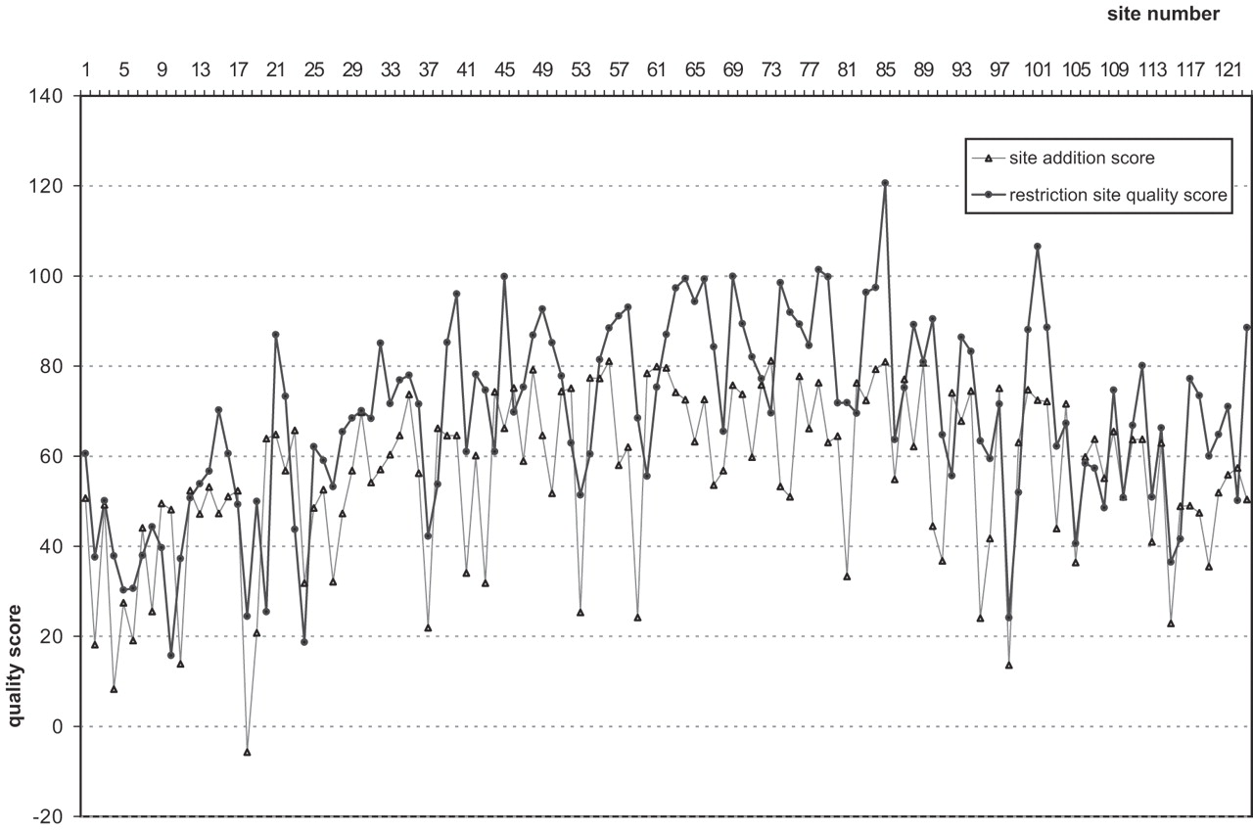
Fig. 5 Two site quality scores. Scores for the 122 cut sites after the refinement of Y.pestis assembly. Darker curve ...
Notes:
Fig. 5 Two site quality scores. Scores for the 122 cut sites after the refinement of Y.pestis assembly. Darker curve gives a quality score of the cuts of the consensus, lighter curve gives quality score for addition of cuts between adjacent consensus sites.
Unless provided in the caption above, the following copyright applies to the content of this slide: © The Author 2006. Published by Oxford University Press. All rights reserved. For Permissions, please email: journals.permissions@oxfordjournals.org

Slide 6
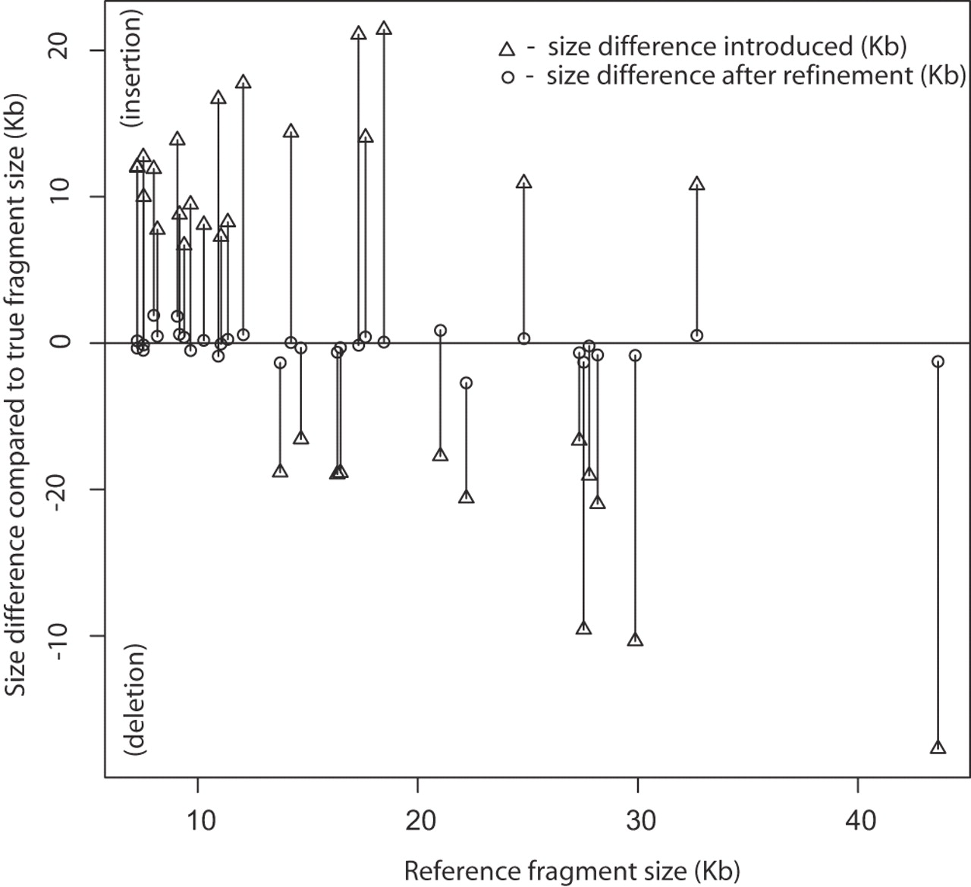
Fig. 6 Size errors before and after refinement. The horizontal axis marks sizes of fragments (in Kb) where indels ...
Notes:
Fig. 6 Size errors before and after refinement. The horizontal axis marks sizes of fragments (in Kb) where indels were made. Vertical axis marks the sizes of indels made (also in Kb). Triangles mark the indels before the refinement, circles mark size discrepancies (compared with reference map) after the refinement.
Unless provided in the caption above, the following copyright applies to the content of this slide: © The Author 2006. Published by Oxford University Press. All rights reserved. For Permissions, please email: journals.permissions@oxfordjournals.org

