Slide 1
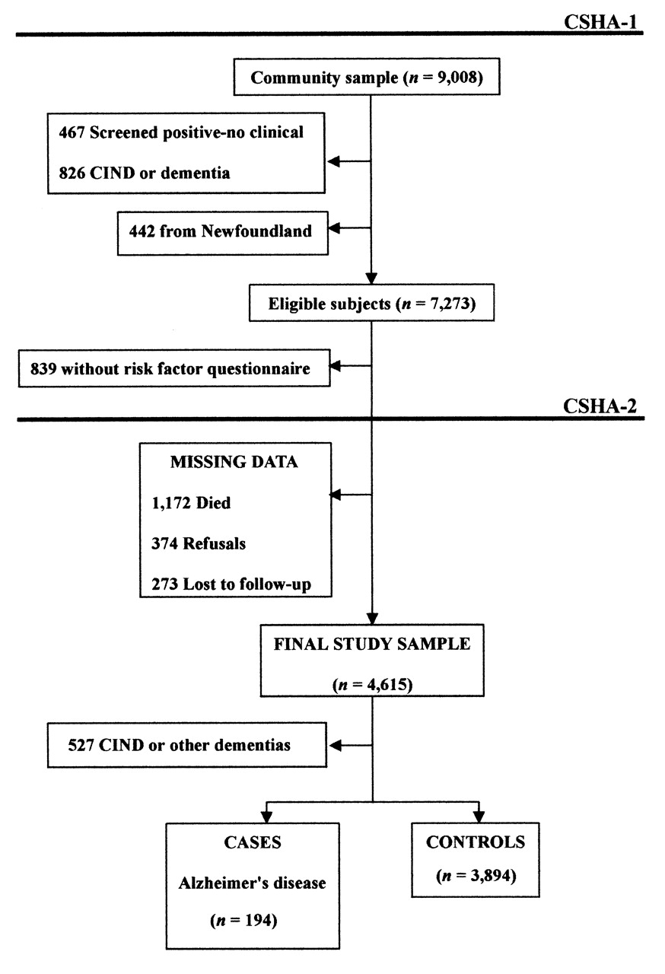
FIGURE 1. Study sample for the analysis of risk factors for incident Alzheimer’s disease, Canadian Study of ...
Notes:
FIGURE 1. Study sample for the analysis of risk factors for incident Alzheimer’s disease, Canadian Study of Health and Aging (CSHA), 1991–1992 (CSHA-1) and 1996–1997 (CSHA-2). no clinical: no clinical examination; CIND: cognitive impairment, no dementia.
Unless provided in the caption above, the following copyright applies to the content of this slide:

