Slide 1
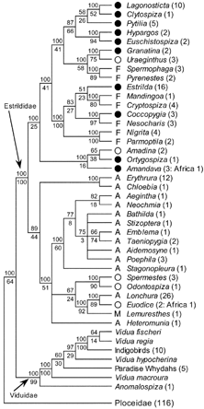
Figure 1 Phylogeny of estrildid finch genera based on this majority rule consensus tree from a Bayesian analysis of ...
Notes:
Figure 1 Phylogeny of estrildid finch genera based on this majority rule consensus tree from a Bayesian analysis of 1,527 mtDNA nucleotide positions for 103 taxa. Genera for which multiple species were sampled are condensed to a single branch, with the number of extant species in each genus indicated in parentheses (not all species in all genera were included in our analysis). Genera parasitized by Vidua are indicated by solid circles. Other African genera not parasitized by Vidua are indicated by open circles if they nest in relatively open habitats or by F if they nest in forested habitats. A = Australasian genera; M = Madagascan genera. Bayesian posterior probabilities and parsimony bootstrap values are shown above and below branches, respectively. Several nodes in this tree were not present in the MP tree for this data set.
Unless provided in the caption above, the following copyright applies to the content of this slide: © 2004 Society of Systematic BiologistsThis article is published and distributed under the terms of the Oxford University Press, Standard Journals Publication Model (https://academic.oup.com/journals/pages/open_access/funder_policies/chorus/standard_publication_model)

Slide 2
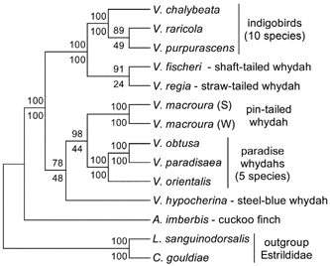
Figure 2 Phylogeny of Vidua based on 6,488 mtDNA nucleotide positions. The Bayesian majority rule consensus tree is ...
Notes:
Figure 2 Phylogeny of Vidua based on 6,488 mtDNA nucleotide positions. The Bayesian majority rule consensus tree is shown with posterior branch probabilities and parsimony bootstrap values above and below nodes, respectively. The MP tree for this data set is identical except that V. fischeri is placed as the sister taxon of indigobirds. Samples of V. macroura from southern (S) and western (W) Africa are included.
Unless provided in the caption above, the following copyright applies to the content of this slide: © 2004 Society of Systematic BiologistsThis article is published and distributed under the terms of the Oxford University Press, Standard Journals Publication Model (https://academic.oup.com/journals/pages/open_access/funder_policies/chorus/standard_publication_model)

Slide 3
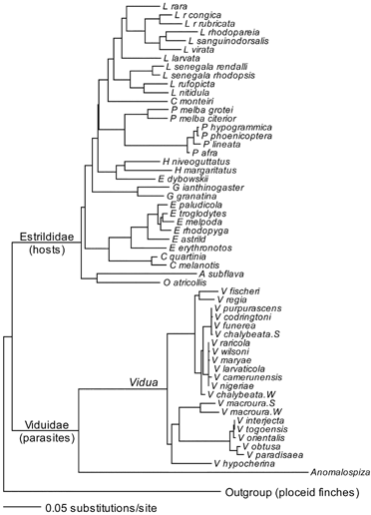
Figure 3 Phylogeny of brood parasitic finches and estrildid finch hosts used in cophylogenetic analyses. The tree ...
Notes:
Figure 3 Phylogeny of brood parasitic finches and estrildid finch hosts used in cophylogenetic analyses. The tree combines the host phylogeny based on the 1,527-bp mtDNA data set (Fig. 1) with the best parasite tree based on the 6,488-bp data set (Fig. 2) and adds several Vidua taxa. ML branch lengths for the 1,527-bp mtDNA data set are shown.
Unless provided in the caption above, the following copyright applies to the content of this slide: © 2004 Society of Systematic BiologistsThis article is published and distributed under the terms of the Oxford University Press, Standard Journals Publication Model (https://academic.oup.com/journals/pages/open_access/funder_policies/chorus/standard_publication_model)

Slide 4
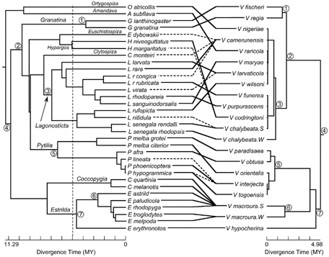
Figure 4 Comparison of phylogenies for estrildid finch host species (left) and brood parasitic Vidua (right), with ...
Notes:
Figure 4 Comparison of phylogenies for estrildid finch host species (left) and brood parasitic Vidua (right), with well-documented associations between hosts and parasites indicated. The primary host for each parasitic species is indicated by a solid line; other hosts are indicated with dashed lines except for V. macroura, which is a host generalist. Trees are drawn to the same scale with branch lengths proportional to divergence times (MY = million years) as estimated in a single analysis with both hosts and parasites in the same tree. Seven possible cospeciation events corresponding to data points in Figure 5 are numbered. The selected comparisons represent only a subset of all possible cospeciation events, are not necessarily mutually compatible in a single historical reconstruction, and are suggested by comparison of tree topologies only. The vertical dashed line indicates the time depth of the parasite tree. Note that nodes in both trees were rotated to maximize the appearance of congruence between the two trees.
Unless provided in the caption above, the following copyright applies to the content of this slide: © 2004 Society of Systematic BiologistsThis article is published and distributed under the terms of the Oxford University Press, Standard Journals Publication Model (https://academic.oup.com/journals/pages/open_access/funder_policies/chorus/standard_publication_model)

Slide 5
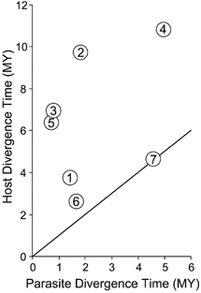
Figure 5 Comparison of host and parasite divergence times (MY = million years) for the possible cospeciation events ...
Notes:
Figure 5 Comparison of host and parasite divergence times (MY = million years) for the possible cospeciation events highlighted in Figure 4. The solid line indicates equal times for hosts and parasites. A similar pattern is obtained even when no correction is made for different rates of sequence evolution in Vidua parasites and their hosts; genetic distances among Vidua are smaller than those among their hosts.
Unless provided in the caption above, the following copyright applies to the content of this slide: © 2004 Society of Systematic BiologistsThis article is published and distributed under the terms of the Oxford University Press, Standard Journals Publication Model (https://academic.oup.com/journals/pages/open_access/funder_policies/chorus/standard_publication_model)

