Slide 1
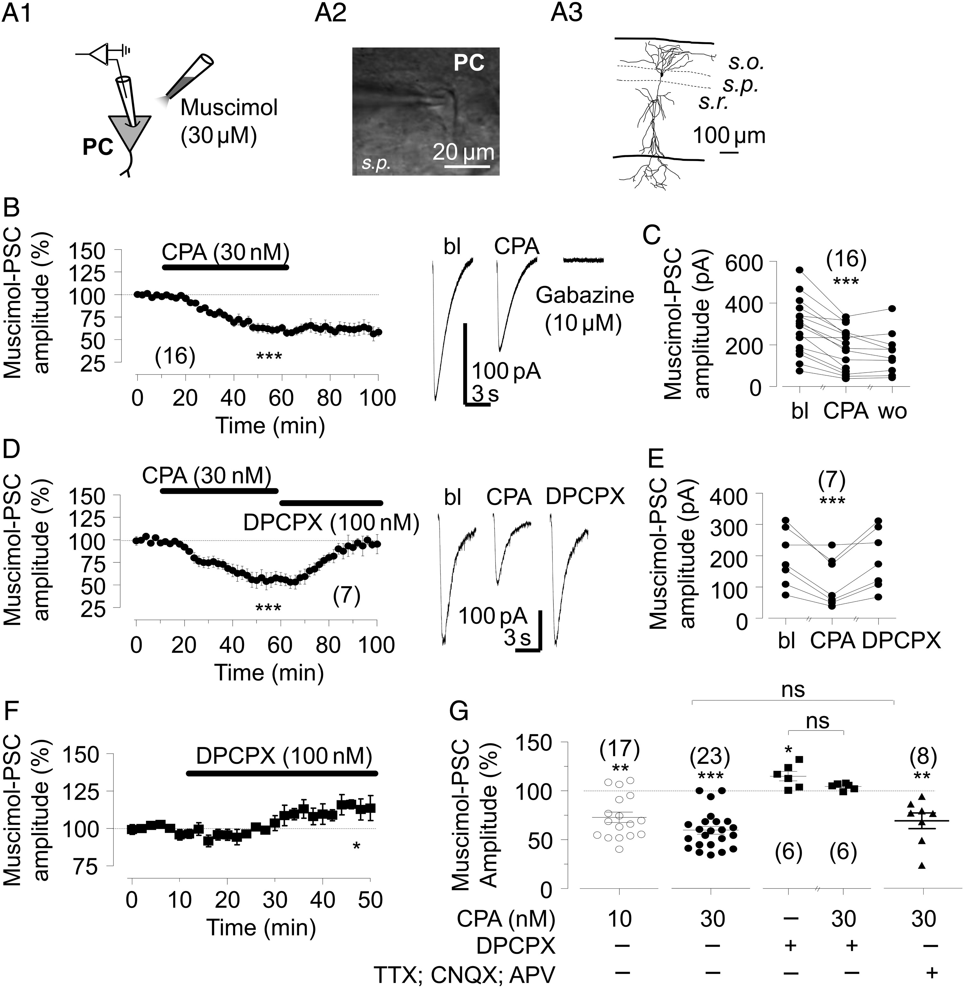
Figure 1. Adenosine A₁R suppresses local agonist-evoked GABA_{A} currents in pyramidal cells. (A1) ...
Notes:
Figure 1. Adenosine A1R suppresses local agonist-evoked GABAA currents in pyramidal cells. (A1) Schematic representation of the experimental design to evoke postsynaptic GABAA currents by local application of a GABAAR agonist, muscimol (30 µM, muscimol-PSC) on the soma of a voltage-clamped pyramidal cell. (A2) Differential interference contrast-infrared (DIC-IR) image. (A3) Illustration of a recorded pyramidal cell. (B) Left: A1R agonist, CPA (30 nM) reduces the agonist-evoked GABAAR current amplitude (baseline-normalized mean ± SEM, n = 16); right: Representative PSCs from one cell in baseline (bl), in the presence of CPA and after application of gabazine (10 µM); each trace is the average of 5 consecutive responses. (C) Muscimol-PSC amplitude (pA) of all cells in B, in baseline (bl), following wash-in of CPA and after 30 min washout of CPA (wo). Values from each cell are connected with line. (D) Left: Wash-in of A1R antagonist DPCPX (100 nM), fully restored CPA-inhibited muscimol-PSCs to the baseline level (baseline-normalized mean ± SEM, n = 7); right: Representative PSCs from one cell in the baseline (bl), in the presence on CPA and following further application of DPCPX; each trace is the average of 5 consecutive responses. (E) Muscimol-PSC amplitudes (in pA) of all cells in D, in baseline (bl), in the presence of CPA and following DPCPX application. Values from each cell are connected with line. (F) DPCPX (100 nM) had a facilitatory effect on muscimol-PSCs (baseline-normalized mean ± SEM, n = 7). (G) Plot showing baseline-normalized PSC amplitude in different conditions in all studied cells; from left: Effect of CPA (10 nM) after baseline; effect of CPA (30 nM) after baseline; effect of DPCPX (100 nM) after baseline; full prevention of CPA effect on PSC amplitude in the presence of DPCPX; CPA-induced suppression of GABAAR currents in the presence of glutamate blockers (CNQX, 10 µM; APV, 50 µM), and TTX (0.5 µM; mean ± SEM, baseline-normalized). In all panels, the number of experiments is shown in brackets; ns: not statistically significant; *P < 0.05; **P < 0.01; ***P < 0.001 (Student's t-test); PC: pyramidal cell; s.r.: Stratum radiatum; s.p.: Stratum pyramidale; s.o.: Stratum oriens.
Unless provided in the caption above, the following copyright applies to the content of this slide: © The Author 2014. Published by Oxford University Press. All rights reserved. For Permissions, please e-mail: journals.permissions@oup.com

Slide 2
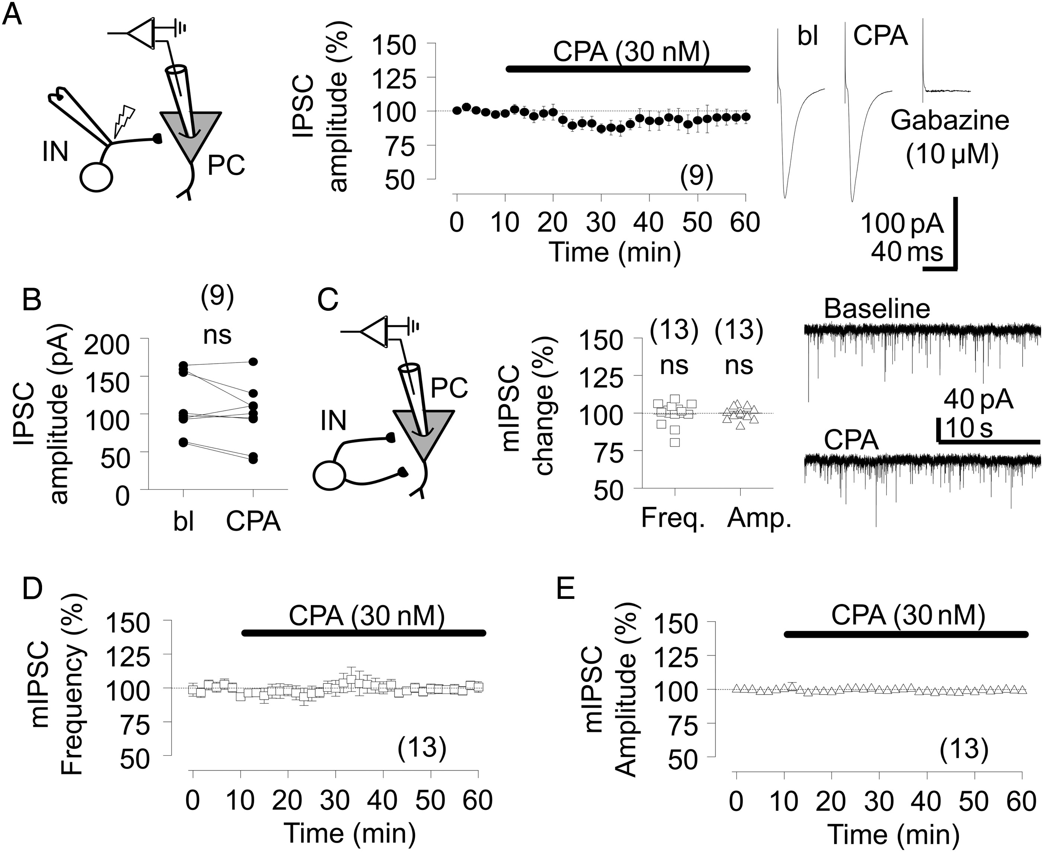
Figure 2. Synaptic GABA_{A}R currents evoked by electrical afferent stimulation or spontaneous quantal release ...
Notes:
Figure 2. Synaptic GABAAR currents evoked by electrical afferent stimulation or spontaneous quantal release are not affected by A1R. (A) Left: Schematic representation of the experimental design for IPSC recordings in pyramidal cells; middle: IPSCs evoked in CA1 pyramidal cells by electrical stimulation of inhibitory afferents are not modulated by CPA (30 nM; baseline-normalized mean ± SEM, n = 9); right: Representative IPSCs in baseline (bl) after wash-in of CPA and after gabazine (10 µM); each trace is the average of 10 consecutive responses. (B) IPSC amplitude (pA) in all cells during baseline (bl) and following wash-in of CPA; values from each cell are connected with line. (C) Left: Experimental design for mIPSC recordings in pyramidal cells; middle: mIPSC frequency and amplitude in individual cells (baseline-normalized; 100%: 9.6 ± 1.7 Hz and 11.8 ± 1.6 pA); right: Sample traces from one cell in baseline and following wash-in of CPA. (D and E) CPA has no significant effect on either miniature frequency (D) or amplitude (E) of mIPSCs (baseline-normalized mean ± SEM, n = 13). In all panels, the number of experiments is shown in brackets; ns: not statistically significant (Student's t-test); PC: pyramidal cell; IN: interneuron.
Unless provided in the caption above, the following copyright applies to the content of this slide: © The Author 2014. Published by Oxford University Press. All rights reserved. For Permissions, please e-mail: journals.permissions@oup.com

Slide 3
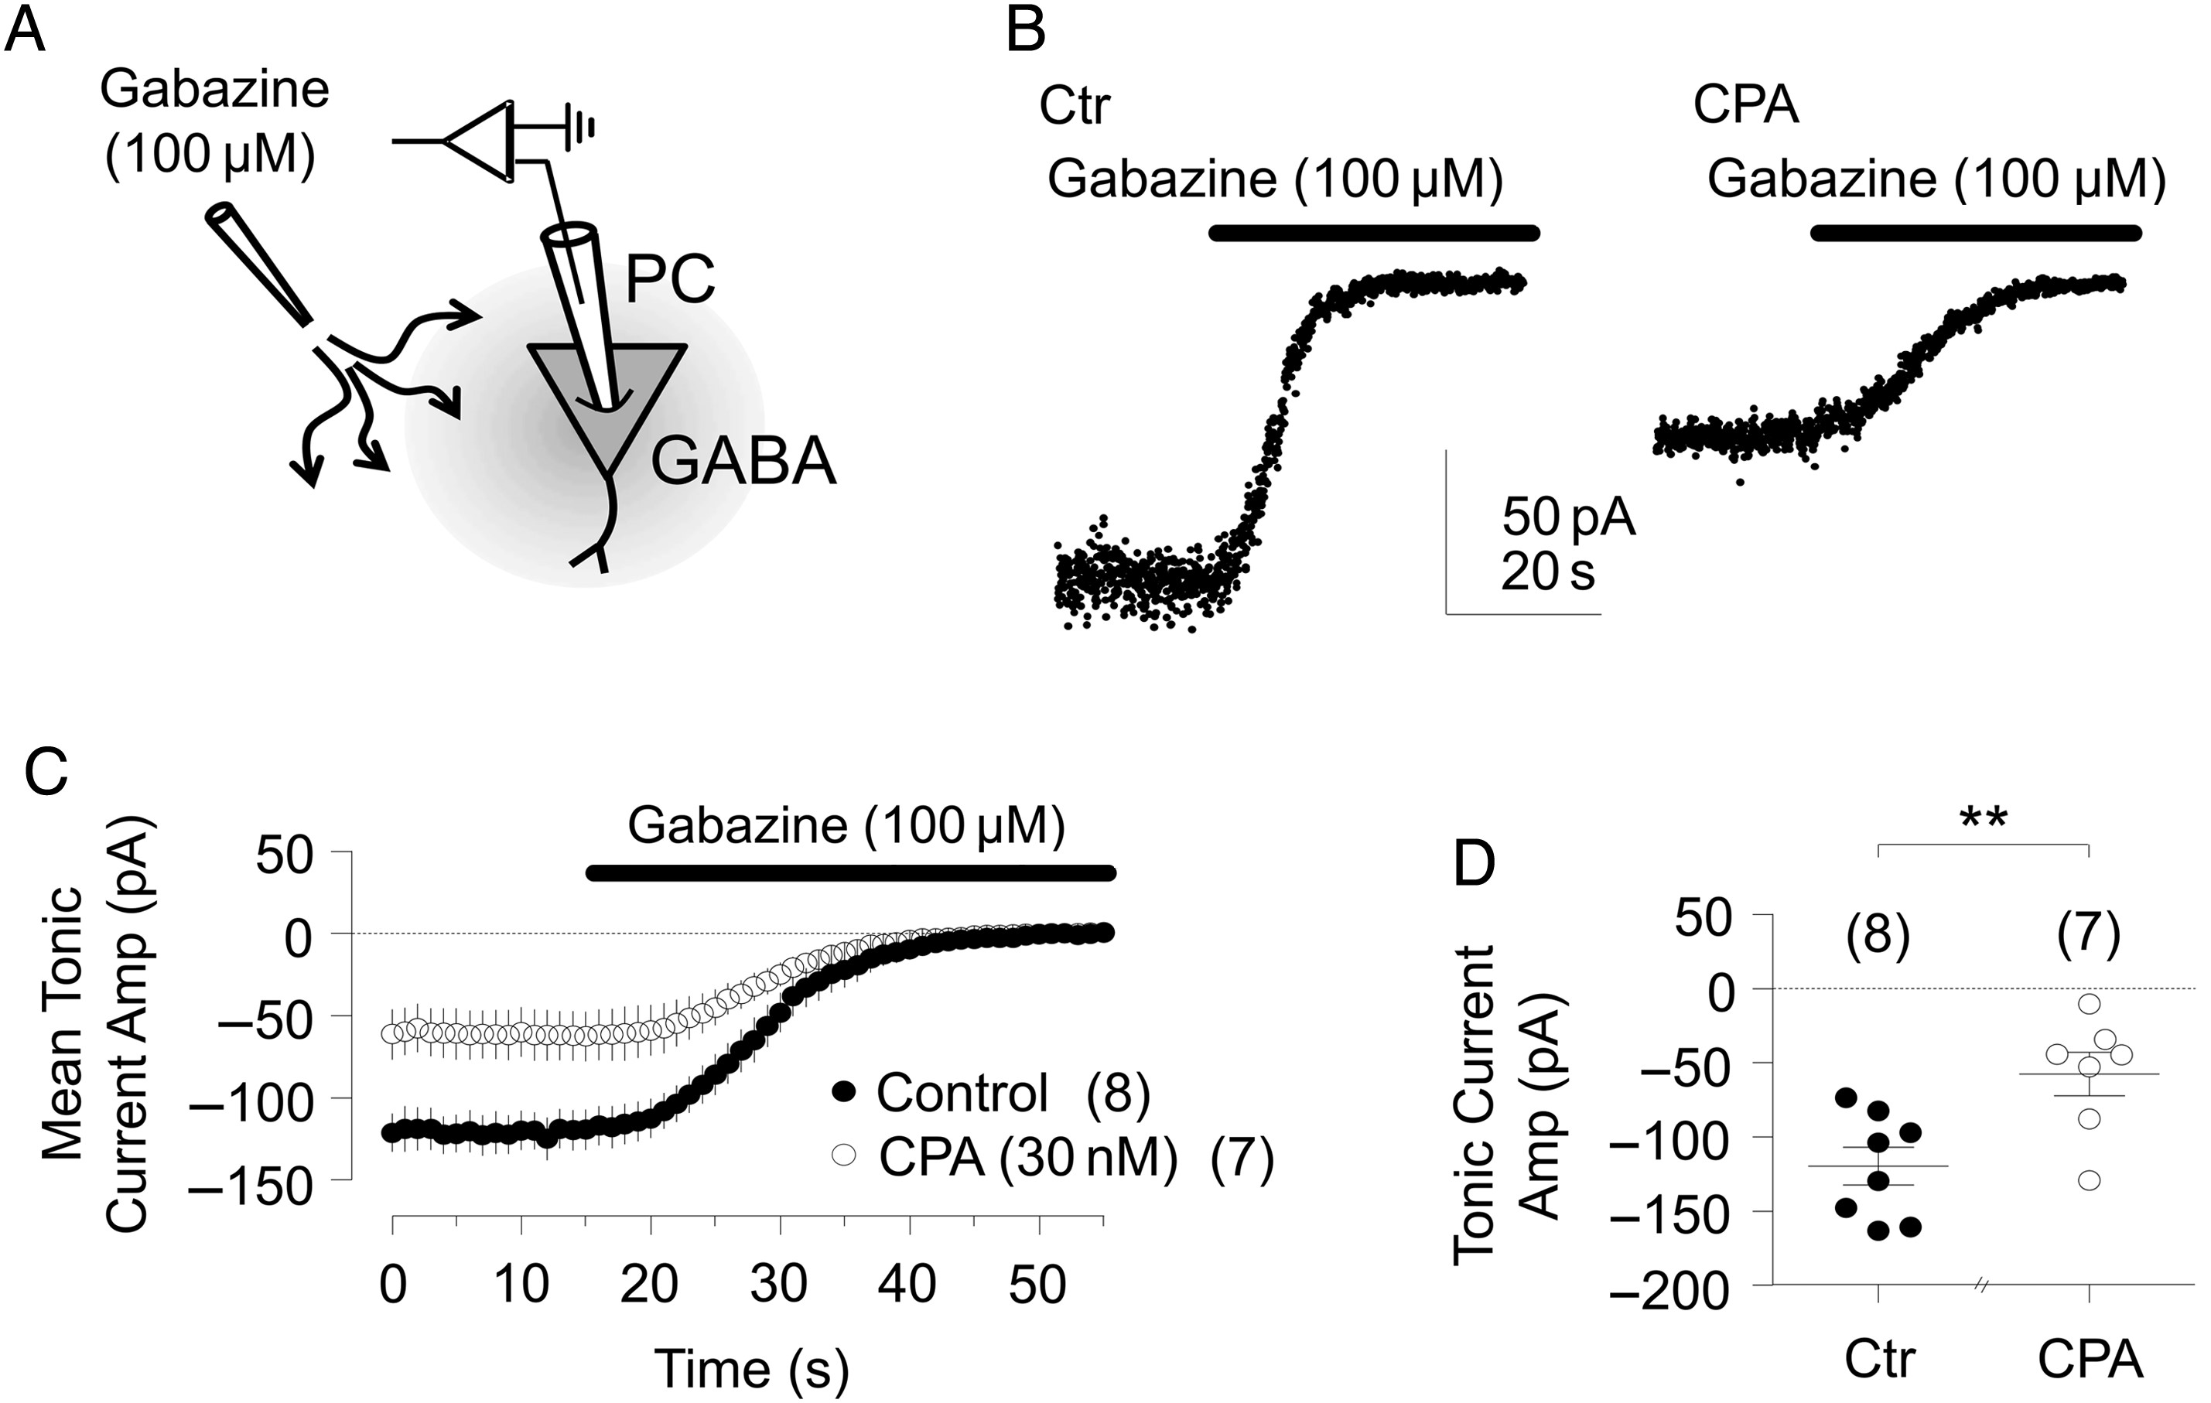
Figure 3. Tonic GABA_{A}R currents in pyramidal cells are inhibited by adenosine A₁R activation. (A) ...
Notes:
Figure 3. Tonic GABAAR currents in pyramidal cells are inhibited by adenosine A1R activation. (A) Schematic representation of the experimental design used to access tonic currents; tonic GABAA inhibition (amplified by adding 5 µM ambient GABA; see Glykys and Mody 2007a) was revealed by application of gabazine (100 µM); the difference between the holding current in the absence and presence of gabazine being used as tonic current measurement (see Materials and Methods). (B) Tonic current (plotted at 5 ms intervals) recorded from an individual pyramidal cell in a control slice (left) and in a CPA (30 nM)-incubated slice (right). (C) Averaged tonic current (mean ± SEM, pA) recorded from pyramidal cells in control slices (filled circles, n = 8) and in slices where CPA (30 nM) was added at least 50 min prior gabazine (open circles; n = 7); note that tonic GABAA currents were quantitatively smaller in the presence of CPA. (D) Plot showing tonic GABAA current in all studied cells in control slices and in slices incubated with CPA. In all panels, the number of experiments is shown in brackets; **P < 0.01 (Student's t-test); PC: pyramidal cell.
Unless provided in the caption above, the following copyright applies to the content of this slide: © The Author 2014. Published by Oxford University Press. All rights reserved. For Permissions, please e-mail: journals.permissions@oup.com

Slide 4
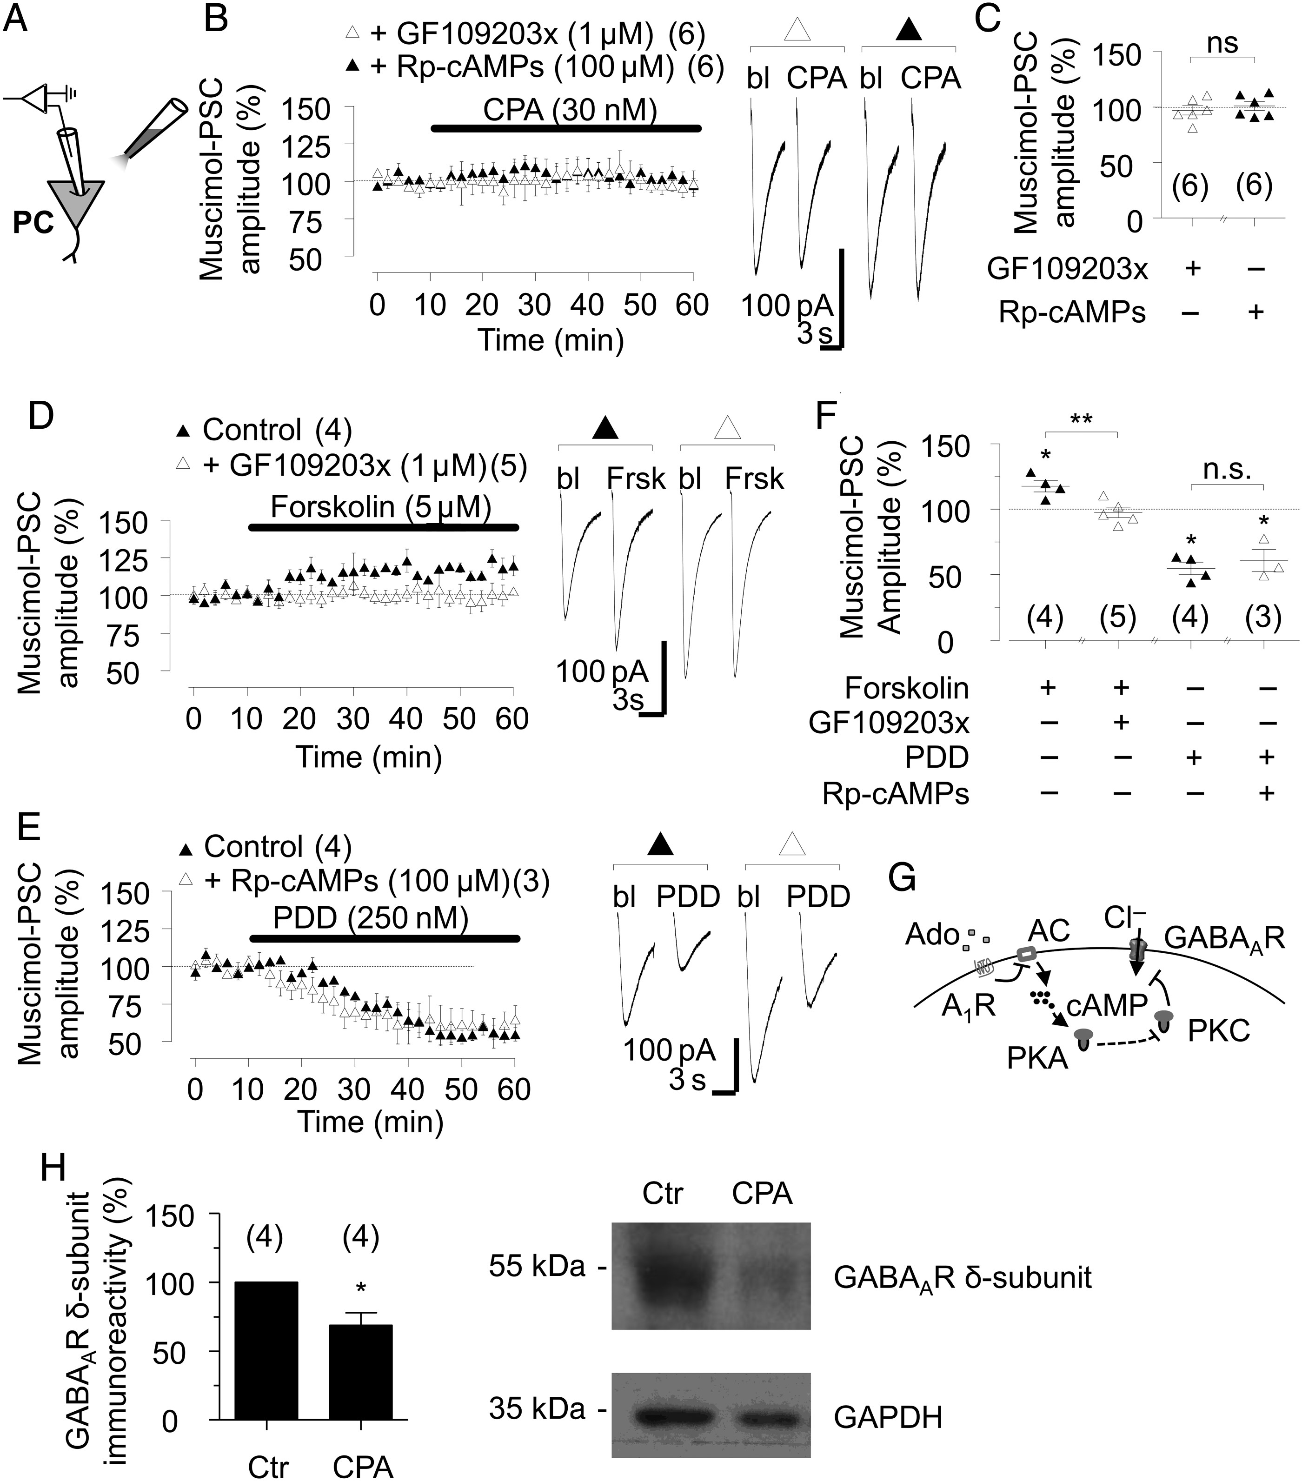
Figure 4. A₁R-mediated modulation of GABAergic responses involves both PKA and PKC signaling cascades and ...
Notes:
Figure 4. A1R-mediated modulation of GABAergic responses involves both PKA and PKC signaling cascades and sustained A1R activation results in decreased expression of GABAAR δ-subunit. (A) Schematic experimental design. (B) Left: Either a PKC inhibitor (GF109203x, 1 μM) or a PKA blocker (Rp-cAMPs, 100 μM) in pipette filling solution prevents suppression of GABAergic currents by CPA (30 nM; baseline-normalised mean ± SEM; n = 6 for both conditions). Right: Representative muscimol-PSCs in the presence of GF109203x (open triangle) or Rp-cAMPs (filled triangle) in baseline (bl) and following application of CPA. (C) Baseline-normalized muscimol-PSCs in all studied cells in the presence of either GF109203x or Rp-cAMP. (D) Left: Plot showing that intracellular application of GF109203x completely prevented the facilitatory effect of Forskolin (5 µM) on muscimol-PSCs (baseline-normalized mean ± SEM; n = 4–5 as indicated). Right: Representative muscimol-PSCs in one pyramidal cell in baseline (bl) and after Forskolin application (Frsk), in the absence (filled triangle) or presence (open triangle) of GF109203x. (E) Left: Plot showing that intracellular Rp-cAMPs failed to prevent a PKC activator PDD (250 nM)-elicited suppression of muscimol-PSCs (baseline-normalized mean ± SEM; n = 3–4 as indicated). Right: Representative muscimol-PSCs in baseline (bl) and after PPD perfusion, in the absence (filled triangle) or presence (open triangle) of intracellular Rp-cAMPs. (F) Baseline-normalized muscimol-PSC in all studied pyramidal cells shown in D and E. From left: Application of Forskolin after baseline; intracellular GF109203x with forskolin application of PDD after baseline; and intracellular Rp-cAMPs with forskolin. (G) Schematic diagram of suggested postsynaptic cascade of PKC and PKA action underlying A1R-mediated inhibition of GABAAR currents. (H) Left: Plot showing control-normalized GABAAR δ-subunit immunoreactivity after incubation of hippocampal slices in the absence (control: Ctr) or presence of CPA (30 nM) for at least 50 min (see Materials and Methods for details). Right: Representative western blot obtained from control slices (left lane) and from slices treated with CPA (30 nM) for at least 50 min (right lane). GAPDH was used as a loading control (bottom lanes). In all panels, the number of experiments is shown in brackets; the representative PSCs correspond to the average of 5 consecutive responses; ns: not statistically significant; *P < 0.05; **P < 0.01 (Student's t-test); PC: pyramidal cell.
Unless provided in the caption above, the following copyright applies to the content of this slide: © The Author 2014. Published by Oxford University Press. All rights reserved. For Permissions, please e-mail: journals.permissions@oup.com

Slide 5
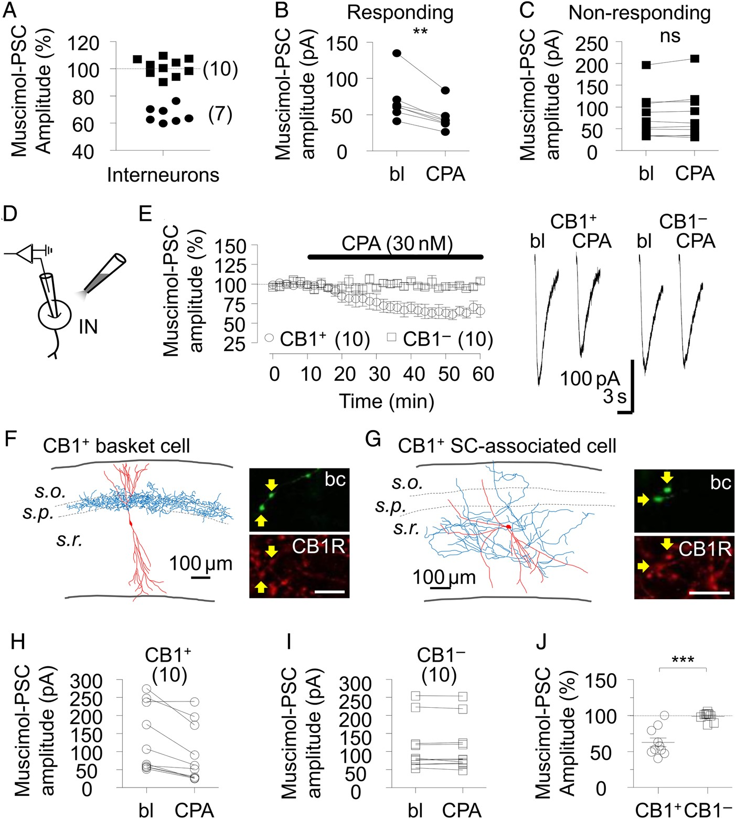
Figure 5. A₁R activation suppresses muscimol-evoked GABA_{A} currents in interneurons expressing ...
Notes:
Figure 5. A1R activation suppresses muscimol-evoked GABAA currents in interneurons expressing CB1R. (A) Circles: A1R activation with CPA (30 nM) significantly depressed baseline-normalized muscimol-PSCs in 7 interneurons. Squares: 10 interneurons where CPA (30 nM) that failed to show an effect (baseline-normalized, t-test). (B and C) Muscimol-PSC amplitudes (in pA) of studied interneurons before (bl) and after CPA superfusion, where data from cells with significant suppression are shown in B and data from cells with no effect of CPA are shown in C; values from each cell are connected with line. (D) Schematic representation of the experimental design to record muscimol-PSCs from interneurons in all experiments illustrated in this figure. (E) CPA (30 nM) suppresses muscimol-PSCs in GABAergic interneurons expressing axonal CB1R (CB1R+), but not in CB1-immunonegative interneurons (CB1R−). Left: Baseline-normalized muscimol-PSCs (mean ± SEM) recorded for CB1R+ (n = 10) and for CB1R− (n = 10) neurons. Right: Representative traces of muscimol-PSCs from one CB1R+ and one CB1R− interneuron in baseline (bl) and in CPA. (F and G) Left: Reconstructed studied CB1R+ basket cell (E) and Schaffer collateral (SC)-associated cell (F) (soma and dendrites in red; axon in blue); right: Confocal images showing positive axonal immunoreaction for CB1R (red, Cy3; scale bar corresponds to 5 µm) in Biocytin/Alexa-Streptavidin reaction-visualized axon (green, bc). Arrows show co-localization. (H and I) Muscimol-PSCs (in pA) of all CB1R+ (H) and CB1R− interneurons (I) in baseline (bl) and in the presence of CPA; values from each cell are connected with line. (J) Baseline-normalized muscimol-PSCs recorded in the presence of CPA from CB1R+ and CB1R− individual cells. In all panels, the number of experiments is shown in brackets; the representative current traces correspond to 5 consecutive responses; ns: not statistically significant; **P < 0.01; ***P < 0.001 (Student's t-test); IN: interneuron; s.r.: Stratum radiatum; s.p.: Stratum pyramidale; s.o.: Stratum oriens.
Unless provided in the caption above, the following copyright applies to the content of this slide: © The Author 2014. Published by Oxford University Press. All rights reserved. For Permissions, please e-mail: journals.permissions@oup.com

Slide 6
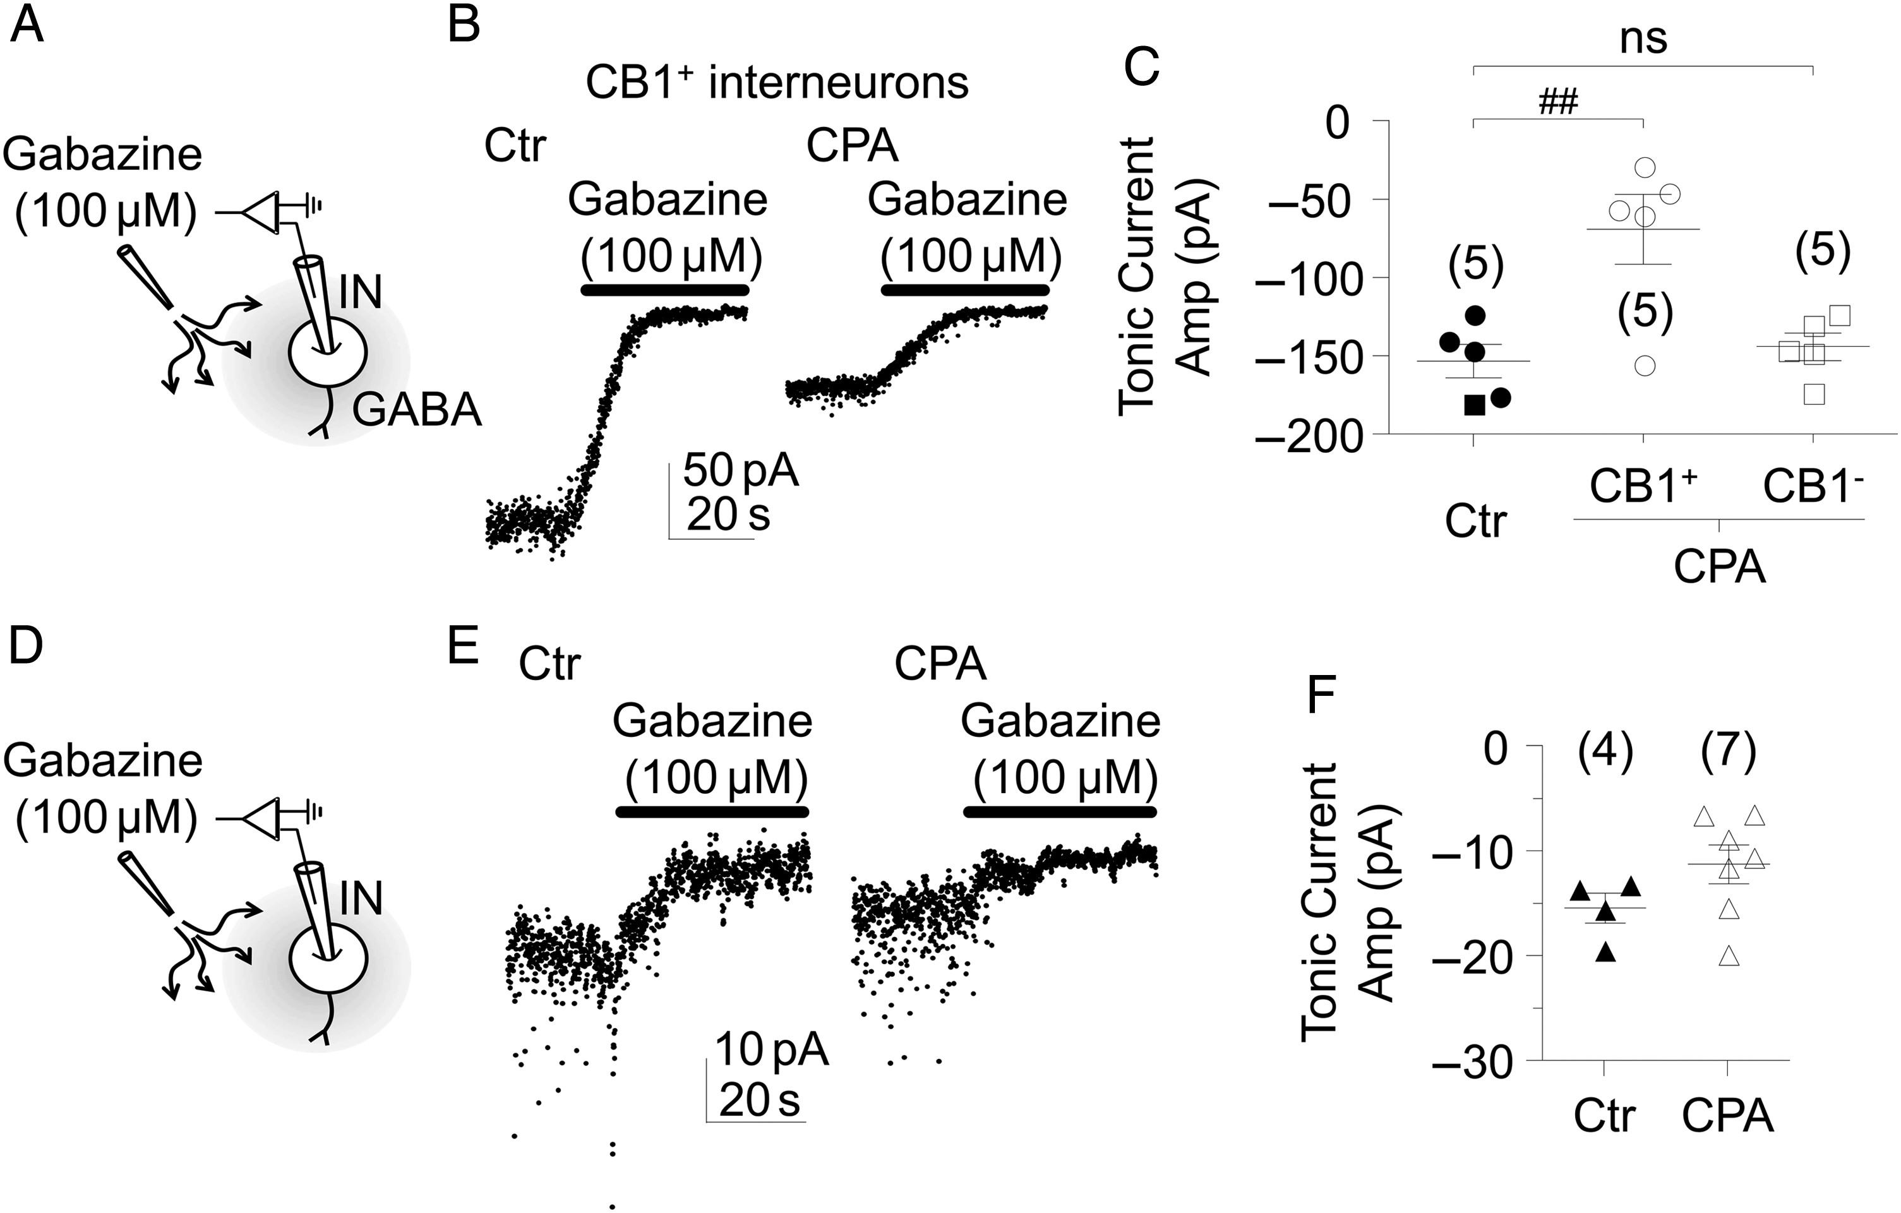
Figure 6. Tonic GABA_{A}R currents in CB1R-immunoposivite interneurons are inhibited by adenosine ...
Notes:
Figure 6. Tonic GABAAR currents in CB1R-immunoposivite interneurons are inhibited by adenosine A1R activation. (A) Schematic representation of experimental design used to access tonic currents; ambient GABA [5 µM, see Glykys and Mody (2007a)] was added to aCSF and tonic-IC was revealed by application of gabazine (100 µM). (B) Representative tonic current (plotted at 5 ms intervals) recorded from a CB1R-positive interneuron in a control slice (left) and in a CPA (30 nM)-incubated slice (right). (C) Averaged tonic current (mean ± SEM, pA) recorded from interneurons (circles correspond to CB1R+ interneurons; squares correspond to CB1R− interneurons) in control slices (filled symbols) and in slices where CPA (30 nM) was added at least 50 min prior gabazine (open symbols). (D) Schematic representation of the experimental design used to access endogenous tonic currents; no GABA was added to aCSF, tonic-IC was revealed by application of gabazine (100 µM). (E) Representative tonic current (plotted at 5 ms intervals) recorded from interneurons in control (left) and in a CPA (30 nM)-incubated slices (right). (F) Averaged tonic current (mean ± SEM, pA) recorded from interneurons in control slices (filled triangles, n = 4) and in slices where CPA (30 nM) was added at least 50 min prior gabazine (open triangles, n = 7). In all panels, the number of experiments is shown in brackets; ##P < 0.01 (one-way ANOVA followed by Bonferroni's multiple comparison test); IN: interneuron.
Unless provided in the caption above, the following copyright applies to the content of this slide: © The Author 2014. Published by Oxford University Press. All rights reserved. For Permissions, please e-mail: journals.permissions@oup.com

Slide 7
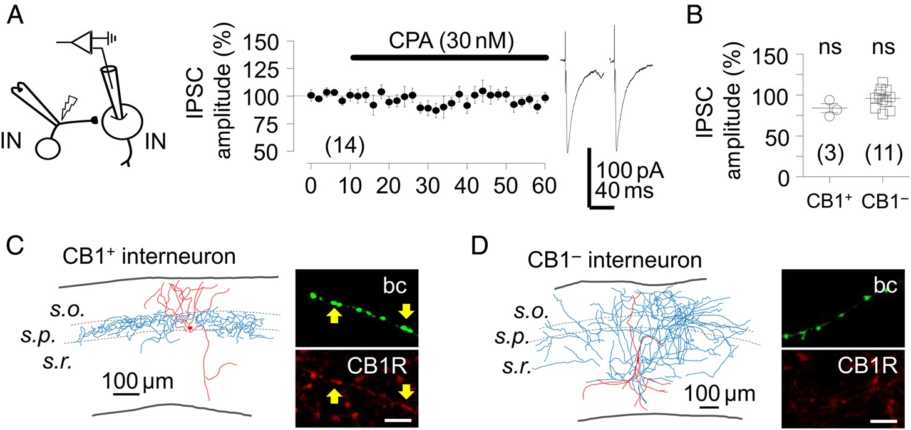
Figure 7. Phasic synaptic IPSCs in interneurons are not suppressed by adenosine A₁R. (A) Left: Schematic ...
Notes:
Figure 7. Phasic synaptic IPSCs in interneurons are not suppressed by adenosine A1R. (A) Left: Schematic experimental design to record IPSCs from interneurons; middle: Time course plot showing that synaptic IPSCs evoked by electrical stimulation were not altered by CPA; right: Representative IPSC recorded from one CB1R+ interneuron in baseline (bl) and in the presence of CPA; each trace corresponds to the average of 10 consecutive responses. (B) Baseline-normalized IPSCs recorded in the presence of CPA from all individual cells studied and tested for CB1R immunoreactivity; note that IPSCs were not affected by CPA, either in CB1R+ or CB1R− interneurons. (C and D) Left: Reconstructed studied CB1R+ (C) and CB1R− (D) interneurons (soma and dendrites in red; axons in blue); right: Confocal images of positive (C) and negative (D) CB1R immunoreaction (red, Cy3, scale bar corresponds to 5 µm) in Biocytin/Alexa-Sterptavidin reaction (green, bc). Arrows point at co-staining. In all panels, the number of experiments is shown in brackets; ns: not statistically significant (Student's t-test); IN: interneuron; s.r.: Stratum radiatum; s.p.: Stratum pyramidale; s.o.: Stratum oriens.
Unless provided in the caption above, the following copyright applies to the content of this slide: © The Author 2014. Published by Oxford University Press. All rights reserved. For Permissions, please e-mail: journals.permissions@oup.com

Slide 8
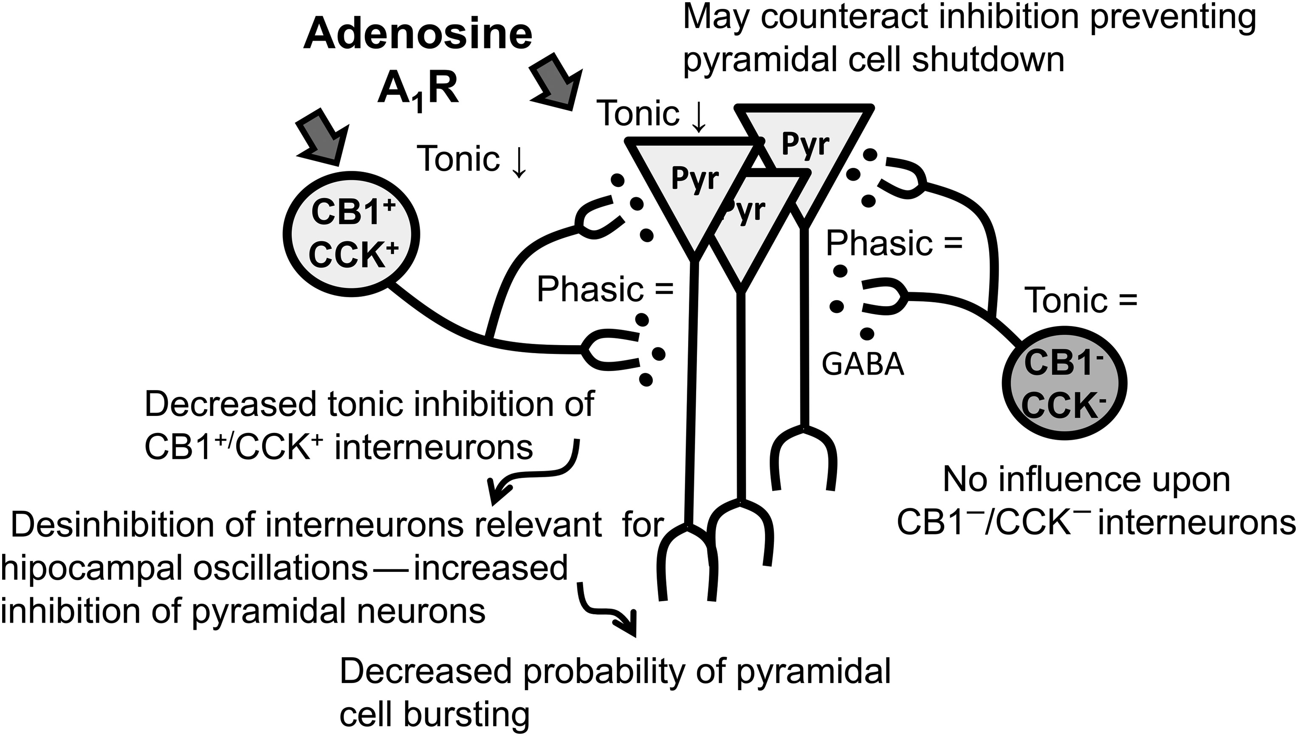
Figure 8. Schematic representation of the A₁R-mediated actions upon GABAergic transmission into CA1 ...
Notes:
Figure 8. Schematic representation of the A1R-mediated actions upon GABAergic transmission into CA1 hippocampal pyramidal cells and interneurons.
Unless provided in the caption above, the following copyright applies to the content of this slide: © The Author 2014. Published by Oxford University Press. All rights reserved. For Permissions, please e-mail: journals.permissions@oup.com

