Slide 1
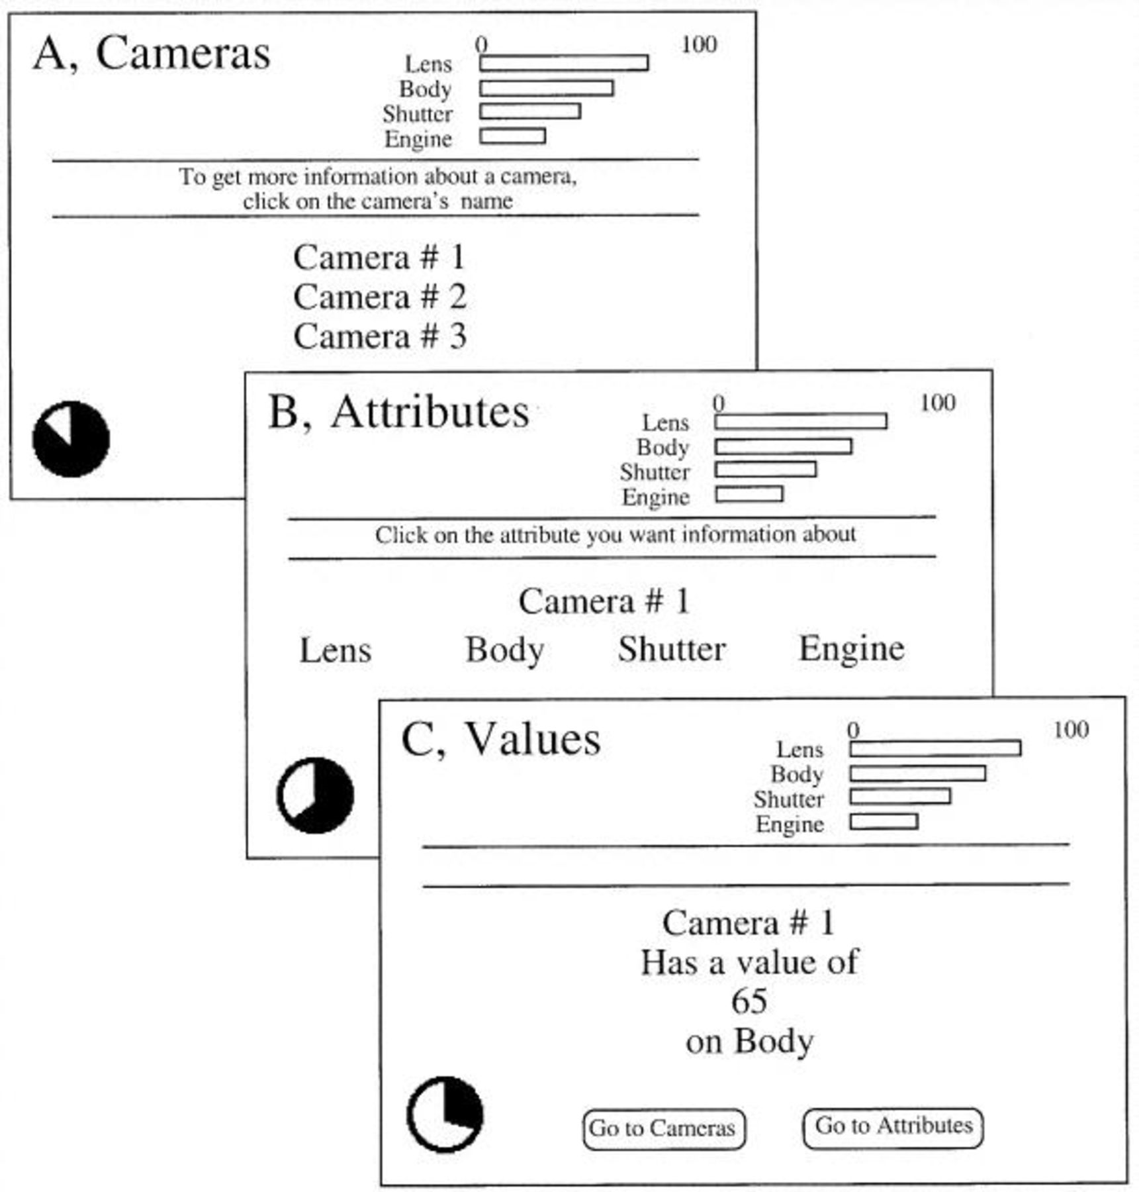
Figure 1 An example of the screens in the hierarchical information system Note.—Panel A represents the highest level ...
Notes:
Figure 1 An example of the screens in the hierarchical information system Note.—Panel A represents the highest level of the system, panel B the middle one, and panel C the lowest level. Note that subjects in the Low-InfoControl condition viewed only the screens represented in panel C.
Unless provided in the caption above, the following copyright applies to the content of this slide: © 2000 by JOURNAL OF CONSUMER RESEARCH, Inc.

Slide 2
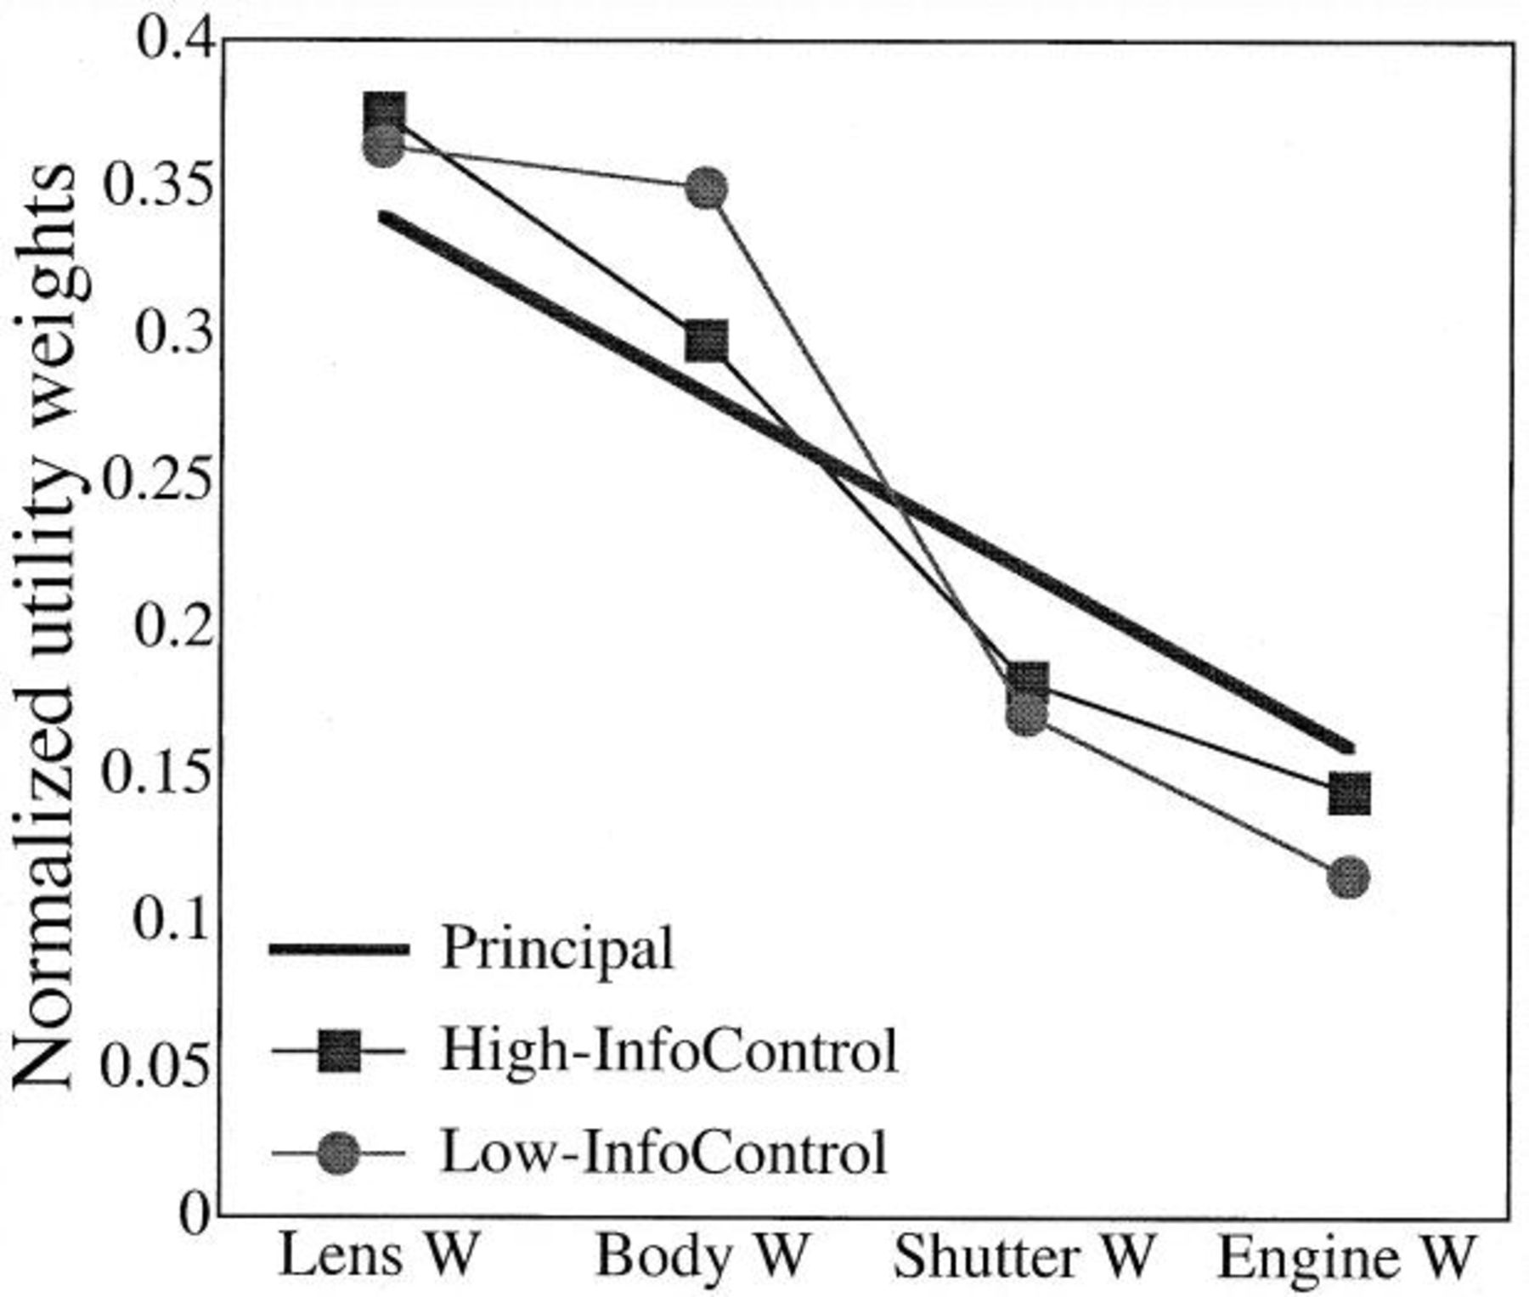
Figure 2 The principals and recovered utilities for the High and Low InfoControl conditions Note.—Each set of ...
Notes:
Figure 2 The principals and recovered utilities for the High and Low InfoControl conditions Note.—Each set of utilities is converted to a scale such that the sum of utilities in each set is equal to one.
Unless provided in the caption above, the following copyright applies to the content of this slide: © 2000 by JOURNAL OF CONSUMER RESEARCH, Inc.

Slide 3
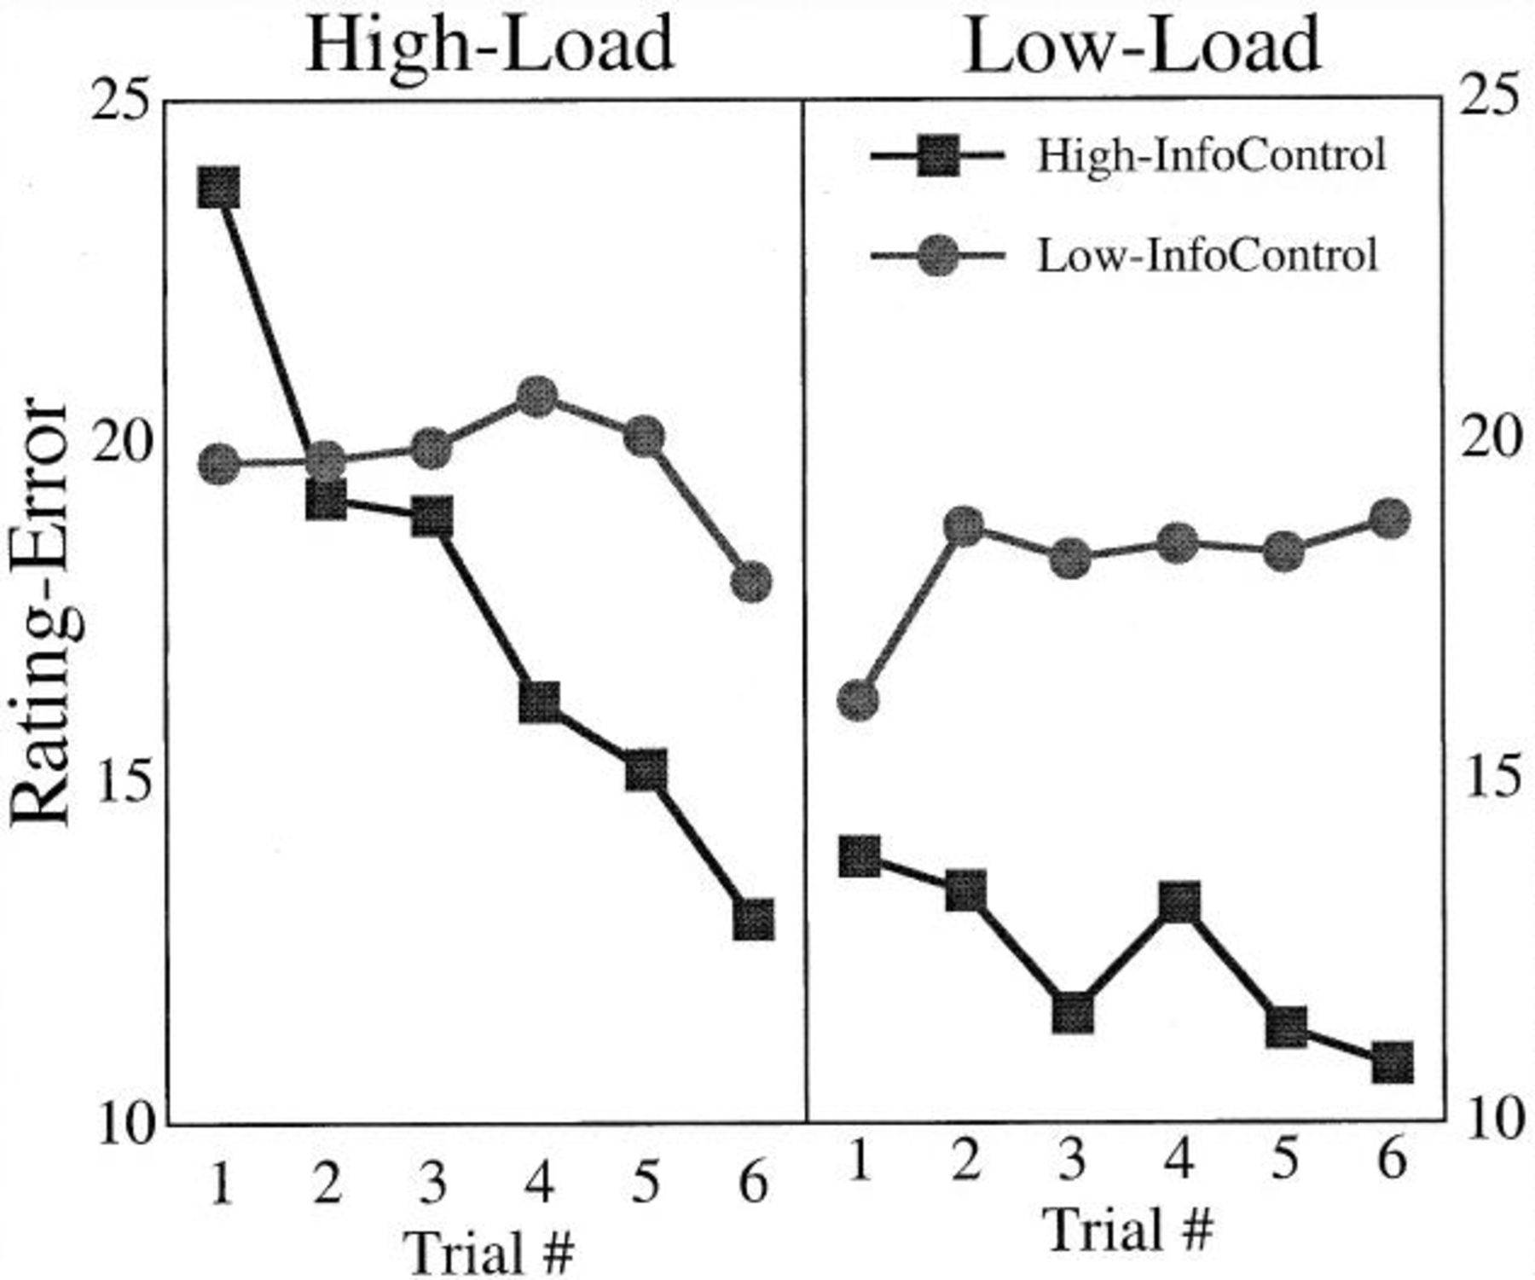
Figure 3 Mean rating-error measure, based on the absolute difference between the principal's and subjects' ...
Notes:
Figure 3 Mean rating-error measure, based on the absolute difference between the principal's and subjects' ratings Note.—Plotted by InfoControl, cognitive load, and trial.
Unless provided in the caption above, the following copyright applies to the content of this slide: © 2000 by JOURNAL OF CONSUMER RESEARCH, Inc.

Slide 4
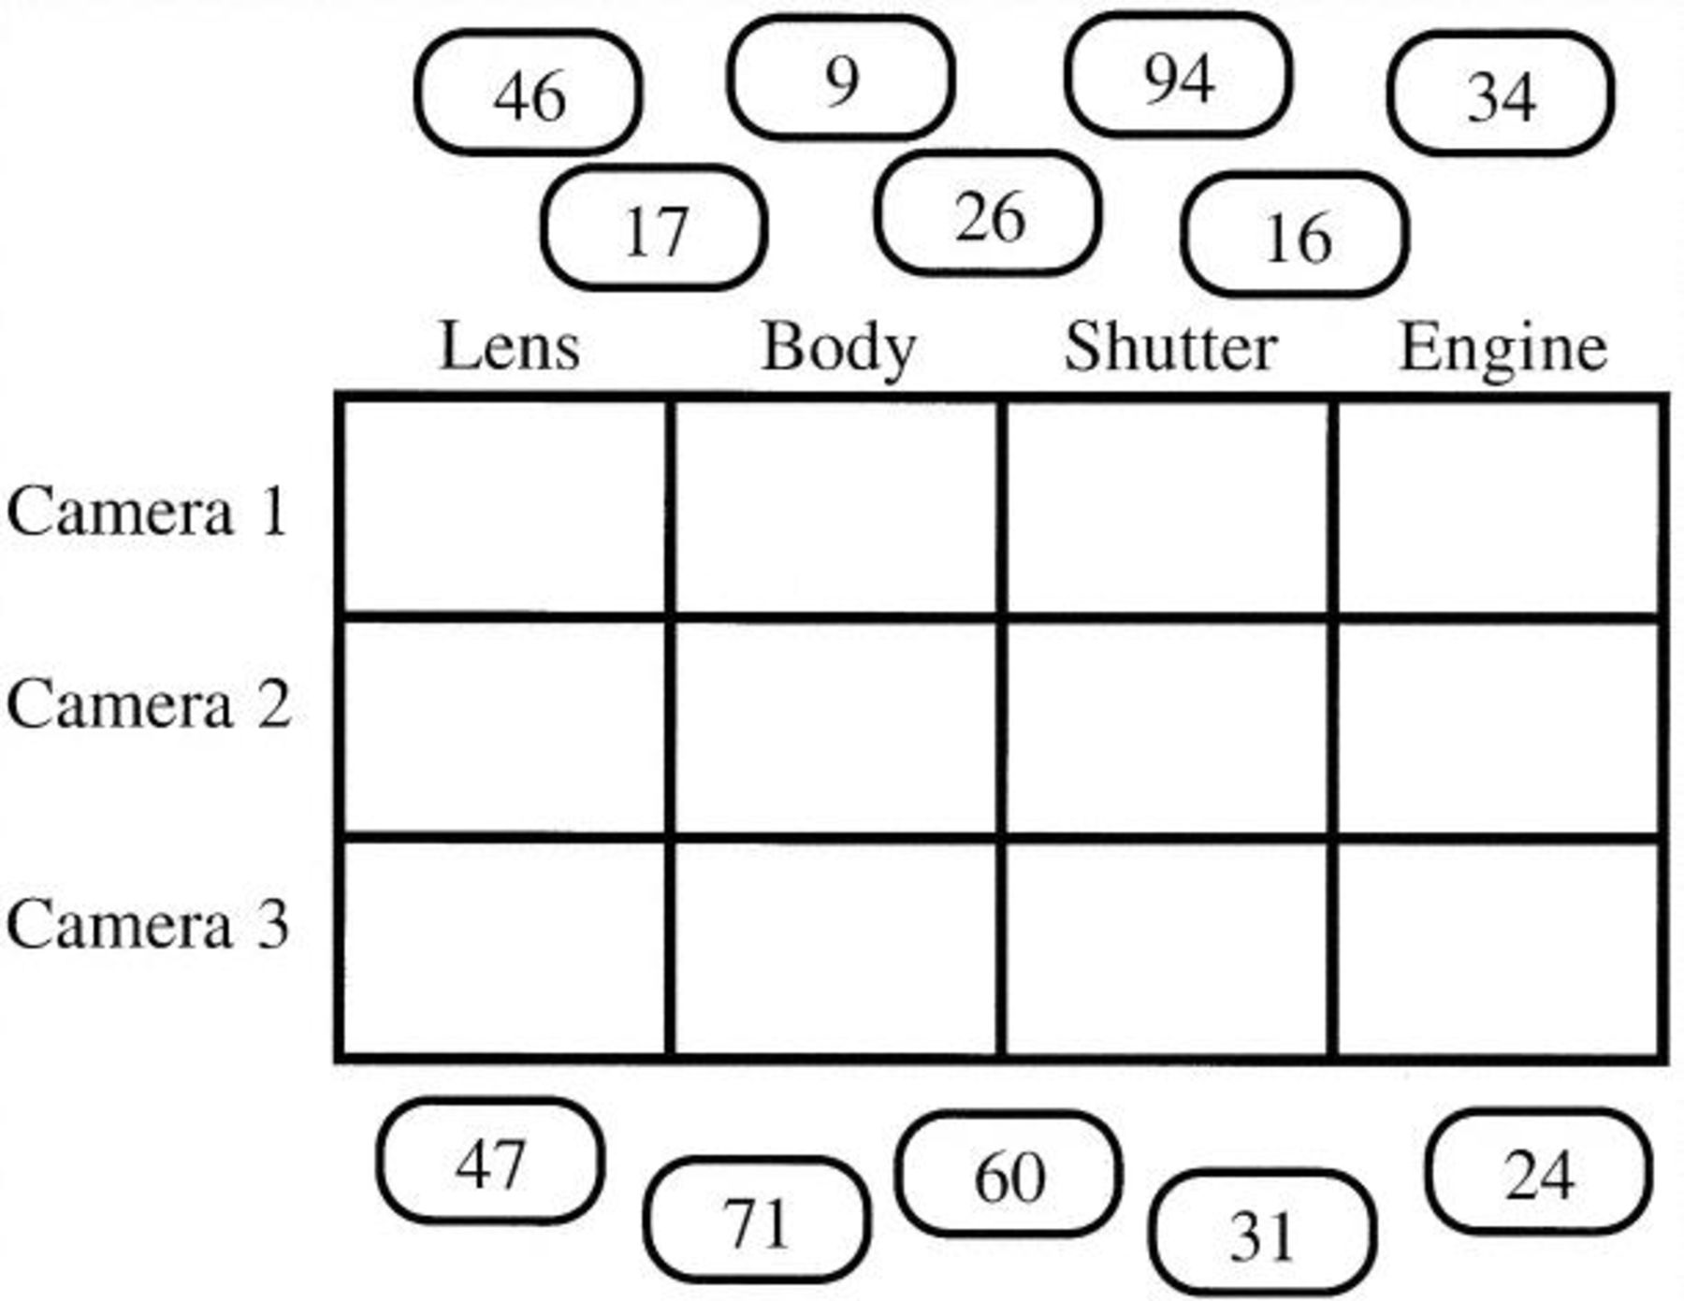
Figure 4 An example of the memory task Note.—All the values used during the last trial are presented outside of the ...
Notes:
Figure 4 An example of the memory task Note.—All the values used during the last trial are presented outside of the matrix, and subjects were asked to drag them to their correct location in the matrix.
Unless provided in the caption above, the following copyright applies to the content of this slide: © 2000 by JOURNAL OF CONSUMER RESEARCH, Inc.

