Slide 1
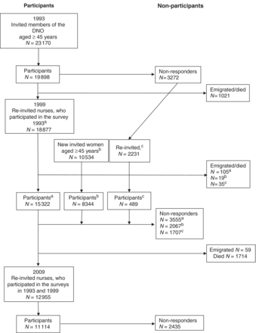
Figure 1 Flowchart of participants and non-participants in the 1993, 1999 and 2009 surveys. ªRe-invited ...
Notes:
Figure 1 Flowchart of participants and non-participants in the 1993, 1999 and 2009 surveys. aRe-invited participants; bnew invited participants and cnon-responders in 1993 and re-invited in 1999
Unless provided in the caption above, the following copyright applies to the content of this slide: Published by Oxford University Press on behalf of the International Epidemiological Association © The Author 2011; all rights reserved.

Slide 2
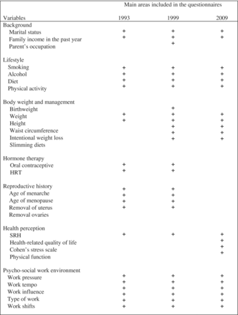
Figure 2 Overview of the main areas of information collected in 1993, 1999 and 2009
Notes:
Figure 2 Overview of the main areas of information collected in 1993, 1999 and 2009
Unless provided in the caption above, the following copyright applies to the content of this slide: Published by Oxford University Press on behalf of the International Epidemiological Association © The Author 2011; all rights reserved.

