Slide 1
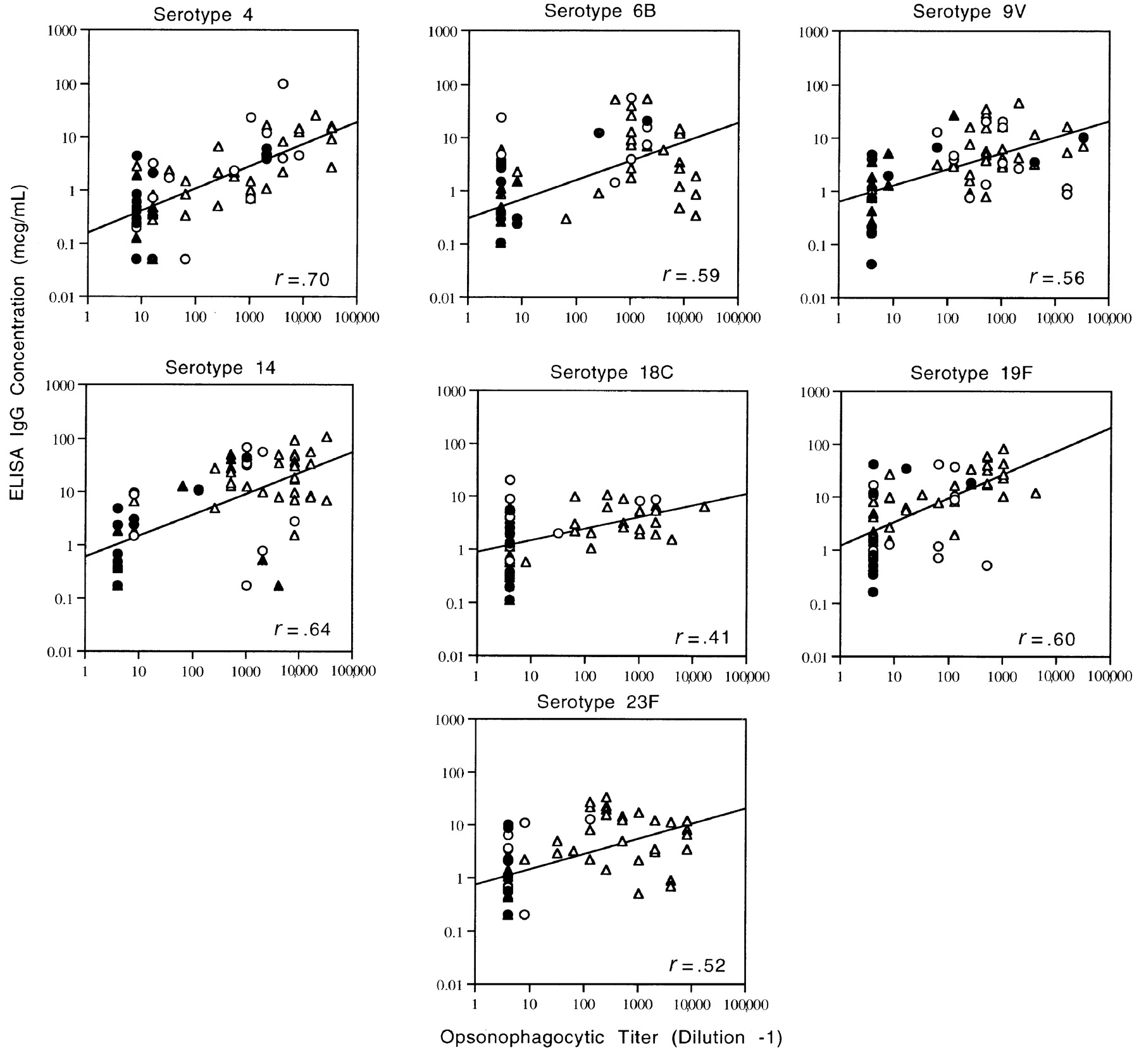
Figure 1 Correlation by least-squares analysis of pneumococcal IgG concentrations measured by ELISA and pneumococcal ...
Notes:
Figure 1 Correlation by least-squares analysis of pneumococcal IgG concentrations measured by ELISA and pneumococcal flow cytometric opsonophagocytic titers for each of 7 serotypes in both 7-valent pneumococcal conjugate vaccine and 23-valent pneumococcal polysaccharide vaccine. ● and ○, pre- and postimmunization serum values for 23v-PS-only group, respectively; ▲ and △, pre- and postimmunization serum values for 7v-Conj/7v-Conj/23v-PS vaccine group, respectively.
Unless provided in the caption above, the following copyright applies to the content of this slide: © 2000 by the Infectious Diseases Society of America

Slide 2
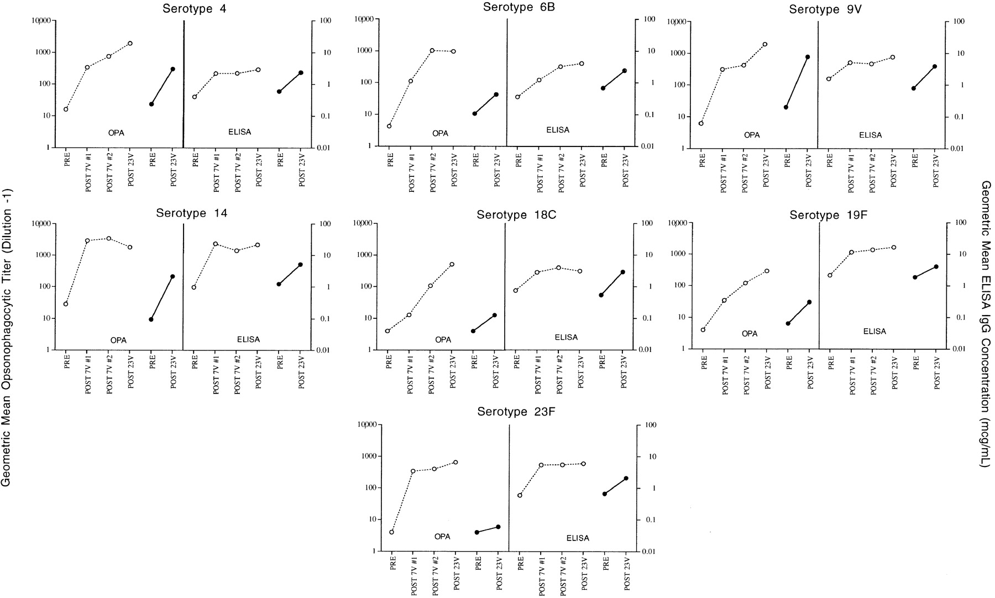
Figure 2 Geometric mean pneumococcal opsonophagocytic titers (left panels) and geometric mean pneumococcal IgG ...
Notes:
Figure 2 Geometric mean pneumococcal opsonophagocytic titers (left panels) and geometric mean pneumococcal IgG concentrations measured by ELISA (right panels) for each of 7 serotypes in both 7-valent pneumococcal conjugate vaccine and 23-valent pneumococcal polysaccharide vaccine. Dashed line with ○, titers of 7v-Conj/7v-Conj/23v-PS vaccine group before and after each immunization; solid line with ●, titers of 23v-PS-only group before and after immunization with 23-valent vaccine.
Unless provided in the caption above, the following copyright applies to the content of this slide: © 2000 by the Infectious Diseases Society of America

