Slide 1
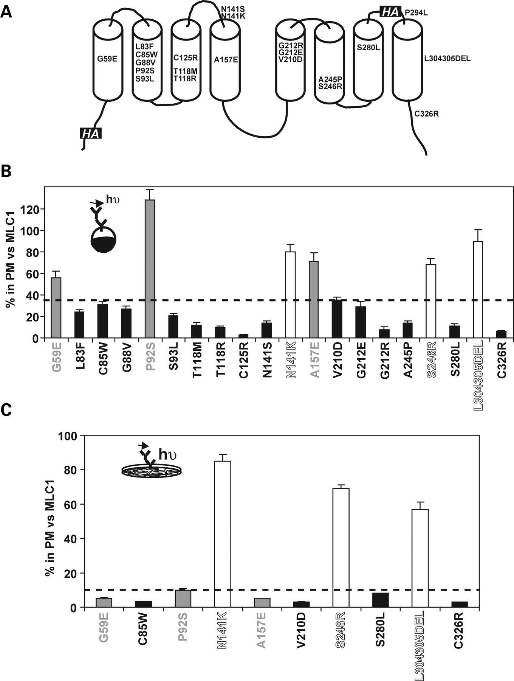
Figure 1. Reduced PM expression of most MLC1 mutants in Xenopus oocytes and HeLa cells. (A) A predicted 2D model of the ...
Notes:
Figure 1. Reduced PM expression of most MLC1 mutants in Xenopus oocytes and HeLa cells. (A) A predicted 2D model of the MLC1 protein, showing the location of the mutations studied and the introduced HA epitope tags. (B) Oocytes were injected with 10 ng of each cRNA construct, and the PM levels were measured using a luminescence-based method. The signal of non-injected oocytes was always below 5% the signal of wild-type (wt) MLC1-injected oocytes. Surface expression was normalized with the expression of wt MLC1. Data correspond to the summary of three experiments with n ≥ 30 oocytes per construct. The inset shows an overview of the method. The total protein steady-state levels were reduced in parallel with their surface expression level (not shown). The dotted line indicated 35% in PM versus wt MLC1, a criteria used to classify the mutants. (C) PM analysis using a luminescence-based method in HeLa cells transfected with wt MLC1 or the selected mutants. Surface expression was normalized with the expression of wt MLC1. Data correspond to two or three experiments with n ≥ 8 data points per construct. The inset shows an overview of the method. Total protein levels of each mutant were analysed at least twice in western blot studies. The dotted line indicated 10% in PM versus wt MLC1, a criteria used to classify the mutants. Mutations were classified in three classes on the basis of their effect on PM expression levels: severe (in black), intermediate (in grey) and mild (in white).
Unless provided in the caption above, the following copyright applies to the content of this slide: © The Author 2008. Published by Oxford University Press. All rights reserved. For Permissions, please email: journals.permissions@oxfordjournals.org

Slide 2
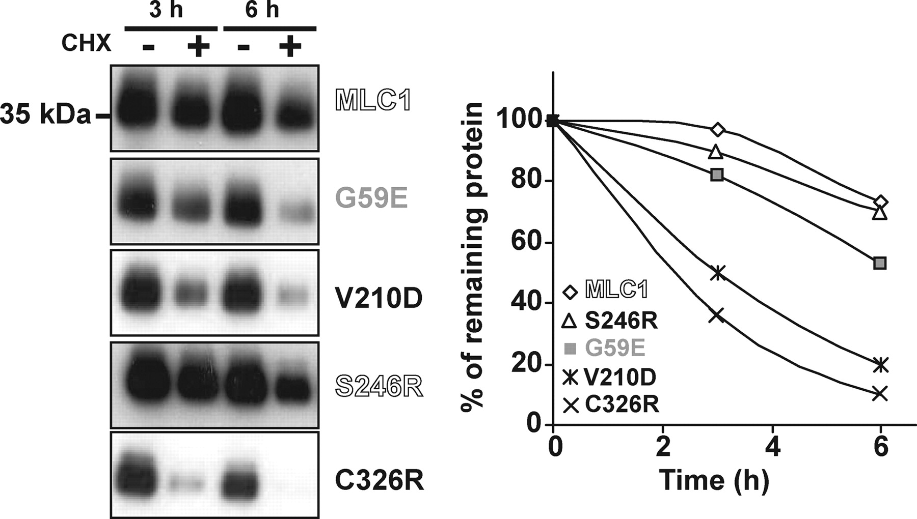
Figure 2. Decreased stability of MLC1 mutants. HeLa cells transfected with wt MLC1 or the G59E, V210D, S246R and C326R ...
Notes:
Figure 2. Decreased stability of MLC1 mutants. HeLa cells transfected with wt MLC1 or the G59E, V210D, S246R and C326R mutants containing HA tags were incubated with the protein synthesis inhibitor CHX (100 µg/ml) for the times indicated (0, 3 and 6 hours). Cells were harvested, solubilized and processed by western blot against the HA epitope. No signal was detected in non-transfected cells. Exposure times varied for the mutants in order to clearly show the decrease in steady-state protein levels. Here, we also show that expression levels of the proteins without CHX were similar at all times indicated. On the right, a quantification of this experiment with adequate exposition times, using ImageJ software, is shown. Pounceau staining was used as a loading control. Two independent experiments gave similar results. Mutant colour refers to the classification explained in Figure 1.
Unless provided in the caption above, the following copyright applies to the content of this slide: © The Author 2008. Published by Oxford University Press. All rights reserved. For Permissions, please email: journals.permissions@oxfordjournals.org

Slide 3
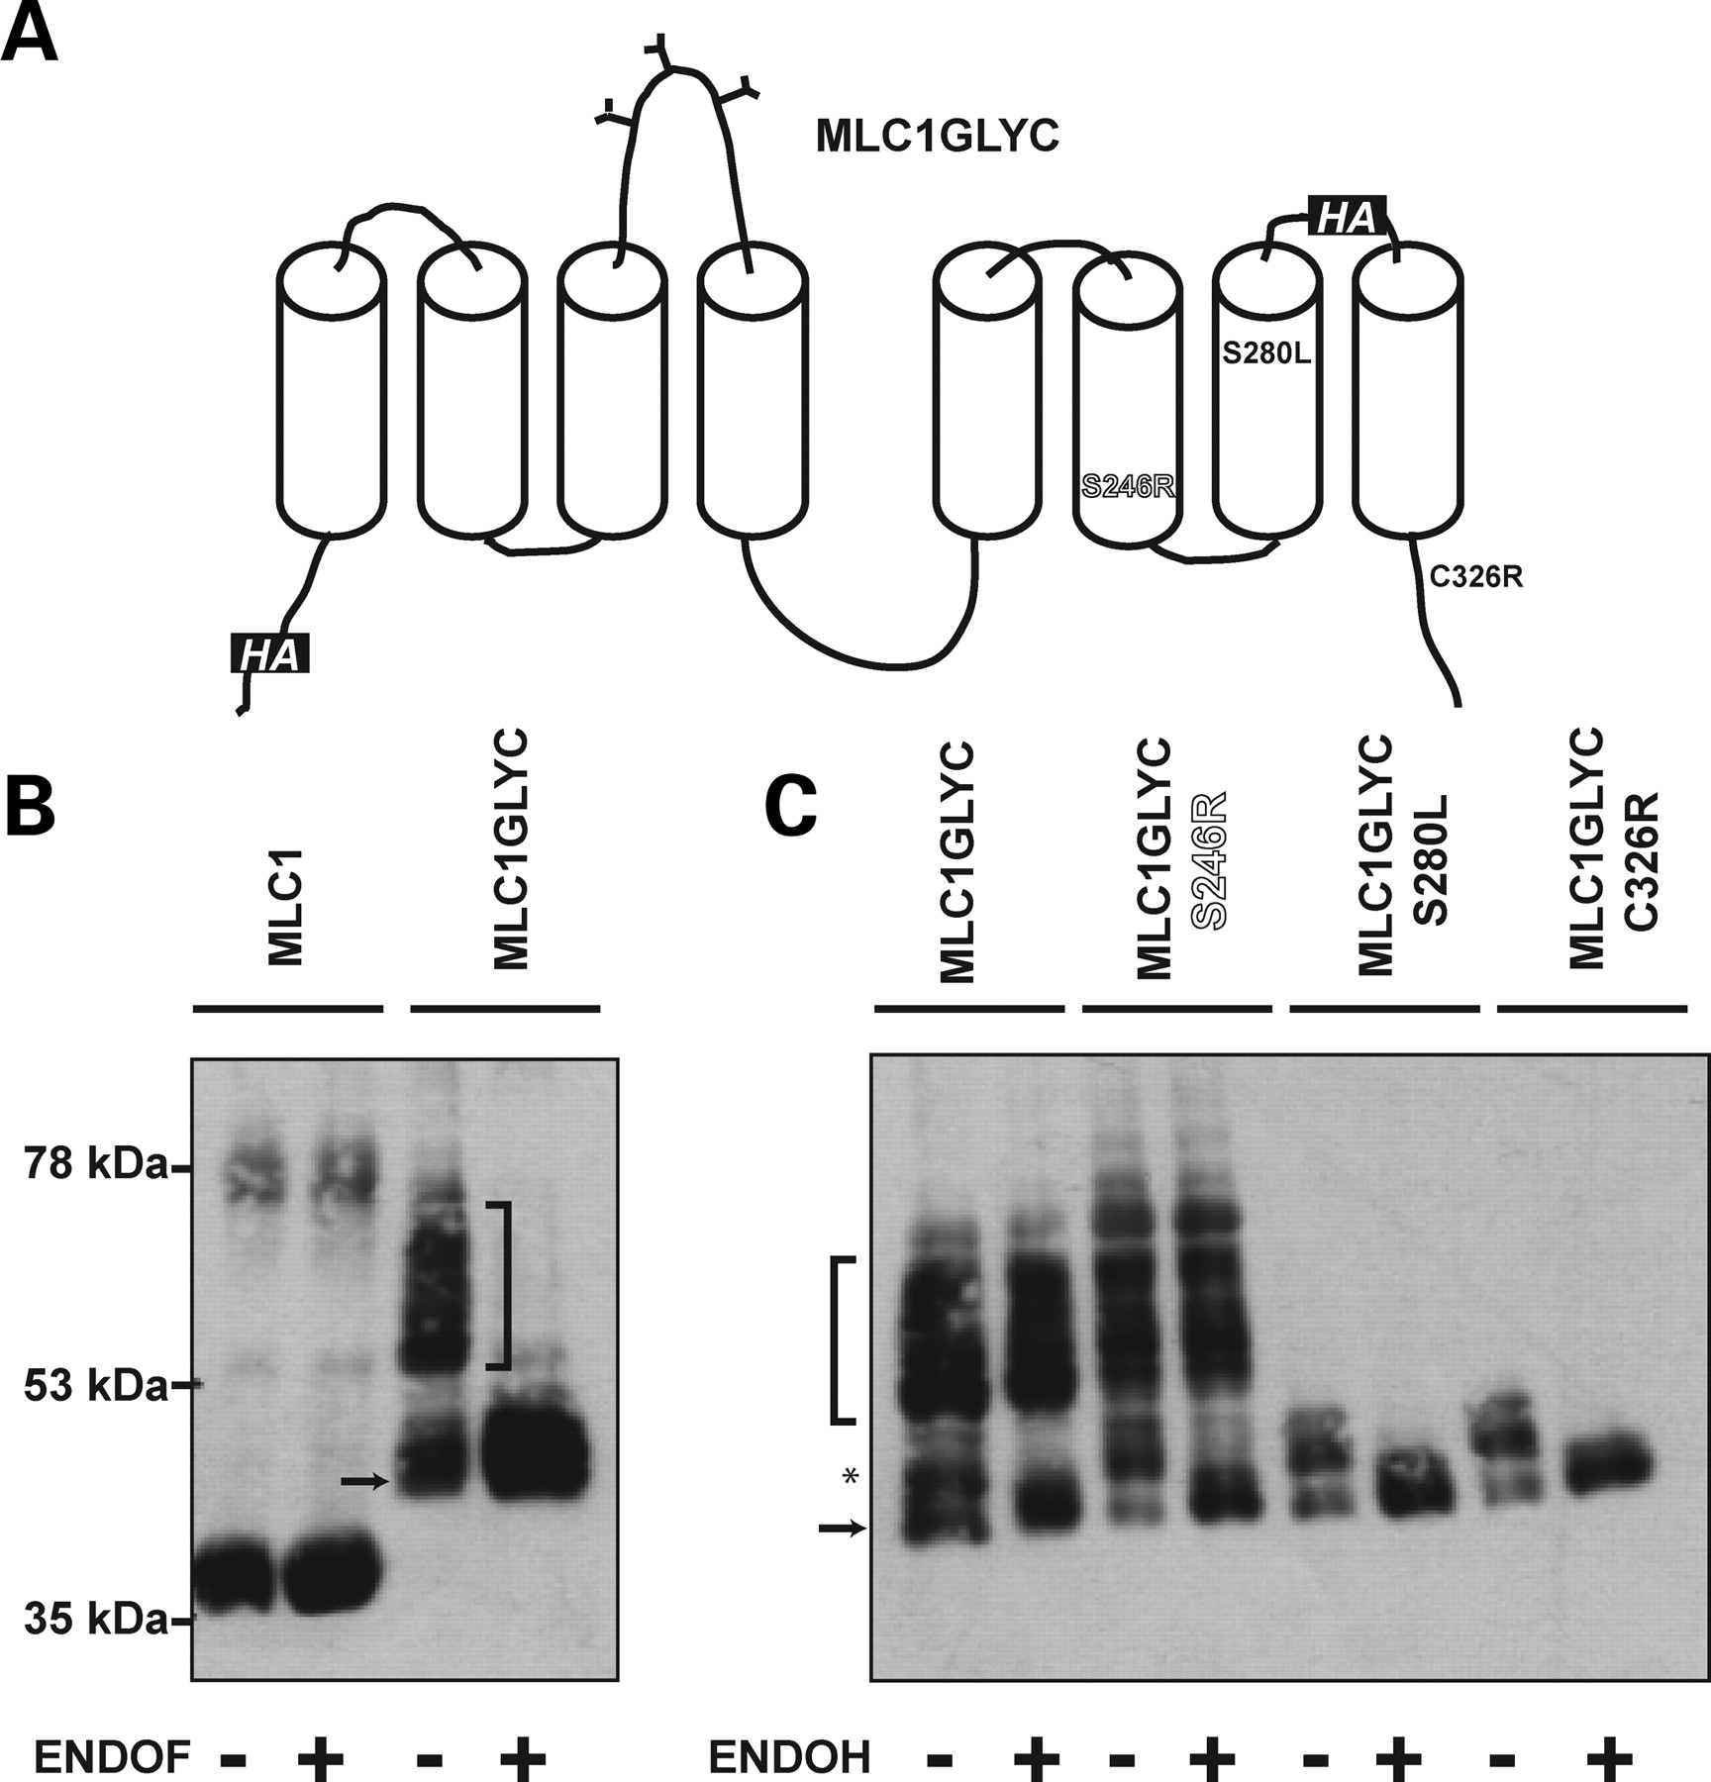
Figure 3. ER retention of MLC1 mutant proteins. (A) Schematic 2D model of the chimera MLC1GLYC reporter protein, ...
Notes:
Figure 3. ER retention of MLC1 mutant proteins. (A) Schematic 2D model of the chimera MLC1GLYC reporter protein, indicating the highly glycosylated loop from the LAT4 transporter (44), added between the putative transmembrane domains 3 and 4, the presence of the two HA epitope tags and the mutations studied with this reporter protein. (B) Extracts from transfected HeLa cells with wt MLC1 or MLC1GLYC containing HA tags were treated with Endoglycosidase F (EndoF), which cleaved glycans of both the high-mannose and the complex type linked through asparagine to the protein backbone. No change in the motility of wt MLC1 was observed after incubating with EndoF; in contrast, the motility of the heavy molecular weight bands from MLC1GLYC (bracket) was reduced, indicating that it was glycosylated. Probably, the lower molecular band of MLC1GLYC (arrow) corresponds to an unglycosylated protein form. The band around 78 kDa of wt MLC1 probably corresponds to the dimeric form. (C) Extracts from transfected HeLa cells with MLC1GLYC alone or MLC1GLYC containing selected mutations were processed by incubation with Endoglycosidase H (EndoH), which is able to remove glycans only if they have not suffered modifications in the Golgi complex. A high molecular weight broad band (bracket) EndoH insensitive in MLC1GLYC and MLC1GLYC S246R was not present in MLC1GLYC S280L or MLC1GLYC C326R. Only a lower molecular weight minor band (asterisk), that was the only glycosylated protein form present in the mutants S280L and C326R was sensitive to EndoH. These results suggest that these mutants are mostly retained in the ER. The band with lower molecular weight (arrow) of MLC1GLYC probably corresponds to an unglycosylated protein form, because its motility does not change after EndoH or EndoF treatment. Another independent experiment gave similar results. Mutant colour refers to the classification explained in Figure 1.
Unless provided in the caption above, the following copyright applies to the content of this slide: © The Author 2008. Published by Oxford University Press. All rights reserved. For Permissions, please email: journals.permissions@oxfordjournals.org

Slide 4
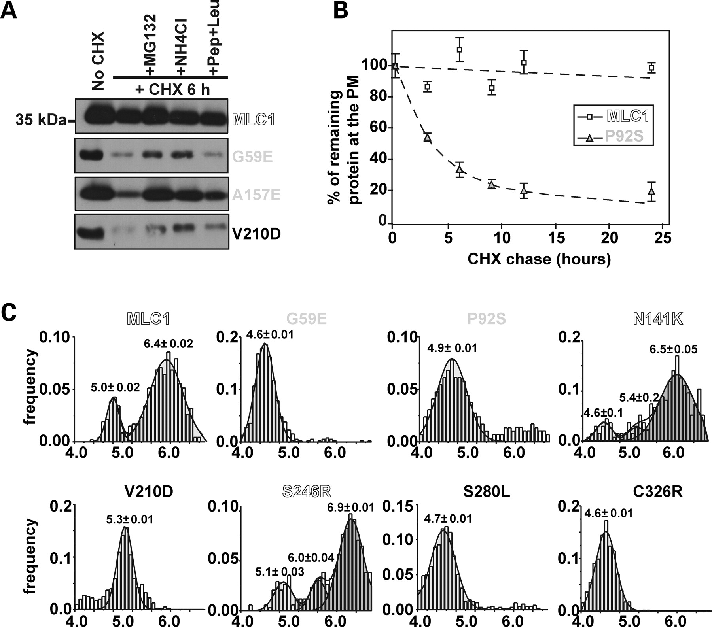
Figure 4. Lysosomal degradation of MLC1 mutants. (A) Transfected HeLa cells with wt MLC1 or the indicated mutants ...
Notes:
Figure 4. Lysosomal degradation of MLC1 mutants. (A) Transfected HeLa cells with wt MLC1 or the indicated mutants containing HA tags were incubated or not 24 h after transfection with the protein synthesis inhibitor CHX (100 µg/ml) for 6 h plus the proteasomal inhibitor Z-Leu-Leu-Leu-al (MG132, 50 µm) or several lysosomal inhibitors [ammonium chloride (NH4Cl, 10 mm) or pepstatin plus leupeptin (Pep + Leu, 5 µg/ml each)]. Cell extracts were obtained and processed by western blot. From three different experiments, for mutants G59E, A157E and V210D, respectively, densitometry studies indicated that MG132 increased mutant expression levels (in percentage) to 22, 31, 36; ammonium chloride to 21, 32, 33 and pepstatin plus leupeptin to 8, 13, 9. β-actin protein detection was used as a loading control. (B) Twenty-four hours after transfection, cells were incubated with CHX. At a range of time points, cells were washed and fixed. PM levels were measured using a luminescence-based method. The signal was normalized to the value at time 0 for each of the experimental groups (wt MLC1 or P92S). The result is a representative experiment of two experiments with similar results. (C) Transiently transfected COS cells were incubated at 37°C for 90 min with FITC-conjugated anti-mouse Fab fragments and anti-HA antibody and chased in the absence of antibodies for 30 min before live imaging. The pH of individual vesicles was measured by fluorescence ratiometric video-image analysis. The figure shows the vesicular pH distribution of endocytosed wt MLC1 and MLC1 mutants. These distributions were obtained from 468, 482, 567, 671, 604, 529, 615 and 639 vesicles for wt MLC1, G59E, P92S, N141K, V210D, S246R, S280L and C326R, respectively. They were obtained in three independent experiments. The results show that severe and intermediate MLC1 mutants are mostly localized in lysosomes after internalization from the PM. A minor proportion of wt MLC1 protein is also targeted to lysosomes, probably as a consequence of the overexpression. Mild mutants N141K and S246R were similar to wt MLC1, although a three-Gaussian distribution was used to fit the average pH of each type of vesicle population (see Material and Methods). Mutant colour refers to the classification explained in Figure 1.
Unless provided in the caption above, the following copyright applies to the content of this slide: © The Author 2008. Published by Oxford University Press. All rights reserved. For Permissions, please email: journals.permissions@oxfordjournals.org

Slide 5
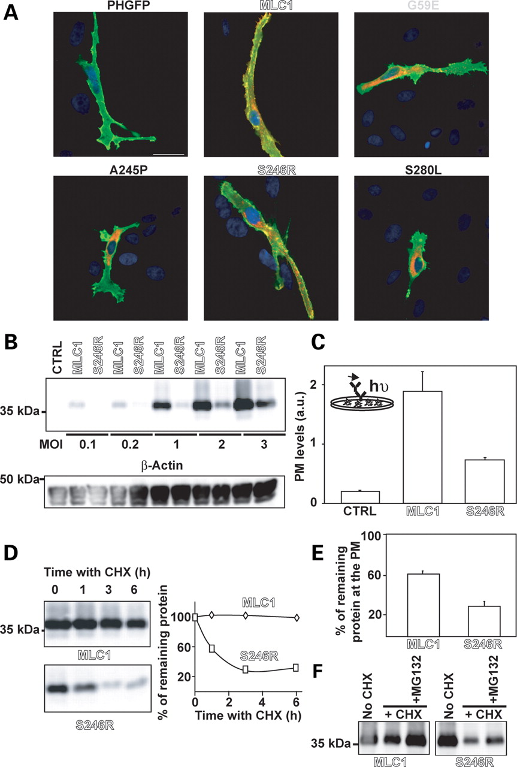
Figure 5. Expression of MLC1 mutants in rat primary astrocyte cultures. (A) Astrocytes were co-transfected with PH-GFP ...
Notes:
Figure 5. Expression of MLC1 mutants in rat primary astrocyte cultures. (A) Astrocytes were co-transfected with PH-GFP (pleckstrin homology domain of PLCδ1 fused to green fluorescent protein), as a marker of PM, together with wt MLC1 or the indicated mutants (G59E, A245P, S246R and S280L) containing HA tags. Cells were fixed and permeabilized, and immunofluorescence was performed using 3F10 (against the HA tags) as a primary antibody. No signal due to the HA epitope was observed in cells transfected only with the PH-GFP plasmid. The bar line correspond to 20 µm. Nuclei were stained using DAPI. PH-GFP is shown in green, MLC1 in red, nuclei in blue and colocalization between the green channel and the red channel in yellow. The degree of colocalization between PH-GFP and MLC1 proteins was analysed using the Pearson's correlation coefficient (Rr) obtained with an ImageJ software plugin, using 10 single plane images from different cells corresponding to two independent experiments. The values of Rr were 0.8 ± 0.02, 0.5 ± 0.07, 0.4 ± 0.05, 0.6 ± 0.04 and 0.4 ± 0.07 for wt MLC1, G59E, A245P, S246R and S280L, respectively. Mutant colour refers to the classification explained in Figure 1. (B) Astrocytes were infected or not with adenoviruses expressing wt MLC1 or S246R mutant containing two HA tags at different MOI. Forty-eight hours later, extracts were obtained and analysed by western blot. At equal MOI, the expression of the S246R mutant was always lower than wt MLC1. β-Actin detection by western blot was used as a loading control. (C) Astrocytes were infected with adenoviruses expressing wt MLC1 or the mutant S246R with HA tags at MOI = 2. PM levels of wt MLC1 and S246R mutant were measured using a luminescence-based method, as described in Materials and Methods. The luminescence signal of non-infected astrocytes was always lower than the signal from infected astrocytes with MLC1 proteins. Data correspond to an independent experiment with four data points per construct, and are expressed in light arbitrary units (a.u.). From six independent experiments (n = 24), the level of the S246R mutant in comparison with wt MLC1 was 26 ± 5%. The inset shows an overview of the method. (D) Astrocytes were infected or not with adenoviruses expressing wt MLC1 and S246R mutant with HA tags at MOI = 2. Thirty-six hours post-infection, cells were treated or not with cycloheximide (CHX, 100 µg/ml) at the times indicated. Cell extracts were obtained, and the remaining protein was analysed by western-blot against the HA epitope. β-Actin detection by western blot was used as a loading control (not shown). The result is a representative experiment of three with similar results. On the right, a quantification of this experiment using ImageJ software is shown. (E) Similarly, 36 hours post-infection with the indicated adenoviruses, astrocytes were incubated or not with CHX (100 µg/ml) for 6 h. Cells were fixed, and the levels of wt MLC1 and the S246R mutant at the PM were measured using a luminescence-based method. The signal was normalized to the value at time 0 for each of the experimental group (wt MLC1 or S246R). Data correspond to a summary of three independent experiments (n = 12). Wt MLC1 surface levels were reduced to 59.3 ± 4.1% and S246R mutant to 35.1 ± 7.1%. (F) In a similar manner, infected astrocytes were incubated with CHX (100 µg/ml) together or not with the proteasome inhibitor MG132 (50 µM) for 6 h. Cell extracts were processed by western blot. β-Actin detection by western blot was used as a loading control (not shown). The result is a representative experiment of three with similar results. Mutant colour refers to the classification explained in Figure 1.
Unless provided in the caption above, the following copyright applies to the content of this slide: © The Author 2008. Published by Oxford University Press. All rights reserved. For Permissions, please email: journals.permissions@oxfordjournals.org

Slide 6
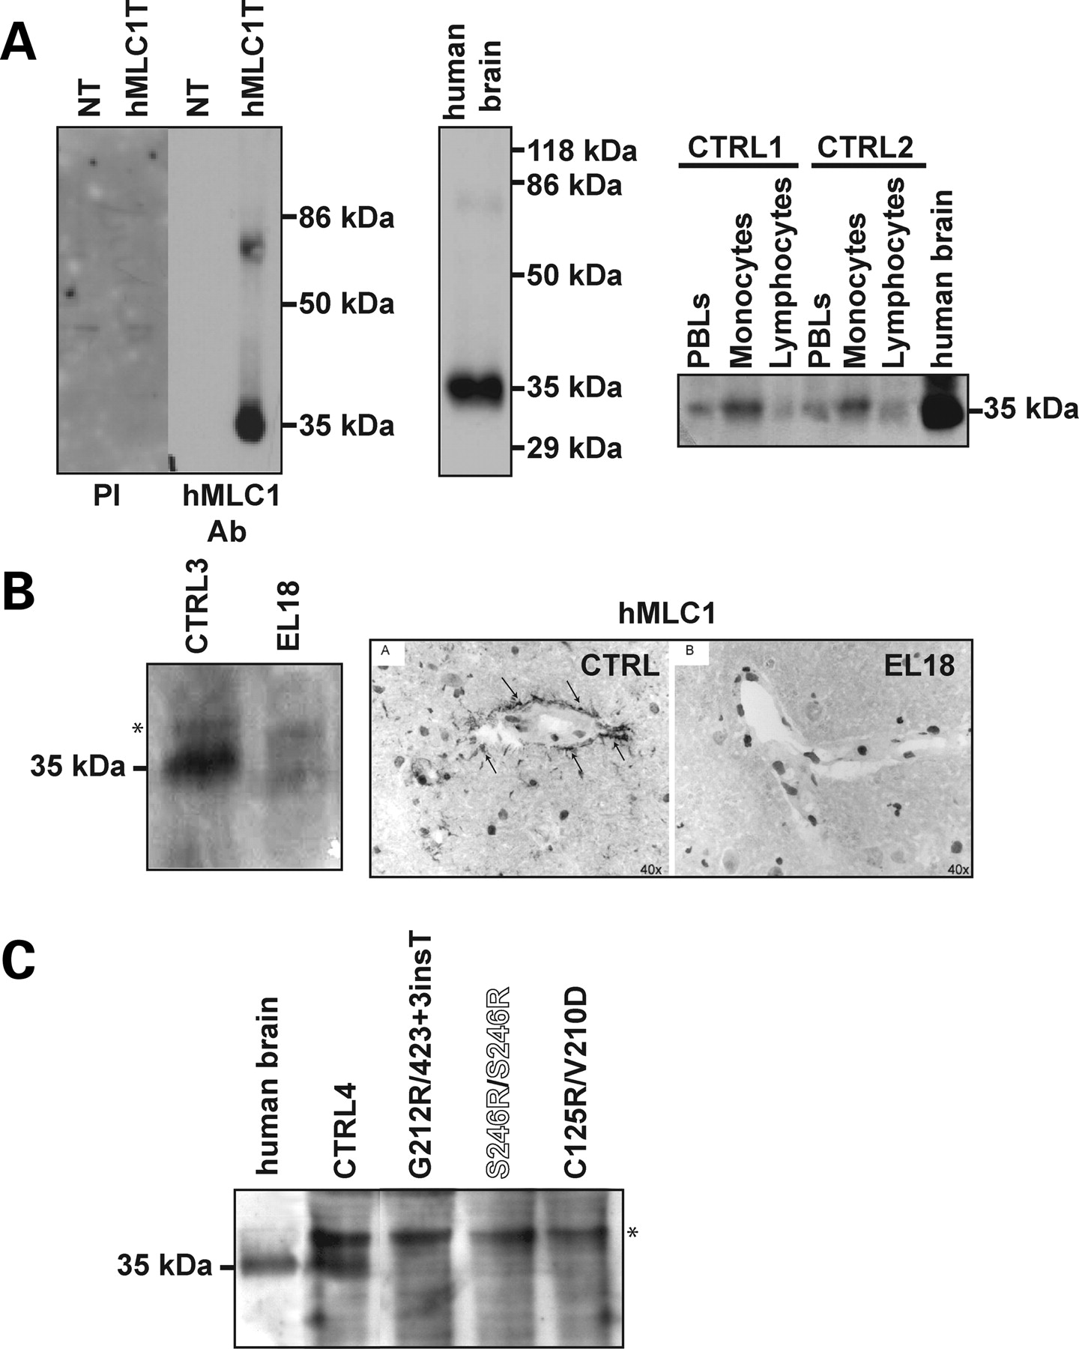
Figure 6. Analysis of MLC1 expression in human MLC patients. (A) Characterization of a new polyclonal antibody against ...
Notes:
Figure 6. Analysis of MLC1 expression in human MLC patients. (A) Characterization of a new polyclonal antibody against human MLC1 protein. Left panel: affinity-purified rabbit antibody against the N-terminal region of human MLC1 recognize a ∼34 kDa and a ∼70 kDa band in lysates of HeLa cells transfected with human MLC1 cDNA (hMLC1T), probably corresponding to the monomeric and dimeric form, respectively. These bands were not visible in non-transfected (NT) cells or in transfected cells (hMLC1T) using the pre-immune serum (PI). Middle panel: this antibody recognizes bands of the same size in extracts from human brain tissue, without showing any unspecific band. Right panel: fresh human PBLs were obtained using a Ficoll gradient. They were further fractionated to monocytes and lymphocytes on the basis of monocyte adherence to plastic dish. Extracts were obtained and processed for western blot analysis. A band showing the same motility as the monomeric form of MLC1 detected in human brain was specifically enriched in control monocytes (CTRL1 and CTRL2). For reasons of clarity, we only show the protein band corresponding to monomeric human MLC1, because the intensity of the band corresponding to dimeric MLC1 was lower. Cells from different controls showed variation in expression level, but this was not investigated further. (B) Left panel: fresh monocytes from an unrelated control (CTRL3) and from patient EL18 were isolated, extracts were obtained and processed by western blot. The band identified as MLC1 protein was absent in the EL18 patient. An unspecific band was visible in some monocyte extracts (asterisk). Right panel: immunohistochemical staining of MLC1 in control brain (A) and patient (EL18) tissue (B). In control tissue (A), the perivascular staining of MLC1 is visible (arrows), but no staining is observed in brain sections from the same patient (B). Cell nuclei are shown as dark circles. As a control of the integrity of the sections, GFAP had a normal staining and distribution in both control and MLC brain tissue (not shown). (C) Fresh monocytes from another unrelated control (CTRL4) and from three different MLC patients containing at least a MLC1 missense mutation were isolated; extracts were obtained and processed by western blot. An unspecific band was visible in some monocyte extracts (asterisk). The band corresponding to monomeric MLC1 (specifically detected in human brain) was present in controls but not in monocytes from MLC patients. A loading control (translation factor eIF2α) showed equal loading of total protein of the monocyte extract samples (not shown). Mutant colour refers to the classification explained in Figure 1.
Unless provided in the caption above, the following copyright applies to the content of this slide: © The Author 2008. Published by Oxford University Press. All rights reserved. For Permissions, please email: journals.permissions@oxfordjournals.org

Slide 7
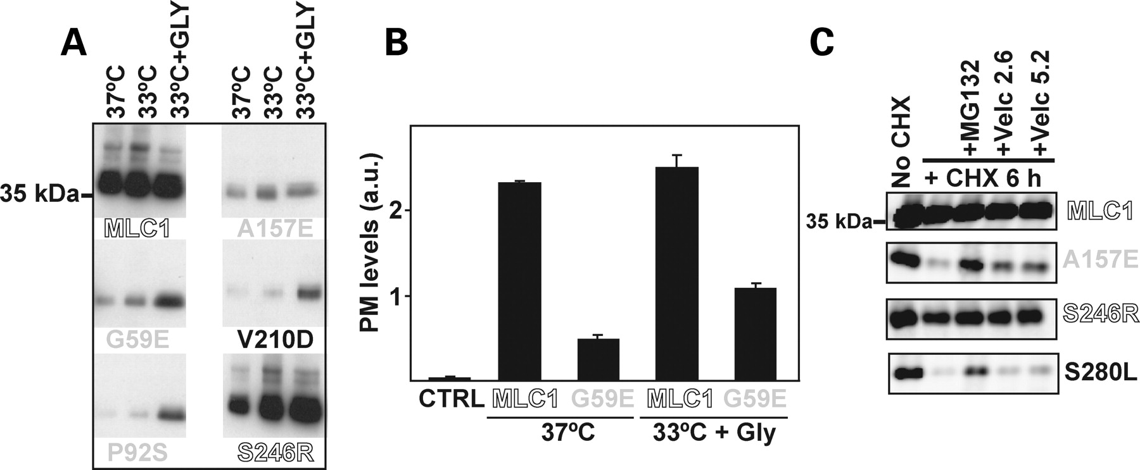
Figure 7. Chemical strategies to improve MLC1 mutants expression. (A) Transfected HeLa cells were incubated at 37°C, at ...
Notes:
Figure 7. Chemical strategies to improve MLC1 mutants expression. (A) Transfected HeLa cells were incubated at 37°C, at 33°C or at 33°C with addition of 10 mm glycerol 24 h after transfection. Twenty-four hours later after glycerol addition, cells were harvested, solubilized and processed by western blot against the HA epitope. Two other independent experiments gave similar results. (B) PM analysis using a luminescence-based method in HeLa cells transfected with wt MLC1 or the G59E mutant after incubation at 33°C plus 10 mm glycerol. Data correspond to an independent experiment with four data points per construct, and are expressed in light arbitrary units (a.u.). Another independent experiment gave similar results. (C) Transfected HeLa cells with wt MLC1 or the mutants indicated containing HA tags were incubated or not 24 h after transfection with the protein synthesis inhibitor cycloheximide (CHX, 100 µg/ml) for 6 h plus the proteasomal inhibitor MG132 (50 µM) or the FDA-approved drug Velcade® (bortezomib) (Millennium Pharmaceuticals, Inc) at 2.6 and 5.4 µm. From three independent experiments, Velcade® (bortezomib) was able to recover protein expression about 25–40% for A157E and 5–15% for S280L mutants. β-Actin detection by western blot was used as a loading control (not shown). Mutant colour refers to the classification explained in Figure 1.
Unless provided in the caption above, the following copyright applies to the content of this slide: © The Author 2008. Published by Oxford University Press. All rights reserved. For Permissions, please email: journals.permissions@oxfordjournals.org

