Slide 1
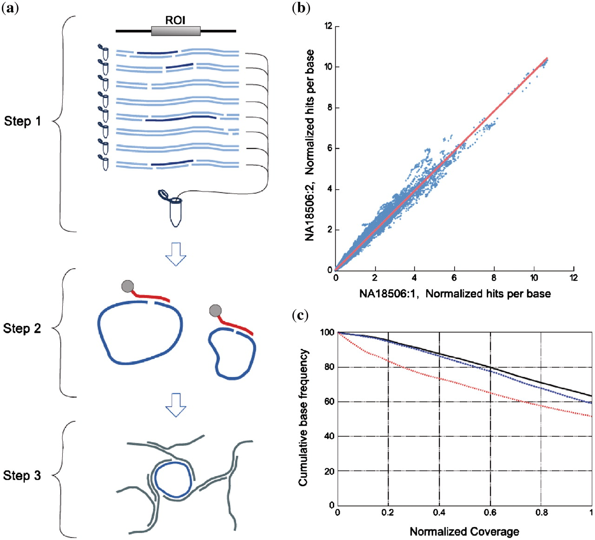
Figure 1. Selector probe technology and performance. ( a ) Overview of the selector-probe amplification procedure. A ...
Notes:
Figure 1. Selector probe technology and performance. ( a ) Overview of the selector-probe amplification procedure. A ROI (e.g. an exon) is targeted by probing several redundant fragments (dark blue) selected from eight separate restriction digestion reactions of a genomic DNA sample (light blue). The restriction-digested DNA samples are pooled and hybridized with biotin-tagged selector probes complementary to the ends of each targeted restriction fragment (red). The targeted fragments are then captured on streptavidin-coated magnetic beads. The fragments are circularized by DNA ligation after removal of non-targeted DNA. Finally, the circularized fragments are released from the beads and specifically amplified using the RCA-based MDA. ( b ) Correlation of the relative coverage of individual bases between two replicate enrichment and sequencing experiments. ( c ) The cumulative fraction of the target sequence covered is plotted as a function of different relative read-depths, indexed to the mean coverage, in three sequencing experiments using DNA from the NA18506 HapMap cell line (black line), fresh-frozen lung cancer tissue (blue broken line) and FFPE lung cancer tissue (red broken line).
Unless provided in the caption above, the following copyright applies to the content of this slide: © The Author(s) 2010. Published by Oxford University Press.This is an Open Access article distributed under the terms of the Creative Commons Attribution Non-Commercial License (http://creativecommons.org/licenses/by-nc/2.5), which permits unrestricted non-commercial use, distribution, and reproduction in any medium, provided the original work is properly cited.

Slide 2
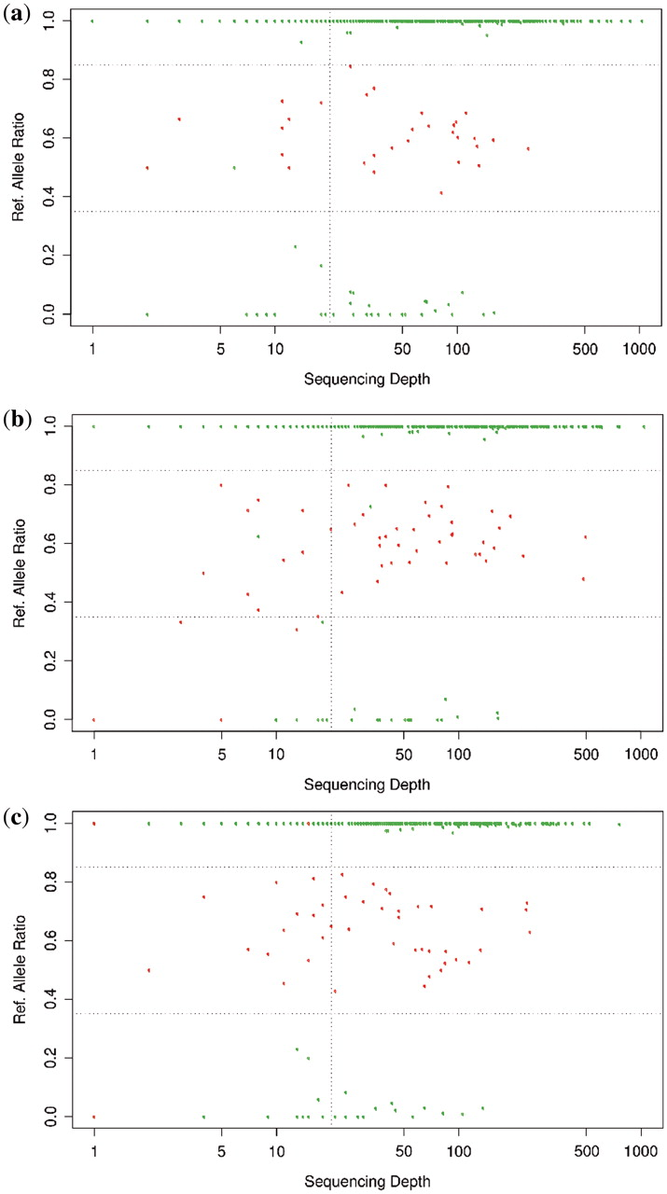
Figure 2. Analysis of concordance with available SNP genotypes of the ( a ) NA18506; ( b ) NA18507; and ( c ) NA18508 ...
Notes:
Figure 2. Analysis of concordance with available SNP genotypes of the ( a ) NA18506; ( b ) NA18507; and ( c ) NA18508 DNA samples. The allele ratio of all positions where the SNP genotype is available in the HapMap database are plotted as a function of read depth. Green dots represent homozygous SNP positions in the database and red dots represent heterozygous positions. Heterozygous positions were defined as having an allelic ratio of ≥0.35 and ≤0.85 (dashed horizontal lines). The vertical dashed line indicates a read depth of 20.
Unless provided in the caption above, the following copyright applies to the content of this slide: © The Author(s) 2010. Published by Oxford University Press.This is an Open Access article distributed under the terms of the Creative Commons Attribution Non-Commercial License (http://creativecommons.org/licenses/by-nc/2.5), which permits unrestricted non-commercial use, distribution, and reproduction in any medium, provided the original work is properly cited.

Slide 3
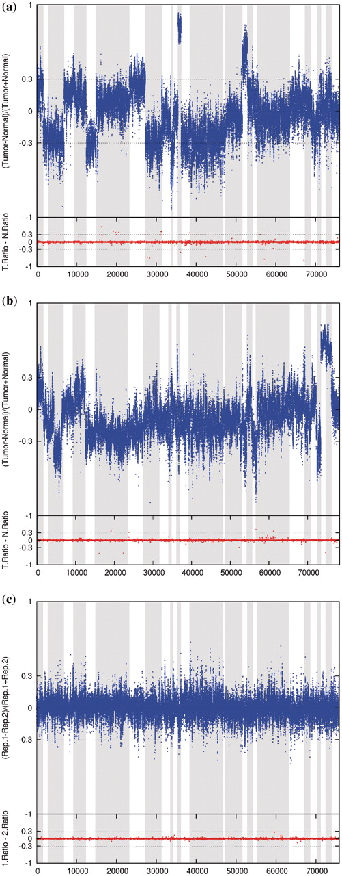
Figure 3. Somatic mutation analysis of two breast cancer cell lines with matched normal controls HCC1143/HCC1143BL ( a ...
Notes:
Figure 3. Somatic mutation analysis of two breast cancer cell lines with matched normal controls HCC1143/HCC1143BL ( a ) and HCC1599/HCC1599BL ( b ). In each position in the targeted region, the number of bases called in the matched normal cell line (HCC1143BL/HCC1599BL) is subtracted from the number of bases called in the tumor-derived cell line (HCC1143/HCC1599) and then divided with the sum of called bases for that position in the two samples. The exons of the 28 genes are concatenated in the order specified in Table 1 and gene shifts are demarked by alternating background color. The lower panels show the value obtained from each base when the allelic ratio between the major and minor allele of the normal sample is subtracted from the corresponding allelic ratio of the tumor sample. ( c ) Base-by-base comparison of two replicate sequencing experiments of the cell line NA18506.
Unless provided in the caption above, the following copyright applies to the content of this slide: © The Author(s) 2010. Published by Oxford University Press.This is an Open Access article distributed under the terms of the Creative Commons Attribution Non-Commercial License (http://creativecommons.org/licenses/by-nc/2.5), which permits unrestricted non-commercial use, distribution, and reproduction in any medium, provided the original work is properly cited.

Slide 4
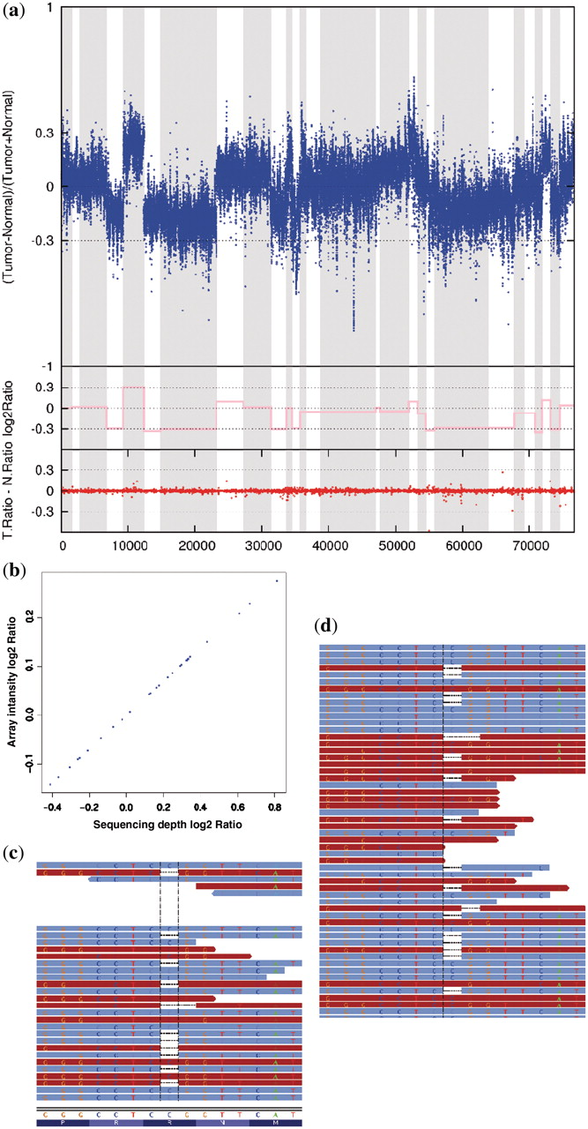
Figure 4. ( a ) Mutation detection and CNV analysis of a lung cancer patient sample with matched control. Upper panel: ...
Notes:
Figure 4. ( a ) Mutation detection and CNV analysis of a lung cancer patient sample with matched control. Upper panel: for each position in the targeted region the number of bases called in the patient-matched normal tissue is subtracted from the number of bases called in the tumor-derived DNA, and then divided with the sum of called bases for that position in the two samples. The exons of the 28 genes are lined up after each other and genes are demarked by alternating background color. Middle panel: the inferred gene copy-number variation in the corresponding genomic loci illustrated by log2 ratios (pink line) derived from SNP array data (Affymetrix Gene Chip Mapping 250K arrays). Middle panel: the log2 ratio (pink line) of the copy-number analysis done on an Affymetrix micro array. Lower panel: the allelic ratio between the major and minor allele at each position is compared between the two samples by subtraction ( b ). A correlation plot between the Affymetrix Gene Chip log2 tumor/normal signal ratio and the log2 tumor/normal sequencing read depth ratio. ( c ) Detection of a single base pair deletion in the TP53 gene. Forward (brown) and reverse (blue) reads are aligned to a 15-bp region of the TP53 gene. Deleted bases are indicated by dashed lines. Alignment visualized in Integrative Genomic Viewer (IGV ver.1.4.2). ( d ) Detection of the same mutation in the FFPE sample from the same tumor.
Unless provided in the caption above, the following copyright applies to the content of this slide: © The Author(s) 2010. Published by Oxford University Press.This is an Open Access article distributed under the terms of the Creative Commons Attribution Non-Commercial License (http://creativecommons.org/licenses/by-nc/2.5), which permits unrestricted non-commercial use, distribution, and reproduction in any medium, provided the original work is properly cited.

Slide 5
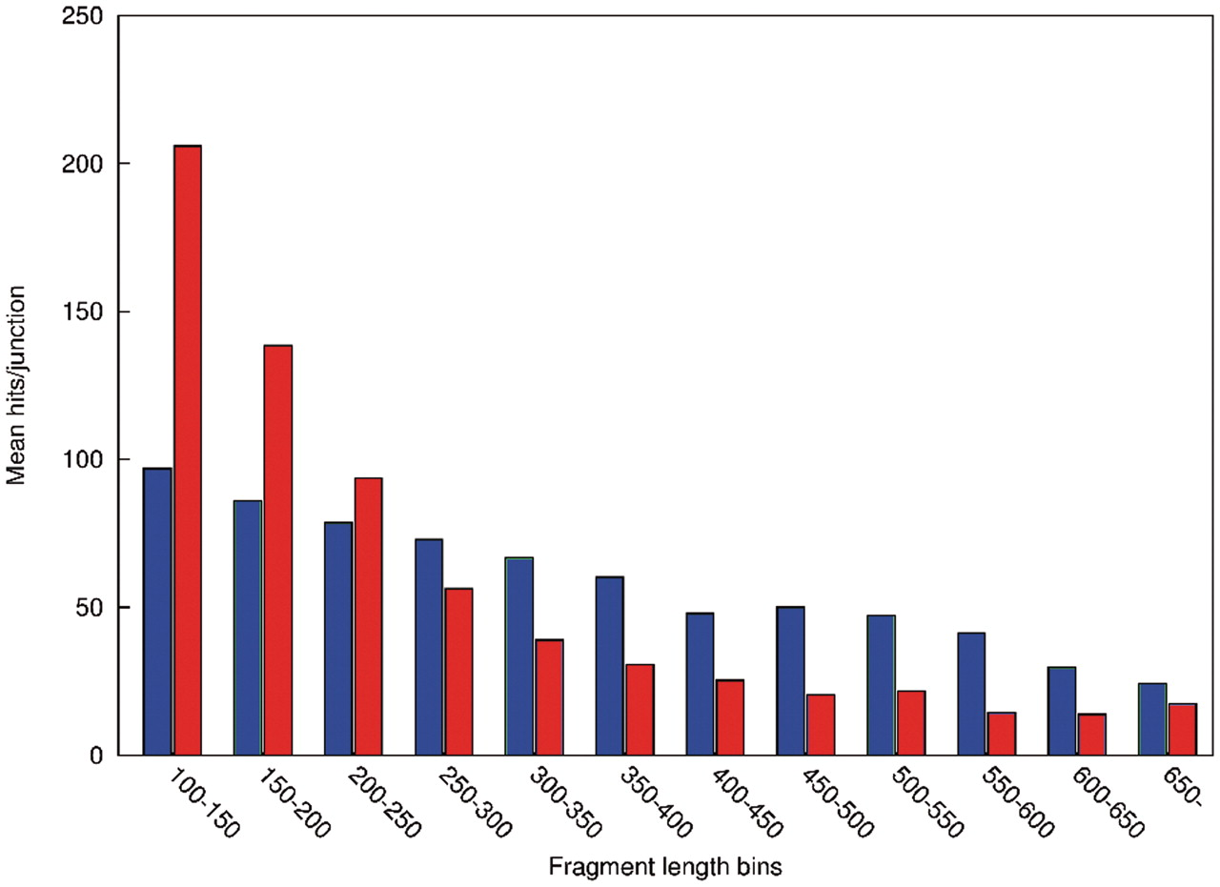
Figure 5. The dependency of the length of selected fragments on amplification efficiency in fresh-frozen and FFPE tumor ...
Notes:
Figure 5. The dependency of the length of selected fragments on amplification efficiency in fresh-frozen and FFPE tumor tissue. Each selector probe in a probe library creates a unique sequence over the ligation junction upon successful ligation and amplification. The junction reads can be used to track the performance of individual probes and fragments. In the graph, the average number of reads spanning a ligation junction of a probe is plotted as a function of the length of the targeted fragments. Fragment lengths are shown in bins of 50 bp. Data from the fresh-frozen and FFPE tumor samples are shown as blue and red bars, respectively.
Unless provided in the caption above, the following copyright applies to the content of this slide: © The Author(s) 2010. Published by Oxford University Press.This is an Open Access article distributed under the terms of the Creative Commons Attribution Non-Commercial License (http://creativecommons.org/licenses/by-nc/2.5), which permits unrestricted non-commercial use, distribution, and reproduction in any medium, provided the original work is properly cited.

