Slide 1
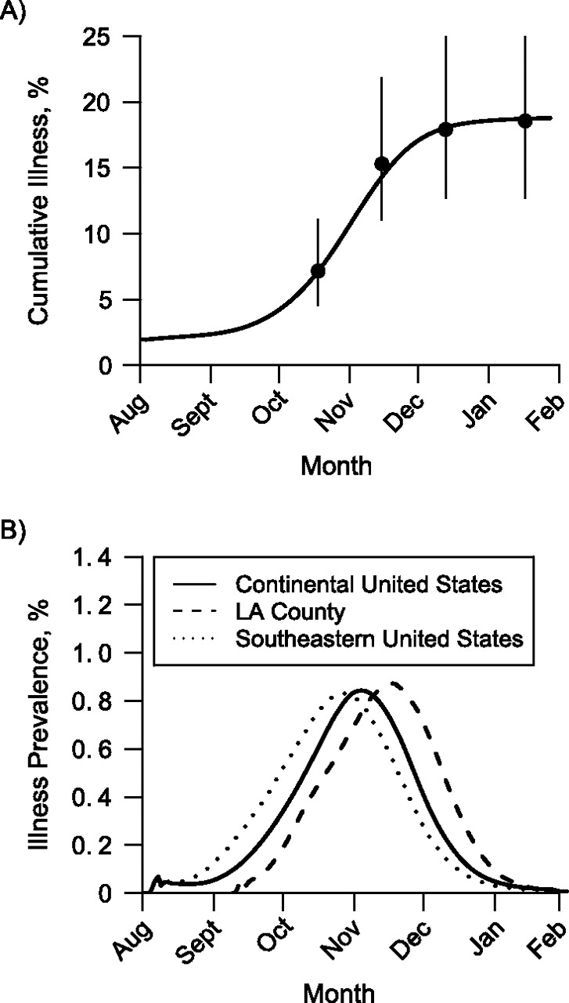
Figure 1. Timing of the 2009–2010 influenza A (H1N1) epidemic in the continental United States and Los Angeles (LA) ...
Notes:
Figure 1. Timing of the 2009–2010 influenza A (H1N1) epidemic in the continental United States and Los Angeles (LA) County, California. A) Simulated cumulative incidence of pandemic H1N1 illness versus observed incidence for the United States. The solid black line shows the simulated cumulative illness in the continental United States. The dots show estimates of numbers of cases obtained from the Centers for Disease Control and Prevention at 4 time points, and the vertical lines show the ranges of the estimates (3). B) Timing of the simulated pandemic H1N1 epidemic for the 2009–2010 influenza season in the continental United States, LA County, and the southeastern United States. In these simulations, vaccine was distributed according to availability in the United States (11).
Unless provided in the caption above, the following copyright applies to the content of this slide: American Journal of Epidemiology © The Author 2011. Published by Oxford University Press on behalf of the Johns Hopkins Bloomberg School of Public Health. All rights reserved. For permissions, please e-mail: journals.permissions@oup.com.

Slide 2
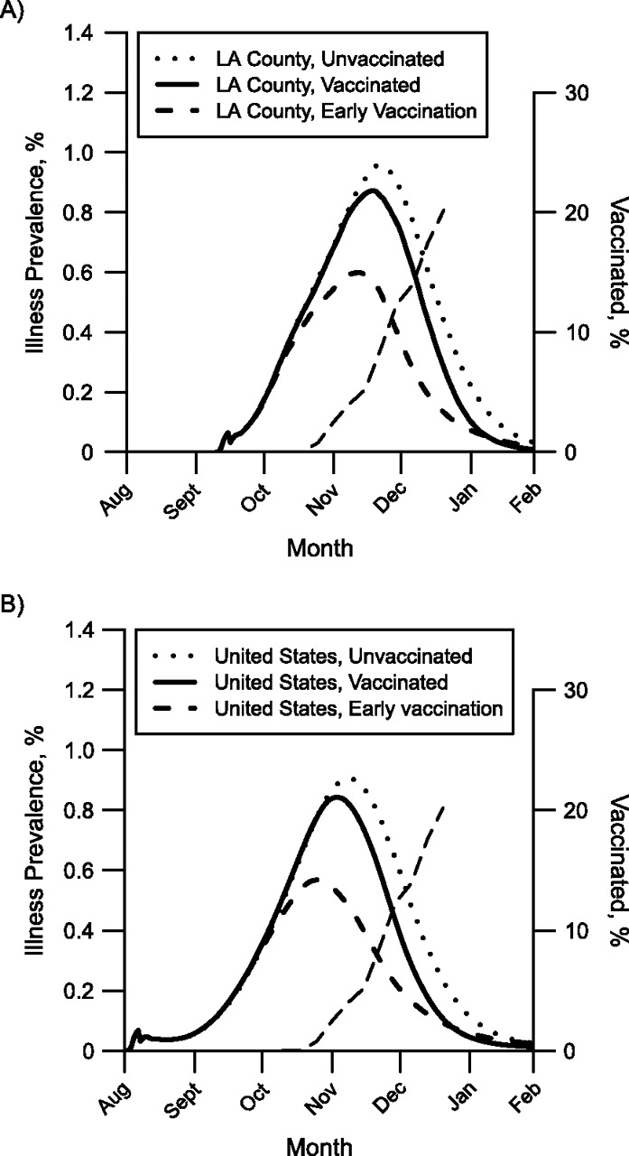
Figure 2. Simulated effect of the 2009 mass vaccination campaign against pandemic influenza A (H1N1) on illness ...
Notes:
Figure 2. Simulated effect of the 2009 mass vaccination campaign against pandemic influenza A (H1N1) on illness prevalence in A) Los Angeles (LA) County, California, and B) the continental United States. Each curve plots the simulated prevalence of pandemic H1N1 from a single stochastic simulation. The solid curves show simulated illness prevalence when vaccination begins on October 9. The dotted curves show simulated illness prevalence when there is no vaccination. The dashed curves show simulated prevalence when vaccination begins 1 month earlier (September 9). The thin dashed curves running diagonally upwards show the fraction of the population vaccinated, assuming 1 dose per person.
Unless provided in the caption above, the following copyright applies to the content of this slide: American Journal of Epidemiology © The Author 2011. Published by Oxford University Press on behalf of the Johns Hopkins Bloomberg School of Public Health. All rights reserved. For permissions, please e-mail: journals.permissions@oup.com.

Slide 3
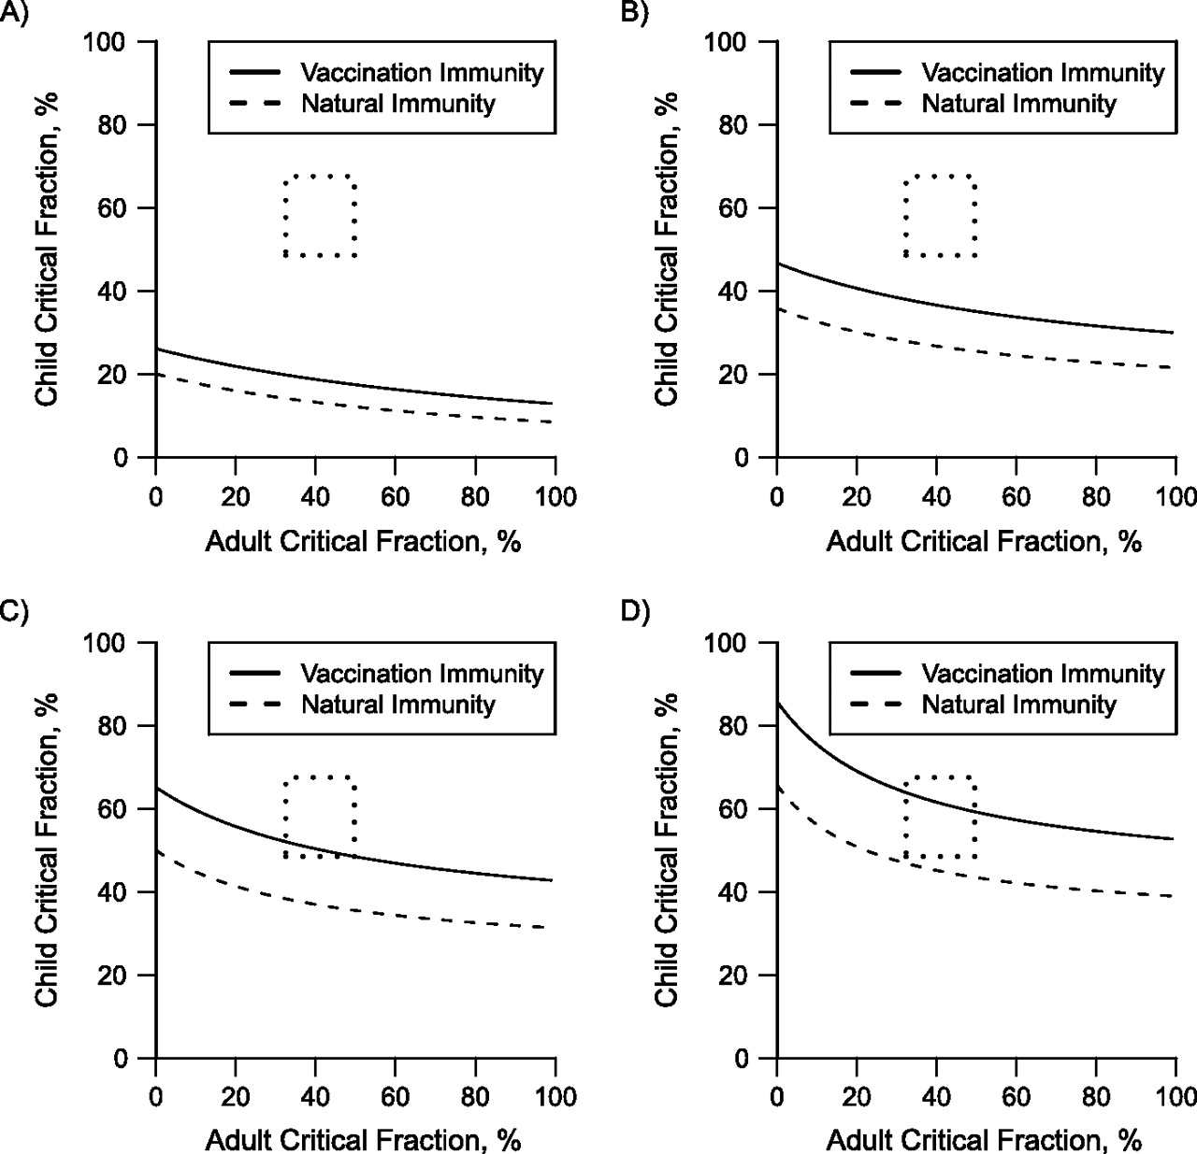
Figure 3. Critical percentage of natural or vaccine-induced immunity needed to prevent an epidemic of influenza A ...
Notes:
Figure 3. Critical percentage of natural or vaccine-induced immunity needed to prevent an epidemic of influenza A (H1N1). The region between the 2 curves indicates the amount of preexisting immunity required to prevent an epidemic for A) Rn = 1.2, B) Rn = 1.4, C) Rn = 1.6, and D) Rn = 1.8. The upper bound of each region (solid line) is the amount of immunity required from vaccination alone, while the lower bound (dashed line) is the amount required from prior infection alone. The dotted rectangle indicates the range of the estimated level of immunity to pandemic H1N1 from infection or vaccination in the United States at the beginning of 2010.
Unless provided in the caption above, the following copyright applies to the content of this slide: American Journal of Epidemiology © The Author 2011. Published by Oxford University Press on behalf of the Johns Hopkins Bloomberg School of Public Health. All rights reserved. For permissions, please e-mail: journals.permissions@oup.com.

