Slide 1
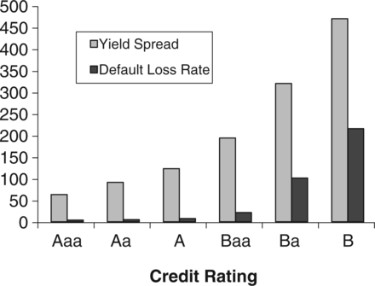
Figure 1 Historical average yield spreads and default loss rates for ten-year bonds This figure plots the historical ...
Notes:
Figure 1 Historical average yield spreads and default loss rates for ten-year bonds This figure plots the historical average yield spread (in basis points) of ten-year corporate bonds and the average default loss rate (in basis points) over a ten-year time interval, for each rating group. Average yield spreads for investment-grade bonds are based on monthly Lehman bond index data over January 1973–December 1993. Average spreads for junk bonds are from Caouette, Altman, and Narayanan (1998). Default loss rates are estimated using historical default rates and average recovery rates from the Moody’s that are provided in Table 1. Note that the stylized fact illustrated here—the low ratio of default loss rates to observed spreads for investment-grade bonds—is not a “puzzle” per se and that the issue of interest here is how much of the credit risk premium can be explained by structural models.
Unless provided in the caption above, the following copyright applies to the content of this slide: © The Author 2012. Published by Oxford University Press on behalf of The Society for Financial Studies. All rights reserved. For Permissions, please email: journals.permissions@oup.com

Slide 2
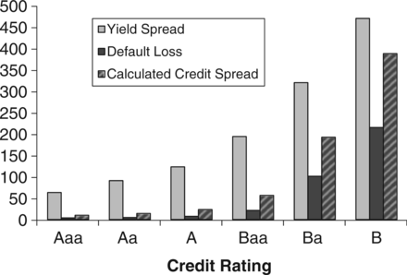
Figure 2 Historical average yield spreads and default loss rates, and predicted credit spreads for ten-year bonds This ...
Notes:
Figure 2 Historical average yield spreads and default loss rates, and predicted credit spreads for ten-year bonds This figure plots the historical average yield spread (in basis points) and calculated credit spreads of ten-year corporate bonds, and the average default loss rate (in basis points) over a ten-year time interval, for each rating category. Average yield spreads for investment-grade bonds are based on monthly Lehman bond index data over January 1973–December 1993. Average spreads for junk bonds are from Caouette, Altman, and Narayanan (1998). Default loss rates are estimated using historical default rates and average recovery rates from the Moody’s that are reported in Table 1. Predicted (or calculated) credit spreads are obtained using the one-factor Longstaff and Schwartz (1995) model under the base case, as reported in column 7 of Table 2.
Unless provided in the caption above, the following copyright applies to the content of this slide: © The Author 2012. Published by Oxford University Press on behalf of The Society for Financial Studies. All rights reserved. For Permissions, please email: journals.permissions@oup.com

