Slide 1
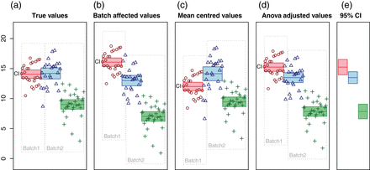
Fig. 1. We simulated expression of one gene from three study groups unevenly distributed in two batches, designed to ...
Notes:
Fig. 1. We simulated expression of one gene from three study groups unevenly distributed in two batches, designed to illustrate the spurious effects that may arise from different batch adjustments. The Y-axis represents the expression values, while the X-axis is used to visually separate the groups and batches. Circles, triangles, and crosses indicate values from each of the three groups. Surrounding boxes indicate batches. For each group, the filled bar indicates mean and its 95% confidence interval, which give some indication as to which group differences would be found significant. (a) The “true values” measured in a system without batch effects. The first two groups are drawn from normal distributions with the same mean and variance, while the third has a lower mean. (b) Batch effects have been added to the “true values”, as indicated by the shifting of the batch frames, leading to apparent differences between the first two groups. (c) The measurements in (b) are adjusted by mean-centering each batch. All groups appear significantly different. (d) The measurements in (b) are adjusted with two-way ANOVA-based batch centering (using limma). Again, all groups appear to be significantly different. (e) The least squares estimates of the group means from a two-way ANOVA have the same means as in (d), but more appropriate confidence intervals.
Unless provided in the caption above, the following copyright applies to the content of this slide: © The Author 2015. Published by Oxford University Press.This is an Open Access article distributed under the terms of the Creative Commons Attribution License (http://creativecommons.org/licenses/by/4.0/), which permits unrestricted reuse, distribution, and reproduction in any medium, provided the original work is properly cited.

Slide 2
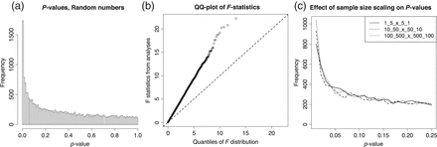
Fig. 2. This is a sanity check where the use of ComBat with a covariate fails, adapted from the user guide in the sva ...
Notes:
Fig. 2. This is a sanity check where the use of ComBat with a covariate fails, adapted from the user guide in the sva package. Real data are substituted with random numbers from a normal distribution, but the batch–group design is retained. ComBat is applied, followed by an F-test. (a) p-Value distribution; (b) QQ plot of the F-statistics; (c) p-value distributions for 3 equally unbalanced random number experiments with different sample sizes, 12 120 and 1200 samples from two study groups with a 1:5 and 5:1 distribution in two batches, respectively. A random batch effect is added for 10% of the 20 000 genes. This example is not from the sva package.
Unless provided in the caption above, the following copyright applies to the content of this slide: © The Author 2015. Published by Oxford University Press.This is an Open Access article distributed under the terms of the Creative Commons Attribution License (http://creativecommons.org/licenses/by/4.0/), which permits unrestricted reuse, distribution, and reproduction in any medium, provided the original work is properly cited.

Slide 3
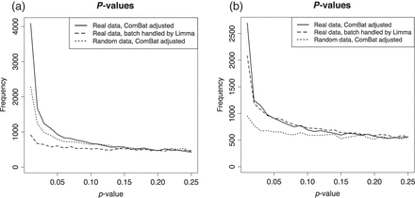
Fig. 3. Three analyses of two published data sets where batch effects were adjusted for with ComBat. First, analyzed ...
Notes:
Fig. 3. Three analyses of two published data sets where batch effects were adjusted for with ComBat. First, analyzed as described on the real data using ComBat. Secondly, with ComBat, but with random numbers instead of real data. Thirdly, instead of ComBat, analyses of the real data with limma blocking by batch. (a) Reanalysis of Towfic and others (2014), glatiramer acetate vs. generic, and (b) reanalysis of “Data set 2” (Johnson and others, 2007), TAL1 inhibition vs. control.
Unless provided in the caption above, the following copyright applies to the content of this slide: © The Author 2015. Published by Oxford University Press.This is an Open Access article distributed under the terms of the Creative Commons Attribution License (http://creativecommons.org/licenses/by/4.0/), which permits unrestricted reuse, distribution, and reproduction in any medium, provided the original work is properly cited.

