Slide 1
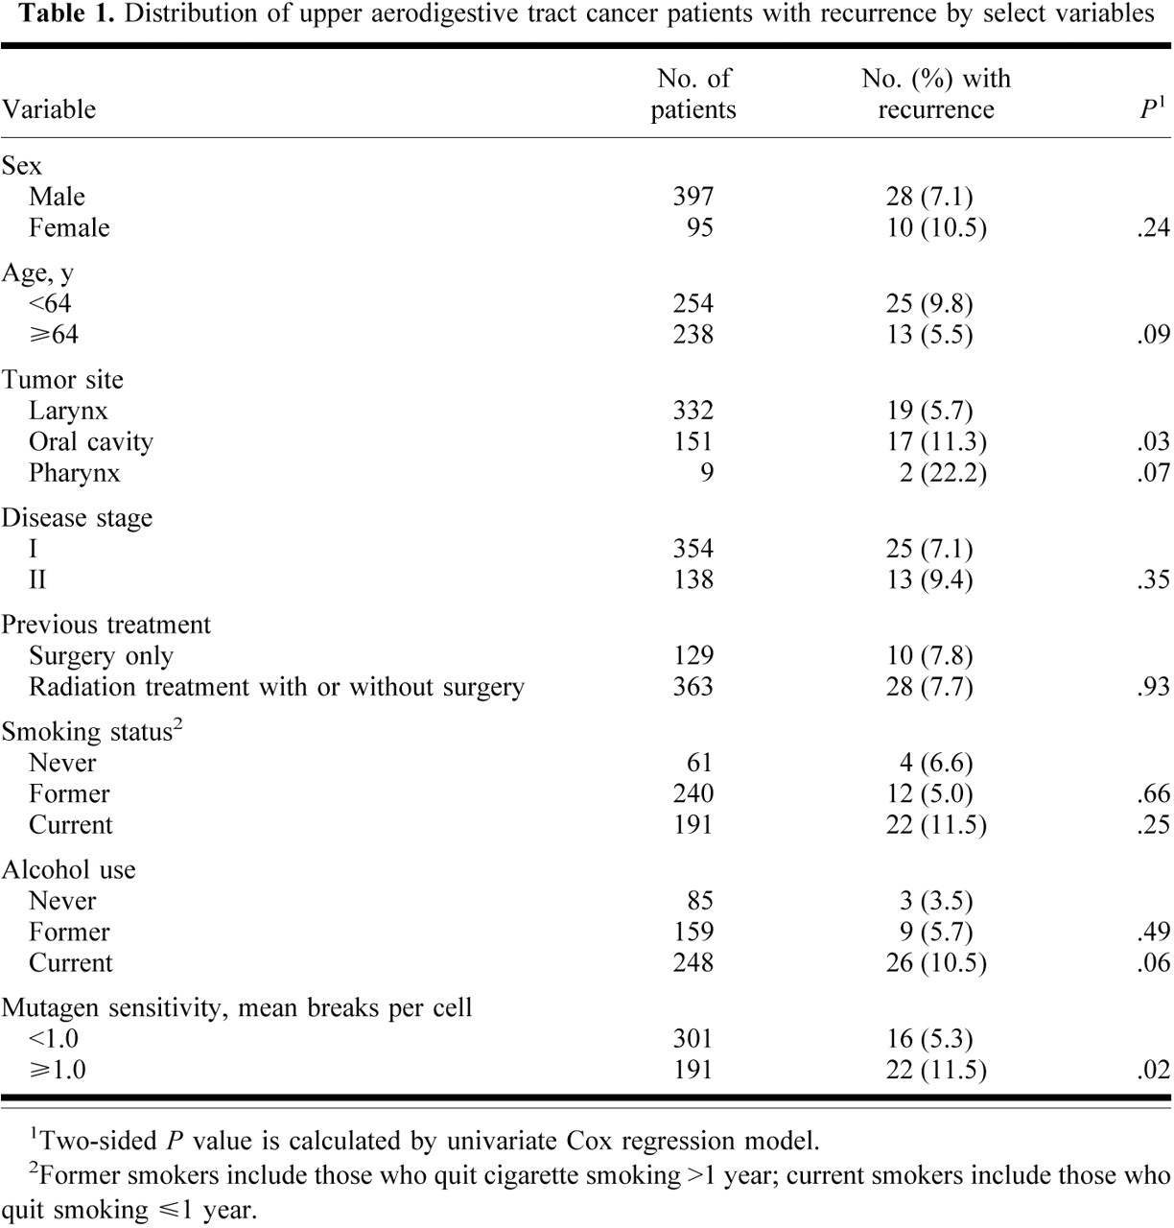
Notes:
Unless provided in the caption above, the following copyright applies to the content of this slide: © Oxford University Press

Slide 2
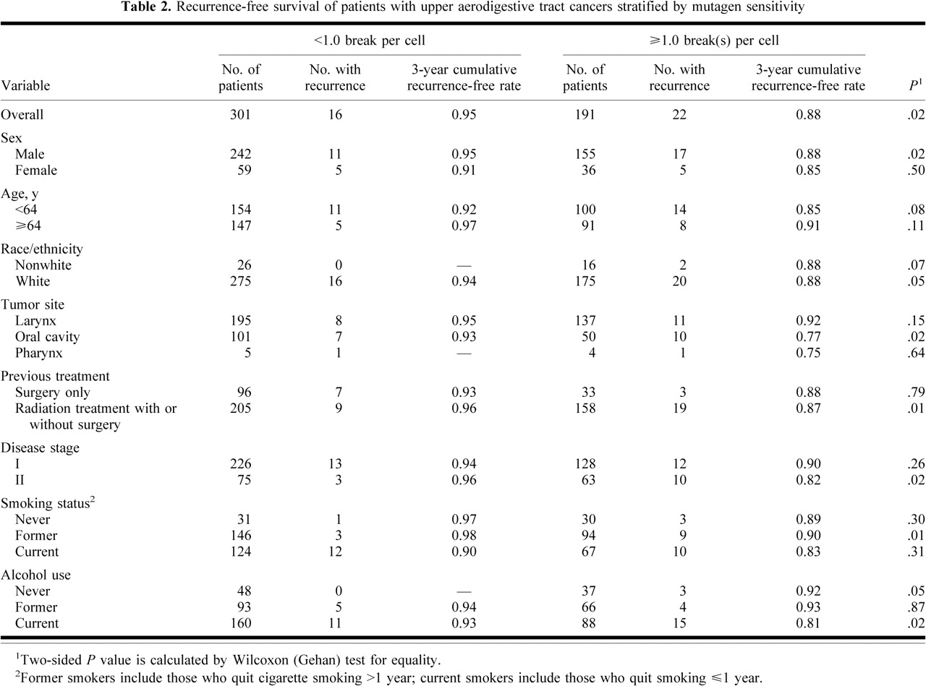
Notes:
Unless provided in the caption above, the following copyright applies to the content of this slide: © Oxford University Press

