Slide 1
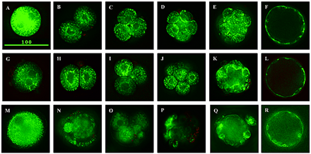
Figure 1. Representative images of mouse and human embryos stained with JC‐1 (A–F). In vivo fertilized mouse ...
Notes:
Figure 1. Representative images of mouse and human embryos stained with JC‐1 (A–F). In vivo fertilized mouse embryos: (A) zygote, (B) 2‐cell, (C) 4‐cell, (D) 8‐cell, (E) compacted morula and (F) blastocyst. (G–L) In vitro fertilized mouse embryos: (G) zygote, (H) 2‐cell, (I) 4‐cell, (J) 8‐cell, (K) compacted morula and (L) blastocyst. (M–R) Human embryos donated to research: (M) pronuclear, (N) 2‐cell, (O) 5‐cell, (P) 8‐cell, (Q) compacted morula and (R) blastocyst.
Unless provided in the caption above, the following copyright applies to the content of this slide: European Society of Human Reproduction and Embryology

Slide 2
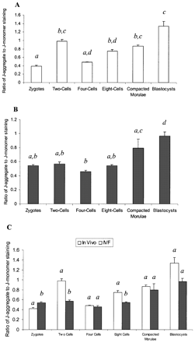
Figure 2. Ratio of JC‐1 staining during mouse preimplantation development. (A) In vivo fertilized embryos. ...
Notes:
Figure 2. Ratio of JC‐1 staining during mouse preimplantation development. (A) In vivo fertilized embryos. (B) In vitro fertilized embryos. (C) Direct comparison of JC‐1 staining in in vitro and in vivo fertilized embryos at the specific preimplantation stages of development. Above ratios were computed through obtaining a ratio of J‐aggregate to J‐monomer staining for each individual embryo section, averaged per embryo and then averaged among embryos from the same stage of development. Bars represent the mean ± SEM of individual embryos. Within each graph, data with different letters indicate a statistically significant difference (P < 0.05) by Kruskal–Wallis ANOVA on ranks followed by Dunn’s test, except in (C) where data were compared within and not between the same embryonic stage.
Unless provided in the caption above, the following copyright applies to the content of this slide: European Society of Human Reproduction and Embryology

Slide 3
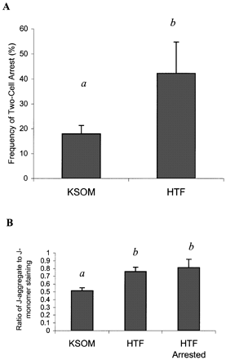
Figure 3.In vitro arrest experiment. (A) Incidence of in vitro arrest for ICR 2‐cells in potassium‐enriched ...
Notes:
Figure 3.In vitro arrest experiment. (A) Incidence of in vitro arrest for ICR 2‐cells in potassium‐enriched synthetic oviductal medium (KSOM) and human tubal fluid (HTF) media. Bars represent the mean ± SEM of in vitro arrest. Within the graph, data with different letters indicate a statistically significant difference (P < 0.05) by χ2 analysis. (B) Ratio of JC‐1 staining of 2‐cell embryos in KSOM and HTF, and arrested 2‐cell embryos in HTF. Above ratios were computed through obtaining a ratio of J‐aggregate to J‐monomer staining for each individual embryo section, averaged per embryo and then averaged among embryos from the same stage of development. Bars represent the mean ± SEM of individual embryos. Within each graph, data with different letters indicate a statistically significant difference (P < 0.05) by Kruskal–Wallis ANOVA on ranks followed by Dunn’s test.
Unless provided in the caption above, the following copyright applies to the content of this slide: European Society of Human Reproduction and Embryology

Slide 4
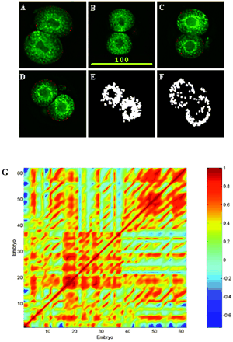
Figure 4. Qualitative and quantitative analysis of mitochondrial distribution in 2‐cell embryos using JC‐1 ...
Notes:
Figure 4. Qualitative and quantitative analysis of mitochondrial distribution in 2‐cell embryos using JC‐1 staining. (A) Potassium‐enriched synthetic oviductal medium (KSOM) cultured 2‐cell embryo, (B) human tubal fluid (HTF) cultured 2‐cell embryo, (C) HTF cultured arrested 2‐cell embryo, (D) HTF cultured arrested 2‐cell embryo from which images (E) and (F) were extracted. (E) Computer analysis of mitochondrial distribution from the fluorescein isothiocyanate channel for embryo (D). (F) Computer analysis of mitochondrial distribution from the rhodamine isothiocyanate channel for embryo (D). (G) Pseudocolour representation of a correlation matrix, showing a relationship between JC‐1 staining in the KSOM, HTF and HTF arrested 2‐cell embryos. Embryos 1–20 are HTF cultured, 21–39 are HTF arrested, and 40–61 are KSOM cultured. The colour map corresponds to the scale of correlation coefficients; non‐correlated data display a coefficient of zero (light blue), negative correlation dark blue, and positive correlation ranging from yellow to red. The diagonal of the symmetric correlation matrix represents self‐correlation and thus is equal to 1 (dark red).
Unless provided in the caption above, the following copyright applies to the content of this slide: European Society of Human Reproduction and Embryology

Slide 5
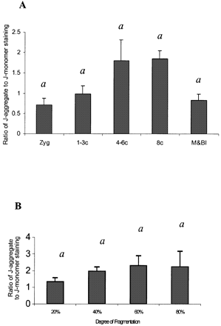
Figure 5. Analysis of human embryos. (A) Ratio of JC‐1 staining at the human preimplantation stages of ...
Notes:
Figure 5. Analysis of human embryos. (A) Ratio of JC‐1 staining at the human preimplantation stages of development. (B) Ratio of JC‐1 staining in human 8‐cell embryos broken down by degree of fragmentation. Above ratios were computed through obtaining a ratio of J‐aggregate to J‐monomer staining for each individual embryo section, averaged per embryo and then averaged among embryos from the same stage of development. Bars represent the mean ± SEM of individual embryos. Each data set was tested for significance using the Kruskal–Wallis ANOVA on ranks followed by Dunn’s test; there were no significant differences between the groups.
Unless provided in the caption above, the following copyright applies to the content of this slide: European Society of Human Reproduction and Embryology

