Slide 1
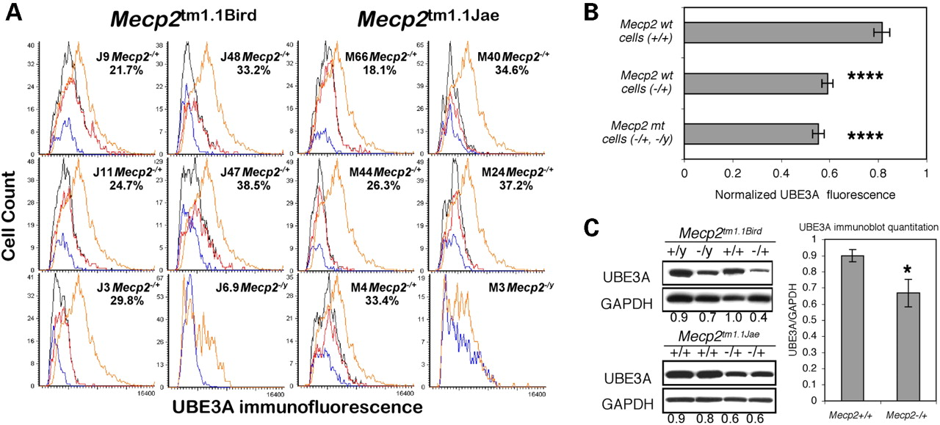
Figure 1. UBE3A expression in Mecp2 -null mouse brain. ( A ) A multiple tissue microarray containing wt and ...
Notes:
Figure 1. UBE3A expression in Mecp2 -null mouse brain. ( A ) A multiple tissue microarray containing wt and knock-out mouse cerebral cortex samples ( 16 ) was stained for immunofluorescence using a C-terminal reactive anti-MeCP2 and an anti-UBE3A antibody. The MeCP2-negative cells ( Mecp2 mt-expressing, blue histograms, percentage shown) were separately gated from MeCP2-positive cells ( Mecp2 wt-expressing, red histograms) and the total population (black histograms) and compared with age-matched wt control female or male samples (orange histograms). ( B ) The graph shows combined LSC results (mean±SEM) from four replicate slides using two different anti-UBE3A antibodies. ( C ) Protein extracts from whole adult mouse brain were probed on an immunoblot with anti-UBE3A or anti-GAPDH. A representative image shows lower expression in brain of UBE3A in both hemizygous male (−/y) and heterozygous female (−/+) brain compared with wild-type (wt, +/y and +/+) littermate controls for both Mecp2tm1.1Bird and Mecp2tm1.1Jae strains. The graph demonstrates combined GAPDH-normalized results (mean±SEM, quantitation as previously described ( 32 ), example ratios shown below each lane) from eight different −/+ and six different +/+ brain samples from Mecp2tm1.1Bird and Mecp2tm1.1Jae strains. * P <0.05, **** P <0.0001 by t -test.
Unless provided in the caption above, the following copyright applies to the content of this slide: Human Molecular Genetics, Vol. 14, No. 4 © Oxford University Press 2005; all rights reserved

Slide 2
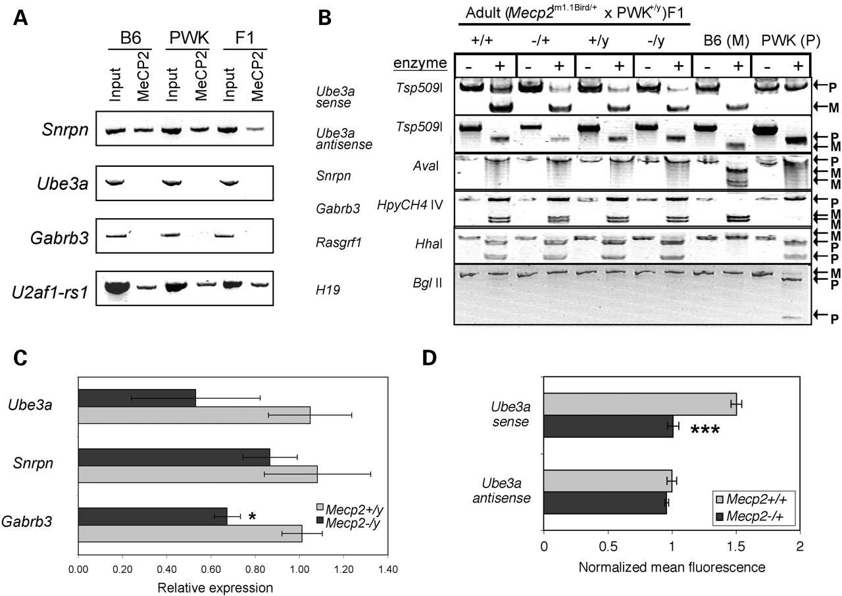
Figure 2. Imprinting and transcriptional analyses in mouse brain. ( A ) Chromatin from adult mouse cerebrum ...
Notes:
Figure 2. Imprinting and transcriptional analyses in mouse brain. ( A ) Chromatin from adult mouse cerebrum samples [C57B6, PWK or (B6×PWK)F1] was isolated for ChIP. Anti-MeCP2 (C-terminal) was used to immunoprecipitate DNA fragments from ‘Input’ control. Ube3a and Gabrb3 promoters were not detected in the anti-MeCP2 precipitated chromatin, in contrast to the Snrpn promoter sequences that showed association with MeCP2. U2af1-rs1 was a positive control for a promoter previously demonstrated to bind MeCP2 in brain ( 34 ). ( B ) Mecp2tm1.1Bird/+ (B6) females were crossed with wt PWK males to obtain F1 mice heterozygous for single nucleotide polymorphisms in the coding regions of several imprinted genes. RT–PCR followed by restriction enzyme digestion (+) was performed on RNA from adult brain samples of all Mecp2 genotypes as well as parental B6 and PWK samples (P, paternal; M, maternal). As reported previously for wt (B6×PWK)F1 brain ( 67 ), Ube3a sense exhibited preferential maternal expression, Ube3a antisense and Snrpn were exclusively paternal and Gabrb3 was biallelic, with no significant effect of Mecp2 genotype on these imprints. In addition, Rasgrf1 showed preferential paternal expression ( 68 ), whereas H19 showed exclusive maternal expression ( 70 ) in all samples. Results are representative of adult and neonatal F1 brain samples. ( C ) TaqMan PCR was used to quantitatively determine expression levels of Ube3a, Snrpn and Gabrb3 in 10-week-old Mecp2−/y and Mecp2+/y brain RNA. Primers spanned intron/exon boundaries and are specific to the Ube3a sense transcript. Results shown are for the average ±SEM of four experimental replicates of two mice per genotype. Although Ube3a and Gabrb3 showed consistently lower expression in Mecp2 -deficient brain compared with controls, Snrpn was not significantly changed. ( D ) Sense and antisense transcripts of Ube3a were detected by fluorescence in situ hybridization using single stranded riboprobes and quantitated by LSC as described previously ( 16 ). Results (mean±SEM of 3 wt and 10 Mecp2−/+ samples) were normalized to control β-actin probe. * P <0.05, *** P <0.001 by t -test.
Unless provided in the caption above, the following copyright applies to the content of this slide: Human Molecular Genetics, Vol. 14, No. 4 © Oxford University Press 2005; all rights reserved

Slide 3
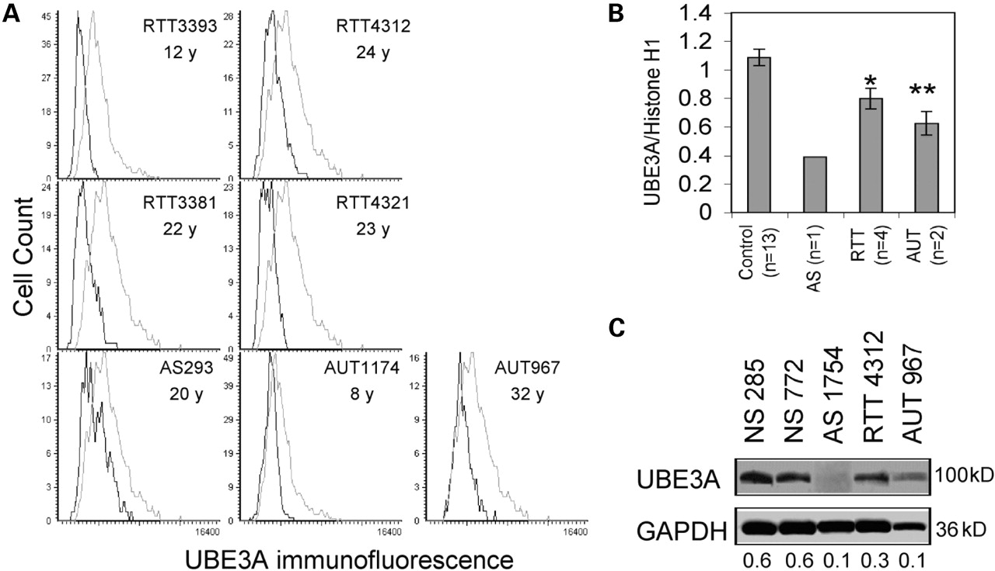
Figure 3. Quantitation of UBE3A expression in Rett, Angelman and autism brain samples. ( A ) The human tissue ...
Notes:
Figure 3. Quantitation of UBE3A expression in Rett, Angelman and autism brain samples. ( A ) The human tissue microarray previously described ( 16 ) containing frontal cortex layers III–V from Brodman area (BA9) was analyzed for UBE3A expression by LSC. Histograms show lower expression of patient samples (black) from Rett (RTT), Angelman (AS) and autism (AUT) compared with age-matched controls (gray). ( B ) UBE3A immunofluorescence values were normalized to those of control histone H1 and the results of four replicate slides using two different anti-UBE3A antibodies (Affinity Bioreagents and BD Biosciences) were averaged (mean±SEM) for each brain sample shown in (A) ( n , number of different samples). ( C ) Immunoblot analysis of UBE3A expression (anti-UBE3A, Affinity, recognizing all known isoforms) confirmed decreased expression in AS, RTT and AUT compared with controls (UBE3A/GAPDH ratios are shown). * P <0.05, ** P <0.01 by t -test.
Unless provided in the caption above, the following copyright applies to the content of this slide: Human Molecular Genetics, Vol. 14, No. 4 © Oxford University Press 2005; all rights reserved

Slide 4
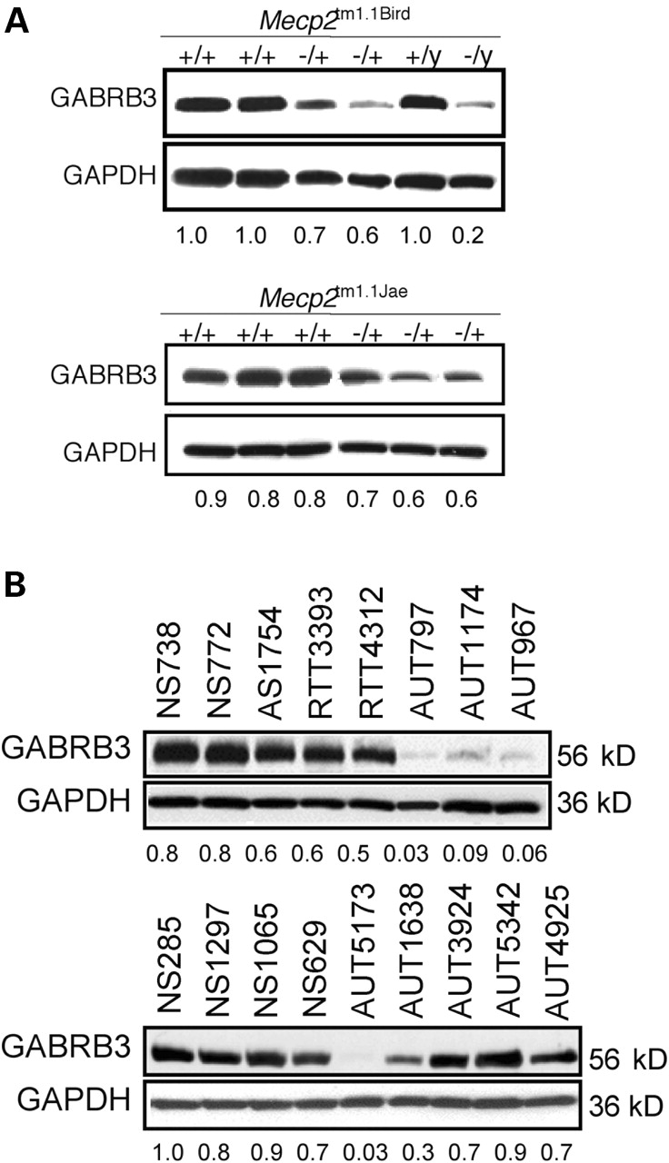
Figure 4. Analysis of GABRB3 expression in mouse and human brain. ( A ) Immunoblot analysis of GABRB3 ...
Notes:
Figure 4. Analysis of GABRB3 expression in mouse and human brain. ( A ) Immunoblot analysis of GABRB3 expression (anti-GABRB3, Affinity Bioreagents, recognizing all known isoforms) shows lower expression in Mecp2−/+ and Mecp2−/y adult mouse brain compared with controls. Combined GAPDH-normalized results from eight different Mecp2−/+ and six different Mecp2+/+ adult brain samples from Mecp2tm1.1Bird and Mecp2tm1.1Jae strains were significantly lower than wild-type controls ( P <0.01). ( B ) Representative immunoblot analyses of GABRB3 and GAPDH in AS, RTT, autism and control (NS) cerebral samples with GABRB3/GAPDH ratios shown. Replicate immunoblot results for all samples and significance tests are shown in Table 1 . Additional information about postmortem brain samples used in these studies is provided online (Supplementary Material, Table S1).
Unless provided in the caption above, the following copyright applies to the content of this slide: Human Molecular Genetics, Vol. 14, No. 4 © Oxford University Press 2005; all rights reserved

