Slide 1
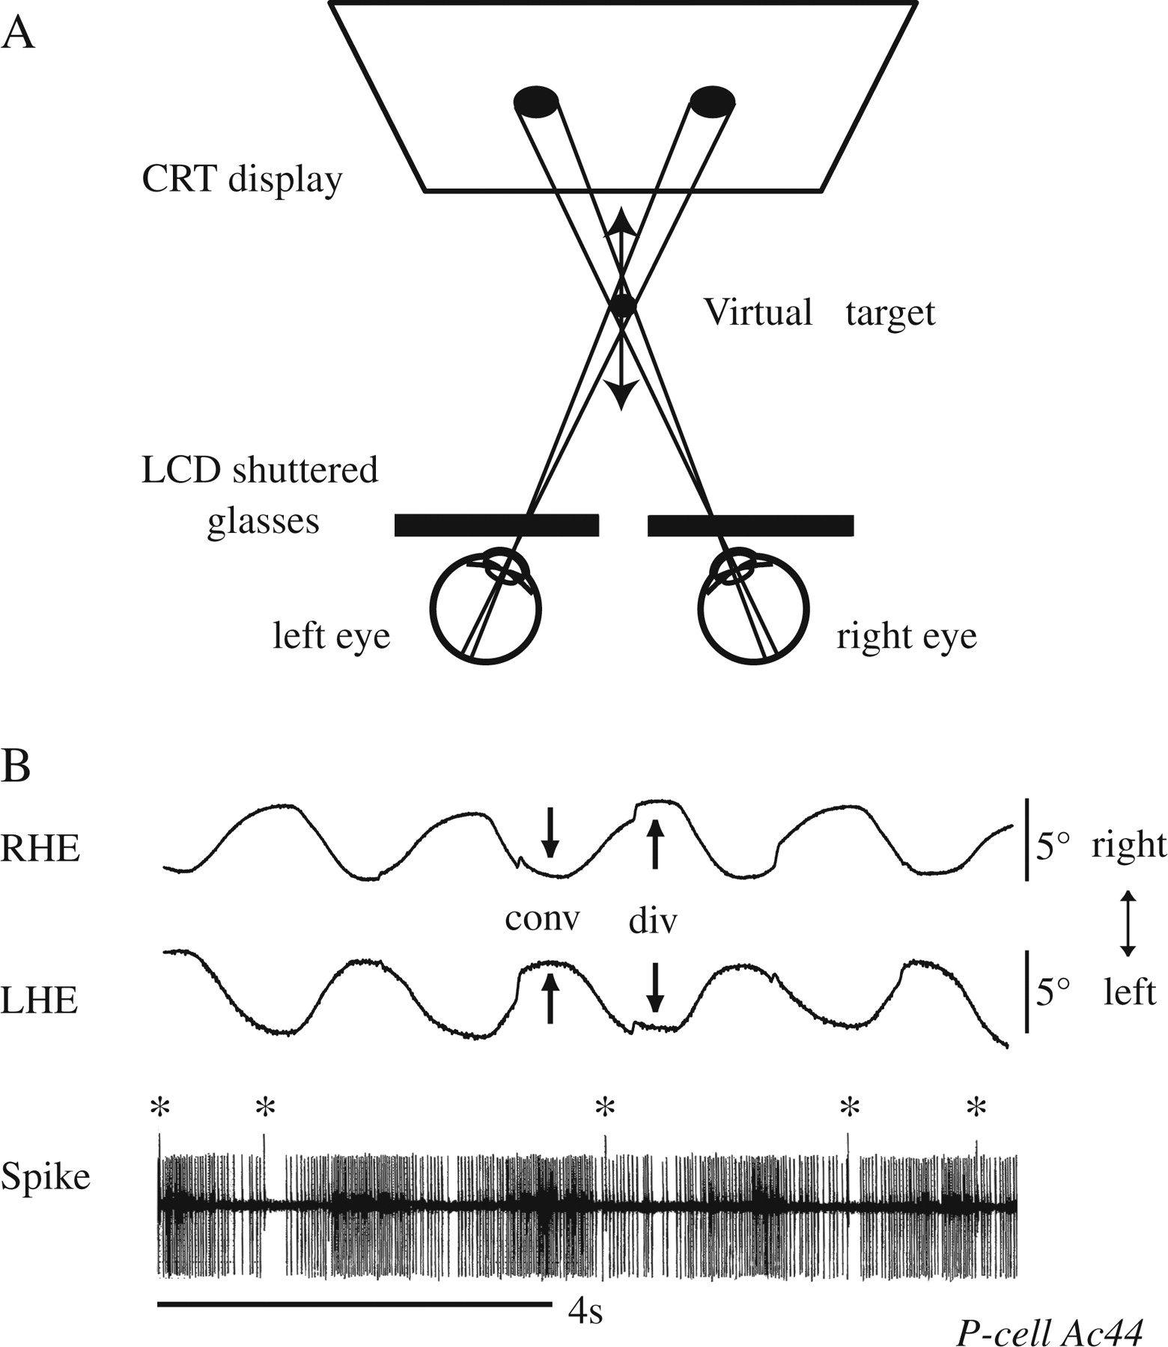
Figure 1. Methods for presentation of a stereo target and representative discharge of a vergence-related P-cell. (A) ...
Notes:
Figure 1. Methods for presentation of a stereo target and representative discharge of a vergence-related P-cell. (A) Schematic illustration of stereo target presentation. The virtual target was generated from 2 alternating images viewed by the left and right eyes through polarization shutter glasses that were switched at 120 Hz. (B) Simple spike activity of a P-cell during vergence pursuit. Asterisks on spike trace indicate complex spikes. Conv and div arrows indicate convergence and divergence eye movements, respectively.
Unless provided in the caption above, the following copyright applies to the content of this slide: © 2007 The AuthorsThis is an Open Access article distributed under the terms of the Creative Commons Attribution Non-Commercial License (http://creativecommons.org/licenses/by-nc/2.0/uk/) which permits unrestricted non-commercial use, distribution, and reproduction in any medium, provided the original work is properly cited.

Slide 2
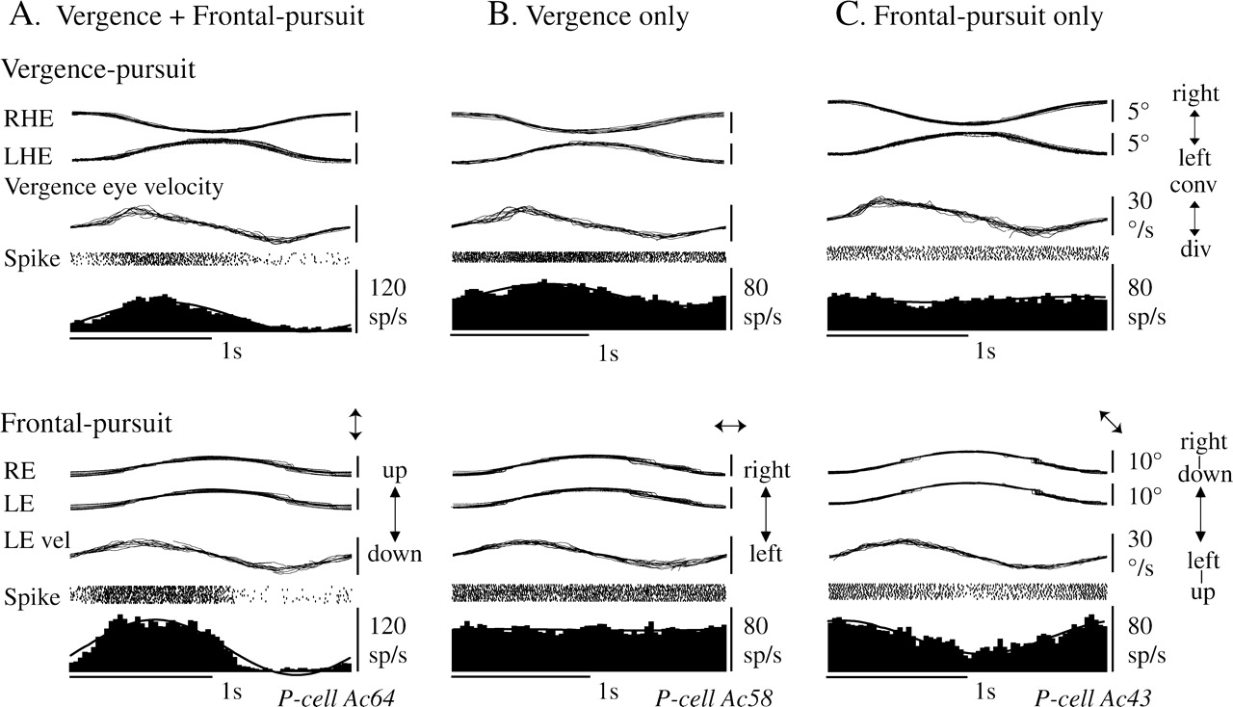
Figure 2. Representative discharge of 3 types of vermal-pursuit P-cells. All analog traces were superimposed to show ...
Notes:
Figure 2. Representative discharge of 3 types of vermal-pursuit P-cells. All analog traces were superimposed to show eye movements during vergence pursuit and frontal pursuit. The bottom 2 traces in each panel are spike rasters and histograms with superimposed fitted sine curves. During frontal pursuit, eye position, velocity traces, and P-cell discharge are shown for preferred (A, C) or tested (B) directions as indicated at upper right corner of each panel. LE vel indicates left eye velocity.
Unless provided in the caption above, the following copyright applies to the content of this slide: © 2007 The AuthorsThis is an Open Access article distributed under the terms of the Creative Commons Attribution Non-Commercial License (http://creativecommons.org/licenses/by-nc/2.0/uk/) which permits unrestricted non-commercial use, distribution, and reproduction in any medium, provided the original work is properly cited.

Slide 3
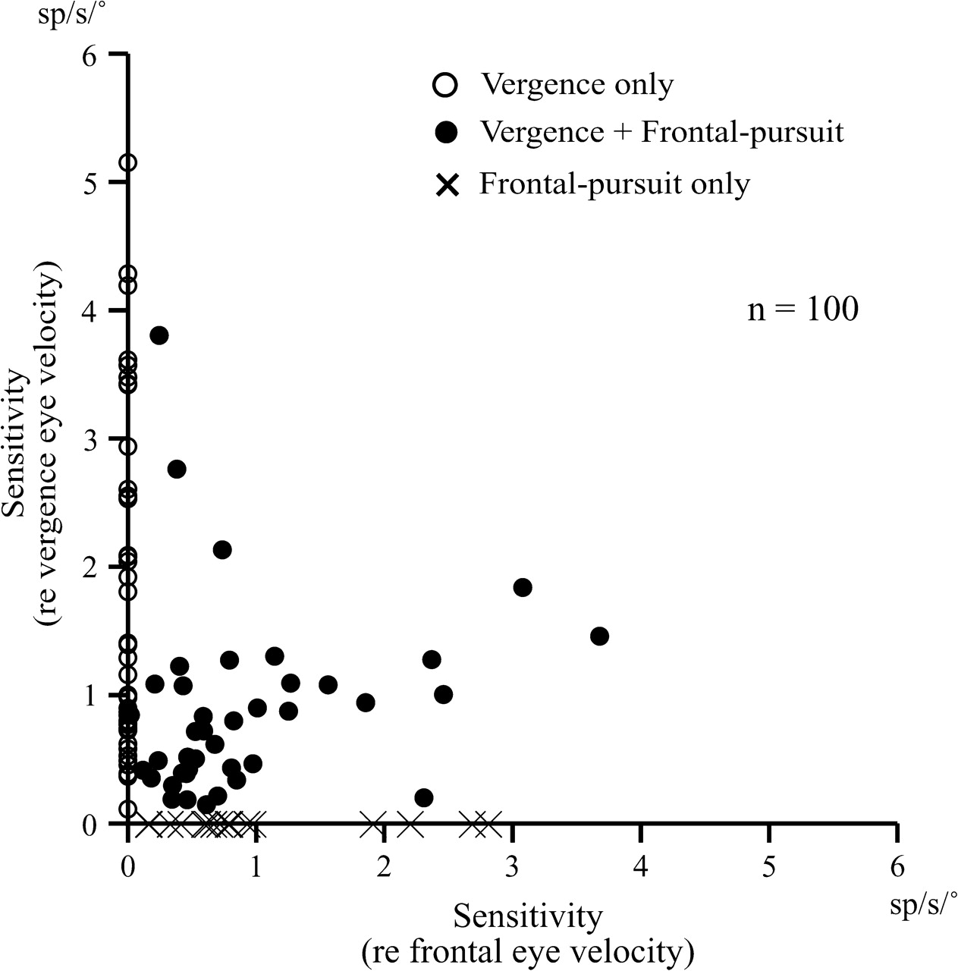
Figure 3. Comparison of vergence and frontal-pursuit eye velocity sensitivity of vermal-pursuit P-cells. Vergence eye ...
Notes:
Figure 3. Comparison of vergence and frontal-pursuit eye velocity sensitivity of vermal-pursuit P-cells. Vergence eye velocity sensitivity of 100 P-cells is plotted against frontal-pursuit eye velocity sensitivity. Sensitivity was calculated from P-cell modulation during sinusoidal pursuit at 0.5 Hz. Sensitivity of P-cell that did not show significant modulation was plotted as zero.
Unless provided in the caption above, the following copyright applies to the content of this slide: © 2007 The AuthorsThis is an Open Access article distributed under the terms of the Creative Commons Attribution Non-Commercial License (http://creativecommons.org/licenses/by-nc/2.0/uk/) which permits unrestricted non-commercial use, distribution, and reproduction in any medium, provided the original work is properly cited.

Slide 4
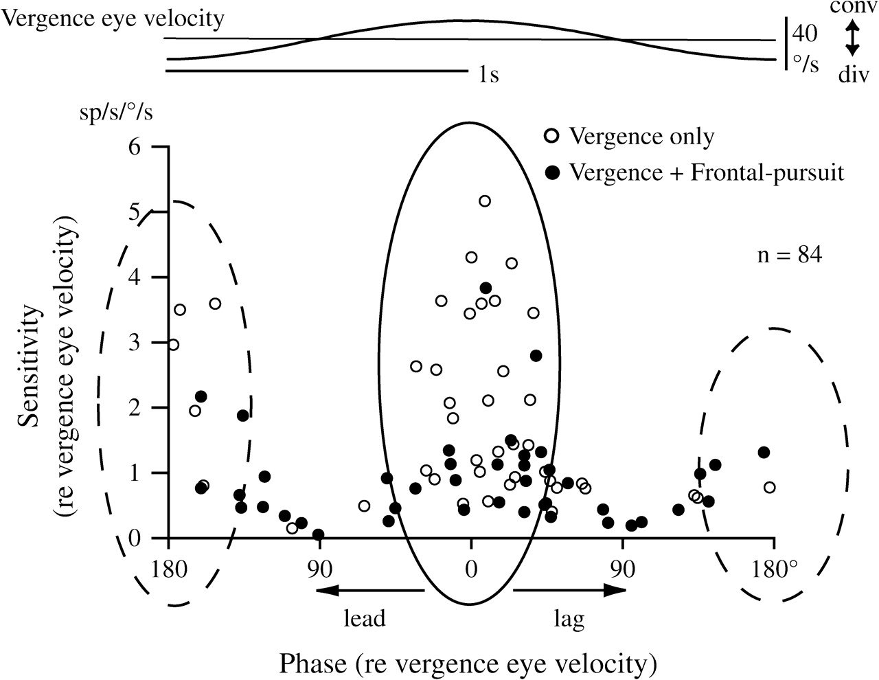
Figure 4. Response phase and sensitivity of vergence-related vermal P-cells during vergence pursuit. Sensitivity of ...
Notes:
Figure 4. Response phase and sensitivity of vergence-related vermal P-cells during vergence pursuit. Sensitivity of individual vergence-related P-cells was plotted against response phase (re peak convergence eye velocity) during sinusoidal vergence pursuit at 0.5 Hz (±5°). Ideal vergence eye velocity trace is shown above. Points around phase 0° (within solid oval) indicate that peak discharge of these P-cells was seen around peak convergence eye velocity. Points around phase 180° (within broken ovals) indicate that peak discharge of these P-cells was seen around peak divergence eye velocity. Open circles indicate P-cells that responded only during vergence pursuit. Filled circles indicate P-cells that responded to both frontal pursuit and vergence pursuit.
Unless provided in the caption above, the following copyright applies to the content of this slide: © 2007 The AuthorsThis is an Open Access article distributed under the terms of the Creative Commons Attribution Non-Commercial License (http://creativecommons.org/licenses/by-nc/2.0/uk/) which permits unrestricted non-commercial use, distribution, and reproduction in any medium, provided the original work is properly cited.

Slide 5
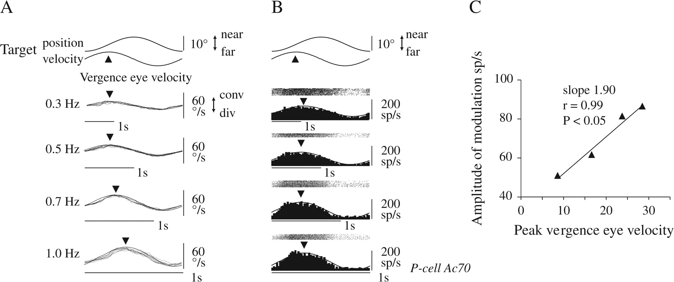
Figure 5. Vergence eye velocity sensitivity. (A, B) Representative discharge of a vermal P-cell (B) and simultaneously ...
Notes:
Figure 5. Vergence eye velocity sensitivity. (A, B) Representative discharge of a vermal P-cell (B) and simultaneously recorded vergence eye velocity traces with fitted sine curves at 0.3–1.0 Hz (±5°, A). (C) Amplitude of discharge modulation of this P-cell plotted against peak vergence eye velocity.
Unless provided in the caption above, the following copyright applies to the content of this slide: © 2007 The AuthorsThis is an Open Access article distributed under the terms of the Creative Commons Attribution Non-Commercial License (http://creativecommons.org/licenses/by-nc/2.0/uk/) which permits unrestricted non-commercial use, distribution, and reproduction in any medium, provided the original work is properly cited.

Slide 6
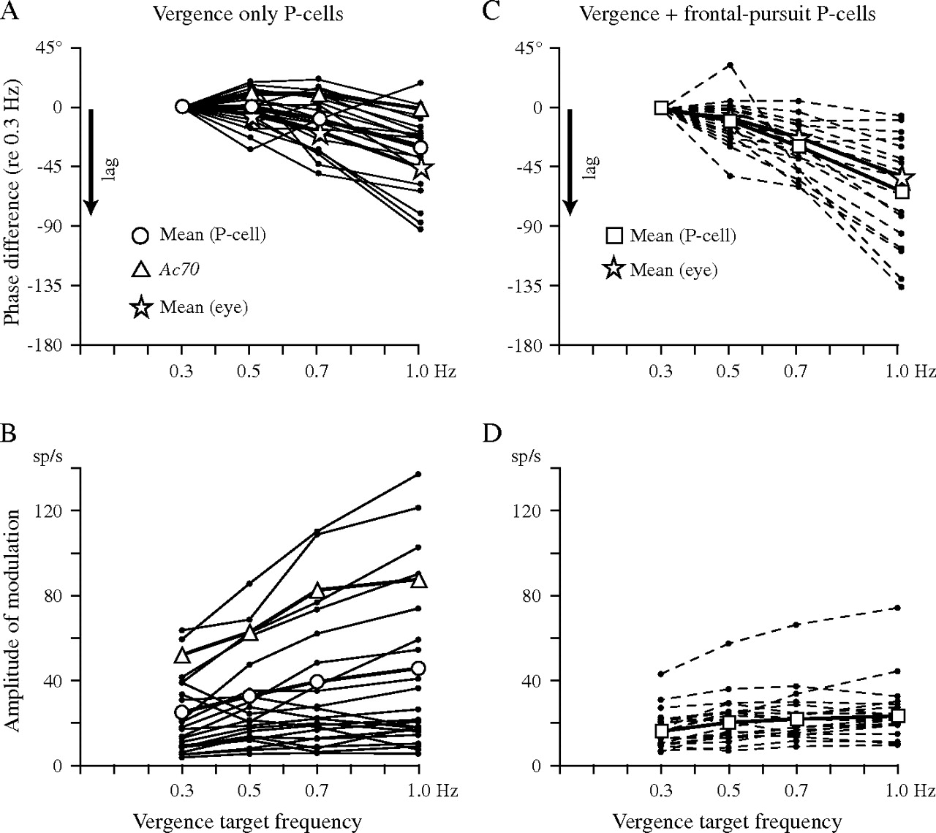
Figure 6. Frequency response of vergence eye velocity and P-cell responses during vergence pursuit at 0.3–1.0 Hz (±5°). ...
Notes:
Figure 6. Frequency response of vergence eye velocity and P-cell responses during vergence pursuit at 0.3–1.0 Hz (±5°). (A, B) Phase shift (re value at 0.3 Hz) and peak vergence eye velocity plotted against vergence target frequency. (C, D) Phase shift (re value at 0.3 Hz) and amplitude of modulation of P-cells against target frequency. Responses of individual P-cells are connected by lines.
Unless provided in the caption above, the following copyright applies to the content of this slide: © 2007 The AuthorsThis is an Open Access article distributed under the terms of the Creative Commons Attribution Non-Commercial License (http://creativecommons.org/licenses/by-nc/2.0/uk/) which permits unrestricted non-commercial use, distribution, and reproduction in any medium, provided the original work is properly cited.

Slide 7
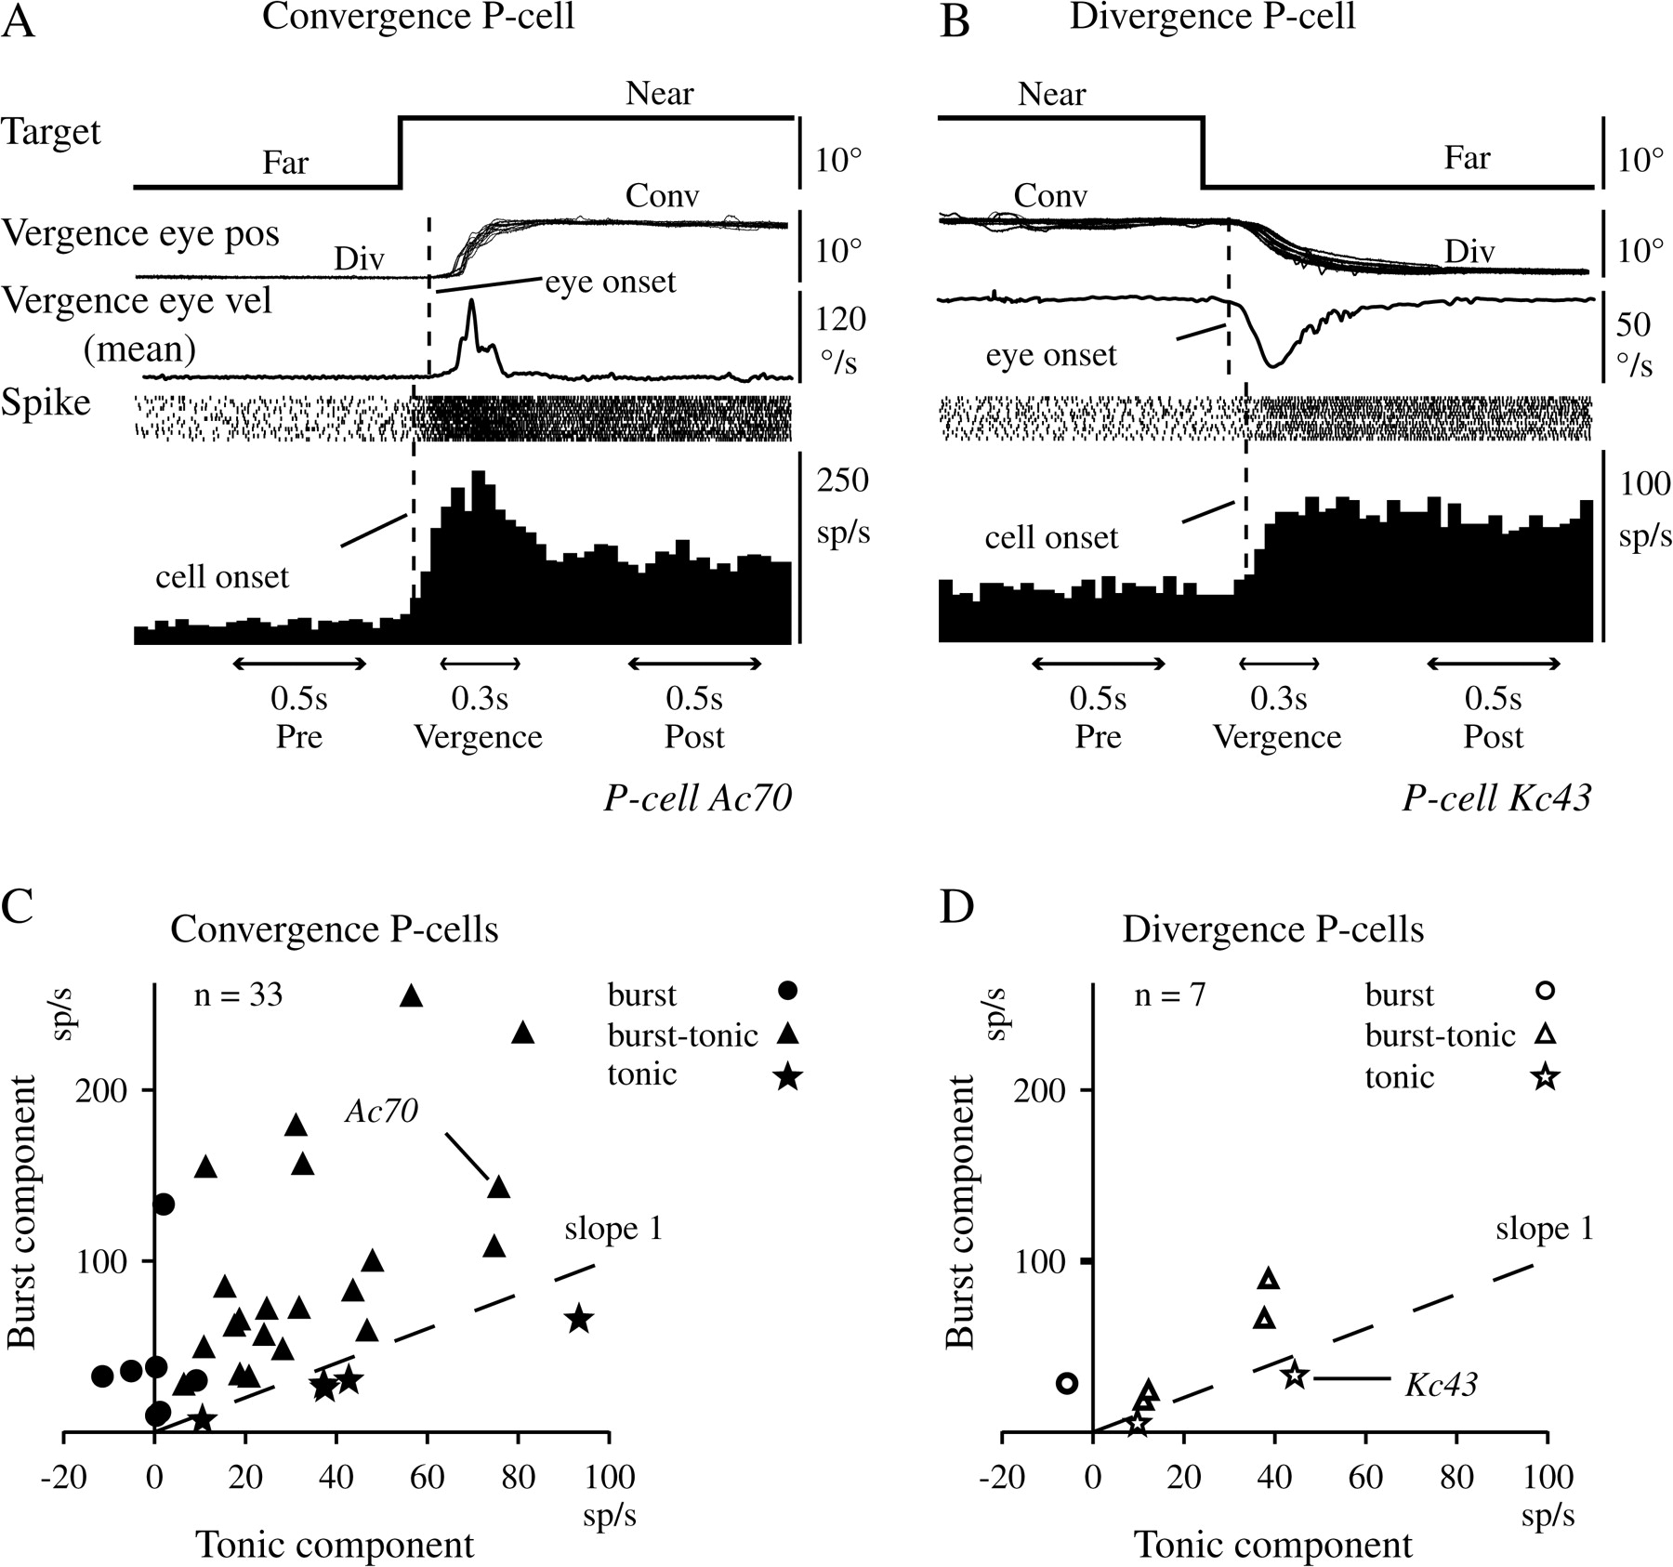
Figure 7. Discharge characteristics of vermal P-cells during vergence pursuit to step target motion-in-depth. (A, B) ...
Notes:
Figure 7. Discharge characteristics of vermal P-cells during vergence pursuit to step target motion-in-depth. (A, B) Discharge of a convergence P-cell (A) and a divergence P-cell (B). (C, D) Burst components plotted against tonic components for 33 convergence P-cells (C) and 7 divergence P-cells (D). In (C) and (D), some burst P-cells showed tonic components with negative values because these P-cells exhibited slightly lower tonic rates after the burst discharge.
Unless provided in the caption above, the following copyright applies to the content of this slide: © 2007 The AuthorsThis is an Open Access article distributed under the terms of the Creative Commons Attribution Non-Commercial License (http://creativecommons.org/licenses/by-nc/2.0/uk/) which permits unrestricted non-commercial use, distribution, and reproduction in any medium, provided the original work is properly cited.

Slide 8
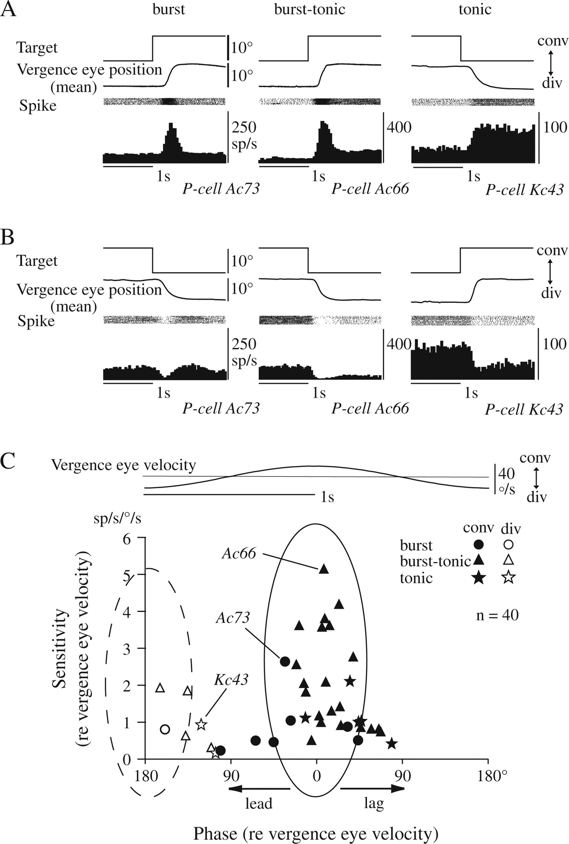
Figure 8. Discharge characteristics of vermal P-cells during vergence step and comparison with modulation during ...
Notes:
Figure 8. Discharge characteristics of vermal P-cells during vergence step and comparison with modulation during sinusoidal pursuit. (A, B) Representative discharge of burst, burst tonic, and tonic P-cells during on-direction (A) and off-direction vergence step (B). (C) Response phase and sensitivity of convergence and divergence P-cells with the 3 response types (inset).
Unless provided in the caption above, the following copyright applies to the content of this slide: © 2007 The AuthorsThis is an Open Access article distributed under the terms of the Creative Commons Attribution Non-Commercial License (http://creativecommons.org/licenses/by-nc/2.0/uk/) which permits unrestricted non-commercial use, distribution, and reproduction in any medium, provided the original work is properly cited.

Slide 9
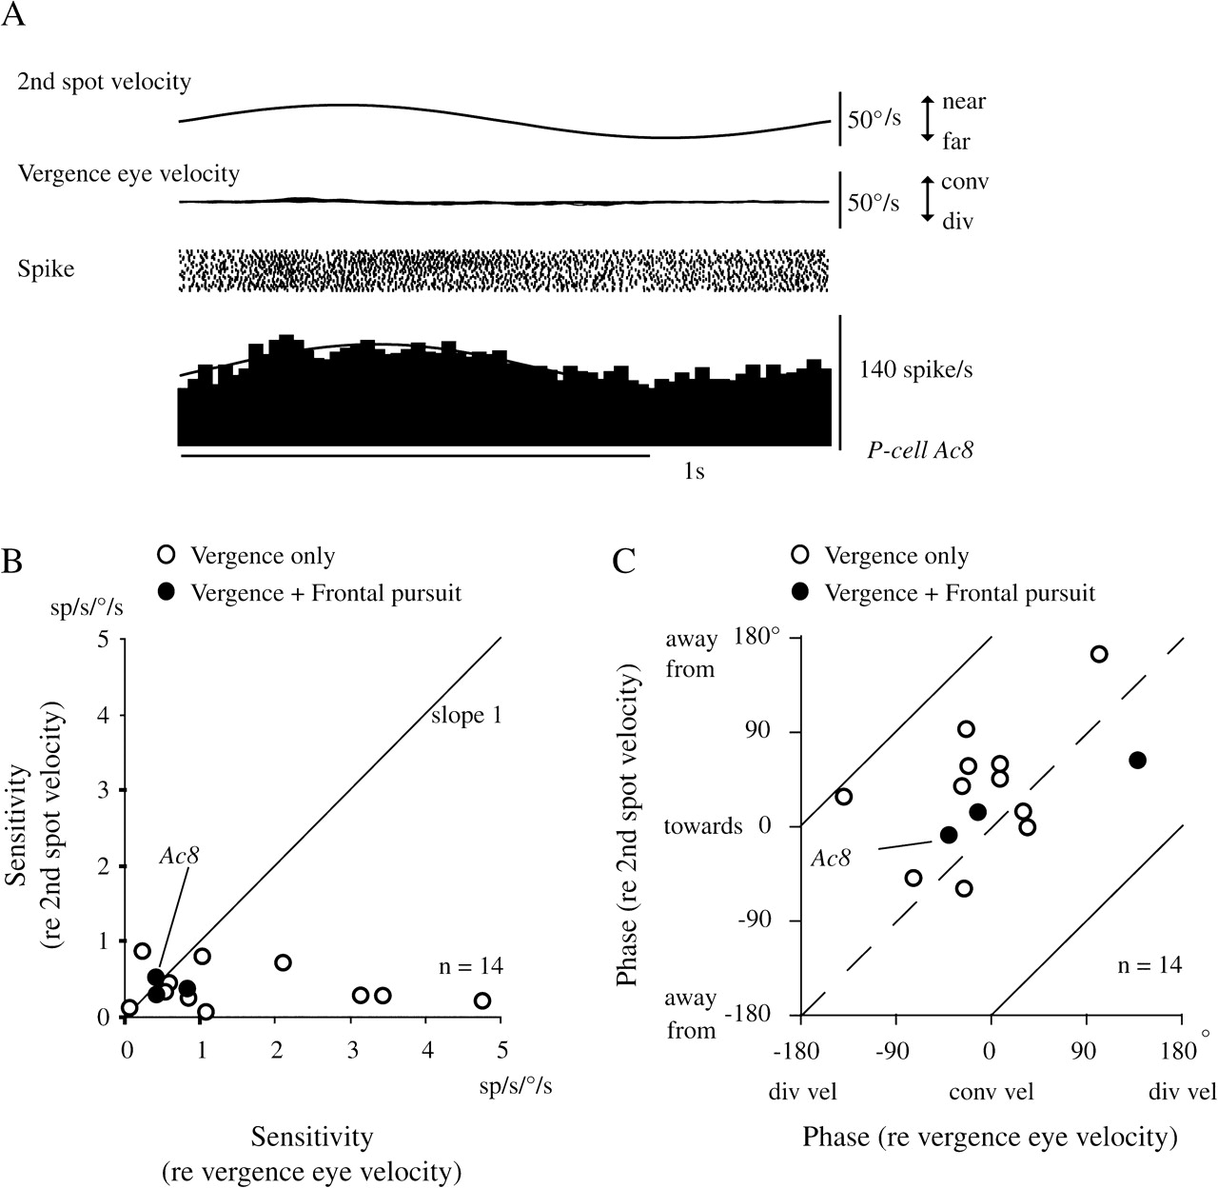
Figure 9. Visual response of vergence-related vermal P-cells. (A) Representative P-cell response to second spot ...
Notes:
Figure 9. Visual response of vergence-related vermal P-cells. (A) Representative P-cell response to second spot velocity in-depth, whereas the monkey fixated a stationary spot. (B) Sensitivity to second spot velocity in-depth during fixation is plotted against sensitivity to vergence eye velocity during vergence pursuit for vergence-only P-cells and vergence+ frontal-pursuit P-cells (keys). (C) Response phases relative to the second spot velocity in-depth during fixation are plotted against phase to vergence eye velocity during vergence pursuit. Solid and dashed lines are slope = one line and are drawn to ease comparison. Points around the dashed line indicate similar preferred direction between visual responses to second spot velocity in-depth and vergence pursuit.
Unless provided in the caption above, the following copyright applies to the content of this slide: © 2007 The AuthorsThis is an Open Access article distributed under the terms of the Creative Commons Attribution Non-Commercial License (http://creativecommons.org/licenses/by-nc/2.0/uk/) which permits unrestricted non-commercial use, distribution, and reproduction in any medium, provided the original work is properly cited.

Slide 10
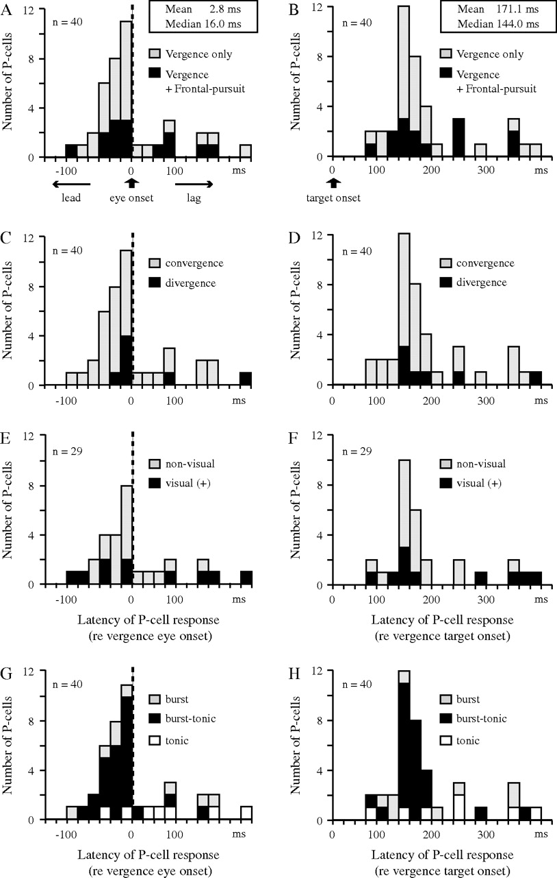
Figure 10. Latencies of vergence-related P-cell discharge. (A, C, E, G) Latencies relative to the onset of vergence eye ...
Notes:
Figure 10. Latencies of vergence-related P-cell discharge. (A, C, E, G) Latencies relative to the onset of vergence eye movements. (B, D, F, H) Latencies relative to the onset of target motion-in-depth. (A–D) show latencies of all tested P-cells (n = 40). (E, F) show latencies of 29 vergence-related P-cells that were tested for visual responses to target motion-in-depth during fixation. (G, H) show latencies of burst, burst tonic, and tonic P-cells (n = 40). In (A, C, E, G), P-cells with “minus” latency indicate that these P-cells discharged before the onset of vergence eye movements.
Unless provided in the caption above, the following copyright applies to the content of this slide: © 2007 The AuthorsThis is an Open Access article distributed under the terms of the Creative Commons Attribution Non-Commercial License (http://creativecommons.org/licenses/by-nc/2.0/uk/) which permits unrestricted non-commercial use, distribution, and reproduction in any medium, provided the original work is properly cited.

Slide 11
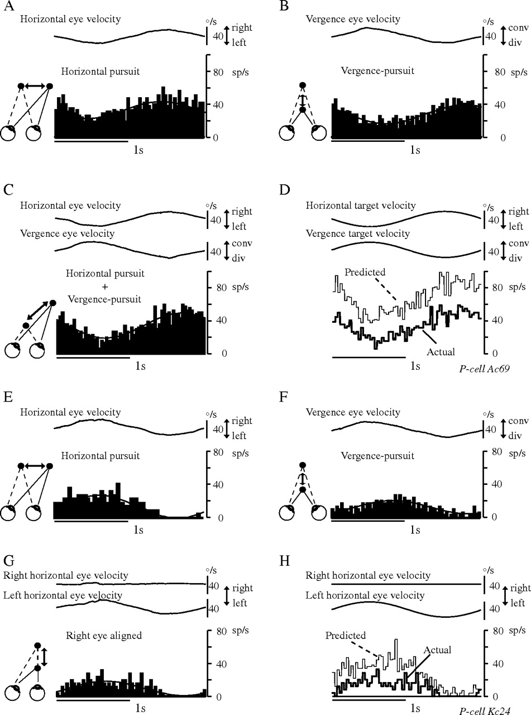
Figure 11. Addition of discharge modulation during frontal pursuit and vegence pursuit. (A–D and E–H) are different ...
Notes:
Figure 11. Addition of discharge modulation during frontal pursuit and vegence pursuit. (A–D and E–H) are different P-cells. (A) Discharge during frontal pursuit and mean horizontal eye velocity. (B) Discharge during midsagittal vergence pursuit and mean vergence eye velocity. (C) Actual discharge during pursuit when target motion in (A, B) was combined. (D) Predicted response to the combination of frontal pursuit and vergence pursuit. Predicted modulation (thin line) was calculated by linear addition of discharge rates during frontal pursuit and midsagittal vergence pursuit. Actual modulation is illustrated as a thick line. (E) during horizontal pursuit, (F) during midsagittal vergence pursuit, and (G) during right eye–aligned vergence pursuit. (H) Actual (thick line) and predicted discharge (thin line) during right eye–aligned vergence pursuit that was calculated by addition of discharge rates during frontal pursuit and midsagittal vergence pursuit. Ideal eye velocity traces for each eye are shown above.
Unless provided in the caption above, the following copyright applies to the content of this slide: © 2007 The AuthorsThis is an Open Access article distributed under the terms of the Creative Commons Attribution Non-Commercial License (http://creativecommons.org/licenses/by-nc/2.0/uk/) which permits unrestricted non-commercial use, distribution, and reproduction in any medium, provided the original work is properly cited.

Slide 12
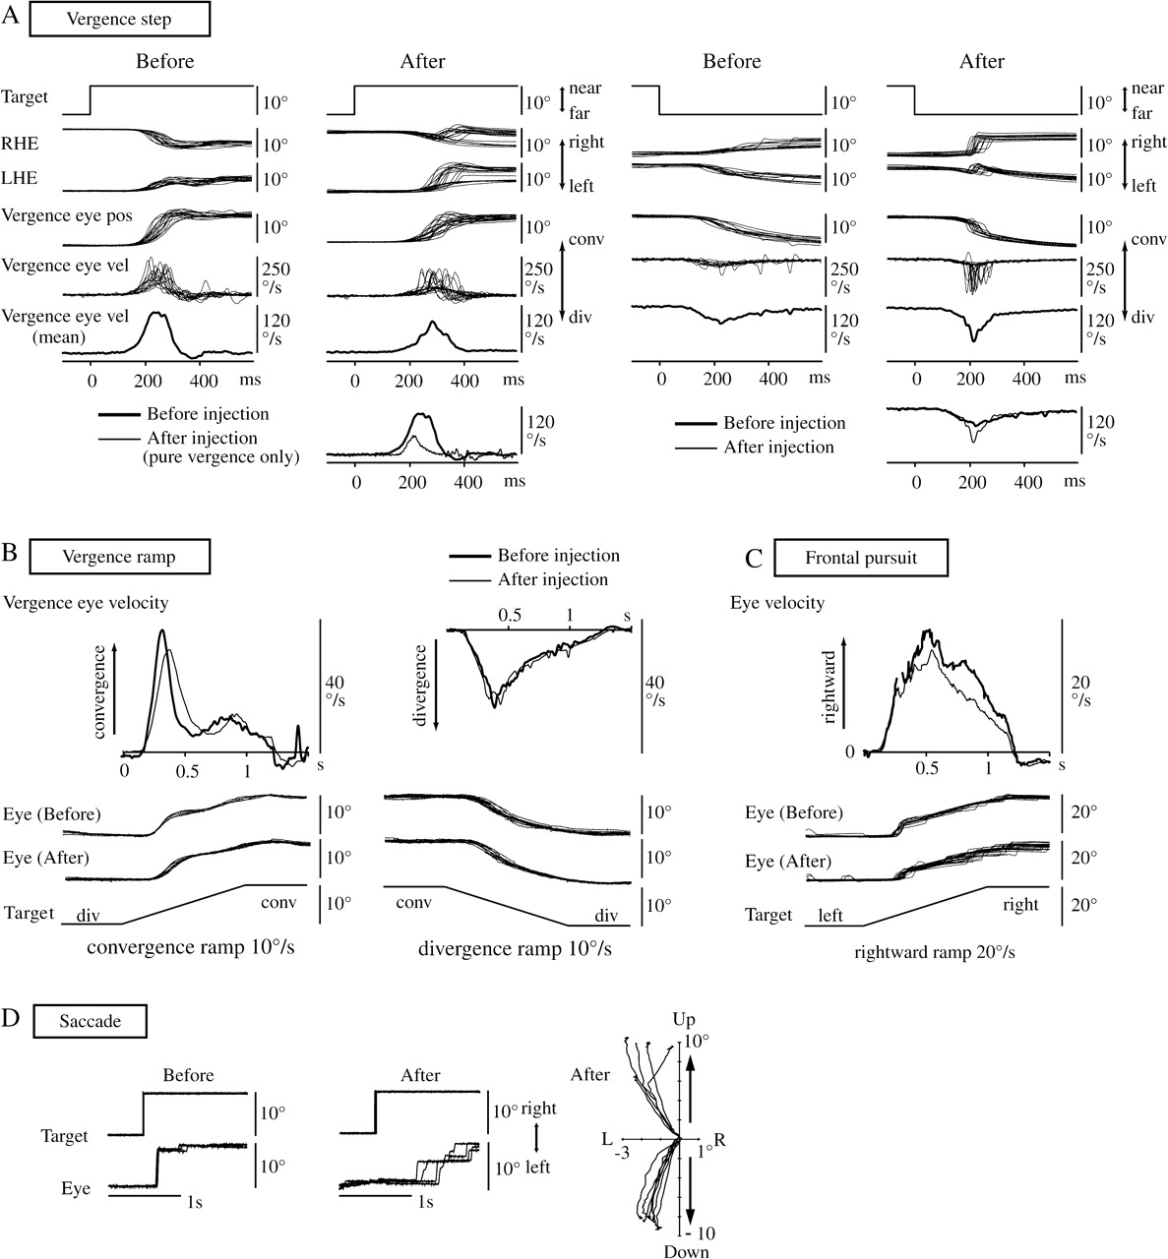
Figure 12. Muscimol infusion into the dorsal vermis (lobule VI). Muscimol was injected into the left (A) and right (B–D) ...
Notes:
Figure 12. Muscimol infusion into the dorsal vermis (lobule VI). Muscimol was injected into the left (A) and right (B–D) dorsal vermis. (A) Right and left horizontal eye positions, vergence eye position, and velocity induced by step target motion-in-depth before and after muscimol infusion. All traces were aligned with the onset of target step. (B) Averaged vergence eye velocities during convergence (left) and divergence (right) before (thick line) and after (thin line) injection. Vergence eye and target positions are illustrated below. (C) Averaged horizontal eye velocities during rightward frontal pursuit before (thick line) and after (thin line) muscimol injection. Horizontal eye and target positions are illustrated below. (D) Horizontal target and eye positions during rightward saccades before and after muscimol injection. After muscimol injection, rightward saccade became hypometric (middle) and vertical saccade drifted to the left side (right). For further explanation, see text.
Unless provided in the caption above, the following copyright applies to the content of this slide: © 2007 The AuthorsThis is an Open Access article distributed under the terms of the Creative Commons Attribution Non-Commercial License (http://creativecommons.org/licenses/by-nc/2.0/uk/) which permits unrestricted non-commercial use, distribution, and reproduction in any medium, provided the original work is properly cited.

Slide 13
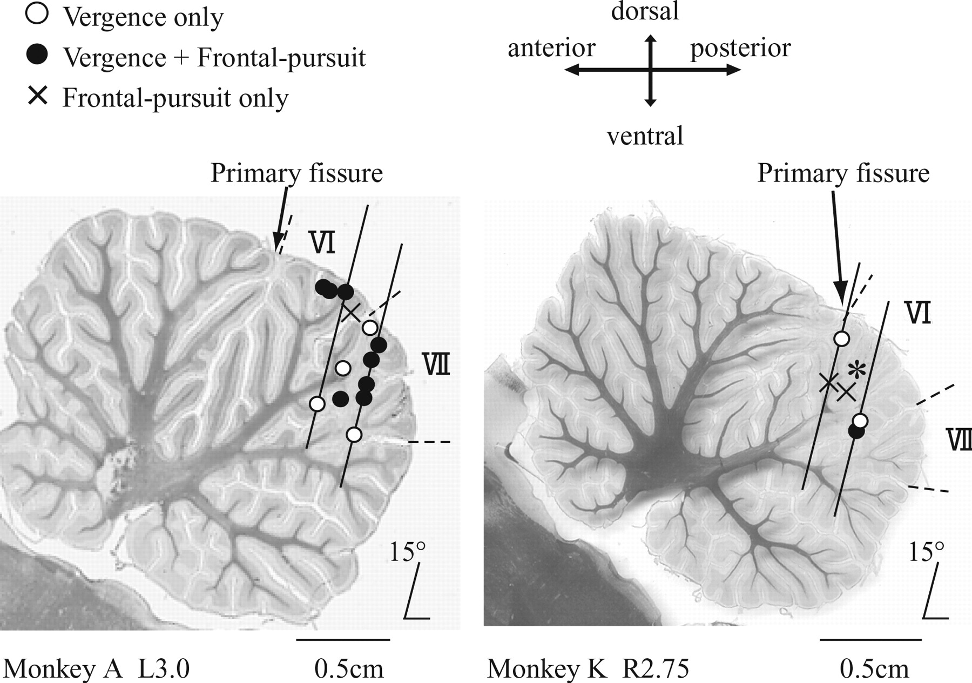
Figure 13. Reconstructed recording sites of P-cells and the muscimol injection. Representative sagittal sections at ...
Notes:
Figure 13. Reconstructed recording sites of P-cells and the muscimol injection. Representative sagittal sections at lateral 3 mm (left vermis of monkey A) and lateral 2.75 mm (right vermis of monkey K) are shown with the location of responsive P-cells and recording tracks. Three types of P-cells (keys) were intermingled and were found in this and neighboring sections within 1 mm of these sections. The asterisk indicates the muscimol injection site in Figure 12B–D. VI and VII indicate the range of vermal lobules VI and VII, respectively.
Unless provided in the caption above, the following copyright applies to the content of this slide: © 2007 The AuthorsThis is an Open Access article distributed under the terms of the Creative Commons Attribution Non-Commercial License (http://creativecommons.org/licenses/by-nc/2.0/uk/) which permits unrestricted non-commercial use, distribution, and reproduction in any medium, provided the original work is properly cited.

