Slide 1
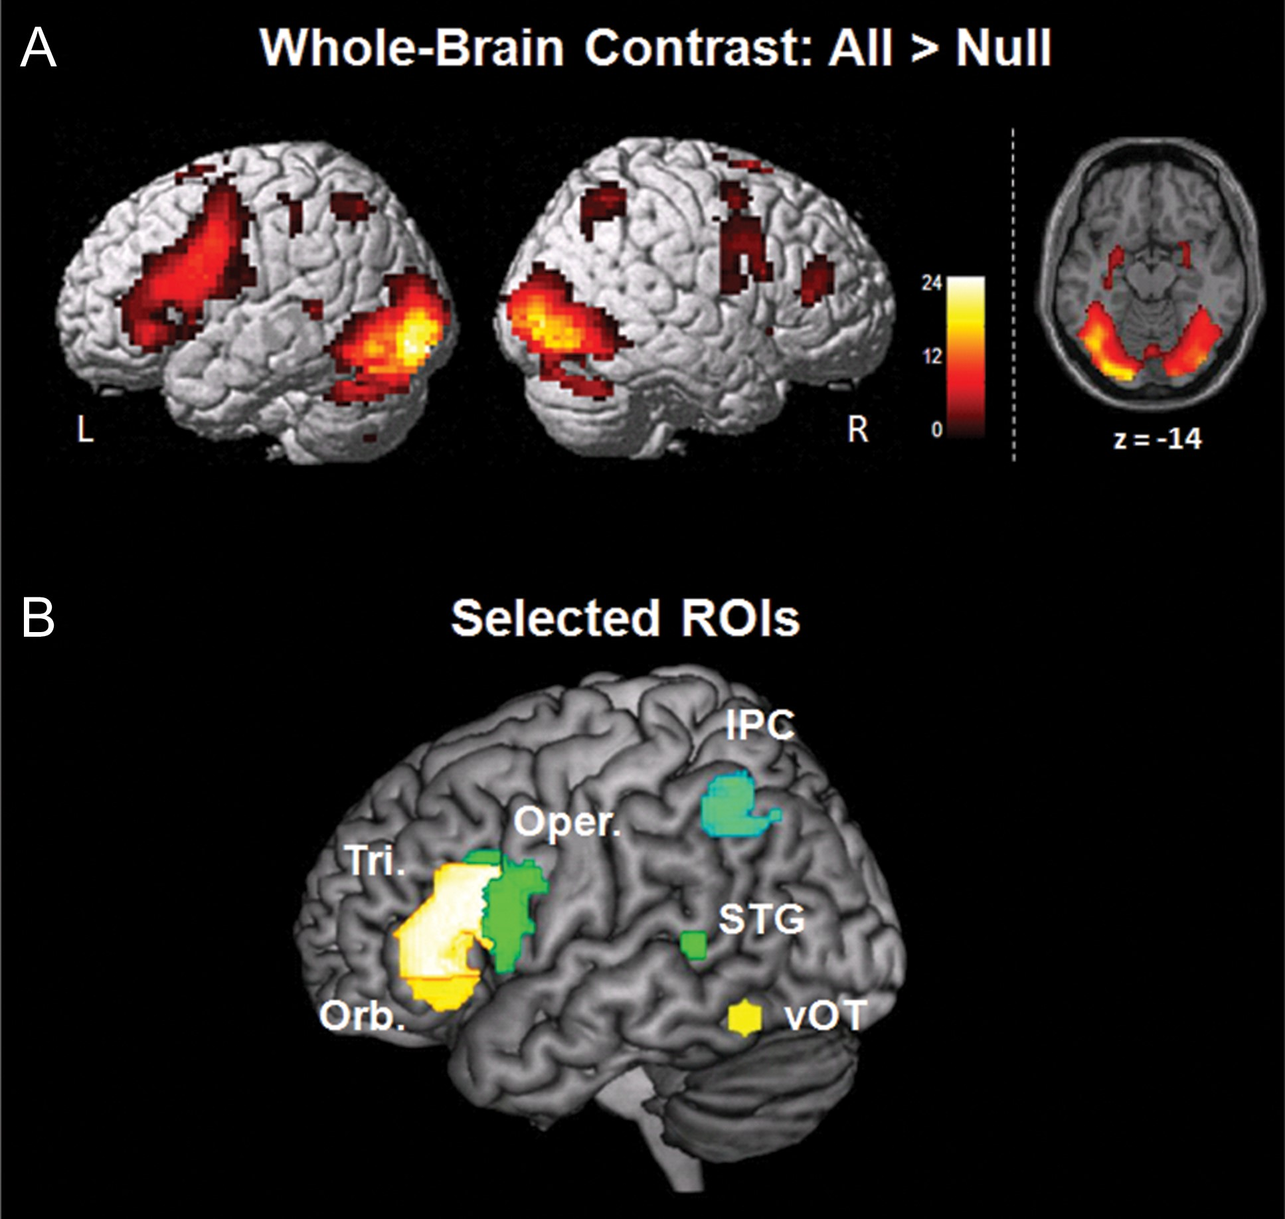
Figure 1. Brain renderings showing (A) activations for the All > Null whole-brain contrast across all subjects at a ...
Notes:
Figure 1. Brain renderings showing (A) activations for the All > Null whole-brain contrast across all subjects at a statistical threshold of q < 0.001 FDR-corrected and z-axis slice section for vOT cortex and (B) location of the selected left-hemisphere ROIs within the ventral reading network (yellow shades), including pars triangularis, pars orbitalis, and vOT, and within the dorsal reading network (green shades), including pars opercularis, STG, and IPC for the dorsal reading network. Tri., pars triangularis; Orb., pars orbitalis; Oper., pars opercularis.
Unless provided in the caption above, the following copyright applies to the content of this slide: © The Author 2016. Published by Oxford University Press. All rights reserved. For Permissions, please e-mail: journals.permissions@oup.com

Slide 2
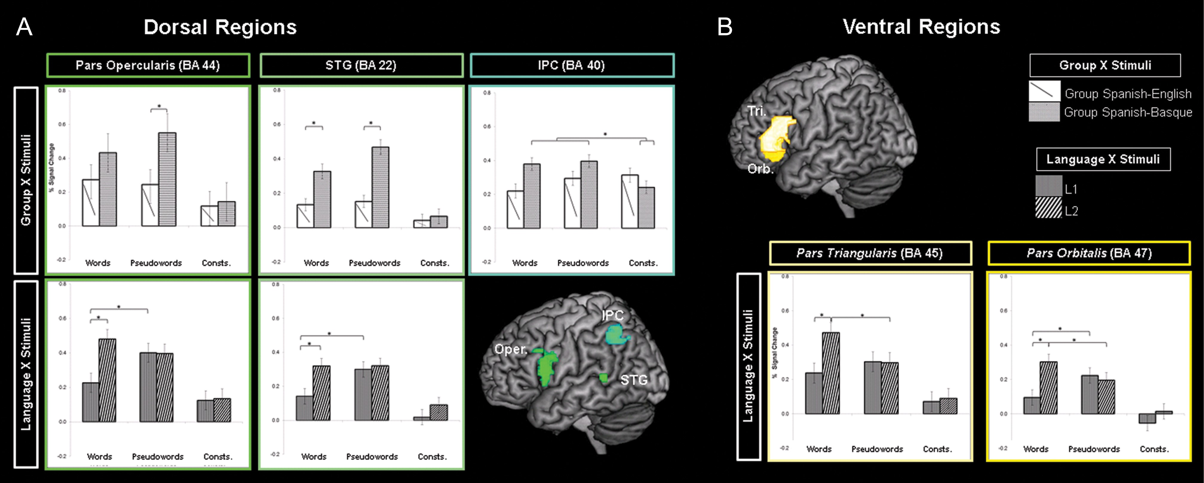
Figure 2. ROI analyses for left-lateralized regions within the dorsal and ventral reading network. (A) Dorsal regions ...
Notes:
Figure 2. ROI analyses for left-lateralized regions within the dorsal and ventral reading network. (A) Dorsal regions showed Group × Stimuli and Language × Stimuli interactions in pars opercularis (−49 11 18; BA 44) and STG (−51 –44 7; BA 22), and Group × Stimuli interaction in IPC (−30 –54 46; BA 40). (B) Ventral regions within the left IFG, including pars triangularis (−48 27 14; BA 45) pars orbitalis (−40 30 –7; BA 47), showed Language × Stimuli interactions. Bar graphs show averaged parameter estimates (% signal change) for these interactions as a function of Group/Language and Stimuli. Asterisks within bar graphs indicate comparisons that showed statistically significant differences in % signal change (Ps < 0.05). Consts., consonant strings; Oper., pars opercularis; Tri., pars triangularis; Orb., pars orbitalis.
Unless provided in the caption above, the following copyright applies to the content of this slide: © The Author 2016. Published by Oxford University Press. All rights reserved. For Permissions, please e-mail: journals.permissions@oup.com

Slide 3
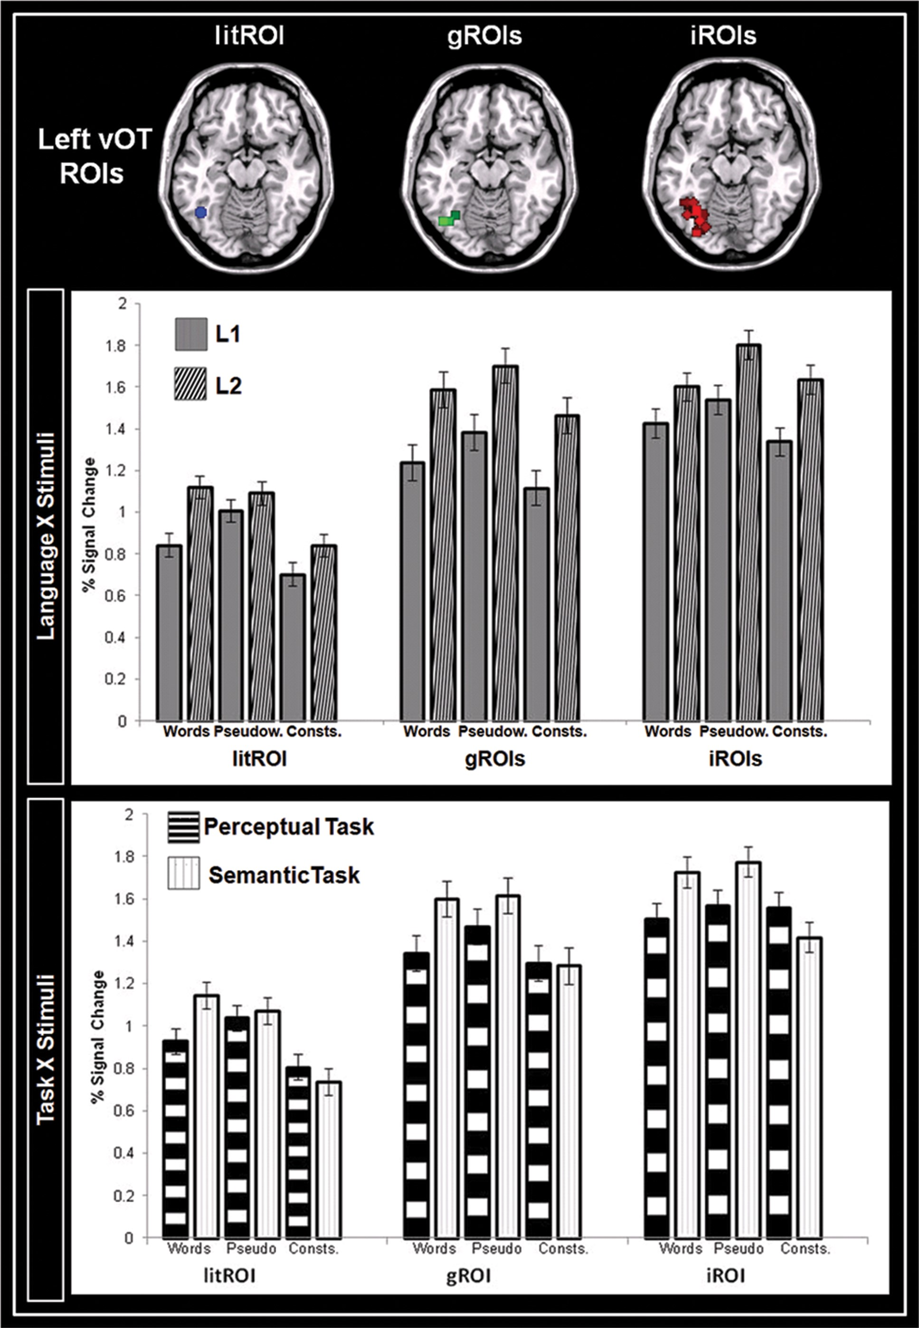
Figure 3. Left vOT ROI analyses based on three different approaches:litROI, gROIs, and iROIs. Bar graphs show averaged ...
Notes:
Figure 3. Left vOT ROI analyses based on three different approaches:litROI, gROIs, and iROIs. Bar graphs show averaged parameter estimates (% signal change) for these three left vOT ROI definitions as a function of Language/Task and Stimuli. For gROIs and iROIs, the bar graphs show results for ROIs where local maximas were selected based on the highest T value within the FG, at the group or at the individual level, respectively. Pseudow., pseudowords; Consts., consonant strings.
Unless provided in the caption above, the following copyright applies to the content of this slide: © The Author 2016. Published by Oxford University Press. All rights reserved. For Permissions, please e-mail: journals.permissions@oup.com

Slide 4
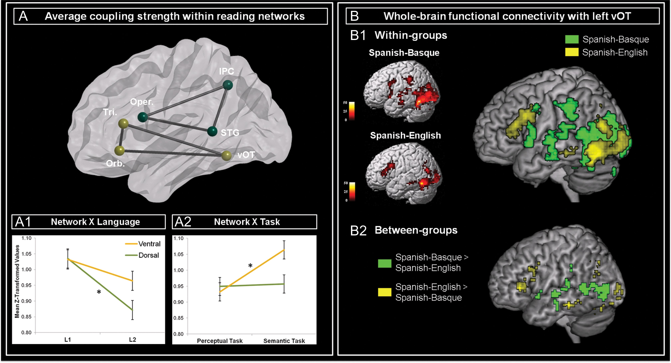
Figure 4. Functional connectivity analyses for ventral and dorsal reading networks. (A) A schematic sagittal view of ...
Notes:
Figure 4. Functional connectivity analyses for ventral and dorsal reading networks. (A) A schematic sagittal view of the regions within dorsal (green) and ventral (yellow) reading networks and the pairwise connections among them that were submitted to functional connectivity analyses. All nodes correspond to 5-mm radius spheres centered at the highest local maxima for left-lateralized regions identified at the group level (i.e., pars orbitalis, triangularis, opercularis, STG, IPC) and at the individual level (iROIs) for the left vOT, based on the highest T value within the FG. Line graphs show average coupling strength (i.e., mean z-transformed values of the beta-series correlation) for processing word stimuli for the (A1) Network × Language and (A2) Network × Task interactions. Asterisks indicate comparisons that showed statistically significant differences in average strength of functional connectivity (Ps Null (B1) separately for the Spanish-Basque (in green) and Spanish-English (in yellow) groups at an FDR-corrected statistical threshold of q Spanish-English (in green) and Spanish-English > Spanish-Basque (in yellow) comparisons at a FDR-corrected statistical threshold of q < 0.05 (bottom panel). Tri., pars triangularis; Orb., pars orbitalis; Oper., pars opercularis.
Unless provided in the caption above, the following copyright applies to the content of this slide: © The Author 2016. Published by Oxford University Press. All rights reserved. For Permissions, please e-mail: journals.permissions@oup.com

