Slide 1
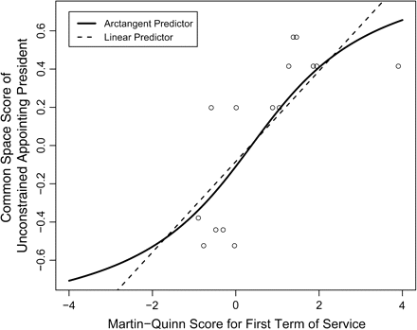
Figure 1. Scatter plot of the Common Space score of an unconstrained appointing President on the Martin-Quinn score for ...
Notes:
Figure 1. Scatter plot of the Common Space score of an unconstrained appointing President on the Martin-Quinn score for the justice's first term of service, with arctangent and linear predictors. Common Space scores are from Poole (2005). Raw Martin-Quinn scores are from Martin and Quinn (2005a).
Unless provided in the caption above, the following copyright applies to the content of this slide: © The Author 2007. Published by Oxford University Press on behalf of Yale University. All rights reserved. For Permissions, please email: journals.permissions@oxfordjournals.org

Slide 2
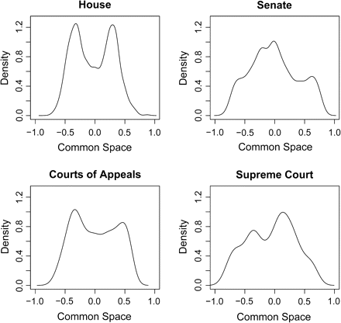
Figure 2. Kernel density plots for all actors in the House, Senate, Courts of Appeals, and Supreme Court, 1953–2000. ...
Notes:
Figure 2. Kernel density plots for all actors in the House, Senate, Courts of Appeals, and Supreme Court, 1953–2000. House and Senate scores are from Poole (2005).
Unless provided in the caption above, the following copyright applies to the content of this slide: © The Author 2007. Published by Oxford University Press on behalf of Yale University. All rights reserved. For Permissions, please email: journals.permissions@oxfordjournals.org

Slide 3
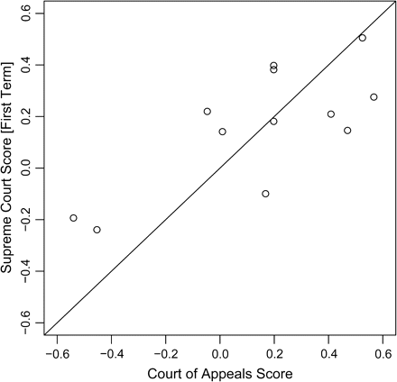
Figure 3. Comparison of Courts of Appeals scores with first-term Supreme Court scores for judges elevated to the ...
Notes:
Figure 3. Comparison of Courts of Appeals scores with first-term Supreme Court scores for judges elevated to the Supreme Court.
Unless provided in the caption above, the following copyright applies to the content of this slide: © The Author 2007. Published by Oxford University Press on behalf of Yale University. All rights reserved. For Permissions, please email: journals.permissions@oxfordjournals.org

Slide 4
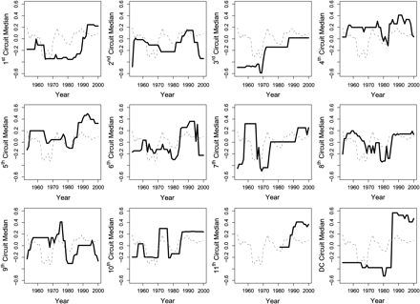
Figure 4. Medians in each Court of Appeals, 1953–2000. The light gray line in each cell is the Supreme Court median.
Notes:
Figure 4. Medians in each Court of Appeals, 1953–2000. The light gray line in each cell is the Supreme Court median.
Unless provided in the caption above, the following copyright applies to the content of this slide: © The Author 2007. Published by Oxford University Press on behalf of Yale University. All rights reserved. For Permissions, please email: journals.permissions@oxfordjournals.org

Slide 5
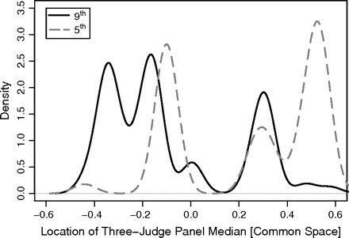
Figure 5. Empirical densities of the location of the median judge on a three-judge panel for the Fifth and Ninth ...
Notes:
Figure 5. Empirical densities of the location of the median judge on a three-judge panel for the Fifth and Ninth Circuits in 1998.
Unless provided in the caption above, the following copyright applies to the content of this slide: © The Author 2007. Published by Oxford University Press on behalf of Yale University. All rights reserved. For Permissions, please email: journals.permissions@oxfordjournals.org

Slide 6
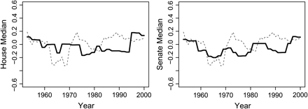
Figure 6. Plot of the median member of the House and Senate, 1953–2000. The light gray line in each cell is the Supreme ...
Notes:
Figure 6. Plot of the median member of the House and Senate, 1953–2000. The light gray line in each cell is the Supreme Court median. House and Senate medians are derived from Poole (2005).
Unless provided in the caption above, the following copyright applies to the content of this slide: © The Author 2007. Published by Oxford University Press on behalf of Yale University. All rights reserved. For Permissions, please email: journals.permissions@oxfordjournals.org

Slide 7
Figure 7. Preferences of the enacting Supreme Court (E), the contemporaneous Supreme Court (C), and the contemporaneous ...
Notes:
Figure 7. Preferences of the enacting Supreme Court (E), the contemporaneous Supreme Court (C), and the contemporaneous lower court (L).
Unless provided in the caption above, the following copyright applies to the content of this slide: © The Author 2007. Published by Oxford University Press on behalf of Yale University. All rights reserved. For Permissions, please email: journals.permissions@oxfordjournals.org

Slide 8
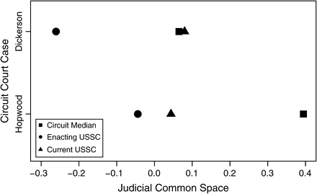
Figure 8. Enacting and contemporaneous judicial regimes in the JCS for the Fourth Circuit in U.S. v. Dickerson and the ...
Notes:
Figure 8. Enacting and contemporaneous judicial regimes in the JCS for the Fourth Circuit in U.S. v. Dickerson and the Fifth Circuit in Hopwood v. Texas. Enacting USSC, the Supreme Court in Bakke (Hopwood)/Miranda (Dickerson); Circuit Median, the circuit at the time of Dickerson/Hopwood; and Current USSC, the Supreme Court at the time the circuit decided Dickerson/Hopwood.
Unless provided in the caption above, the following copyright applies to the content of this slide: © The Author 2007. Published by Oxford University Press on behalf of Yale University. All rights reserved. For Permissions, please email: journals.permissions@oxfordjournals.org

Slide 9
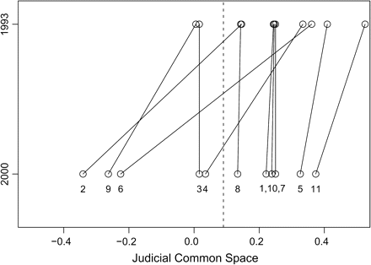
Figure 9. The effects of the Clinton presidency on the composition of the Courts of Appeals and the Supreme Court. Each ...
Notes:
Figure 9. The effects of the Clinton presidency on the composition of the Courts of Appeals and the Supreme Court. Each point represents the circuit median. The vertical line is the estimated Supreme Court median that remained (relatively) constant between 1993 and 2000.
Unless provided in the caption above, the following copyright applies to the content of this slide: © The Author 2007. Published by Oxford University Press on behalf of Yale University. All rights reserved. For Permissions, please email: journals.permissions@oxfordjournals.org

Slide 10
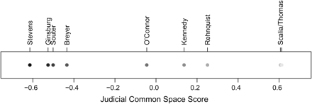
Figure 10. JCS scores for the October 2003 term of the US Supreme Court.
Notes:
Figure 10. JCS scores for the October 2003 term of the US Supreme Court.
Unless provided in the caption above, the following copyright applies to the content of this slide: © The Author 2007. Published by Oxford University Press on behalf of Yale University. All rights reserved. For Permissions, please email: journals.permissions@oxfordjournals.org

Slide 11
Figure 11. JCS scores for the October 1986 term of the US Supreme Court.
Notes:
Figure 11. JCS scores for the October 1986 term of the US Supreme Court.
Unless provided in the caption above, the following copyright applies to the content of this slide: © The Author 2007. Published by Oxford University Press on behalf of Yale University. All rights reserved. For Permissions, please email: journals.permissions@oxfordjournals.org

Slide 12
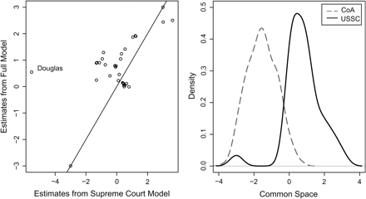
Figure 12. Comparison of estimates from an item response theory model fit to data for the Vinson-Rehnquist Courts ...
Notes:
Figure 12. Comparison of estimates from an item response theory model fit to data for the Vinson-Rehnquist Courts (through the 2003 term). The votes cast by the Court of Appeals judges are coded for each Supreme Court case, where applicable. The left cell compares Supreme Court estimates from Supreme Court–only model (Martin and Quinn 2002) to those from a full model that includes the Court of Appeals judges. The right cell shows the densities of the estimated ideal points for the Courts of Appeal judges and Supreme Court justices.
Unless provided in the caption above, the following copyright applies to the content of this slide: © The Author 2007. Published by Oxford University Press on behalf of Yale University. All rights reserved. For Permissions, please email: journals.permissions@oxfordjournals.org

