Slide 1
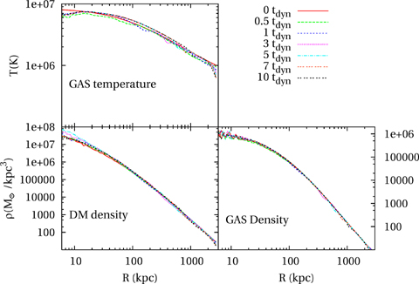
Figure 1 Profiles of gas temperature (top panel), DM density (bottom left-hand panels) and gas density (bottom ...
Notes:
Figure 1 Profiles of gas temperature (top panel), DM density (bottom left-hand panels) and gas density (bottom right-hand panels) for the non-radiative run of the halo H1, evaluated at seven different epochs in the interval [0, 10]tdyn.
Unless provided in the caption above, the following copyright applies to the content of this slide: © 2007 The Authors. Journal compilation © 2007 RAS

Slide 2
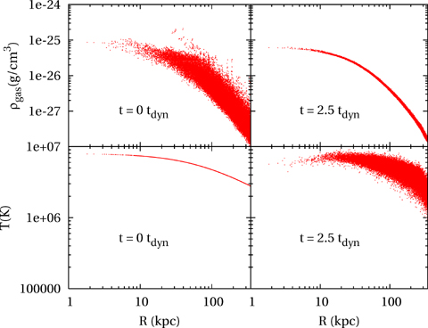
Figure 2 Top panels}: density of gas particles for the non-radiative run of the halo H1, as a function of their ...
Notes:
Figure 2 Top panels}: density of gas particles for the non-radiative run of the halo H1, as a function of their halocentric distance, at t= 0, as assigned in the initial conditions (left-hand panel) and after 2.5tdyn (right-hand panel). Bottom panels: the same as for the top panels, but for the temperature of gas particles.
Unless provided in the caption above, the following copyright applies to the content of this slide: © 2007 The Authors. Journal compilation © 2007 RAS

Slide 3
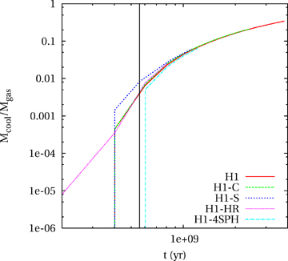
Figure 3 Evolution of the cooled mass M_{cool} for different runs of the H1 halo. Solid line: reference run ...
Notes:
Figure 3 Evolution of the cooled mass Mcool for different runs of the H1 halo. Solid line: reference run with cooling and star formation; dashed curve: run with only cooling (H1-C); short-dashed curve: run with cooling and star formation, with halved gravitational softening (H1-S); dotted curve: run with cooling and star formation at 10 times better mass resolution (H1-HR); dot–dashed curve: run with cooling and star formation at four times more particles and SPH neighbours (H1-4SPH). The vertical black line represents the theoretical central cooling time.
Unless provided in the caption above, the following copyright applies to the content of this slide: © 2007 The Authors. Journal compilation © 2007 RAS

Slide 4
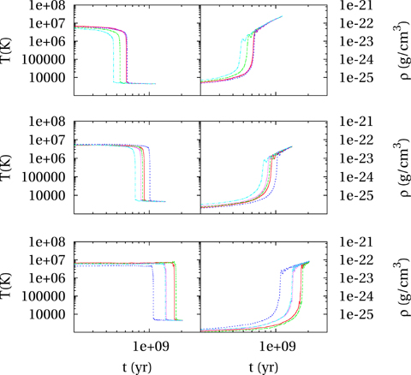
Figure 4 Evolution of temperature (left-hand panels) and density (right-hand panels) for three sets of five particles ...
Notes:
Figure 4 Evolution of temperature (left-hand panels) and density (right-hand panels) for three sets of five particles each, selected within three different radial shells in the initial conditions. Top panels: (rmin, rmax) = (10, 20) kpc; central panels: (rmin, rmax) = (30, 40) kpc. Bottom panels: (rmin, rmax) = (50, 60) kpc.
Unless provided in the caption above, the following copyright applies to the content of this slide: © 2007 The Authors. Journal compilation © 2007 RAS

Slide 5
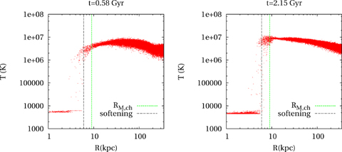
Figure 5 Scatter plot of temperature versus halocentric distance for gas particles in the run of the H1 halo which ...
Notes:
Figure 5 Scatter plot of temperature versus halocentric distance for gas particles in the run of the H1 halo which includes only cooling, without star formation (H1-C). The green, dotted lines give the cooling radius rM,ch as predicted by the closed morgana model, while the black, dashed lines denote the softening scale.
Unless provided in the caption above, the following copyright applies to the content of this slide: © 2007 The Authors. Journal compilation © 2007 RAS

Slide 6
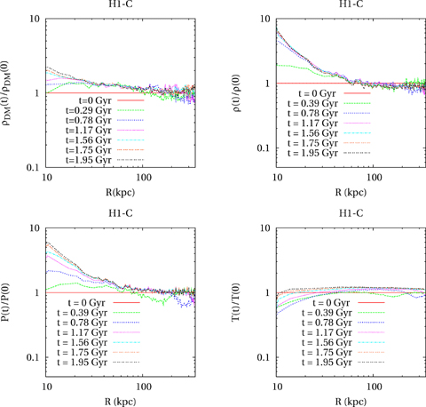
Figure 6 Profiles of DM density (upper left-hand panel), gas density (upper right-hand panel), pressure (lower ...
Notes:
Figure 6 Profiles of DM density (upper left-hand panel), gas density (upper right-hand panel), pressure (lower left-hand panel) and temperature (lower right-hand panel) at different epochs for the H1 simulation with only cooling (H1-C). All profiles are normalized to their initial value.
Unless provided in the caption above, the following copyright applies to the content of this slide: © 2007 The Authors. Journal compilation © 2007 RAS

Slide 7
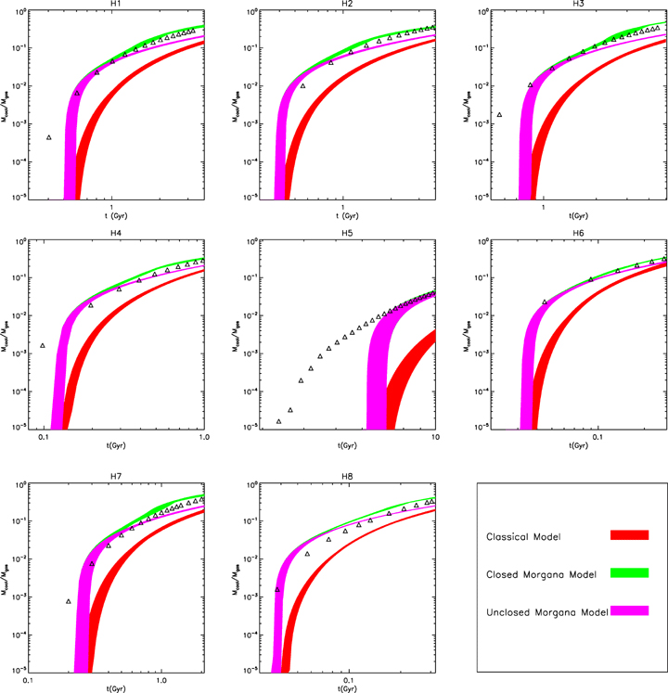
Figure 7 Evolution of the cooled gas fraction, M_{cool}, for the eight simulated haloes, in the radiative runs ...
Notes:
Figure 7 Evolution of the cooled gas fraction, Mcool, for the eight simulated haloes, in the radiative runs with star formation. The open triangles are the simulation results, while the shaded areas (in colour in the online version) represent the prediction of the three different models. Classical model: darkest shade, red; unclosed morgana: lightest shade, magenta; closed morgana: middle shade, green). Each area represents the envelopes of hydrostatic models which provide a good fit to the initial conditions (see the text).
Unless provided in the caption above, the following copyright applies to the content of this slide: © 2007 The Authors. Journal compilation © 2007 RAS

Slide 8
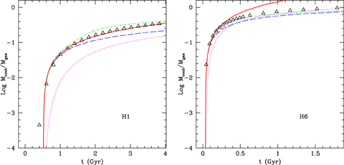
Figure B1 Simple approximation to the cooled mass fraction obtained by integrating in time the constant cooling flow of ...
Notes:
Figure B1 Simple approximation to the cooled mass fraction obtained by integrating in time the constant cooling flow of equation (B11), shown for the H1 and H6 simulations (the others show a similar degree of agreement). The dotted (magenta), dashed (blue) and dot–dashed (green) lines give the predictions of the classical, unclosed and closed morgana models, respectively. The thick continuous line gives the simple analytic fit. For the sake of completeness, the models are obtained using γp= 1.20 and thermal energy equal to 1.18 times the virial energy (H1), and γp= 1.21 and energy equal to 1.15 the virial energy (H6). These values are at the centre of the intervals used for the models shown in Fig. 7.
Unless provided in the caption above, the following copyright applies to the content of this slide: © 2007 The Authors. Journal compilation © 2007 RAS

