Slide 1
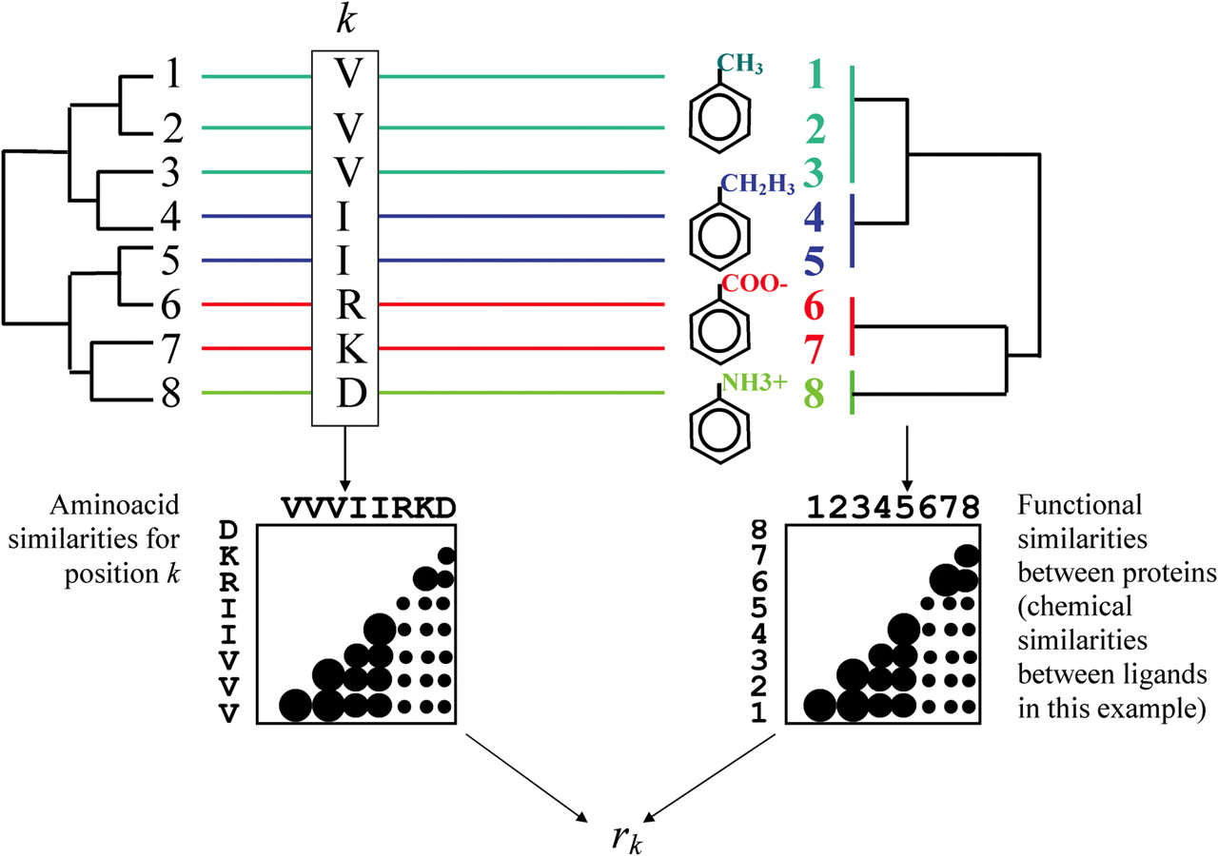
Fig. 1 Schema of the Xdet method. A sequence alignment of eight proteins is depicted. The implicit phylogeny based ...
Notes:
Fig. 1 Schema of the Xdet method. A sequence alignment of eight proteins is depicted. The implicit phylogeny based on the sequence relationships extracted from the alignment is shown on the left. The colors of the proteins represent a functional classification which is not reflected in the phylogeny. In this case, this function is the binding of an effector (small molecule) chemically slightly different for the different members of the family (right). A functional similarity can be defined between the proteins for this particular function (i.e. the chemical similarity between the effector they bind). These similarities could be represented in a tree-like structure or a hierarchy (rightmost tree). To asses whether a given position in the alignment is related with that particular functional hierarchy, a matrix containing all the amino acid changes occurring at that position is constructed and compared with an equivalent matrix containing the functional similarities between the proteins previously defined. The values of these two matrices are depicted here as circles with a radius proportional to the similarity value.
Unless provided in the caption above, the following copyright applies to the content of this slide: © The Author 2006. Published by Oxford University Press. All rights reserved. For Permissions, please email: journals.permissions@oxfordjournals.orgThe online version of this article has been published under an open access model. Users are entitled to use, reproduce, disseminate, or display the open access version of this article for non-commercial purposes provided that: the original authorship is properly and fully attributed; the Journal and Oxford University Press are attributed as the original place of publication with the correct citation details given; if an article is subsequently reproduced or disseminated not in its entirety but only in part or as a derivative work this must be clearly indicated. For commercial re-use, please contact journals.permissions@oxfordjournals.org

Slide 2
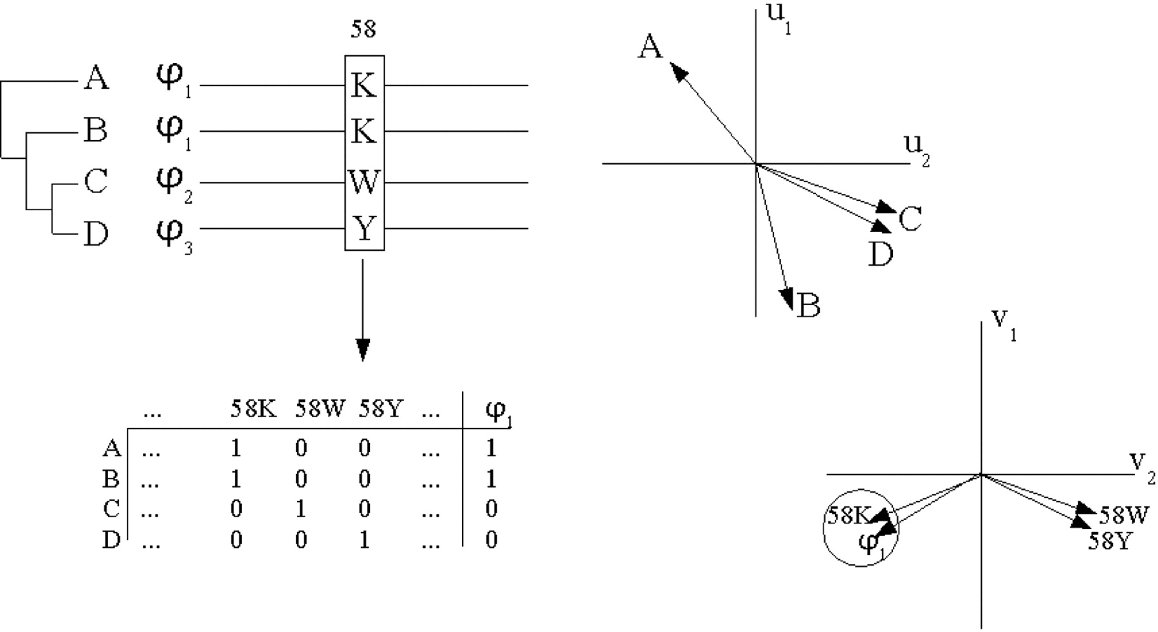
Fig. 2 Schema of the MCdet method. A MSA of four sequences (A, B, C and D) is depicted. The functions of the ...
Notes:
Fig. 2 Schema of the MCdet method. A MSA of four sequences (A, B, C and D) is depicted. The functions of the proteins (Φ1, Φ2 and Φ3) are not related with the alignment-based phylogeny (depicted on the left). MCA is applied to a binary representation of the sequences and the functions of the proteins (matrix at the bottom) generated as explained in Materials and Methods. This procedure leads to related spaces (defined by the eigenvectors of the MCA treatment −ui and vi−) where the vectors of positions important for functional specificities lay close to the vectors of the functions they determine (right).
Unless provided in the caption above, the following copyright applies to the content of this slide: © The Author 2006. Published by Oxford University Press. All rights reserved. For Permissions, please email: journals.permissions@oxfordjournals.orgThe online version of this article has been published under an open access model. Users are entitled to use, reproduce, disseminate, or display the open access version of this article for non-commercial purposes provided that: the original authorship is properly and fully attributed; the Journal and Oxford University Press are attributed as the original place of publication with the correct citation details given; if an article is subsequently reproduced or disseminated not in its entirety but only in part or as a derivative work this must be clearly indicated. For commercial re-use, please contact journals.permissions@oxfordjournals.org

Slide 3
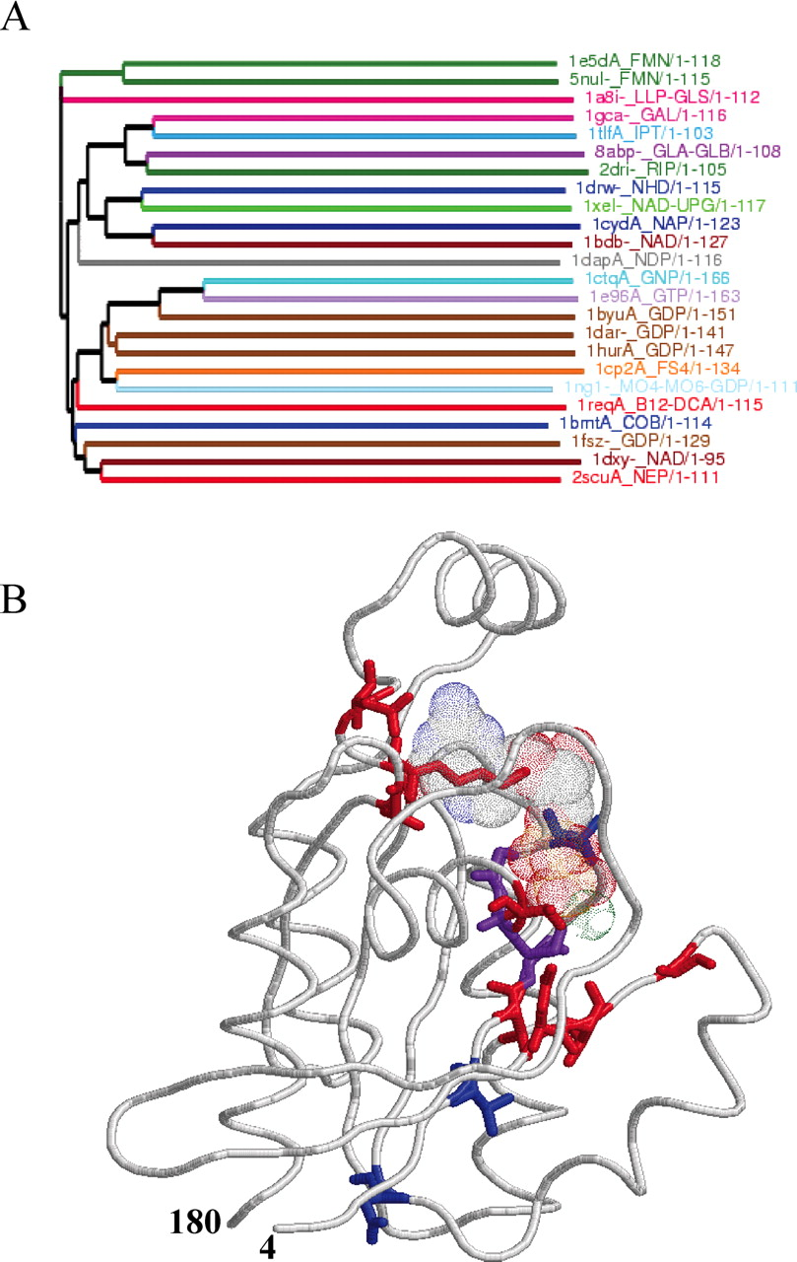
Fig. 3 Results for the Ras oncogene structural homologs. (A) Phylogenetic tree derived from the structure-based ...
Notes:
Fig. 3 Results for the Ras oncogene structural homologs. (A) Phylogenetic tree derived from the structure-based alignment, drawn with Belvu (E. Sonnhammer, unpublished data) which implements a neighbour-joining algorithm to calculate the layout of the tree from the alignment. Additional trees generated with Bayesian techniques are available for this and the forthcoming examples in Supplementary Material. Proteins are labelled with their PDB codes and the bound ligands (PDB nomenclature). The tree is colored according to the set of bound ligands. Proteins binding the same ligand could be colored different if the complete set of bound ligands is not exactly the same. (B) Predictions of the methods mapped on the structure of the human RhoA (PDB 1ftn), a GTP-binding protein. The bound GDP is shown in Van der Walls representation and colored by atom identity (CPK). The residues predicted by the methods are shown in sticks representation and colored blue for the Xdet method, red for MCdet and purple for the positions predicted by both methods. The figure was generated with Rasmol (Sayle and Milner-White, 1995).
Unless provided in the caption above, the following copyright applies to the content of this slide: © The Author 2006. Published by Oxford University Press. All rights reserved. For Permissions, please email: journals.permissions@oxfordjournals.orgThe online version of this article has been published under an open access model. Users are entitled to use, reproduce, disseminate, or display the open access version of this article for non-commercial purposes provided that: the original authorship is properly and fully attributed; the Journal and Oxford University Press are attributed as the original place of publication with the correct citation details given; if an article is subsequently reproduced or disseminated not in its entirety but only in part or as a derivative work this must be clearly indicated. For commercial re-use, please contact journals.permissions@oxfordjournals.org

Slide 4
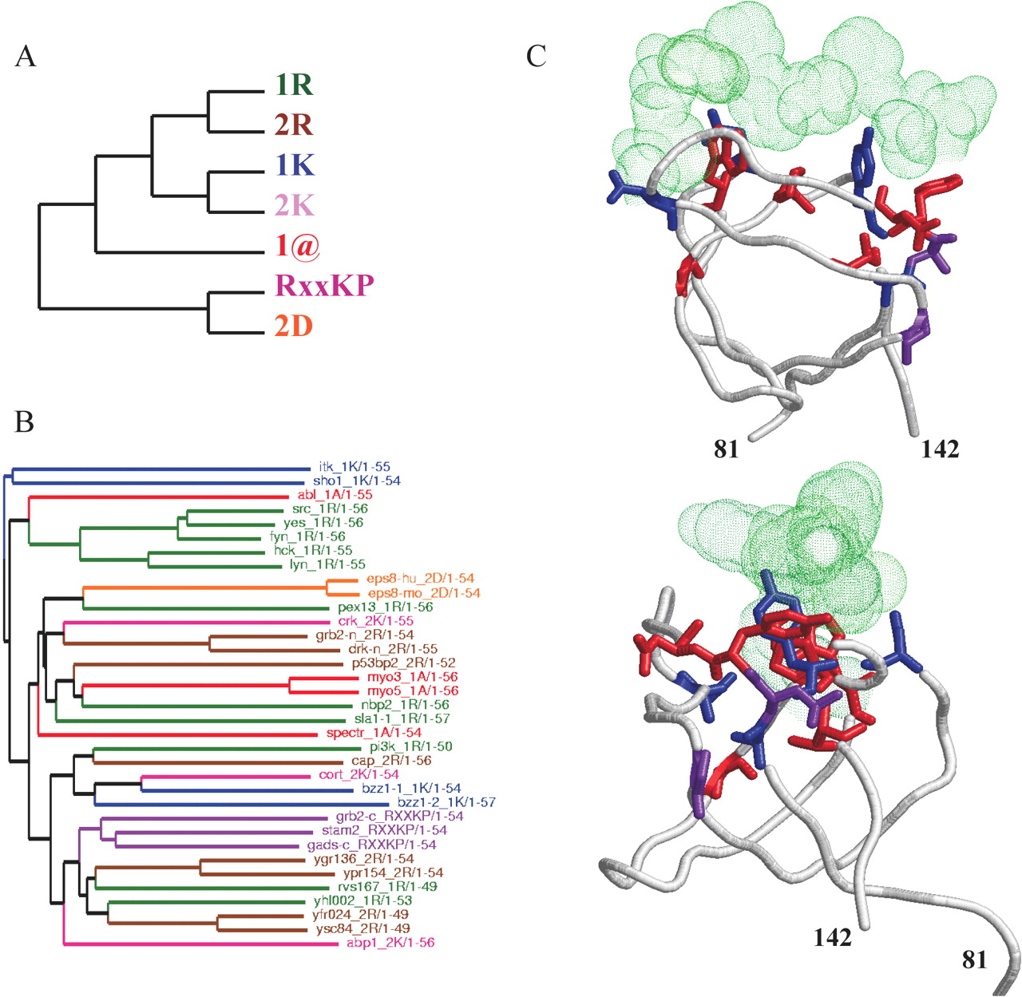
Fig. 4 Results for the SH3 domains. (A) Hierarchical functional classification of SH3 functional classes adapted ...
Notes:
Fig. 4 Results for the SH3 domains. (A) Hierarchical functional classification of SH3 functional classes adapted from (Cesareni et al., 2002). (B) Tree obtained with Belvu from the alignment of SH3 domains described in Methods. Proteins are colored according to the functional class they belong to (panel A). (C) Two orthogonal views of the predictions of both methods mapped on the structure of Fyn Tyrosine Kinase bound to a synthetic peptide (PDB 1fyn). Color codes as in Figure 3.
Unless provided in the caption above, the following copyright applies to the content of this slide: © The Author 2006. Published by Oxford University Press. All rights reserved. For Permissions, please email: journals.permissions@oxfordjournals.orgThe online version of this article has been published under an open access model. Users are entitled to use, reproduce, disseminate, or display the open access version of this article for non-commercial purposes provided that: the original authorship is properly and fully attributed; the Journal and Oxford University Press are attributed as the original place of publication with the correct citation details given; if an article is subsequently reproduced or disseminated not in its entirety but only in part or as a derivative work this must be clearly indicated. For commercial re-use, please contact journals.permissions@oxfordjournals.org

Slide 5
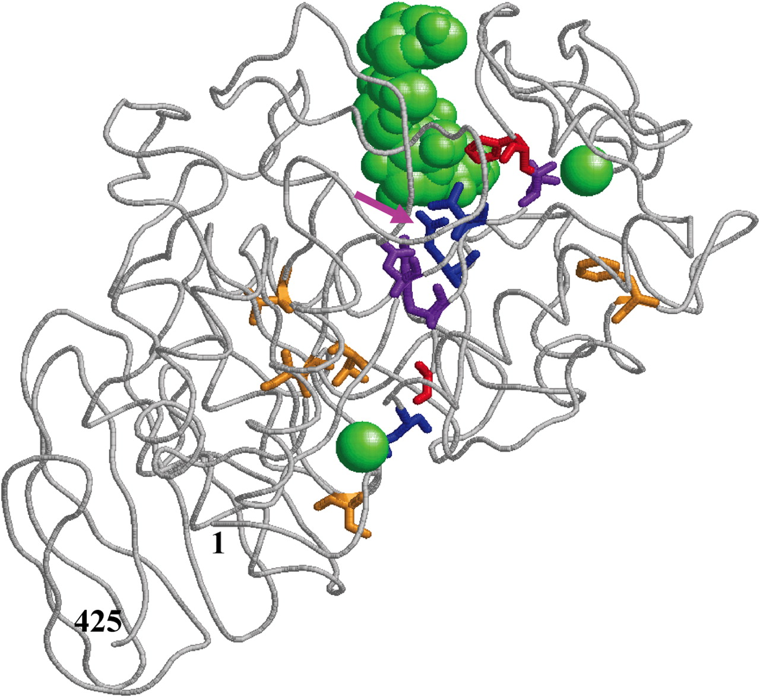
Fig. 5 Results for the TIM-barrel hydrolases. The predictions are mapped on the structure of the B.subtilis ...
Notes:
Fig. 5 Results for the TIM-barrel hydrolases. The predictions are mapped on the structure of the B.subtilis α-Amylase complexed with maltopentaose (PDB 1bag) (Fujimoto et al., 1998). The bound maltopentaose and the two calcium ions are colored green. The color code for the predicted positions is the same as for Figures 3 and 4. The pink arrow marks the E208Q mutant (Fujimoto et al., 1998). Additionally, the residues predicted by the MB-method (del Sol Mesa et al., 2003) based on the phylogeny implicit in the alignment are shown in sticks and colored yellow (except D97 which is also predicted by Xdet and MCdet and hence colored purple).
Unless provided in the caption above, the following copyright applies to the content of this slide: © The Author 2006. Published by Oxford University Press. All rights reserved. For Permissions, please email: journals.permissions@oxfordjournals.orgThe online version of this article has been published under an open access model. Users are entitled to use, reproduce, disseminate, or display the open access version of this article for non-commercial purposes provided that: the original authorship is properly and fully attributed; the Journal and Oxford University Press are attributed as the original place of publication with the correct citation details given; if an article is subsequently reproduced or disseminated not in its entirety but only in part or as a derivative work this must be clearly indicated. For commercial re-use, please contact journals.permissions@oxfordjournals.org

Slide 6
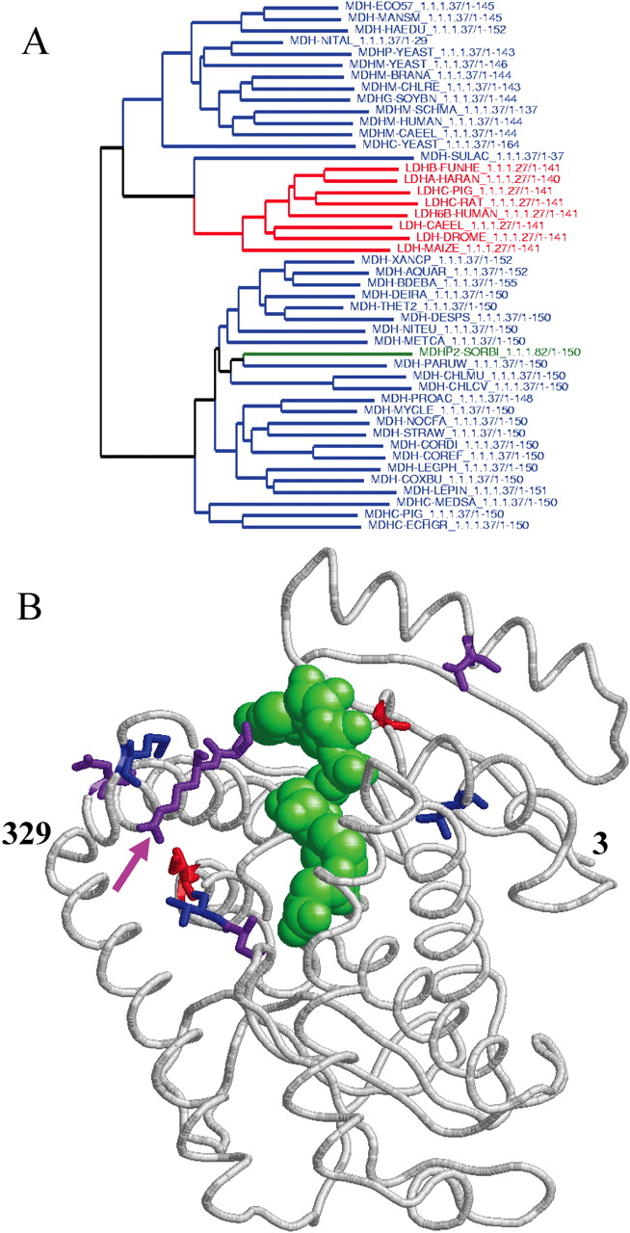
Fig. 6 Results for the Lactate/malate dehydrogenases. (A) Phylogenetic tree generated with Belvu from the MSA of the ...
Notes:
Fig. 6 Results for the Lactate/malate dehydrogenases. (A) Phylogenetic tree generated with Belvu from the MSA of the lactate/malate dehydrogenases described in Methods. MDHs are colored blue while LDHs are colored red. The green protein is a MDH which uses NADPH instead of NADH as cofactor. (B) Positions predicted by both methods mapped on the structure of the Aquaspirillum Arcticum malate dehydrogenase (PDB 1b8u). Color code as in Figures 3–5. The bound NAD is colored green. Position 95 (R in MDH; Q in LDH) is marked with a pink arrow.
Unless provided in the caption above, the following copyright applies to the content of this slide: © The Author 2006. Published by Oxford University Press. All rights reserved. For Permissions, please email: journals.permissions@oxfordjournals.orgThe online version of this article has been published under an open access model. Users are entitled to use, reproduce, disseminate, or display the open access version of this article for non-commercial purposes provided that: the original authorship is properly and fully attributed; the Journal and Oxford University Press are attributed as the original place of publication with the correct citation details given; if an article is subsequently reproduced or disseminated not in its entirety but only in part or as a derivative work this must be clearly indicated. For commercial re-use, please contact journals.permissions@oxfordjournals.org

