Slide 1
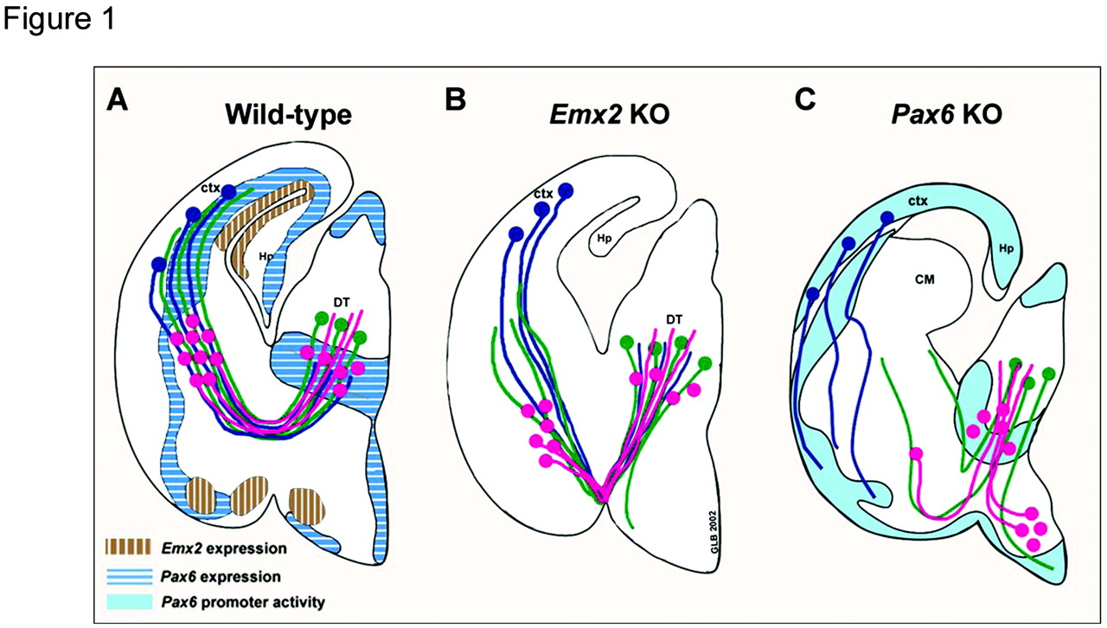
Figure 1. Schematic diagram representing sections through the forebrain of a wild type, Emx2 KO and Pax6 KO brain. The ...
Notes:
Figure 1. Schematic diagram representing sections through the forebrain of a wild type, Emx2 KO and Pax6 KO brain. The diagrams illustrate the relationship between the developing reciprocal thalamocortical (green) and corticofugal (blue) projections and the early subdivisions of the forebrain around embryonic day 18.5. Pax6 expression is marked with shaded blue, Emx2 expression is labeled with brown in the wild-type (WT). Pax6 promoter activity is marked by light blue as was revealed with β-galactosidase staining in the Pax6/LacZ null mutant. Both Pax6 and Emx2 are expressed outside the dorsal cortex. Pink dots indicate cells in the ventral thalamus and internal capsule with projections to the dorsal thalamus (DT). By E18.5 thalamocortical projections reached the appropriate cortical areas while associating with an early corticofugal fiber scaffold. In the Emx2 KO animals, fasciculation abnormalities occur, and some thalamic projections are misrouted ventrally at the diencephalic–telencephalic border. The aberrant thalamocortical and corticofugal fiber trajectories follow the displaced thalamic projections established earlier by the internal capsule cells. Thalamic projections arrive to the Emx2 KO cortex slightly delayed compared to WT. In the Pax6/LacZ null mutant, cells with dorsal thalamic projections are located in the ventral internal capsule and in the hypothalamus. Some thalamocortical projections follow this aberrant route and descend into the hypothalamus and a subset of fibers cross the diencephalic–telencephalic boundary at altered sites. Although some thalamic projections reach the pallial–subpallial boundary, they fail to interact with the corticofugal projections, which instead of turning into the internal capsule, aim to the ventral pallium. The reporter gene expression pattern is displaced ventrolaterally at the pallial–subpallial boundary and a non-labeled cellular mass (CM) protrudes into the lateral ventricle. Figure based on Jones et al. and López-Bendito et al. (Jones et al., 2002; López-Bendito et al., 2002).
Unless provided in the caption above, the following copyright applies to the content of this slide: © Oxford University Press

Slide 2
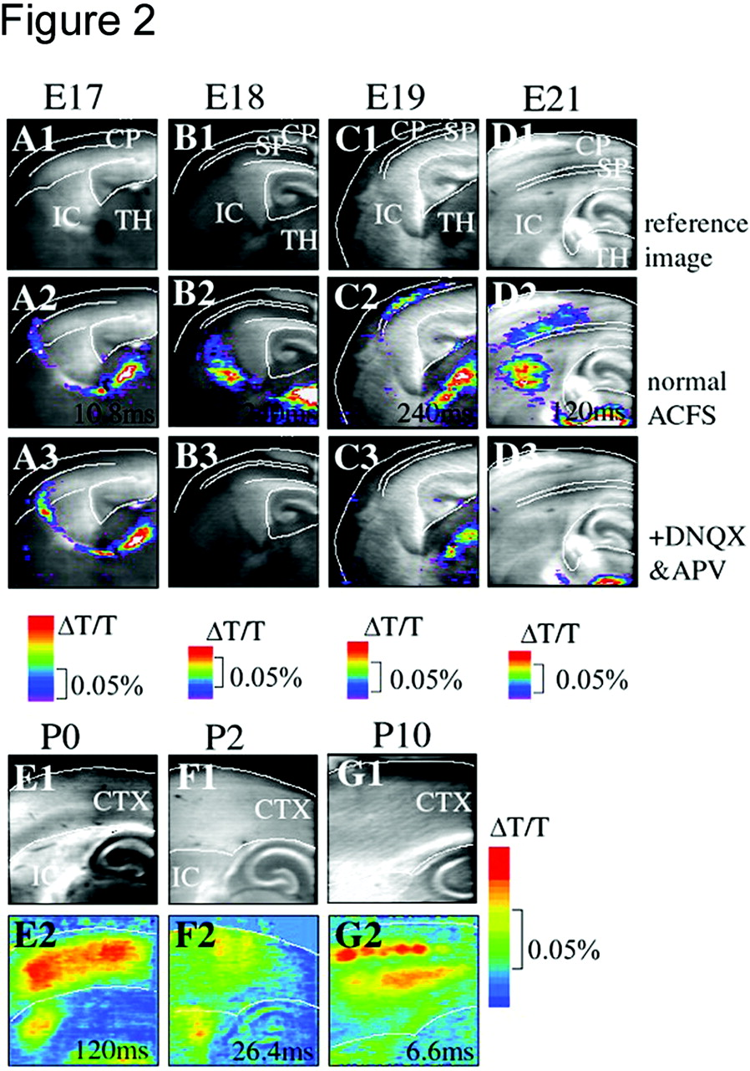
Figure 2. The figure summarizes the embryonic (A–D) and early postnatal (E–G) cortical activation patterns in rat ...
Notes:
Figure 2. The figure summarizes the embryonic (A–D) and early postnatal (E–G) cortical activation patterns in rat revealed with optical recording with voltage sensitive dyes after dorsal thalamic stimulation in thalamocortical slice preparations. Each age is represented by a column; comprised of reference image (top row) and a selected frame of the recording at the peak of the response (time is indicated in milliseconds) viewed with ×4 objectives on the Fuji Deltaron 1700 differential image acquisition system. The lower row indicates the image obtained with the same conditions, but after the bath application of DNQX and APV. Short depolarization, which probably represent spikes, reach the cortex by E17 (A). Sustained depolarization, corresponding to postsynaptic responses appear in the subplate at E19 (C). These are blocked after the application of DNQX and APV (C2). The responses extend through the cortical plate by E21 (D). During postnatal ages the optical response develops much stronger than seen prenatal stages and then periphery-related columnar patterning was apparent from P2 (F), which is refined to layers 4 and 6 by P10 (G). Figure based on Higashi et al. (Higashi et al., 2002).
Unless provided in the caption above, the following copyright applies to the content of this slide: © Oxford University Press

Slide 3
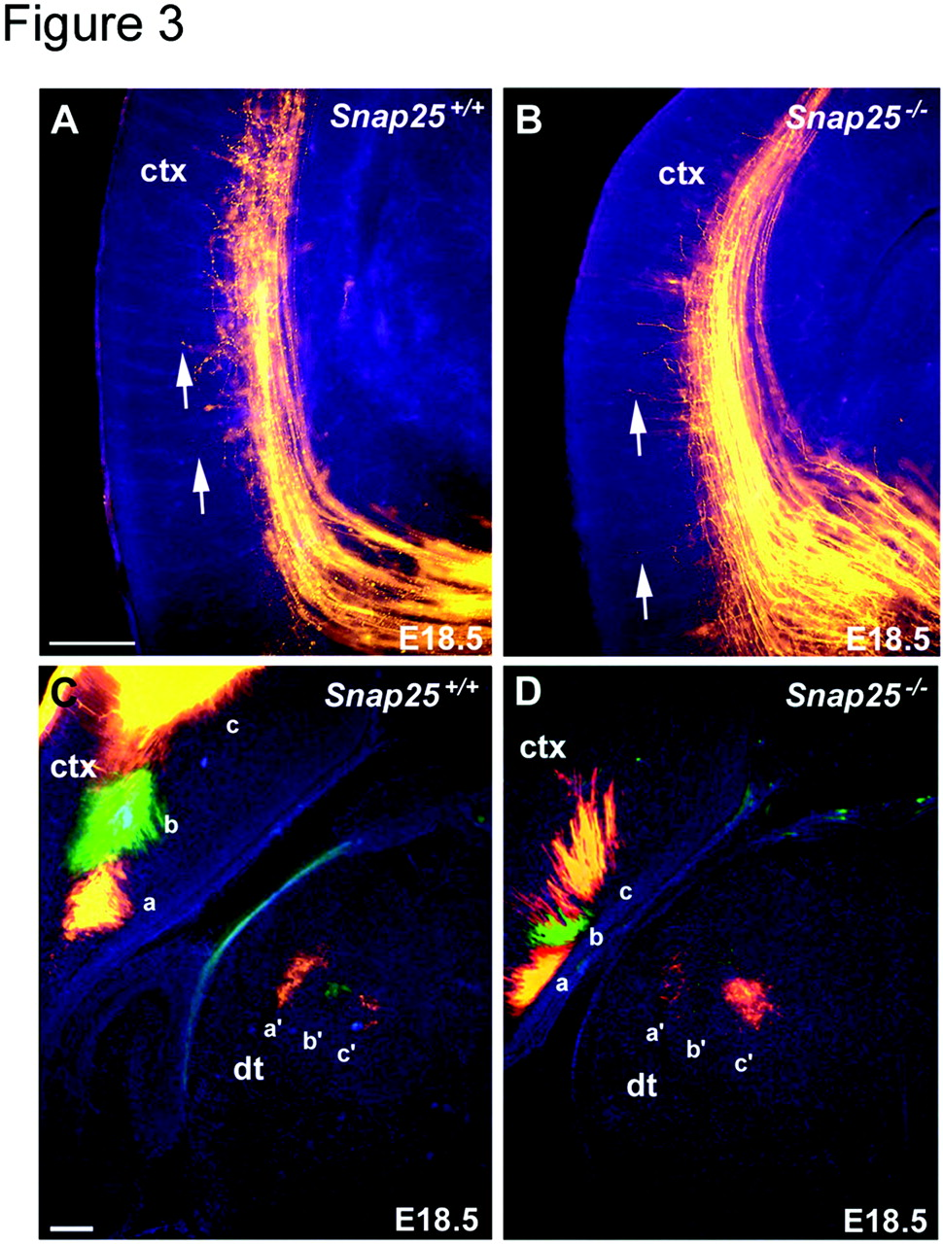
Figure 3. Comparison of thalamocortical fiber outgrowth and topography of the early innervation of the cortex revealed ...
Notes:
Figure 3. Comparison of thalamocortical fiber outgrowth and topography of the early innervation of the cortex revealed with carbocyanine dye tracing from the dorsal thalamus (A and B) or from cortex (C and D) in Snap25 KO brain at E18.5. Corresponding coronal sections are photographed with appropriate filters to reveal the bisbenzimide counterstain (blue) and the DiI labeling (orange/red). Thalamic axons traverse the internal capsule as an organized array of fiber bundles, then defasciculated and turn dorsally to extend through the intermediate zone and subplate below the cortical plate. Although there are slight individual variations in maturity within individual litter, there is no consistent difference between Snap25+/+ (A) and Snap25–/– (B) brains in the state of advancement (arrows), branch formation of thalamocortical fibers. (C, D) Normal targeting of thalamic axons revealed from multiple carbocyanine dye placements to the cortex at E18.5. Posterior cortical crystal placement (a) revealed a group of cells in the lateral thalamus (a′), whereas progressively more anterior crystal placements (b, c) labeled more medial thalamic regions (b′, c′). The pattern was identical in wild-type and null mutants. Scale bar: 200 μm for A–D. Figure is based on Molnár et al. (Molnár et al., 2002).
Unless provided in the caption above, the following copyright applies to the content of this slide: © Oxford University Press

