Slide 1
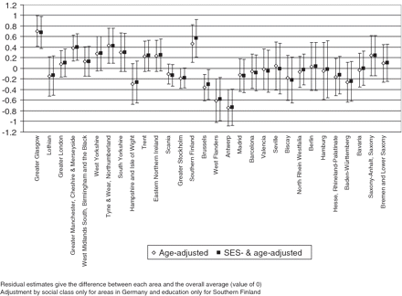
Figure 1 Logistic regression residuals and 95% confidence intervals for self rating of bad/very bad general health for ...
Notes:
Figure 1 Logistic regression residuals and 95% confidence intervals for self rating of bad/very bad general health for men
Unless provided in the caption above, the following copyright applies to the content of this slide: © The Author(s) 2010. Published by Oxford University Press on behalf of the European Public Health Association.This is an Open Access article distributed under the terms of the Creative Commons Attribution Non-Commercial License (http://creativecommons.org/licenses/by-nc/2.5), which permits unrestricted non-commercial use, distribution, and reproduction in any medium, provided the original work is properly cited.

Slide 2
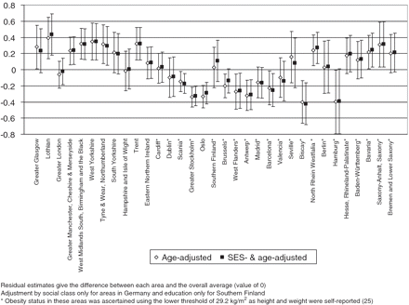
Figure 2 Logistic regression residuals and 95% confidence intervals for obesity for men
Notes:
Figure 2 Logistic regression residuals and 95% confidence intervals for obesity for men
Unless provided in the caption above, the following copyright applies to the content of this slide: © The Author(s) 2010. Published by Oxford University Press on behalf of the European Public Health Association.This is an Open Access article distributed under the terms of the Creative Commons Attribution Non-Commercial License (http://creativecommons.org/licenses/by-nc/2.5), which permits unrestricted non-commercial use, distribution, and reproduction in any medium, provided the original work is properly cited.

