Slide 1
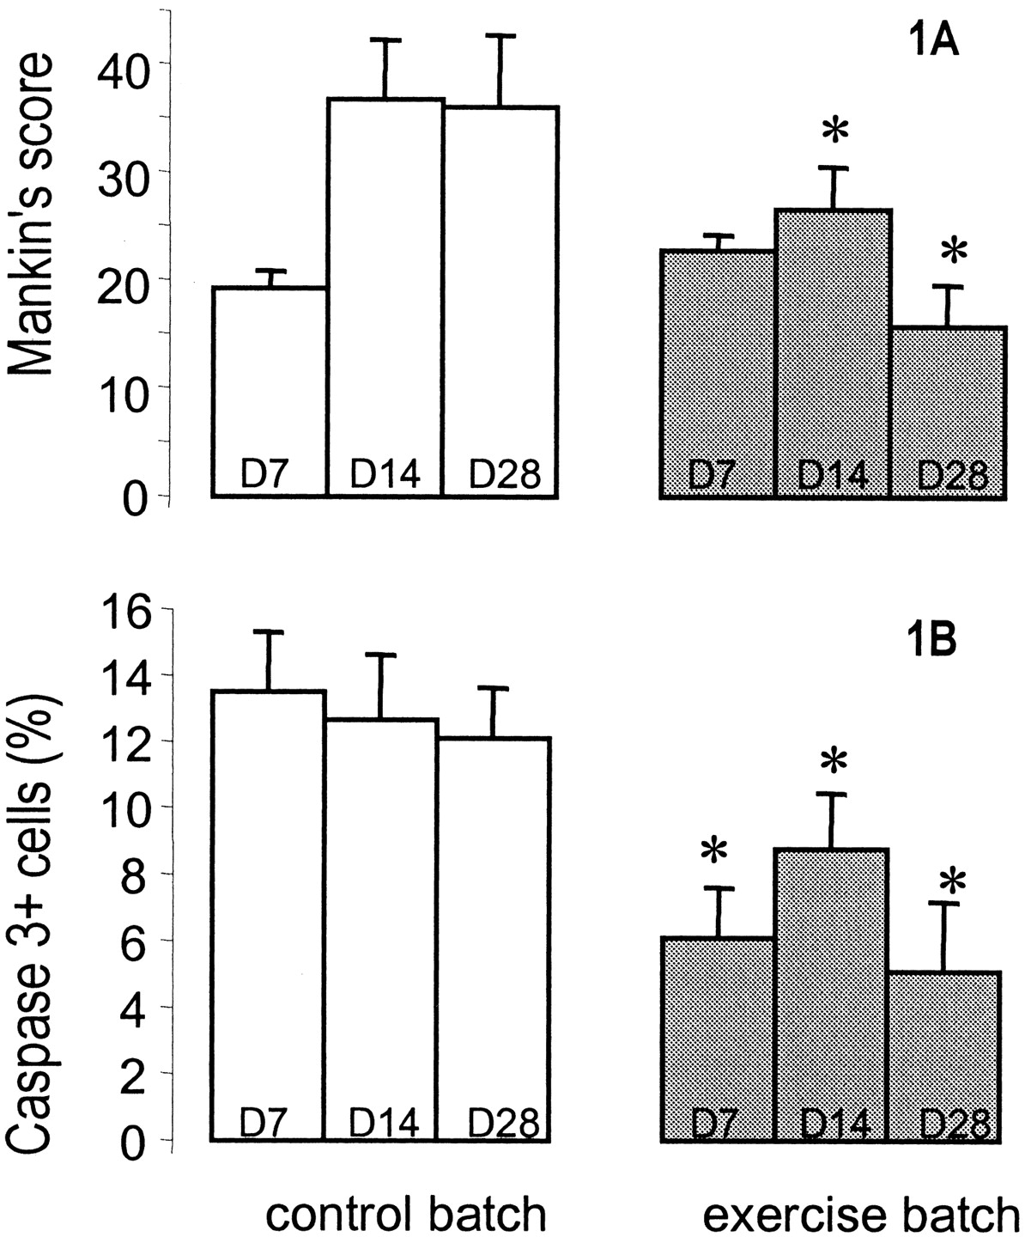
Fig. 1. Time course of OA lesions in control (open columns) and exercised rats (grey columns) that had been subjected ...
Notes:
Fig. 1. Time course of OA lesions in control (open columns) and exercised rats (grey columns) that had been subjected to ACLT. Histological grading was recorded blindly by two observers (LG, SE). Values are mean and s.e.m. for five rats. *P<0.05, exercised rats vs controls at the same times (Student's t test). (A) Histological grading according to Mankin's score, demonstrating the significant beneficial effect of moderate exercise on days 14 and 28. (B) Time course of apoptotic events assessed by immunostaining of activated caspase 3. Note the early apoptotic events in the control group and the significant beneficial effect of exercise on days 7, 14 and 28.
Unless provided in the caption above, the following copyright applies to the content of this slide: Rheumatology 42 ©British Society for Rheumatology 2003; all rights reserved

