Slide 1
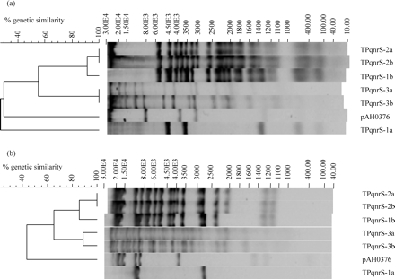
Figure 1. (a) Dendrogram showing PstI restriction digest profiles for qnrS-bearing plasmids. The molecular masses (in ...
Notes:
Figure 1. (a) Dendrogram showing PstI restriction digest profiles for qnrS-bearing plasmids. The molecular masses (in bp) of the fragments generated were calculated by comparison with a Lambda EcoRI/HindIII digest molecular weight ladder (ABgene, Surrey, UK). (b) Dendrogram showing HpaI restriction digest profiles for qnrS-bearing plasmids.
Unless provided in the caption above, the following copyright applies to the content of this slide: © The Author 2007. Published by Oxford University Press on behalf of the British Society for Antimicrobial Chemotherapy. All rights reserved. For Permissions, please e-mail: journals.permissions@oxfordjournals.org

