Slide 1
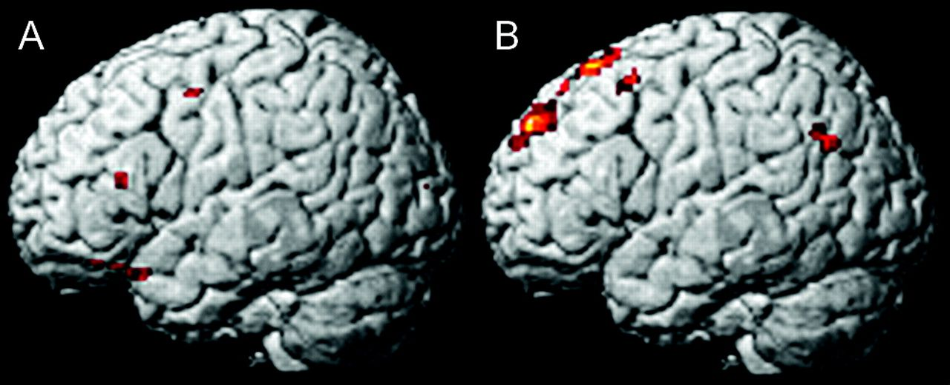
Figure 1. Images showing brain activations in response to (A) MB − N condition and (B) MD − N condition. (A) ...
Notes:
Figure 1. Images showing brain activations in response to (A) MB − N condition and (B) MD − N condition. (A) Significant activation in OFC is shown. (B) Significant activations in MPFC and pSTS are shown.
Unless provided in the caption above, the following copyright applies to the content of this slide: © The Author 2008. Published by Oxford University Press. All rights reserved. For permissions, please e-mail: journals.permissions@oxfordjournals.org

Slide 2
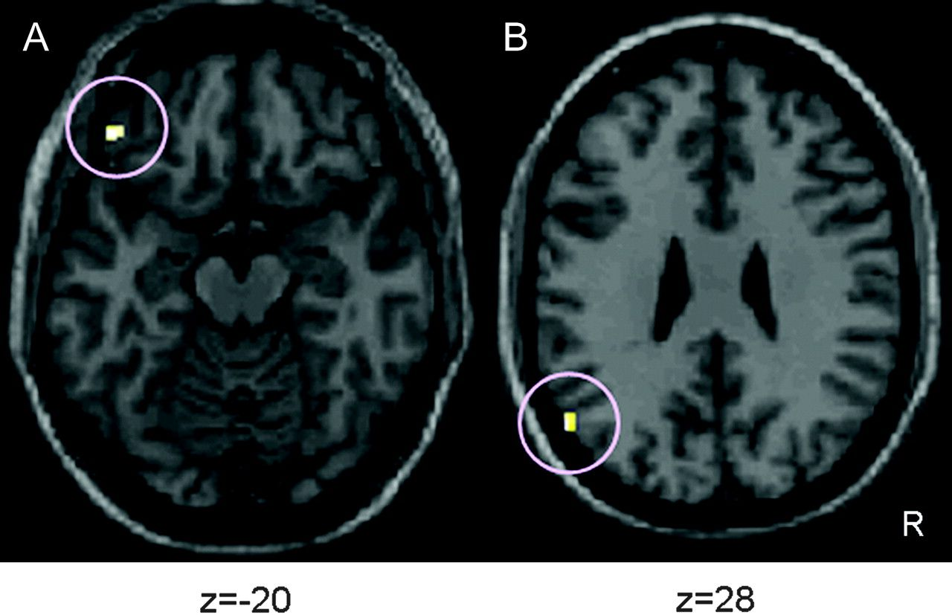
Figure 2. Correlations between self-ratings of (A) praiseworthiness (B) blameworthiness and brain activations. (A) ...
Notes:
Figure 2. Correlations between self-ratings of (A) praiseworthiness (B) blameworthiness and brain activations. (A) Correlation between self-rating of praiseworthiness and degree of activation in left OFC in MB − N contrast. (B) Correlations between self-rating of blameworthiness and degree of activation in pSTS in MD − N contrast. Within the images, R indicates right. Numbers at bottom indicate coordinates of Montreal Neurological Institute brain.
Unless provided in the caption above, the following copyright applies to the content of this slide: © The Author 2008. Published by Oxford University Press. All rights reserved. For permissions, please e-mail: journals.permissions@oxfordjournals.org

Slide 3
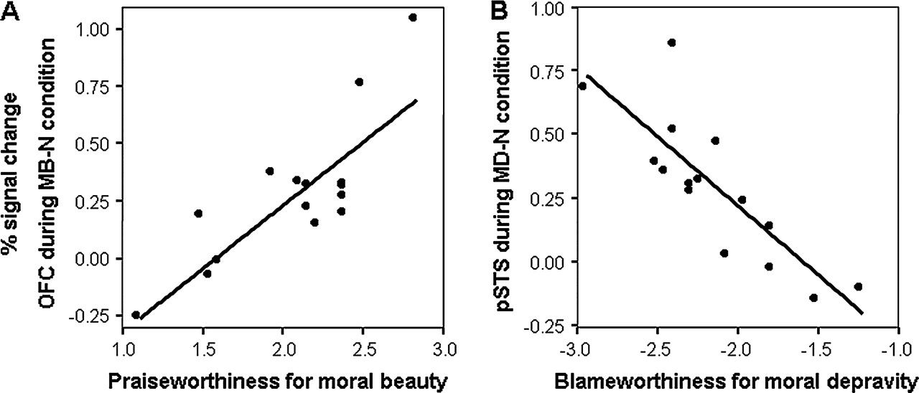
Figure 3. Regression lines of correlations between (A) praiseworthiness (B) blameworthiness and degree of brain ...
Notes:
Figure 3. Regression lines of correlations between (A) praiseworthiness (B) blameworthiness and degree of brain activation. (A) There were correlations (r = 0.82, degrees of freedom [df] = 13, P < 0.001) between self-rating of praiseworthiness and degree of activation in OFC. (B) There were positive linear correlations (r = −0.83, df = 13, P < 0.001) between self-rating of blameworthiness and degree of activation in pSTS.
Unless provided in the caption above, the following copyright applies to the content of this slide: © The Author 2008. Published by Oxford University Press. All rights reserved. For permissions, please e-mail: journals.permissions@oxfordjournals.org

