Slide 1
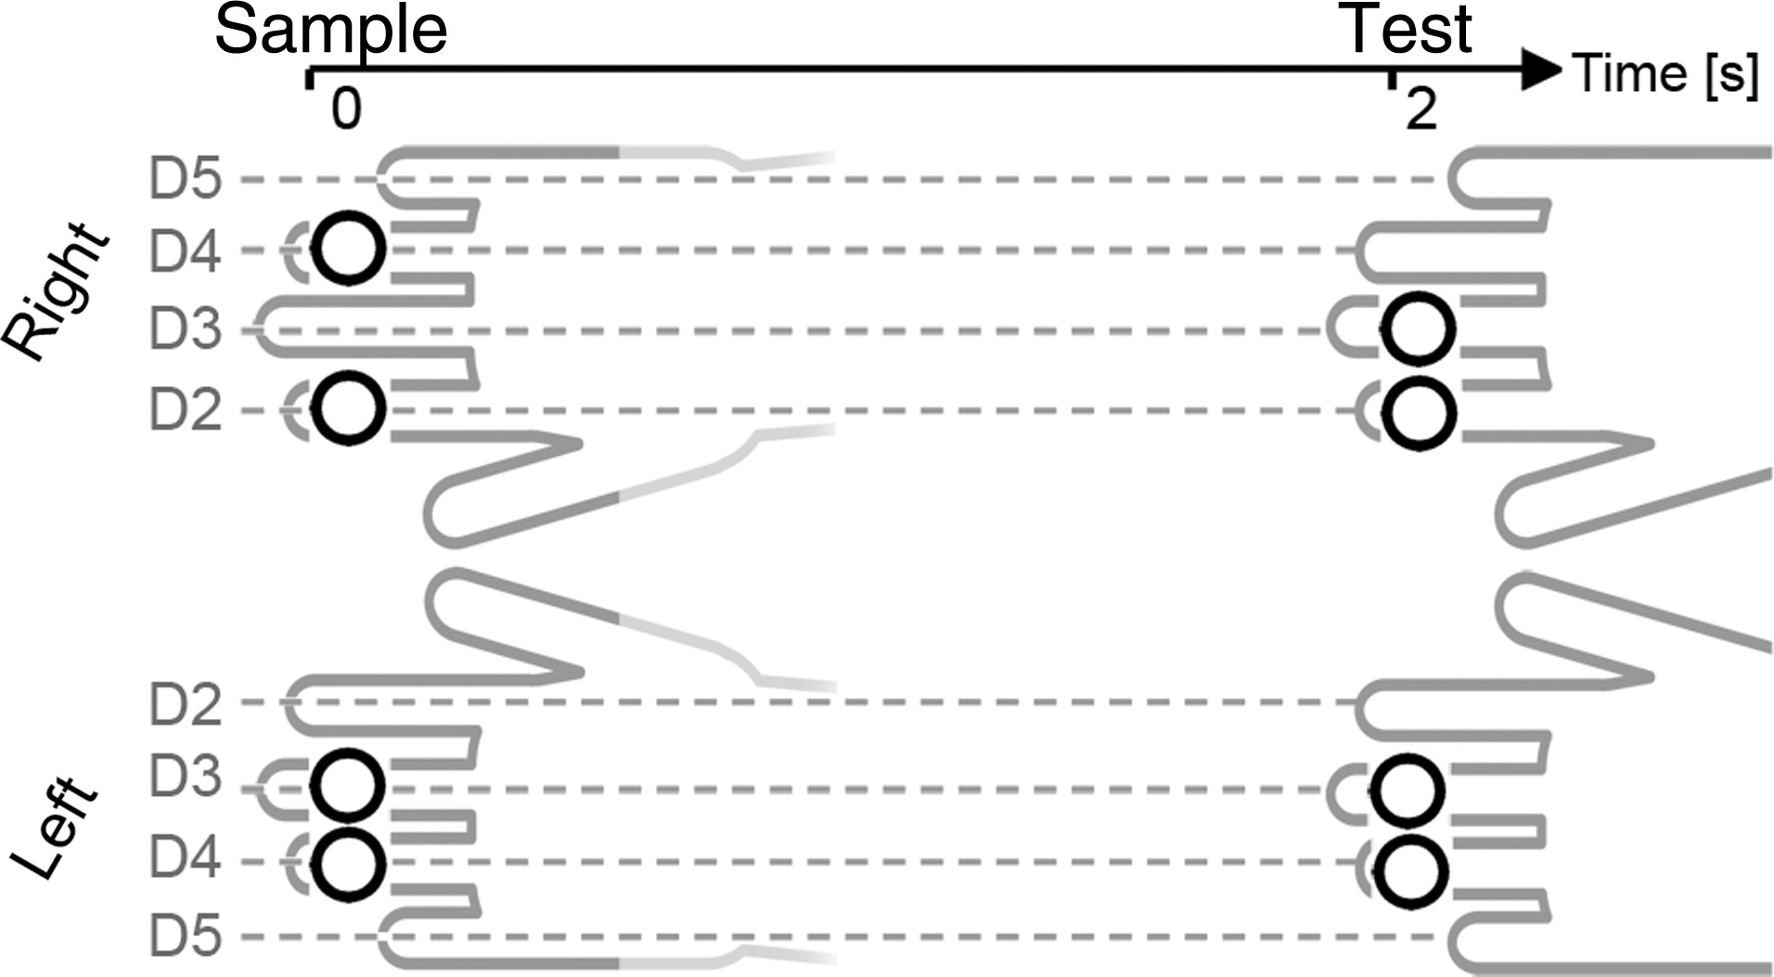
Figure 1. Illustration of the experimental setup. Participants memorized a tactile sample set at one task-relevant hand ...
Notes:
Figure 1. Illustration of the experimental setup. Participants memorized a tactile sample set at one task-relevant hand to compare it with a test set on the same hand after a 2-s retention period. Memory load was varied between trials (low load: one pulse, high load: two pulses per hand). The relevant hand (left, right) was varied between blocks. The example shown here illustrates a high-load trial where the locations of tactile sample and test stimuli (symbolized by white dots) are identical at the left hand (match), but not at the right hand (mismatch).
Unless provided in the caption above, the following copyright applies to the content of this slide: © The Author 2014. Published by Oxford University Press. All rights reserved. For Permissions, please e-mail: journals.permissions@oup.com

Slide 2
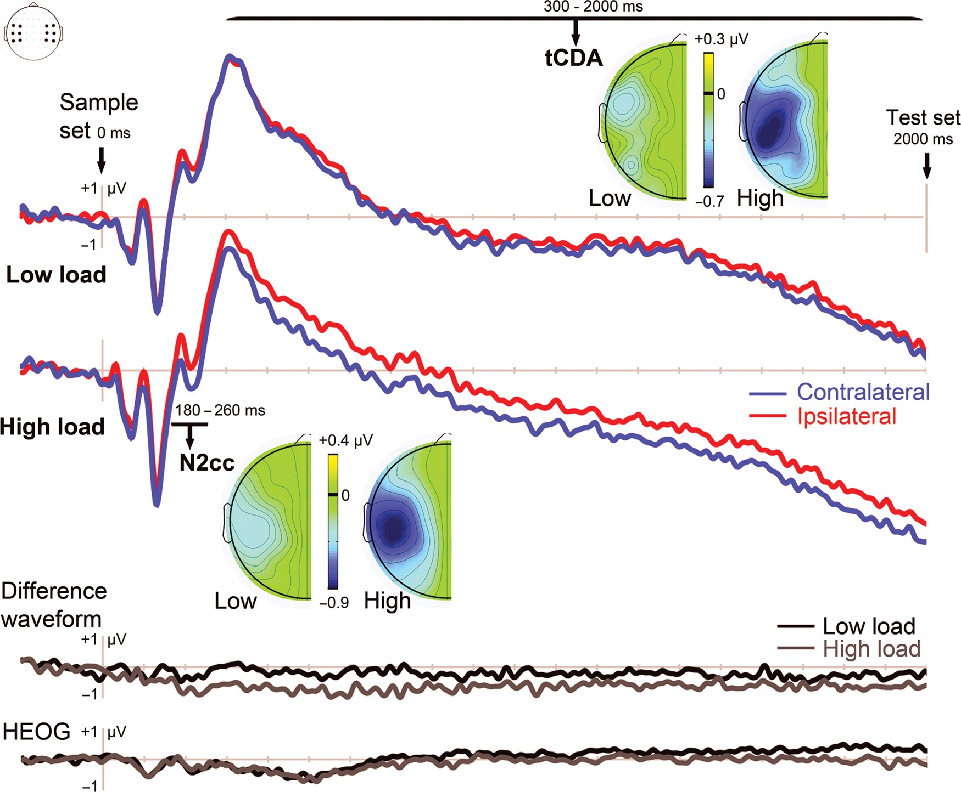
Figure 2. Grand mean ERPs elicited in the 2000-ms interval following sample stimulus onset in the low-load and ...
Notes:
Figure 2. Grand mean ERPs elicited in the 2000-ms interval following sample stimulus onset in the low-load and high-load conditions. ERPs were averaged across lateral central electrode clusters contralateral (blue lines) and ipsilateral (red lines) to the hand where the memory task was performed. Difference maps show the topographical distribution of lateralized effects in the N2cc (bottom) and tCDA (top) time windows. These maps represent the amplitude difference of contralateral minus ipsilateral recordings, collapsed across blocks where the memory task was performed with the left or right hand. Enhanced contralateral negativities are shown in blue. The two bottom panels show difference waveforms for the low-load and high-load condition, obtained by subtracting electrodes ipsilateral to the task-relevant hand from contralateral electrodes, and HEOG difference waveforms, calculated by subtracting HEOG electrodes ipsilateral to the task-relevant hand from contralateral electrodes after artifact rejection. In these HEOG difference waves, any eye movements toward the task-relevant hand would be reflected by negative (downward) HEOG deflections.
Unless provided in the caption above, the following copyright applies to the content of this slide: © The Author 2014. Published by Oxford University Press. All rights reserved. For Permissions, please e-mail: journals.permissions@oup.com

Slide 3
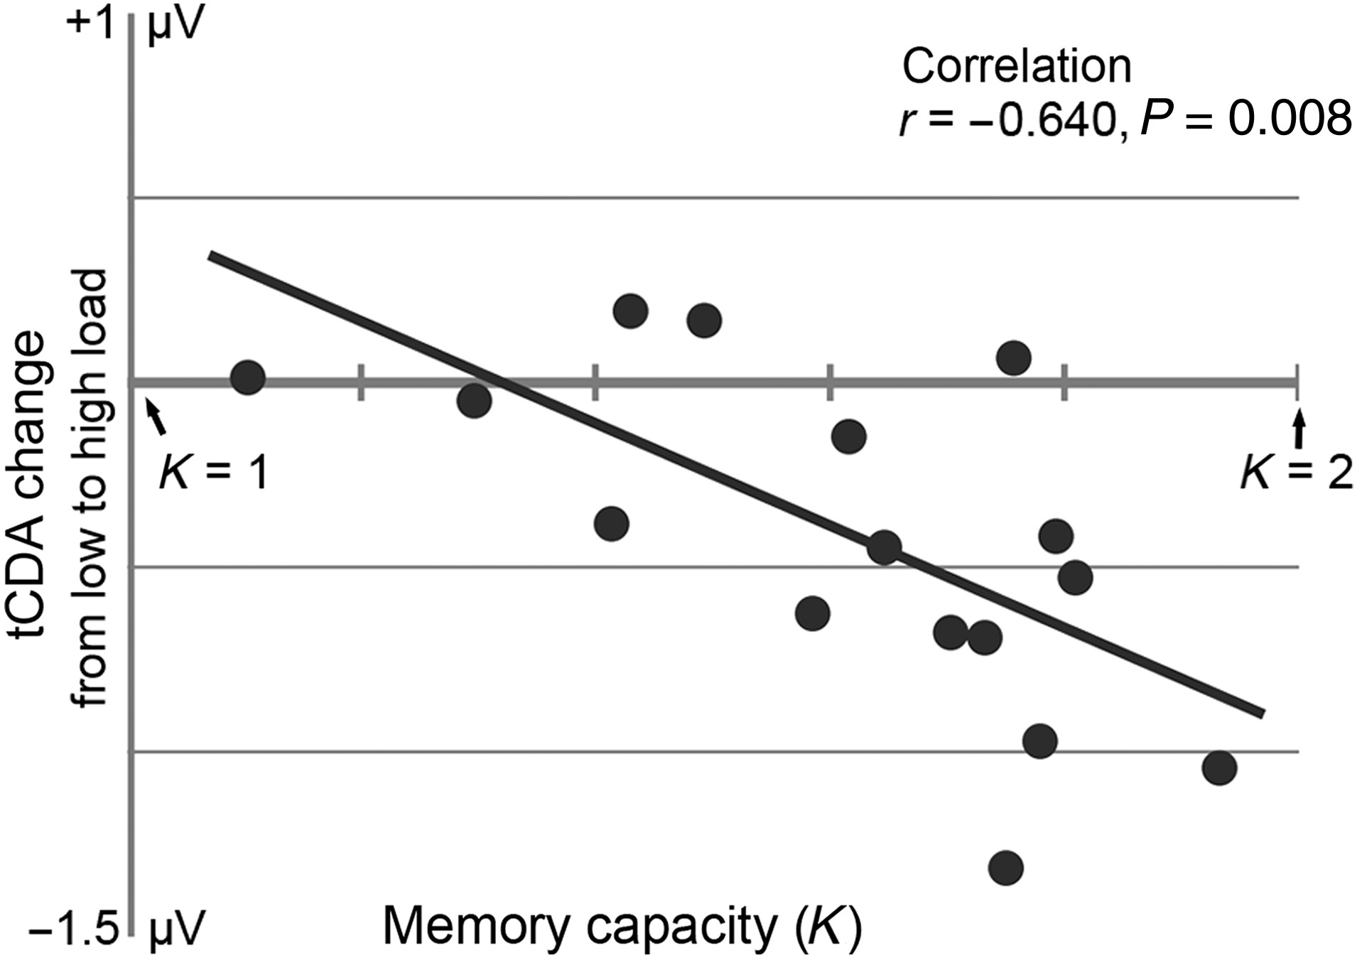
Figure 3. Correlation of individual participant's tactile WM capacity K (x-axis) and the increase of tCDA amplitudes in ...
Notes:
Figure 3. Correlation of individual participant's tactile WM capacity K (x-axis) and the increase of tCDA amplitudes in the high-load relative to the low-load condition measured for each participant (y-axis). K was calculated on the basis of individual performance in the high-load condition.
Unless provided in the caption above, the following copyright applies to the content of this slide: © The Author 2014. Published by Oxford University Press. All rights reserved. For Permissions, please e-mail: journals.permissions@oup.com

Slide 4
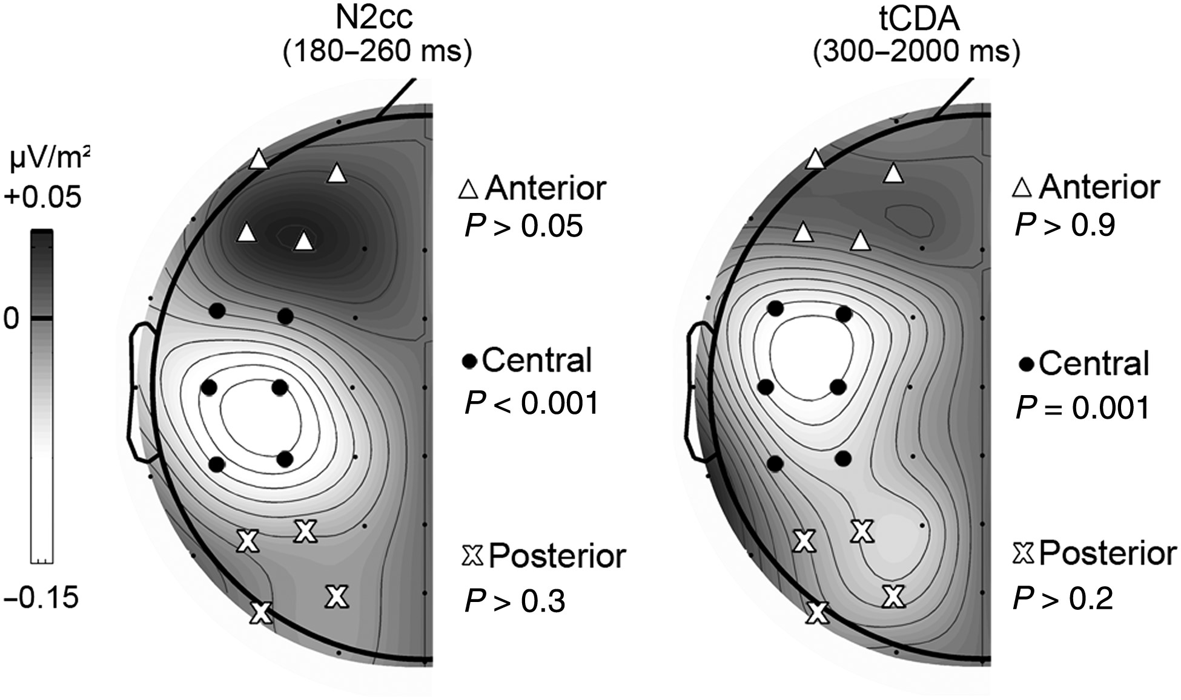
Figure 4. Grand mean CSD topographical maps, showing the scalp distribution of lateralized effects in the N2cc and tCDA ...
Notes:
Figure 4. Grand mean CSD topographical maps, showing the scalp distribution of lateralized effects in the N2cc and tCDA time windows. These maps represent the amplitude difference of contralateral minus ipsilateral recordings, collapsed across blocks where the memory task was performed with the left or right hand, and averaged across the low- and high-load conditions. Six electrodes at lateral central scalp regions (black dots) were averaged for each recording cluster (contra- and ipsilateral to the task-relevant hand). The presence of lateralized effects was also tested for different sets of electrodes over anterior (white triangles) and posterior (white crosses) scalp areas. Reliable lateralized effects were present only for the central electrode cluster.
Unless provided in the caption above, the following copyright applies to the content of this slide: © The Author 2014. Published by Oxford University Press. All rights reserved. For Permissions, please e-mail: journals.permissions@oup.com

