Slide 1
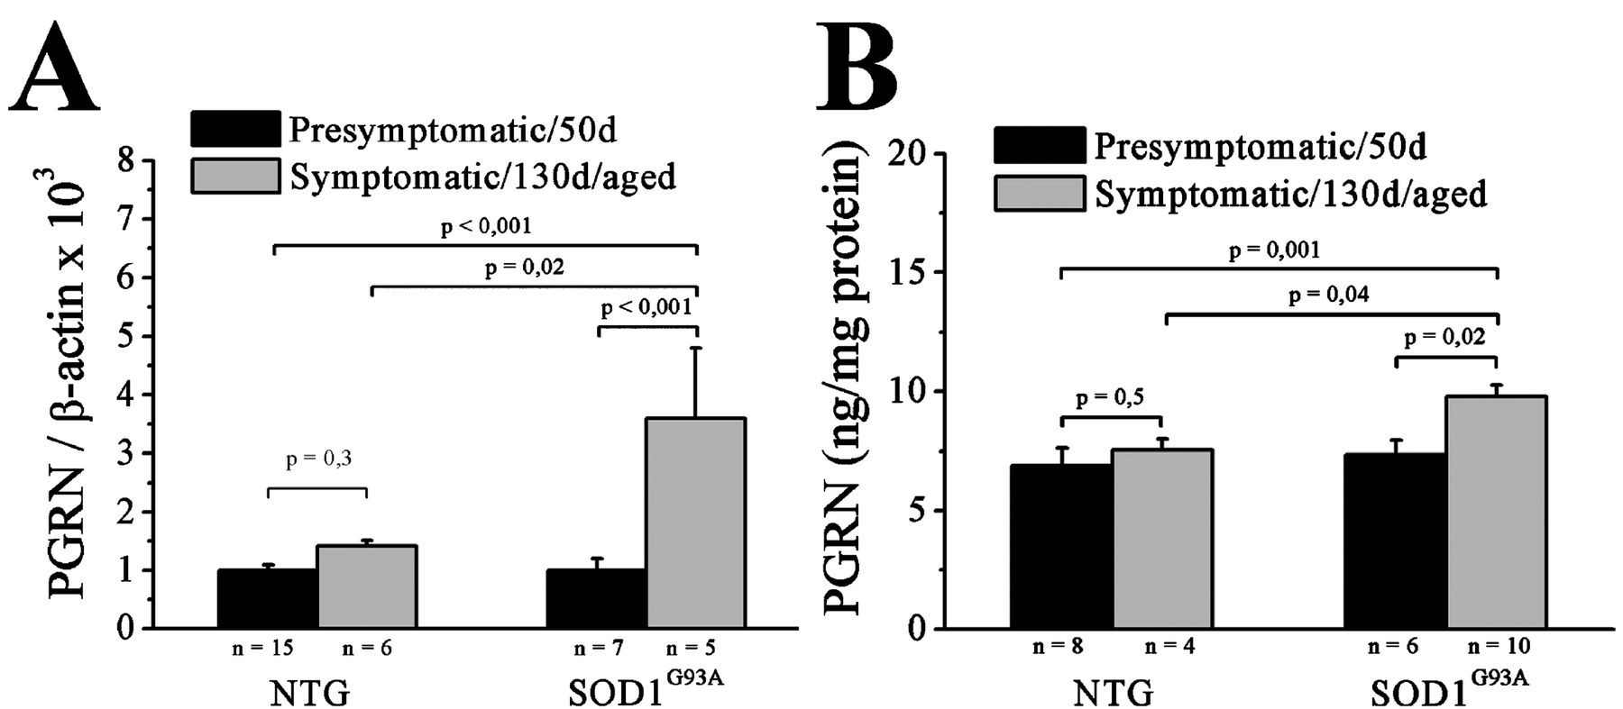
FIGURE 1 Progranulin (PGRN) mRNA and protein levels increase with motor neuron degeneration in mutant ...
Notes:
FIGURE 1 Progranulin (PGRN) mRNA and protein levels increase with motor neuron degeneration in mutant SOD1G93A mice. (A) Spinal cord PGRN mRNA levels measured by quantitative PCR and normalized to presymptomatic stage and β-actin levels in nontransgenic (NTG) and mutant SOD1G93A mice (analysis of variance, F value = 6.5; overall, p = 0.002). (B) Spinal cord PGRN protein levels measured by ELISA normalized to protein content (analysis of variance, F value = 4.9; overall, p = 0.002).
Unless provided in the caption above, the following copyright applies to the content of this slide: Copyright © 2010 by the American Association of Neuropathologists, Inc.

Slide 2
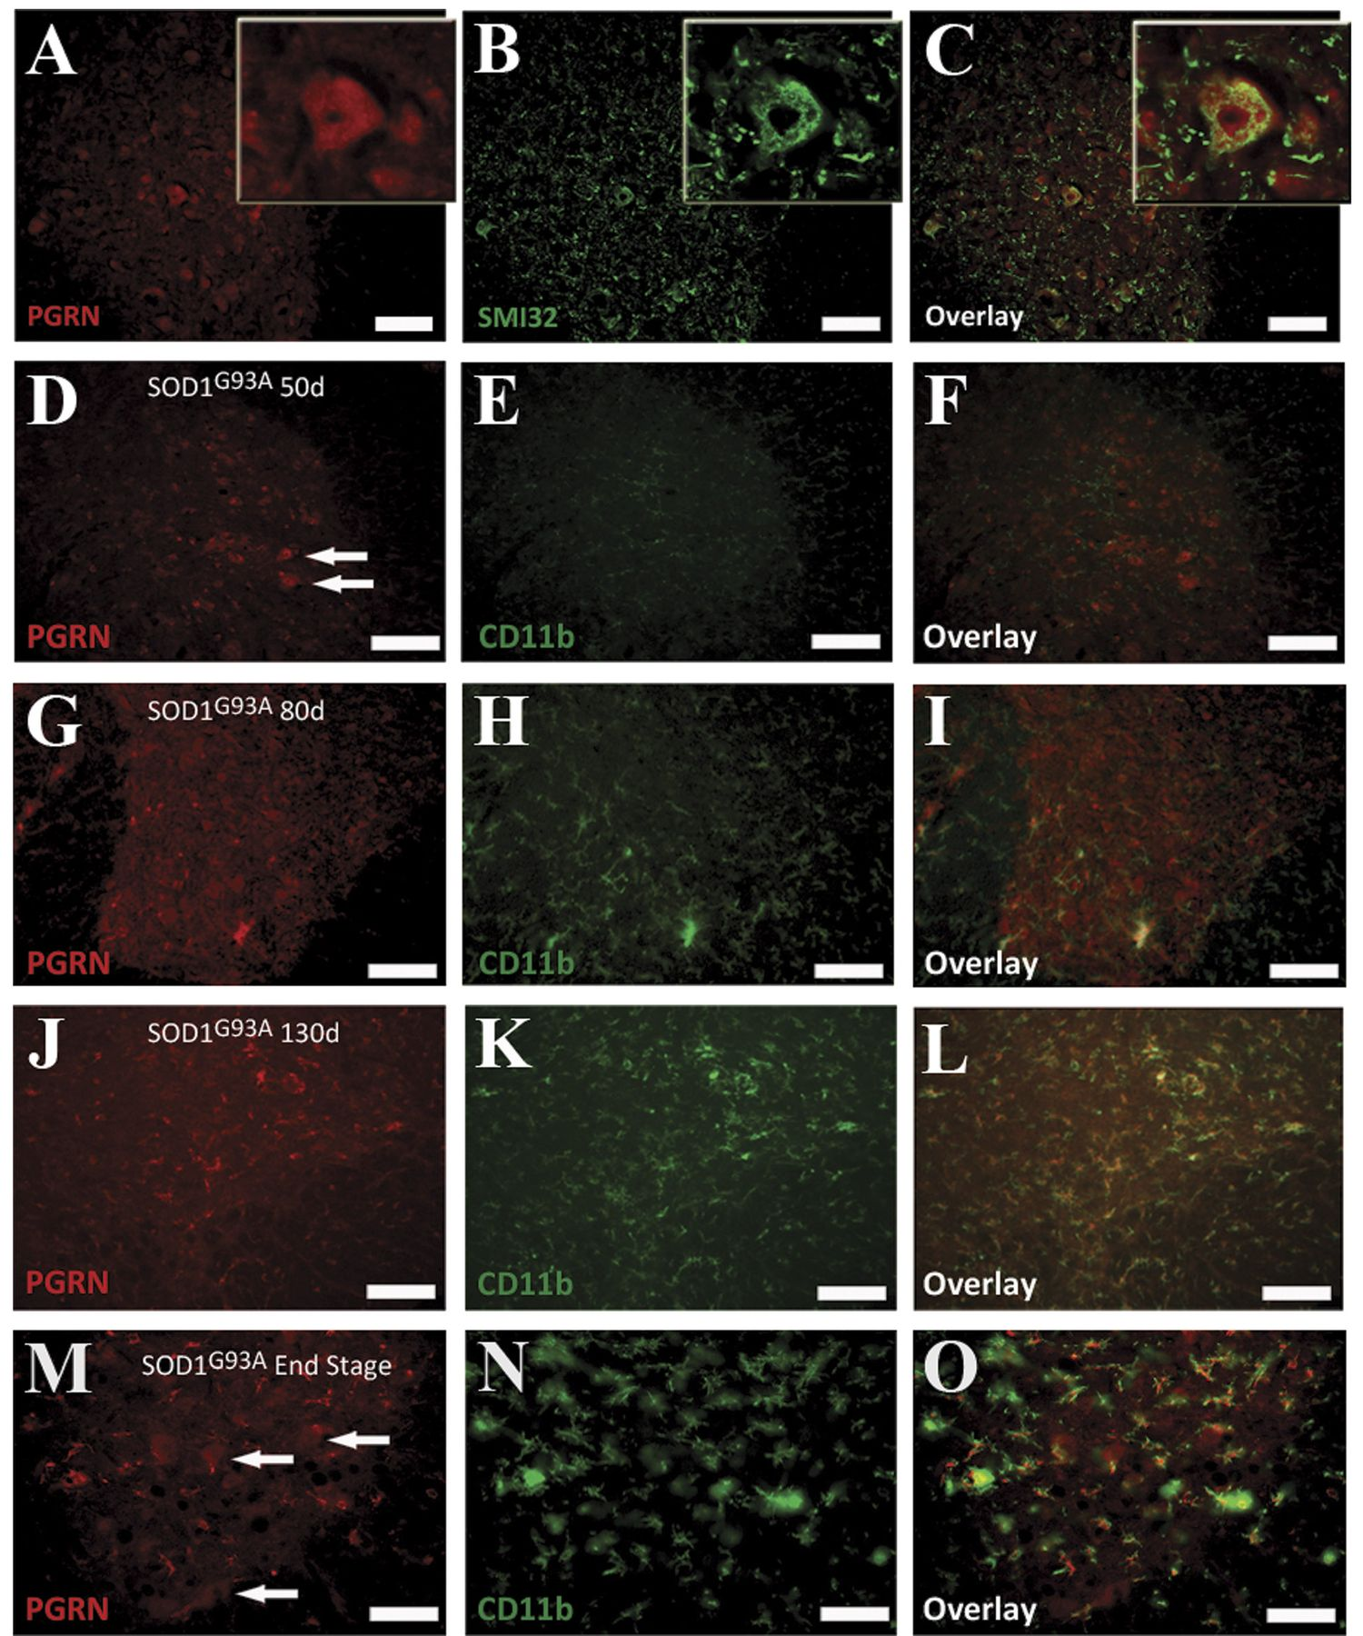
FIGURE 2 Proganulin (PGRN) expression in the mouse spinal cord. (A-C) PGRN⁺ motor neurons in the ventral ...
Notes:
FIGURE 2 Proganulin (PGRN) expression in the mouse spinal cord. (A-C) PGRN+ motor neurons in the ventral horn of the spinal cord. Progranulin staining (A), SMI32 staining (B), and overlay (C) of ventral part of spinal cord from nontransgenic mouse; inset shows detail of motor neuron. (D-L) Proganulin staining of the ventral part of the spinal cord in presymptomatic, early, and late symptomatic mutant SOD1G93A mice (in red, D, G, J), CD11b staining (in green, E, H, K), and overlay (F, I, L); 2 motor neurons are marked by white arrows in D. (D-L) There is a gradual increase in the number of PGRN+ microglia in the spinal cord of mutant SOD1G93A mice. (M-O) At the end stage, surviving cells with motor neuron morphology (CD11b-negative, white arrows) remained PGRN+ in mutant SOD1G93A mice. Scale bar = 50 μm.
Unless provided in the caption above, the following copyright applies to the content of this slide: Copyright © 2010 by the American Association of Neuropathologists, Inc.

Slide 3
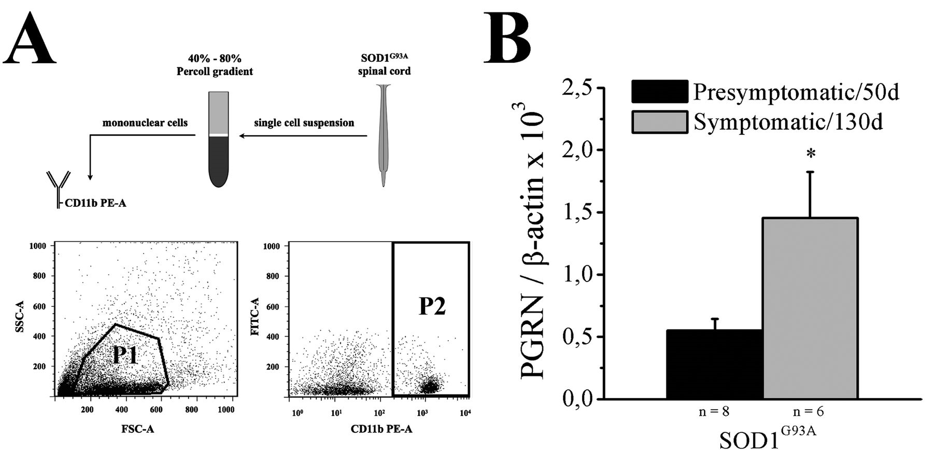
FIGURE 3 Microglial upregulation of progranulin (PRGN). (A) Microglial cells were isolated from adult spinal cord of ...
Notes:
FIGURE 3 Microglial upregulation of progranulin (PRGN). (A) Microglial cells were isolated from adult spinal cord of SOD1G93A mice by loading the cell suspension on a 40% to 80% Percoll gradient. Viable mononuclear cells were gated (P1) and cells immunoreactive for CD11b-phycoerythrin (PE) were collected for further analysis (49). (B) Progranulin mRNA expression measured by quantitative PCR in freshly isolated spinal microglia from presymptomatic and symptomatic mutant SOD1G93A mice (*, p < 0.05).
Unless provided in the caption above, the following copyright applies to the content of this slide: Copyright © 2010 by the American Association of Neuropathologists, Inc.

Slide 4
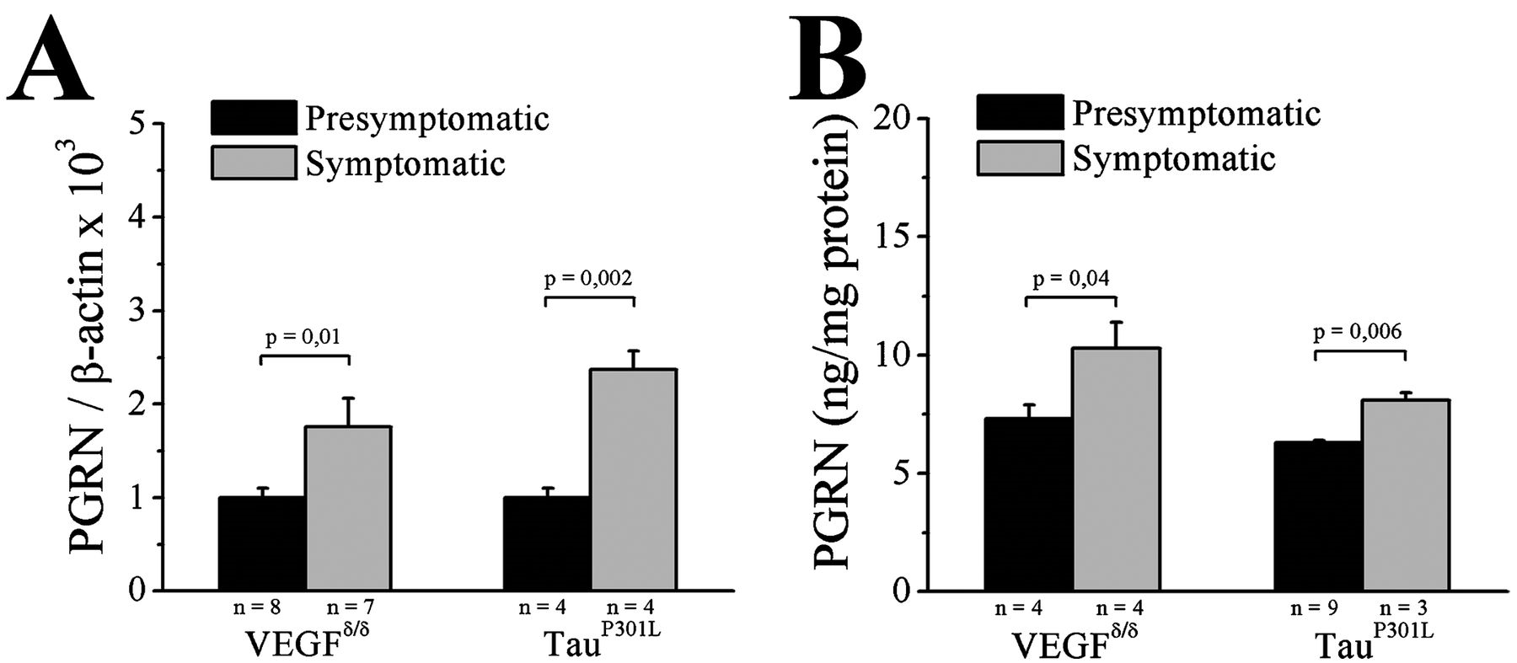
FIGURE 4 Progranulin (PGRN) mRNA and protein levels increase with motor neuron degeneration in VEGF^{δ/δ} and ...
Notes:
FIGURE 4 Progranulin (PGRN) mRNA and protein levels increase with motor neuron degeneration in VEGFδ/δ and mutant tauP301L mice. (A) Spinal cord PGRN mRNA levels measured by quantitative PCR and normalized to β-actin levels in presymptomatic and symptomatic VEGFδ/δ and mutant TauP301L mice. (B) Spinal cord PGRN protein levels measured by ELISA normalized to protein content.
Unless provided in the caption above, the following copyright applies to the content of this slide: Copyright © 2010 by the American Association of Neuropathologists, Inc.

Slide 5
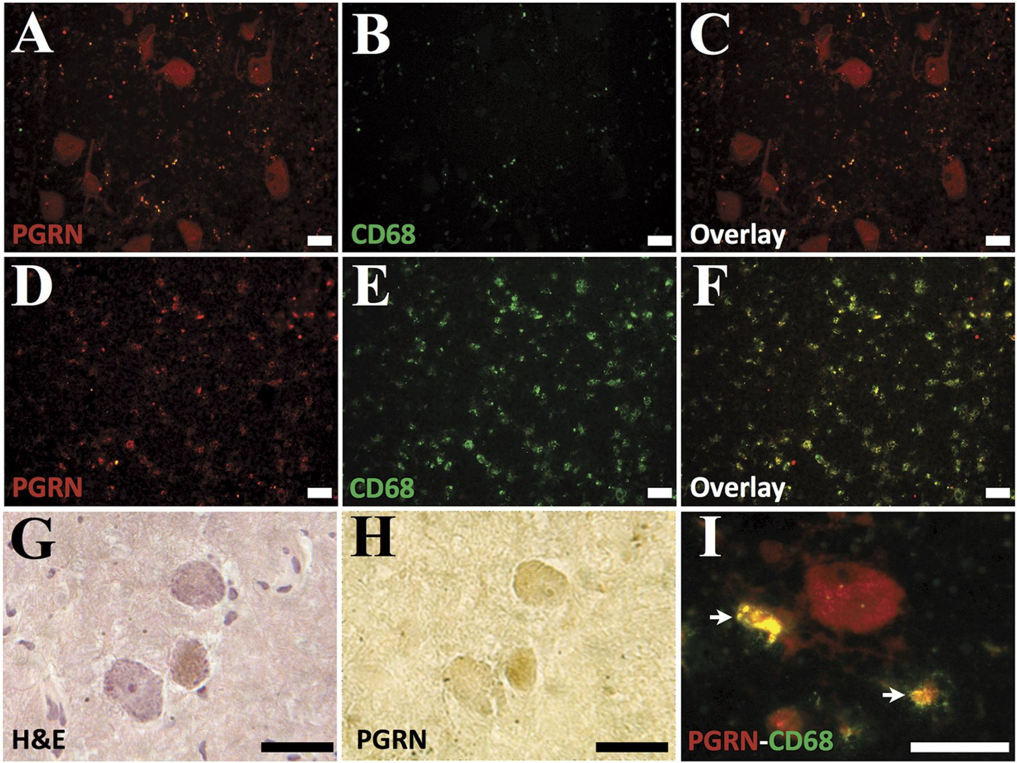
FIGURE 5 Motor neurons and reactive microglia express progranulin (PGRN) in the human spinal cord. (A–I) Progranulin ...
Notes:
FIGURE 5 Motor neurons and reactive microglia express progranulin (PGRN) in the human spinal cord. (A–I) Progranulin staining (red, A, D, I) and CD68 staining (green, B, E, I) of control (A–C) and amyotrophic lateral sclerosis (ALS) (D–F, I) spinal cords. Surviving cells with motor neuron morphology at a higher magnification in the ventral horn of ALS spinal cord on H&E staining remained positive for PGRN (G and H). Fluorescent staining of a CD68-negative PGRN+ cell with motor neuron morphology, surrounded by 2 microglial cells (white arrows) is shown in panel I. Scale bar = 50 μm.
Unless provided in the caption above, the following copyright applies to the content of this slide: Copyright © 2010 by the American Association of Neuropathologists, Inc.

Slide 6
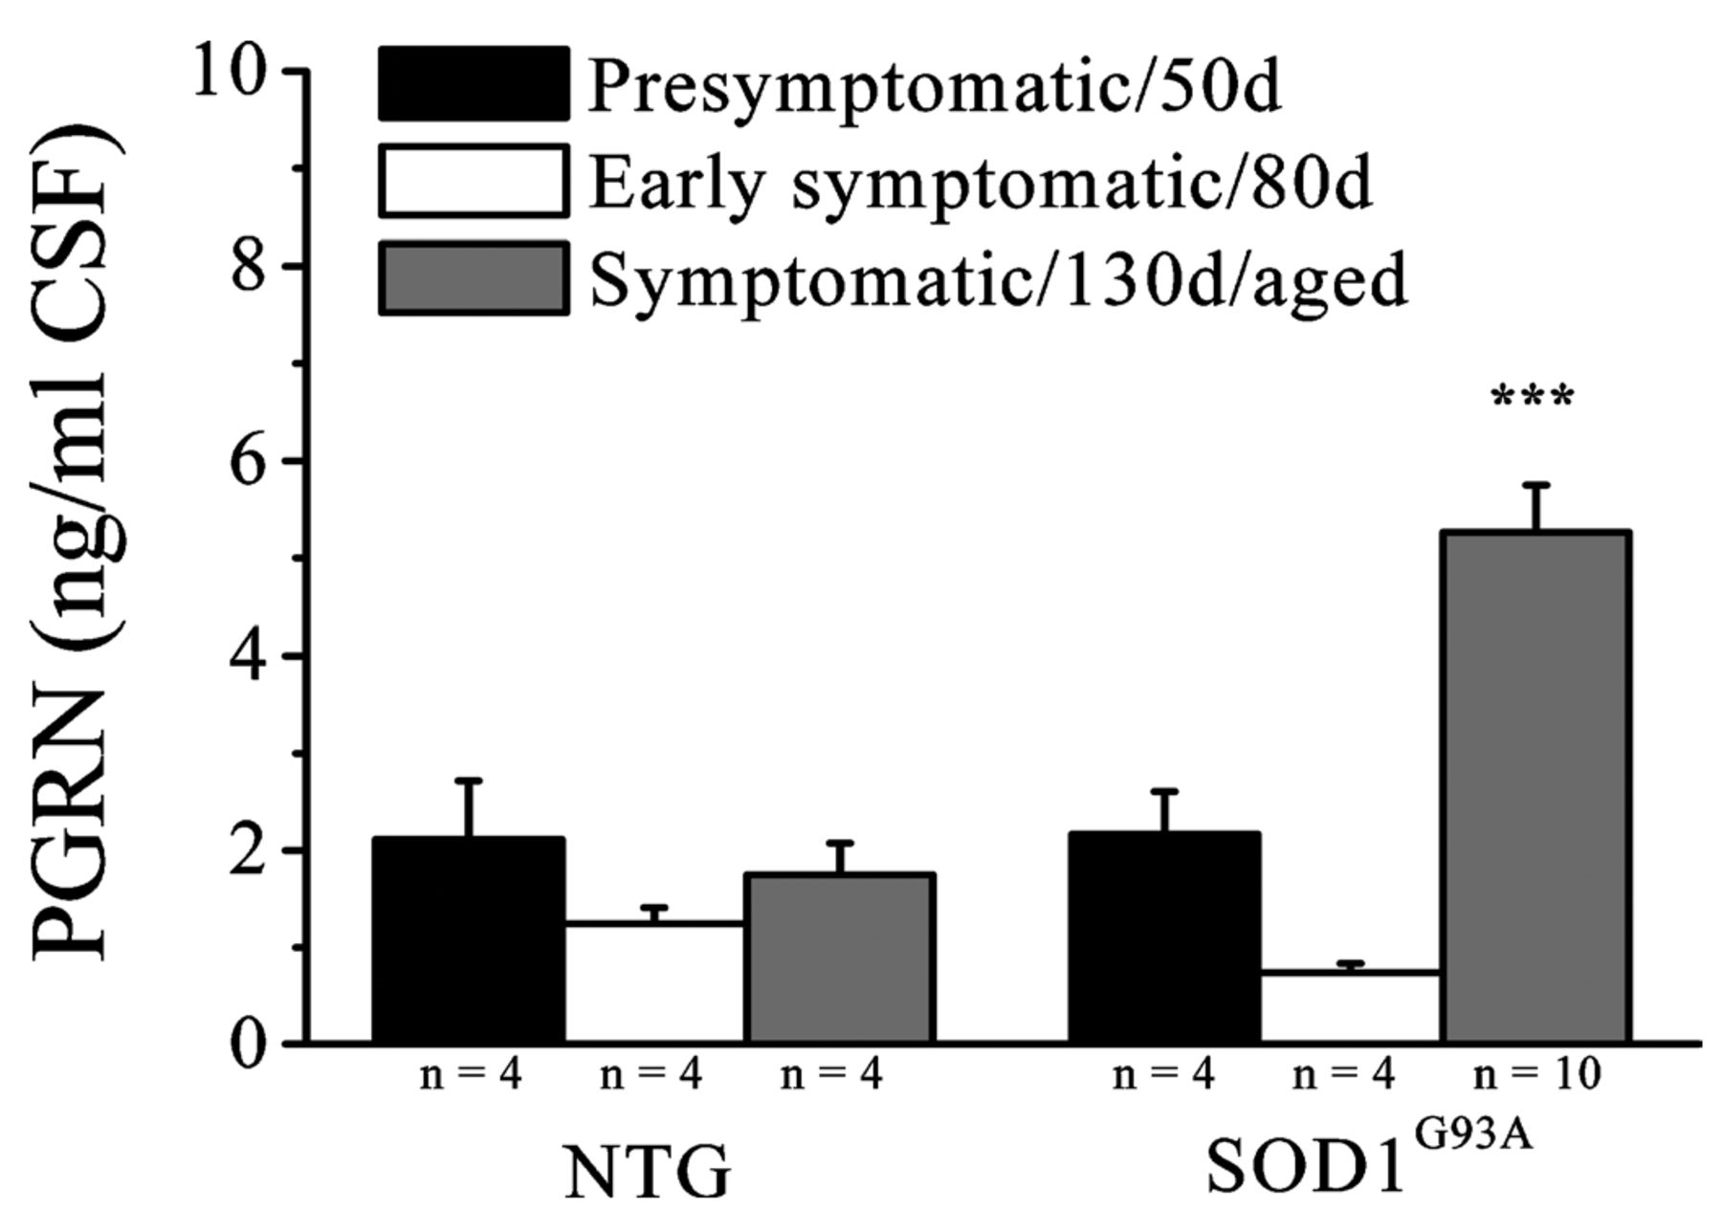
FIGURE 6 Increased progranulin (PGRN) in CSF with disease progression in mutant SOD1^{G93A} mice. ...
Notes:
FIGURE 6 Increased progranulin (PGRN) in CSF with disease progression in mutant SOD1G93A mice. Cerebrospinal fluid PGRN levels measured by ELISA in nontransgenic and mutant SOD1G93A mice (analysis of variance, F value = 15.8; overall, p = 0.000001; ***, p < 0.0001 compared with other groups).
Unless provided in the caption above, the following copyright applies to the content of this slide: Copyright © 2010 by the American Association of Neuropathologists, Inc.

