Slide 1
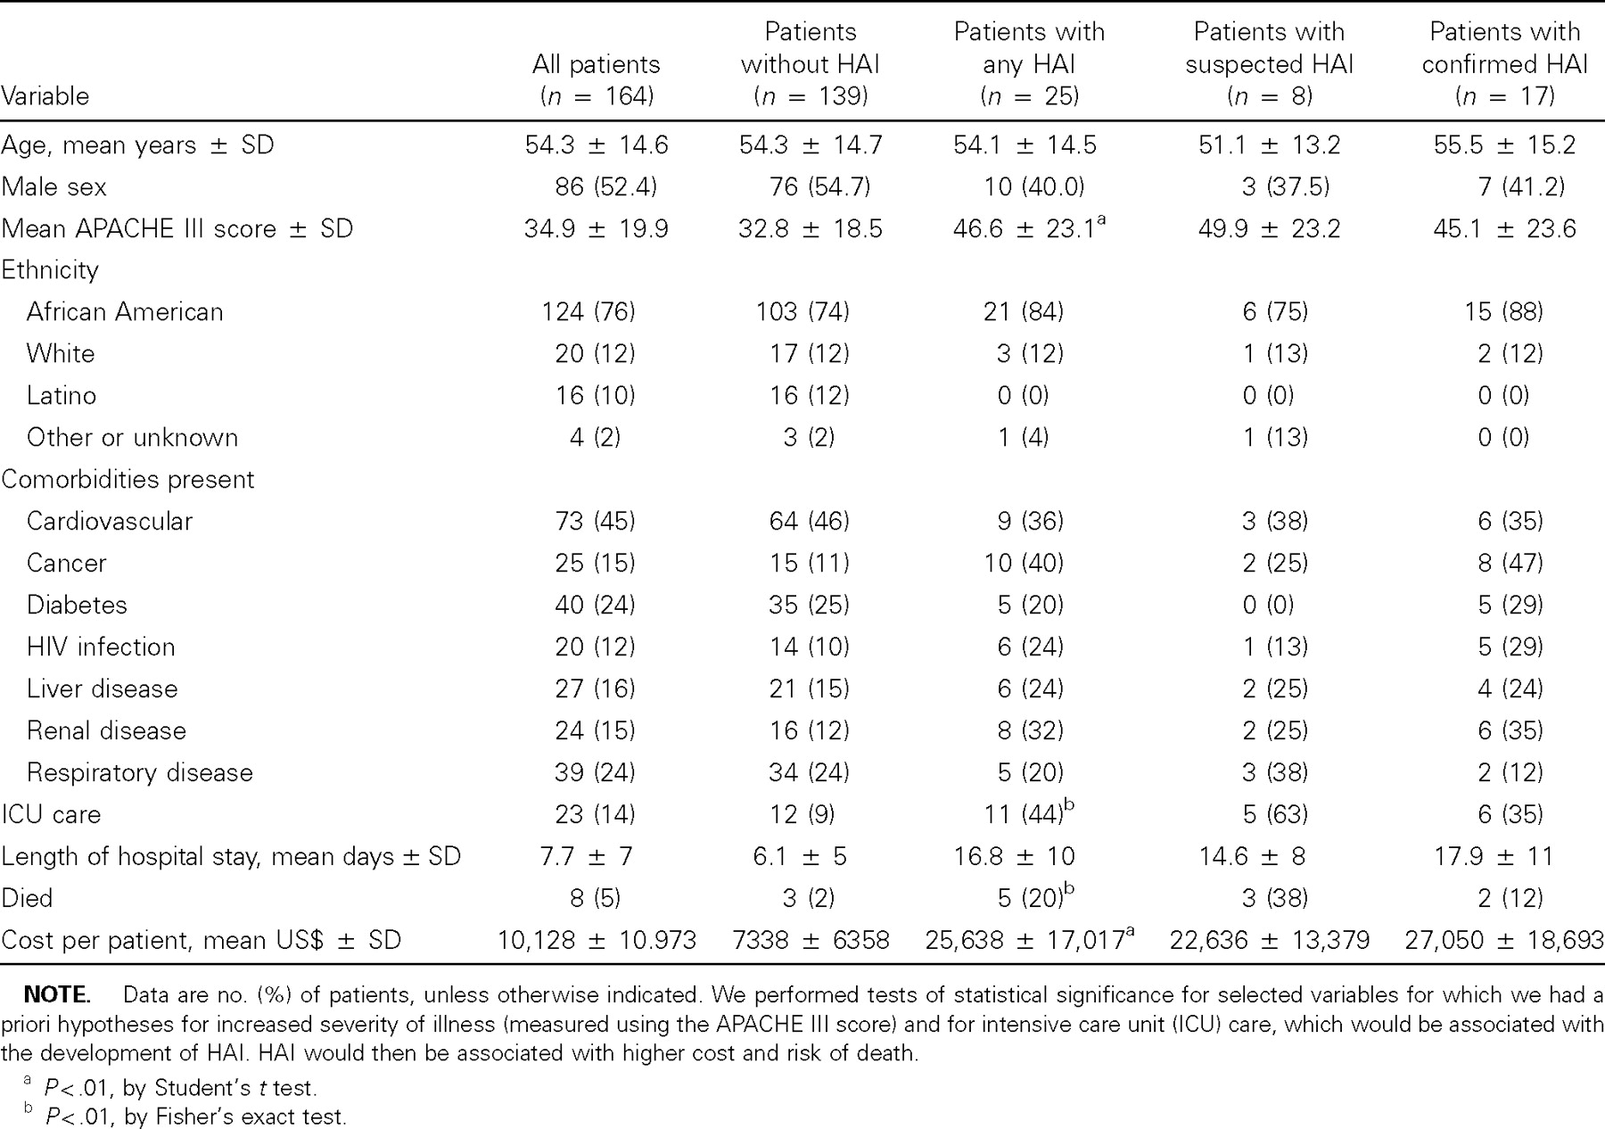
Table 1 Demographic characteristics of patients and outcome variables, stratified by presence of hospital-associated ...
Notes:
Table 1 Demographic characteristics of patients and outcome variables, stratified by presence of hospital-associated infection (HAI).
Unless provided in the caption above, the following copyright applies to the content of this slide: © 2003 by the Infectious Diseases Society of America

Slide 2
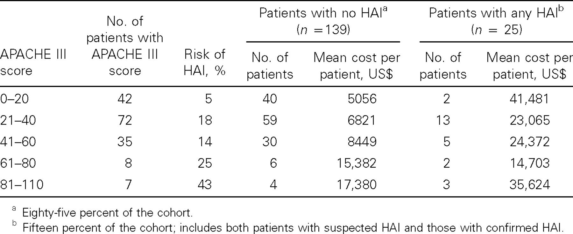
Table 2 Mean cost of health care per patient (n = 164), with and without hospital-associated infection (HAI), ...
Notes:
Table 2 Mean cost of health care per patient (n = 164), with and without hospital-associated infection (HAI), stratified by APACHE III score.
Unless provided in the caption above, the following copyright applies to the content of this slide: © 2003 by the Infectious Diseases Society of America

Slide 3
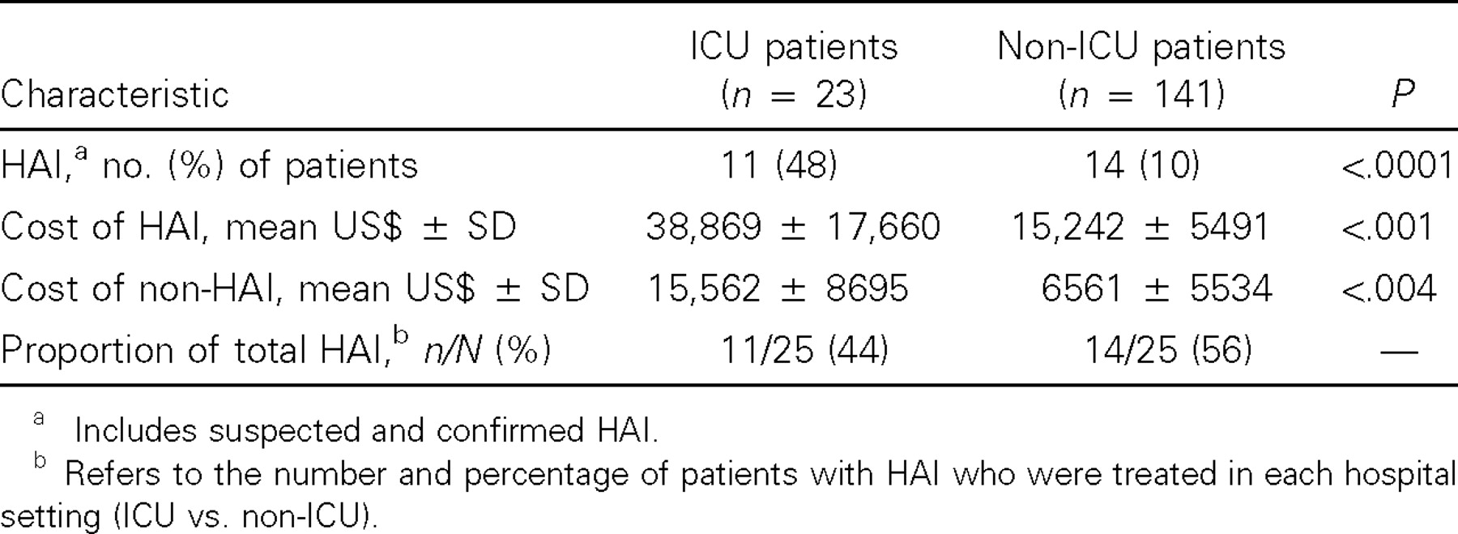
Table 3 Mean costs of health care, APACHE III scores, and rates of hospital-associated infection (HAI) for intensive ...
Notes:
Table 3 Mean costs of health care, APACHE III scores, and rates of hospital-associated infection (HAI) for intensive care unit (ICU) versus non-ICU patients.
Unless provided in the caption above, the following copyright applies to the content of this slide: © 2003 by the Infectious Diseases Society of America

Slide 4
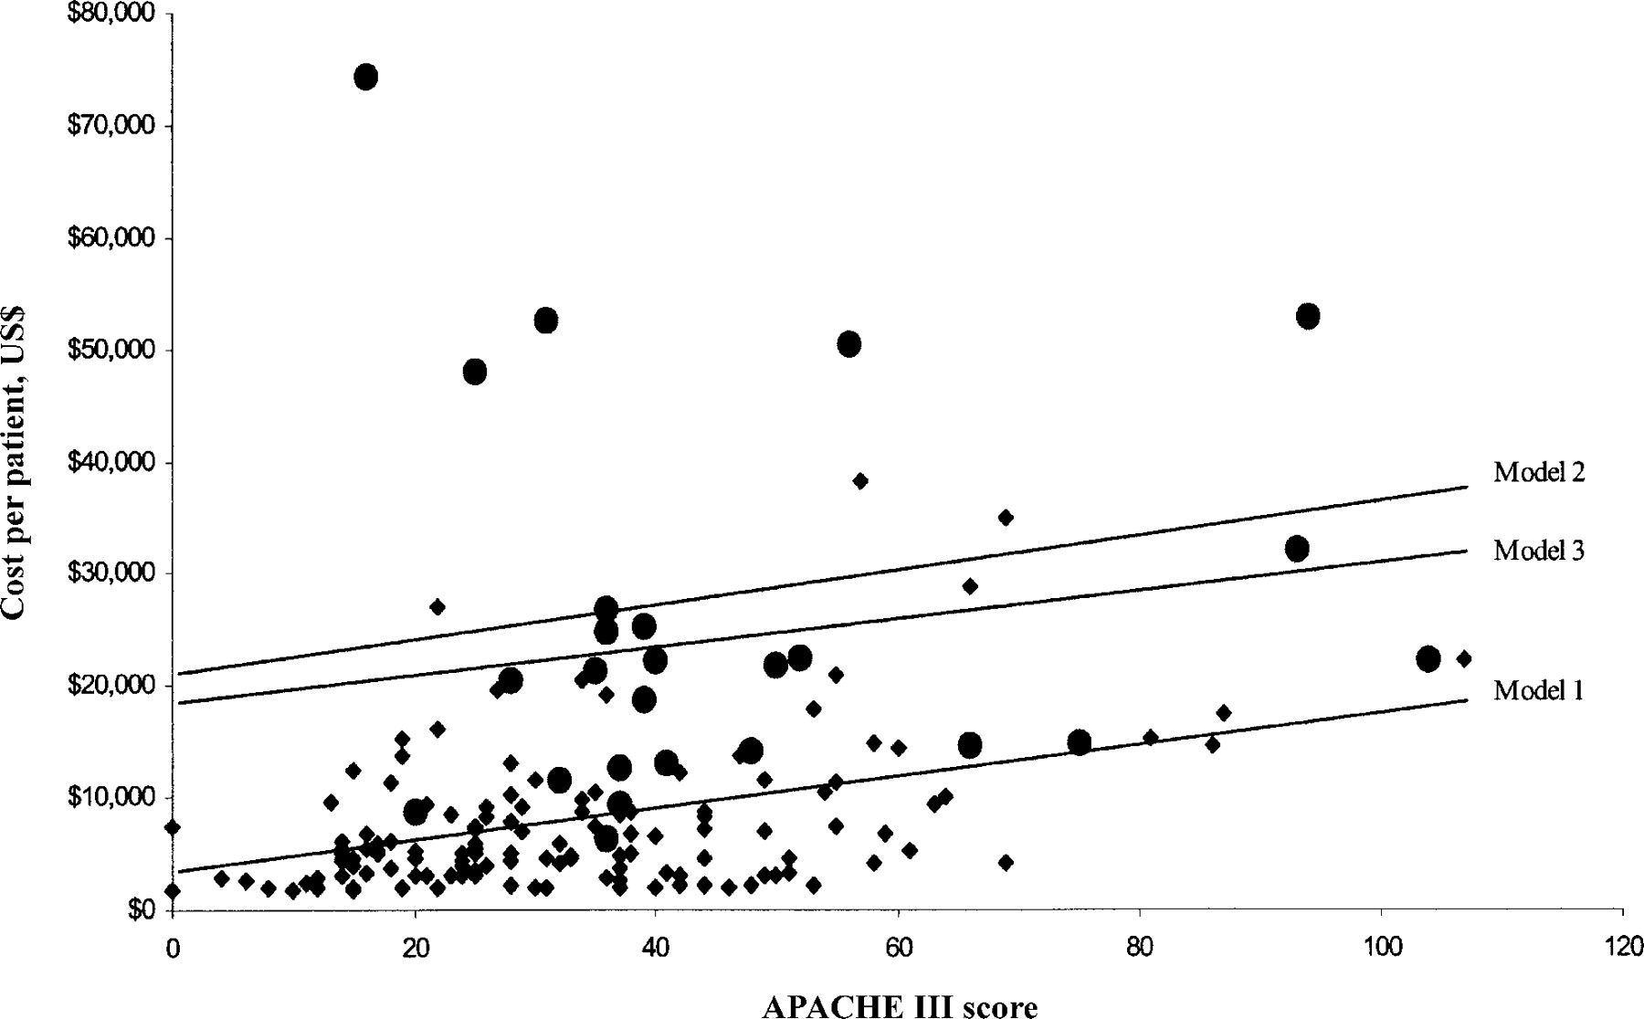
Figure 1 Frequency distribution of cost by APACHE III score for 164 study patients. Circle, patient with a ...
Notes:
Figure 1 Frequency distribution of cost by APACHE III score for 164 study patients. Circle, patient with a hospital-associated infection (HAI); diamond, patient without HAI; lines, regression equations for each economic model.
Unless provided in the caption above, the following copyright applies to the content of this slide: © 2003 by the Infectious Diseases Society of America

Slide 5
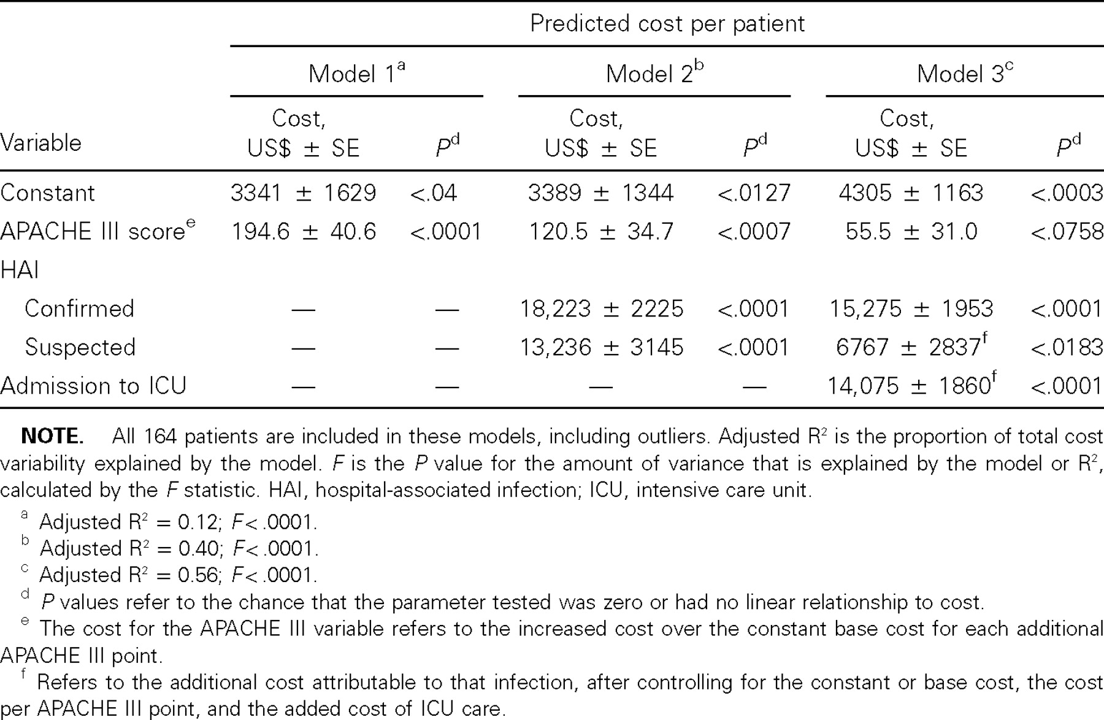
Table 4 Linear regression model results for costs per patient.
Notes:
Table 4 Linear regression model results for costs per patient.
Unless provided in the caption above, the following copyright applies to the content of this slide: © 2003 by the Infectious Diseases Society of America

