Slide 1
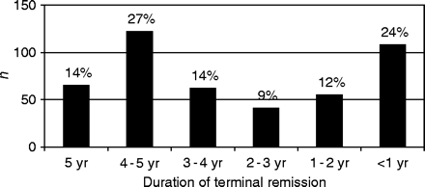
Fig. 1 Outcome of 453 children with newly diagnosed epilepsy at 5 years of follow-up.
Notes:
Fig. 1 Outcome of 453 children with newly diagnosed epilepsy at 5 years of follow-up.
Unless provided in the caption above, the following copyright applies to the content of this slide: Brain Vol. 127 No. 8 © Guarantors of Brain 2004; all rights reserved

Slide 2
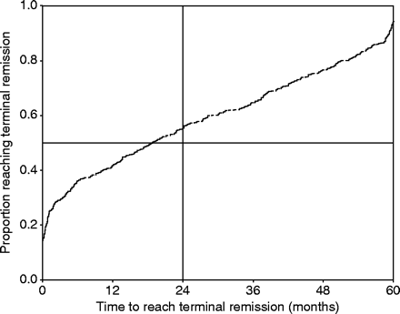
Fig. 2 Moment (time in months) of the last seizure before entering the terminal remission existing at 5 years of ...
Notes:
Fig. 2 Moment (time in months) of the last seizure before entering the terminal remission existing at 5 years of follow-up for 453 children in the cohort. Kaplan–Meier survival curve.
Unless provided in the caption above, the following copyright applies to the content of this slide: Brain Vol. 127 No. 8 © Guarantors of Brain 2004; all rights reserved

Slide 3
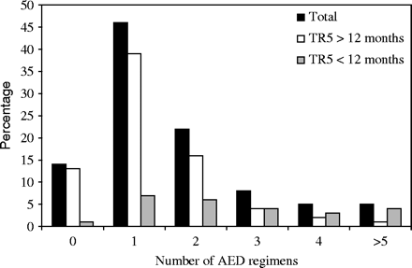
Fig. 3 Number of anti-epileptic drug (AED) regimens during 5 years of follow-up in the entire cohort and in each of ...
Notes:
Fig. 3 Number of anti-epileptic drug (AED) regimens during 5 years of follow-up in the entire cohort and in each of two 5-year outcome categories, all expressed as percentage of the entire cohort (n = 453).
Unless provided in the caption above, the following copyright applies to the content of this slide: Brain Vol. 127 No. 8 © Guarantors of Brain 2004; all rights reserved

Slide 4
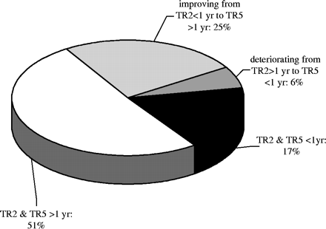
Fig. 4 Correlation between the categorical outcomes at 2 and 5 years for 453 children in the 5-year analysis. The ...
Notes:
Fig. 4 Correlation between the categorical outcomes at 2 and 5 years for 453 children in the 5-year analysis. The outcome measures are terminal remission 1 year at 2 and 5 years of follow-up.
Unless provided in the caption above, the following copyright applies to the content of this slide: Brain Vol. 127 No. 8 © Guarantors of Brain 2004; all rights reserved

Slide 5
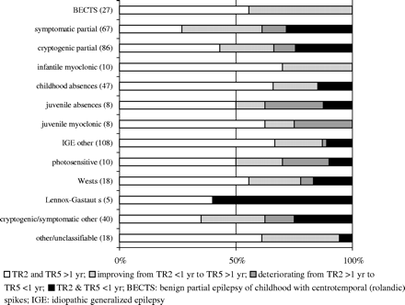
Fig. 5 Outcome at 2 and 5 years of 453 children followed for 5 years, according to epileptic syndrome (Commission on ...
Notes:
Fig. 5 Outcome at 2 and 5 years of 453 children followed for 5 years, according to epileptic syndrome (Commission on Classification and Terminology of the International League Against Epilepsy, 1989) as defined 2 years after intake. Numbers in parentheses are numbers of patients.
Unless provided in the caption above, the following copyright applies to the content of this slide: Brain Vol. 127 No. 8 © Guarantors of Brain 2004; all rights reserved

