Slide 1
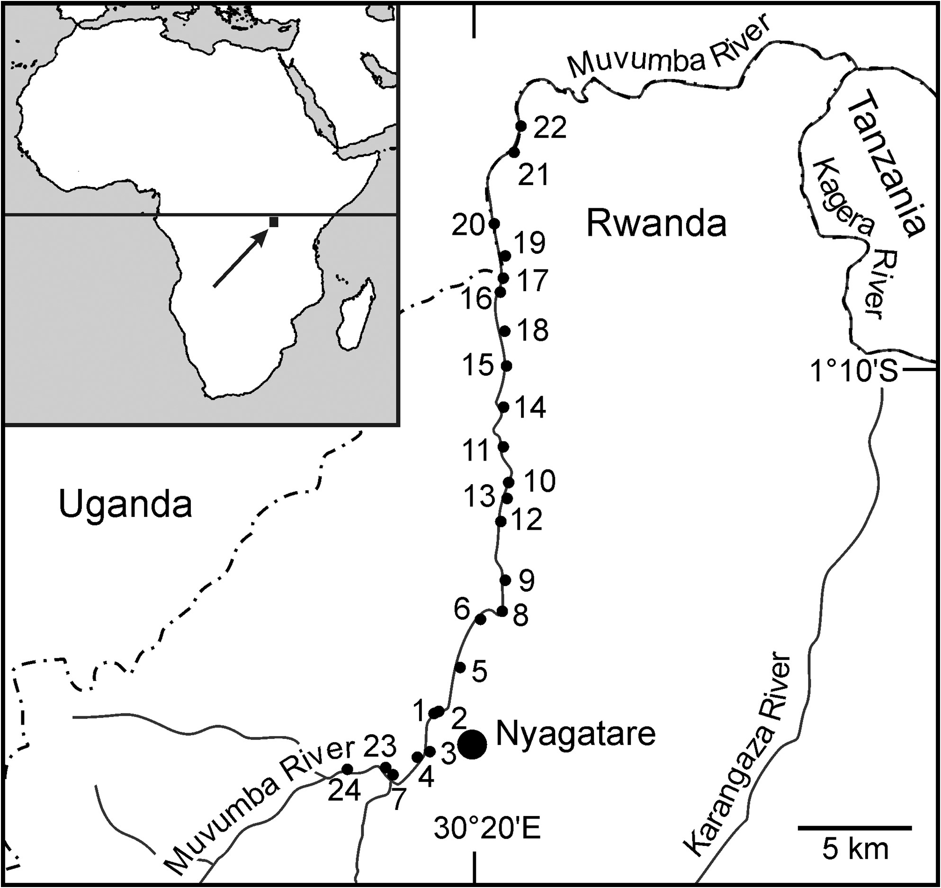
Figure 1. Location of the 24 surveyed plots in the gallery forest along the Muvumba River in northeastern Rwanda. Inset ...
Notes:
Figure 1. Location of the 24 surveyed plots in the gallery forest along the Muvumba River in northeastern Rwanda. Inset shows the position of the study area in Africa.
Unless provided in the caption above, the following copyright applies to the content of this slide: © The Author 2016. Published by Oxford University Press on behalf of The Malacological Society of London, all rights reserved.For Permissions, please email: journals.permissions@oup.com

