Slide 1
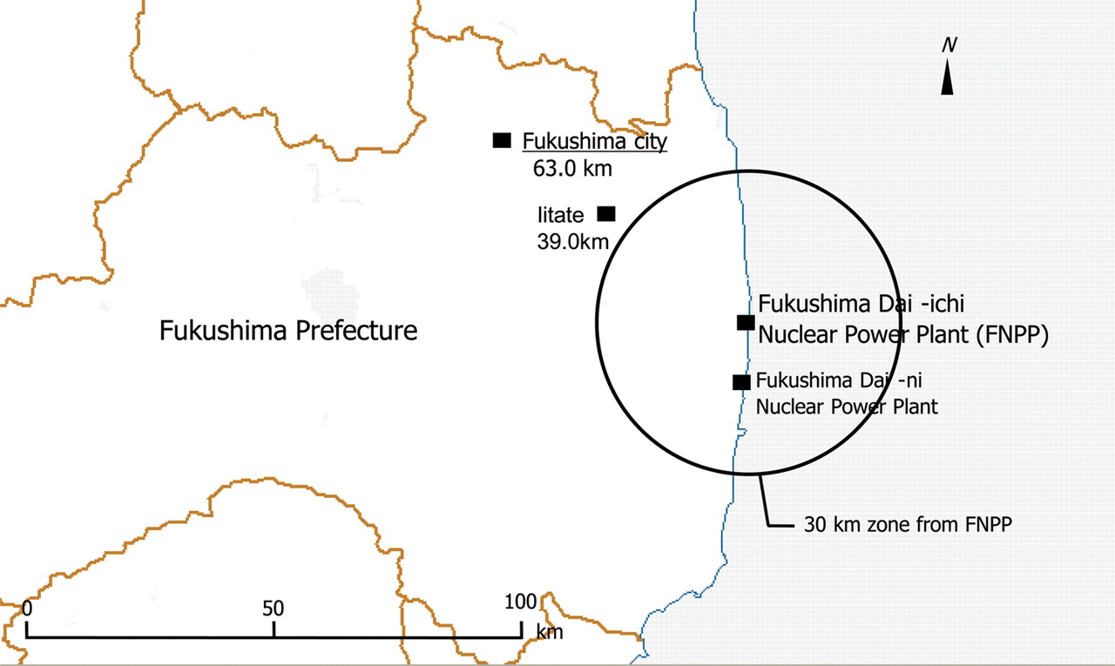
Figure 1. Map of the Fukushima Prefecture.
Notes:
Figure 1. Map of the Fukushima Prefecture.
Unless provided in the caption above, the following copyright applies to the content of this slide: © The Author 2012. Published by Oxford University Press. All rights reserved. For Permissions, please email: journals.permissions@oup.com

Slide 2
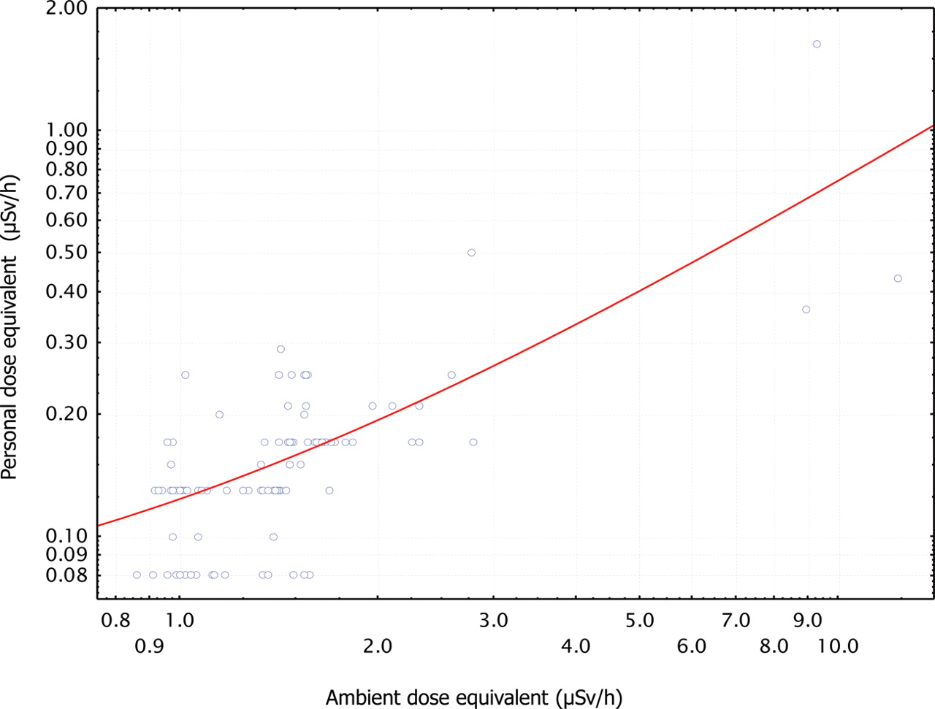
Figure 2. Relationship between the ambient and individual dose rates in Fukushima City.
Notes:
Figure 2. Relationship between the ambient and individual dose rates in Fukushima City.
Unless provided in the caption above, the following copyright applies to the content of this slide: © The Author 2012. Published by Oxford University Press. All rights reserved. For Permissions, please email: journals.permissions@oup.com

