Slide 1
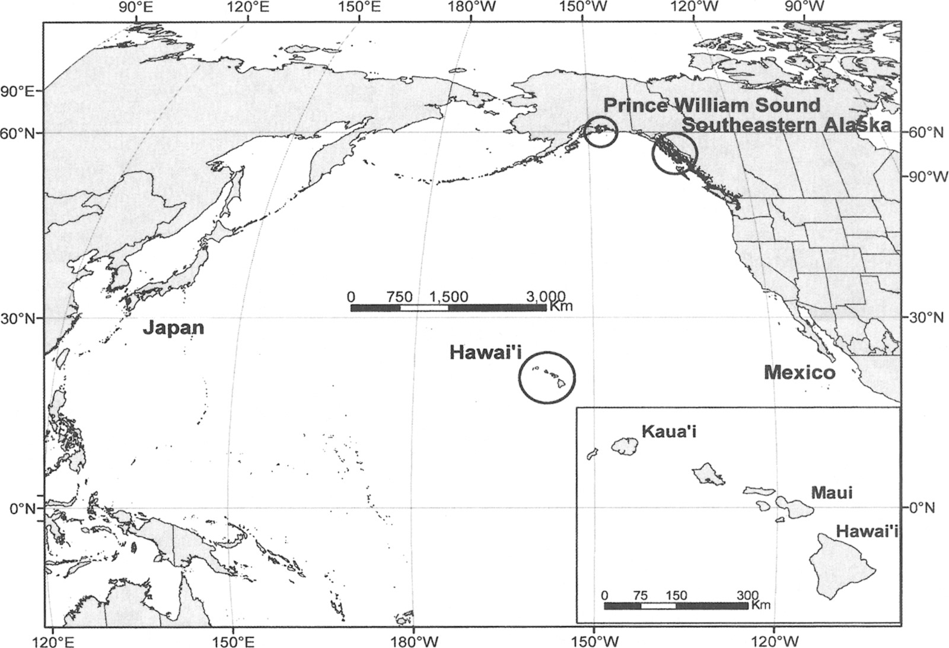
Fig. 1 Areas in the North Pacific where humpback whale research is conducted. Analyses in this paper focus on the ...
Notes:
Fig. 1 Areas in the North Pacific where humpback whale research is conducted. Analyses in this paper focus on the central North Pacific stock, which spends the winter in Hawai'i and summer in feeding areas in Alaska.
Unless provided in the caption above, the following copyright applies to the content of this slide: © 2004 American Society of Mammalogists

Slide 2
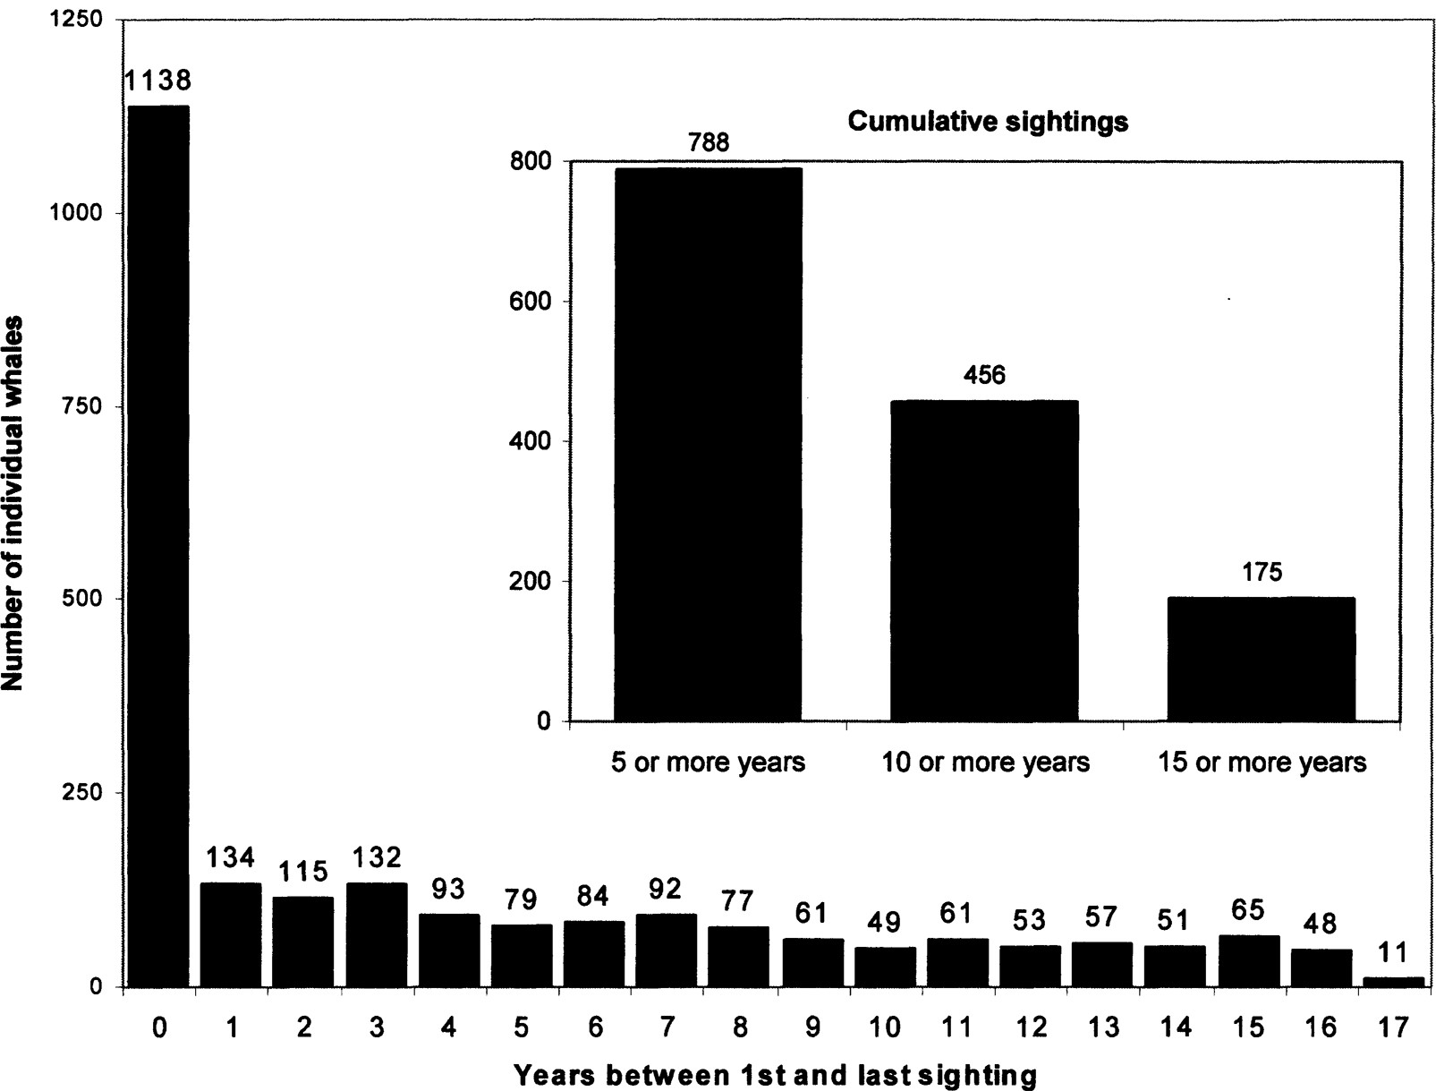
Fig. 2 Long-term sightings and resightings of central North Pacific humpback whales, as shown by number of years ...
Notes:
Fig. 2 Long-term sightings and resightings of central North Pacific humpback whales, as shown by number of years between 1st and last sightings of whales seen 1979–1996.
Unless provided in the caption above, the following copyright applies to the content of this slide: © 2004 American Society of Mammalogists

Slide 3
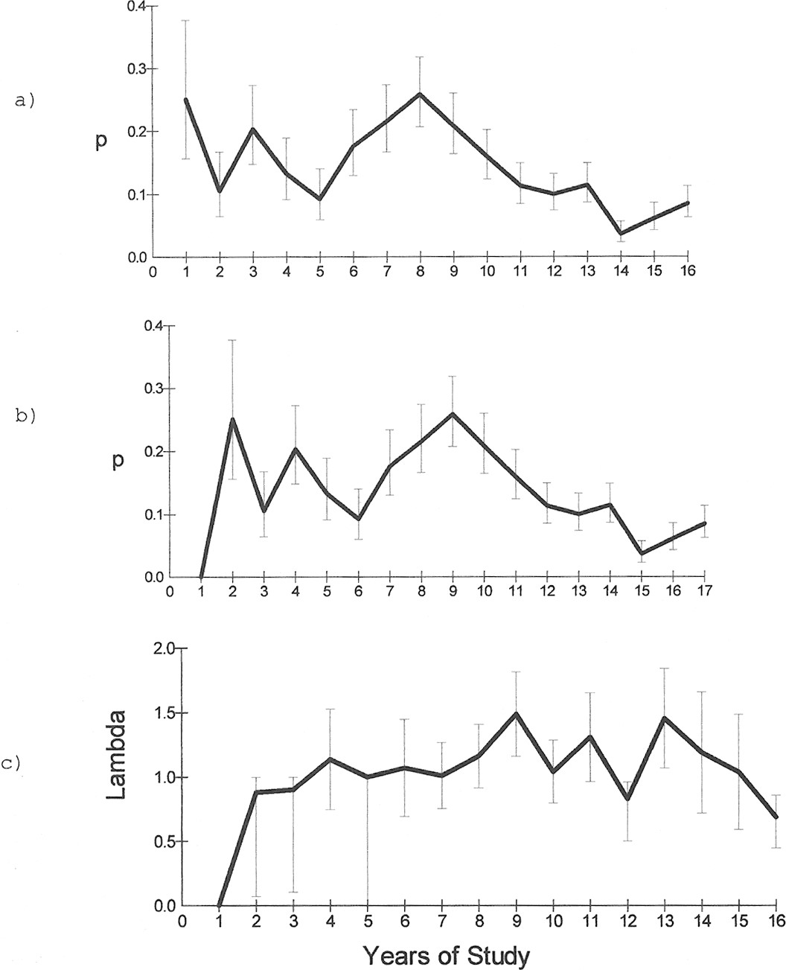
Fig. 3 Estimates of capture probabilities and population rates of increase for whales seen annually in Hawai'ian ...
Notes:
Fig. 3 Estimates of capture probabilities and population rates of increase for whales seen annually in Hawai'ian waters from 1980 to 1996, ĉ = 2.296: a) Cormack–Jolly–Seber estimates of p, capture probability, b) Pradel estimates of p, capture probability, c) Pradel estimates of λ, population rate of increase.
Unless provided in the caption above, the following copyright applies to the content of this slide: © 2004 American Society of Mammalogists

Slide 4
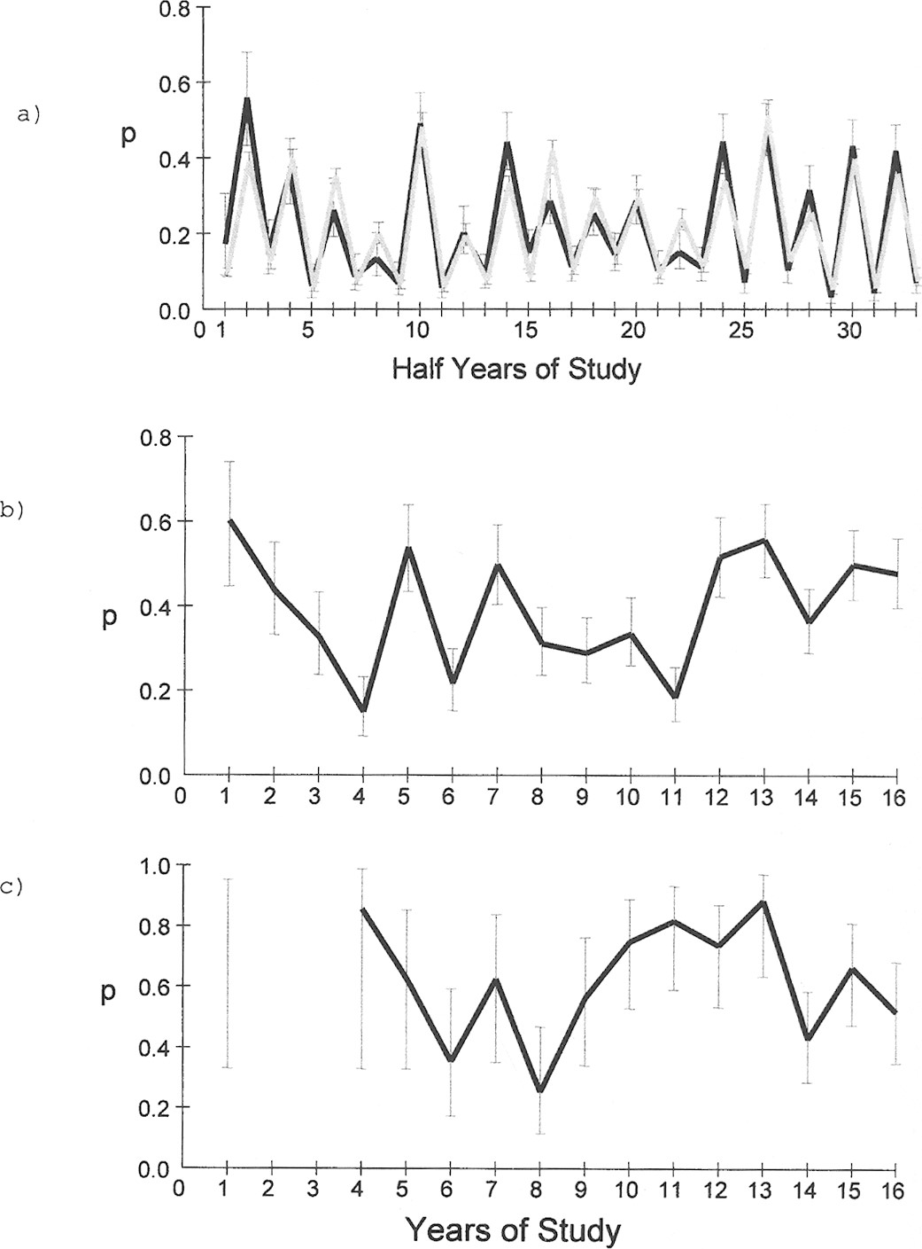
Fig. 4 Estimates of capture probabilities for humpback whales seen in Alaska and/or Hawai'i from 1979 to 1996: a) ...
Notes:
Fig. 4 Estimates of capture probabilities for humpback whales seen in Alaska and/or Hawai'i from 1979 to 1996: a) Cormack–Jolly–Seber estimates of p, capture probabilities, by semiannual periods (dark line) and by area × effort (light line) for SE Alaska whales seen in SE Alaska and Hawai'i (ĉ = 1.905). b) Barker estimates of p, capture probability, for whales seen in SE Alaska (primary capture session) and Hawai'i (resighting between capture session) (ĉ = 2.006). c) Barker estimates of p, capture probability, for whales seen in Prince William Sound (primary capture session) and Hawai'i (resighting between capture session) (ĉ = 1.569).
Unless provided in the caption above, the following copyright applies to the content of this slide: © 2004 American Society of Mammalogists

