Slide 1
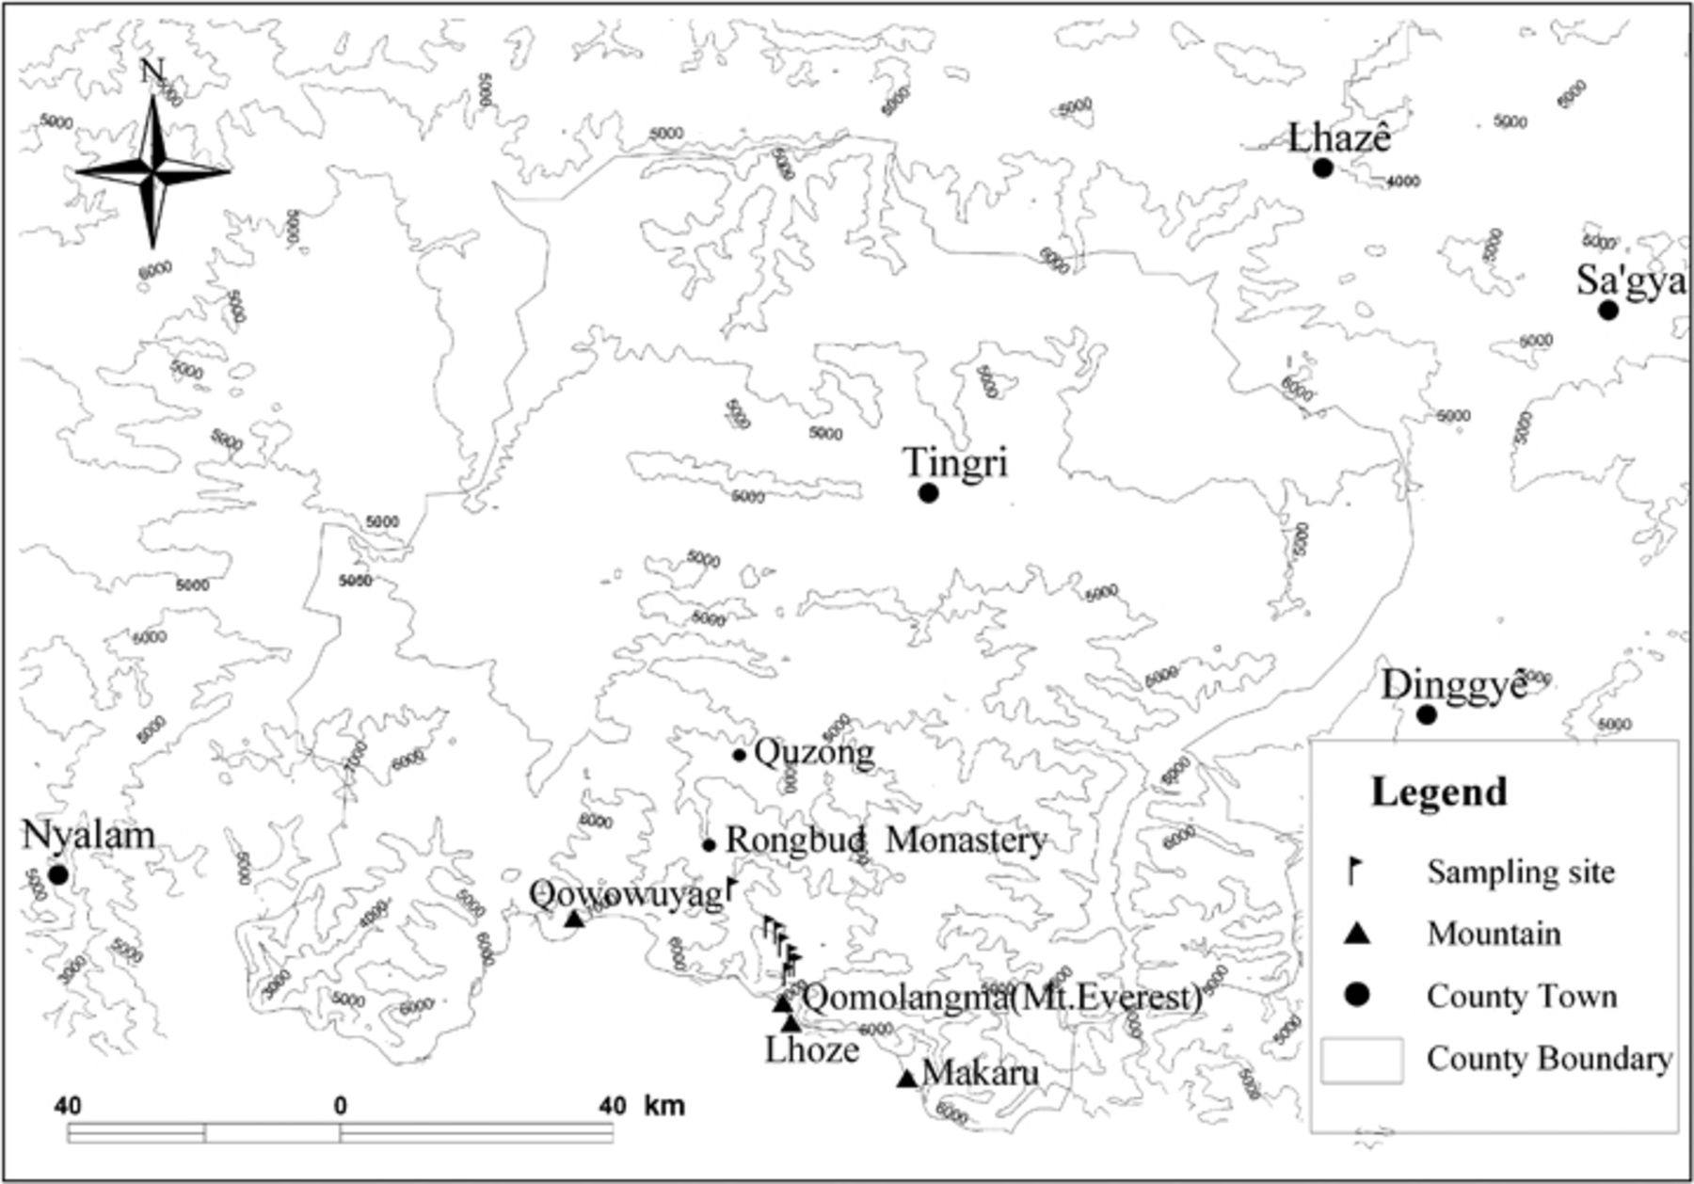
1 Location of soils sampled in the Mount Everest, on the Tibetan Plateau.
Notes:
1 Location of soils sampled in the Mount Everest, on the Tibetan Plateau.
Unless provided in the caption above, the following copyright applies to the content of this slide: © 2009 Federation of European Microbiological Societies. Published by Blackwell Publishing Ltd. All rights reserved

Slide 2
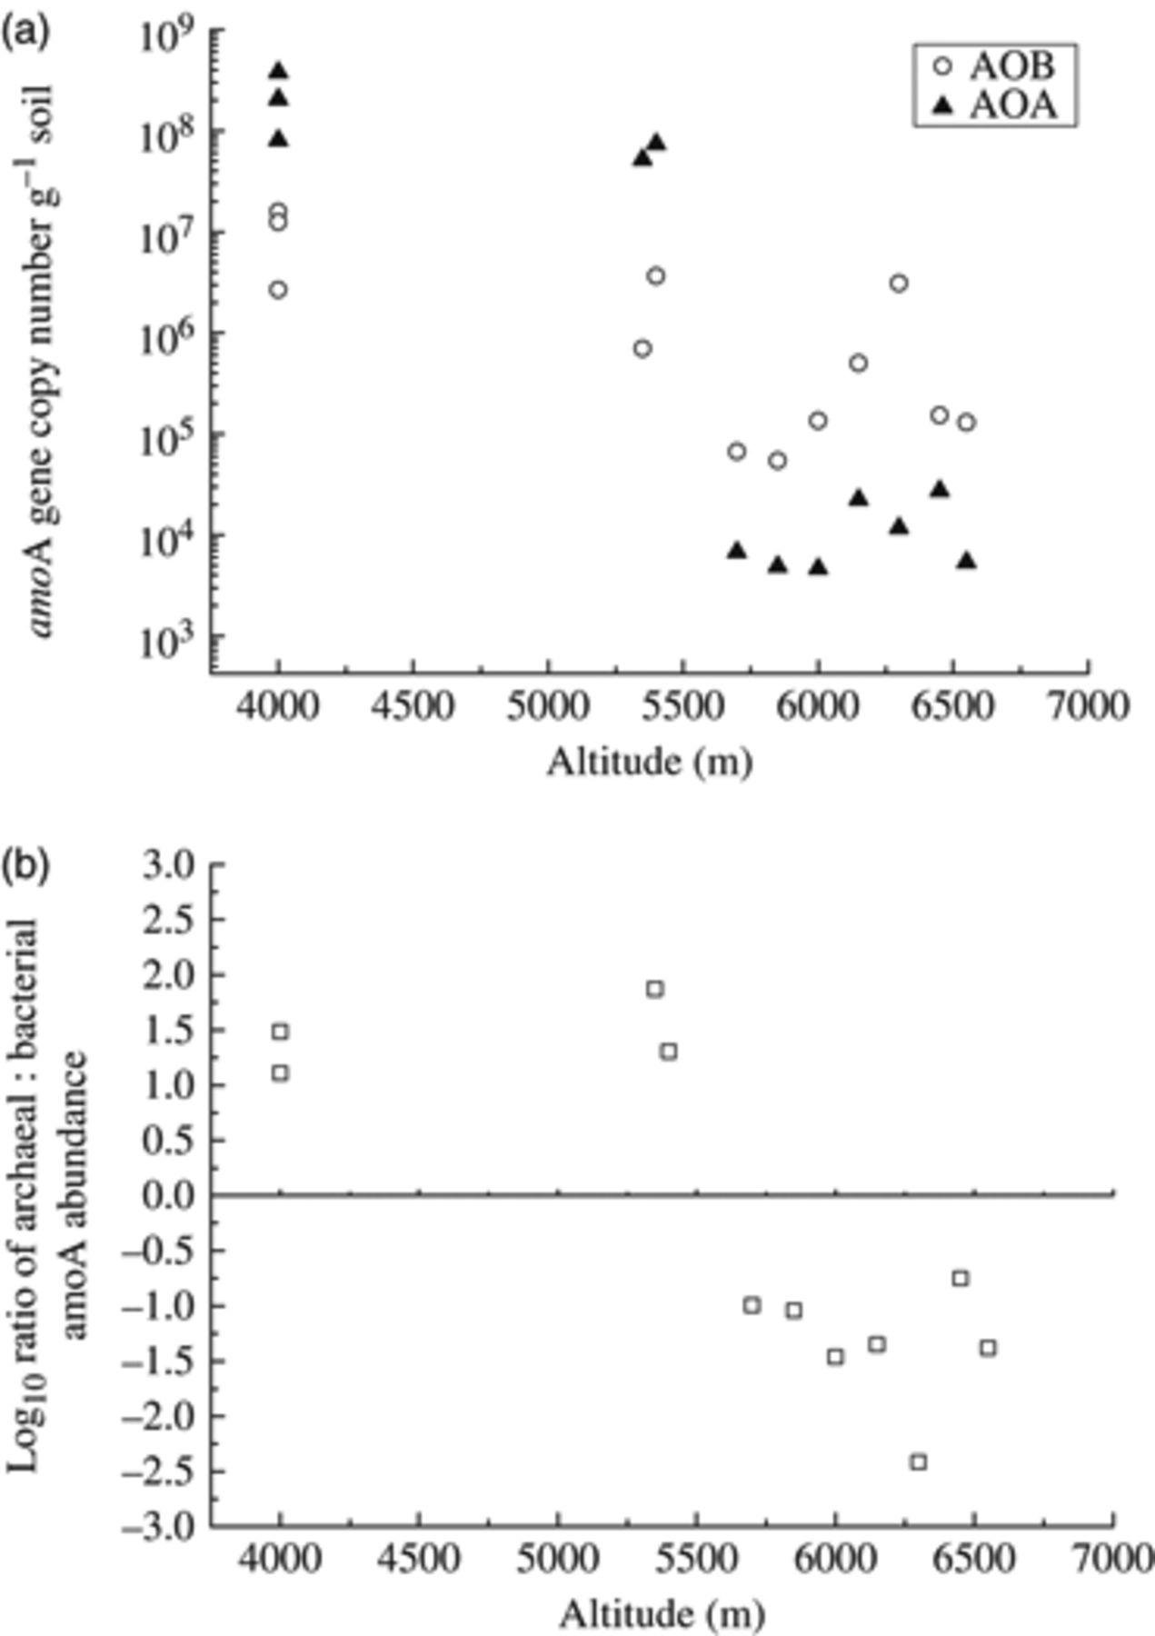
2 Abundance of the bacterial and archaeal amoA along the altitude gradient of Mount Everest on the Tibetan ...
Notes:
2 Abundance of the bacterial and archaeal amoA along the altitude gradient of Mount Everest on the Tibetan Plateau. (a) The abundance of archaeal and bacterial amoA; (b) log10 ratio of archaeal : bacterial amoA abundance.
Unless provided in the caption above, the following copyright applies to the content of this slide: © 2009 Federation of European Microbiological Societies. Published by Blackwell Publishing Ltd. All rights reserved

Slide 3
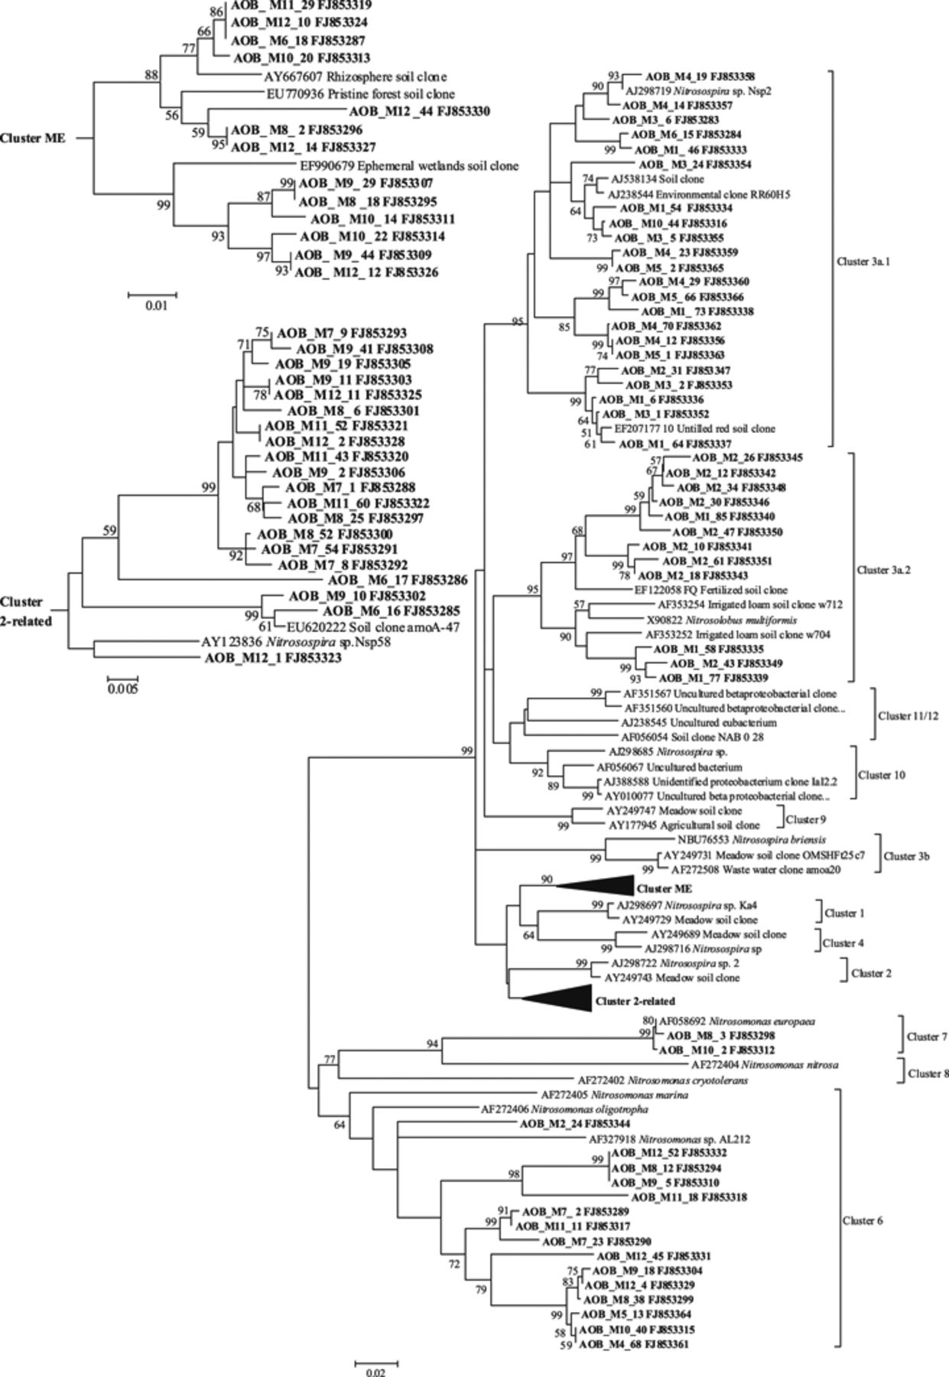
3 Neighbor-joining phylogenetic tree of bacterial amoA sequences (465-bp fragment) retrieved from Mount ...
Notes:
3 Neighbor-joining phylogenetic tree of bacterial amoA sequences (465-bp fragment) retrieved from Mount Everest, on the Tibetan Plateau. Clones from this study are shown in bold with the name AOB, followed by soil code (M1–M12), and then by clone code. The accession number follows each clone. Bootstrap values (>50) are indicated at branch points.
Unless provided in the caption above, the following copyright applies to the content of this slide: © 2009 Federation of European Microbiological Societies. Published by Blackwell Publishing Ltd. All rights reserved

Slide 4
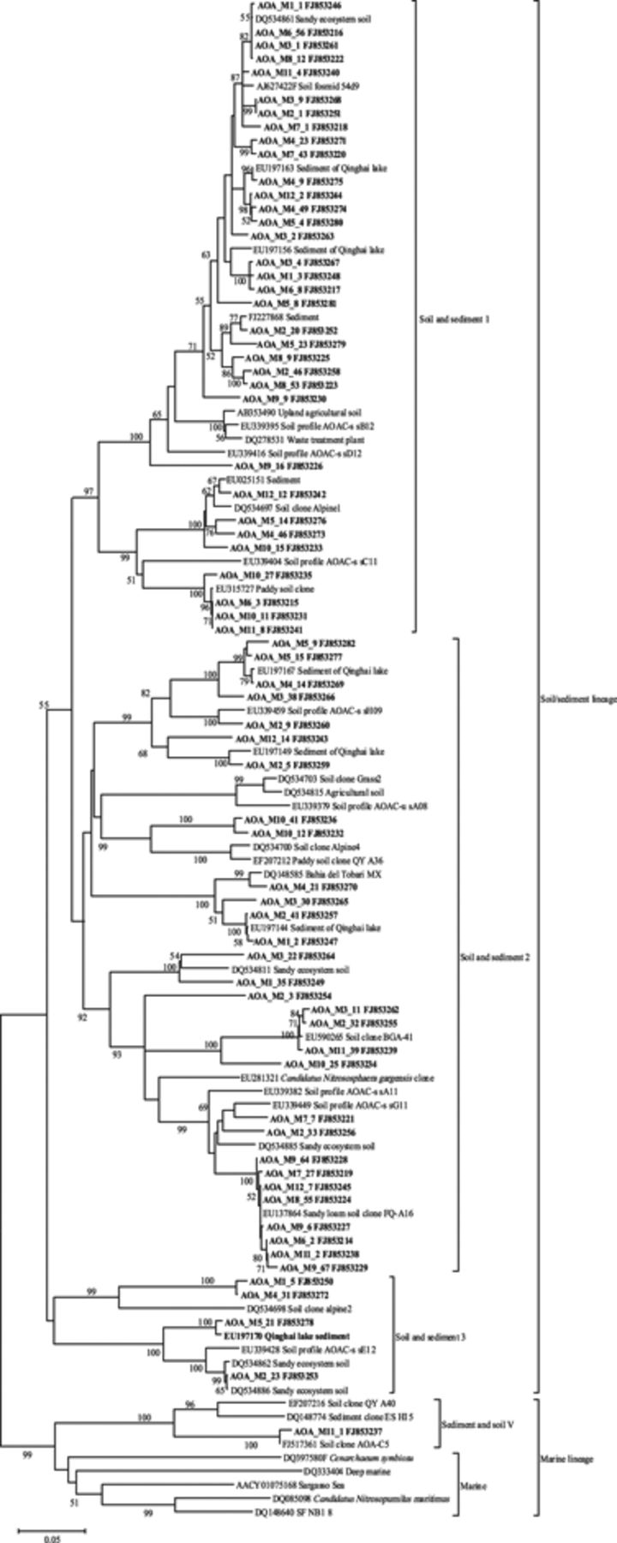
4 Neighbor-joining phylogenetic tree of archaeal amoA sequences (594-bp fragment) retrieved from Mount Everest, ...
Notes:
4 Neighbor-joining phylogenetic tree of archaeal amoA sequences (594-bp fragment) retrieved from Mount Everest, on the Tibetan Plateau. Clones from this study are shown in bold with the name AOA, followed by soil code (M1–M12), and then by clone code. The accession number follows each clone. Bootstrap values (>50) are indicated at branch points.
Unless provided in the caption above, the following copyright applies to the content of this slide: © 2009 Federation of European Microbiological Societies. Published by Blackwell Publishing Ltd. All rights reserved

Slide 5
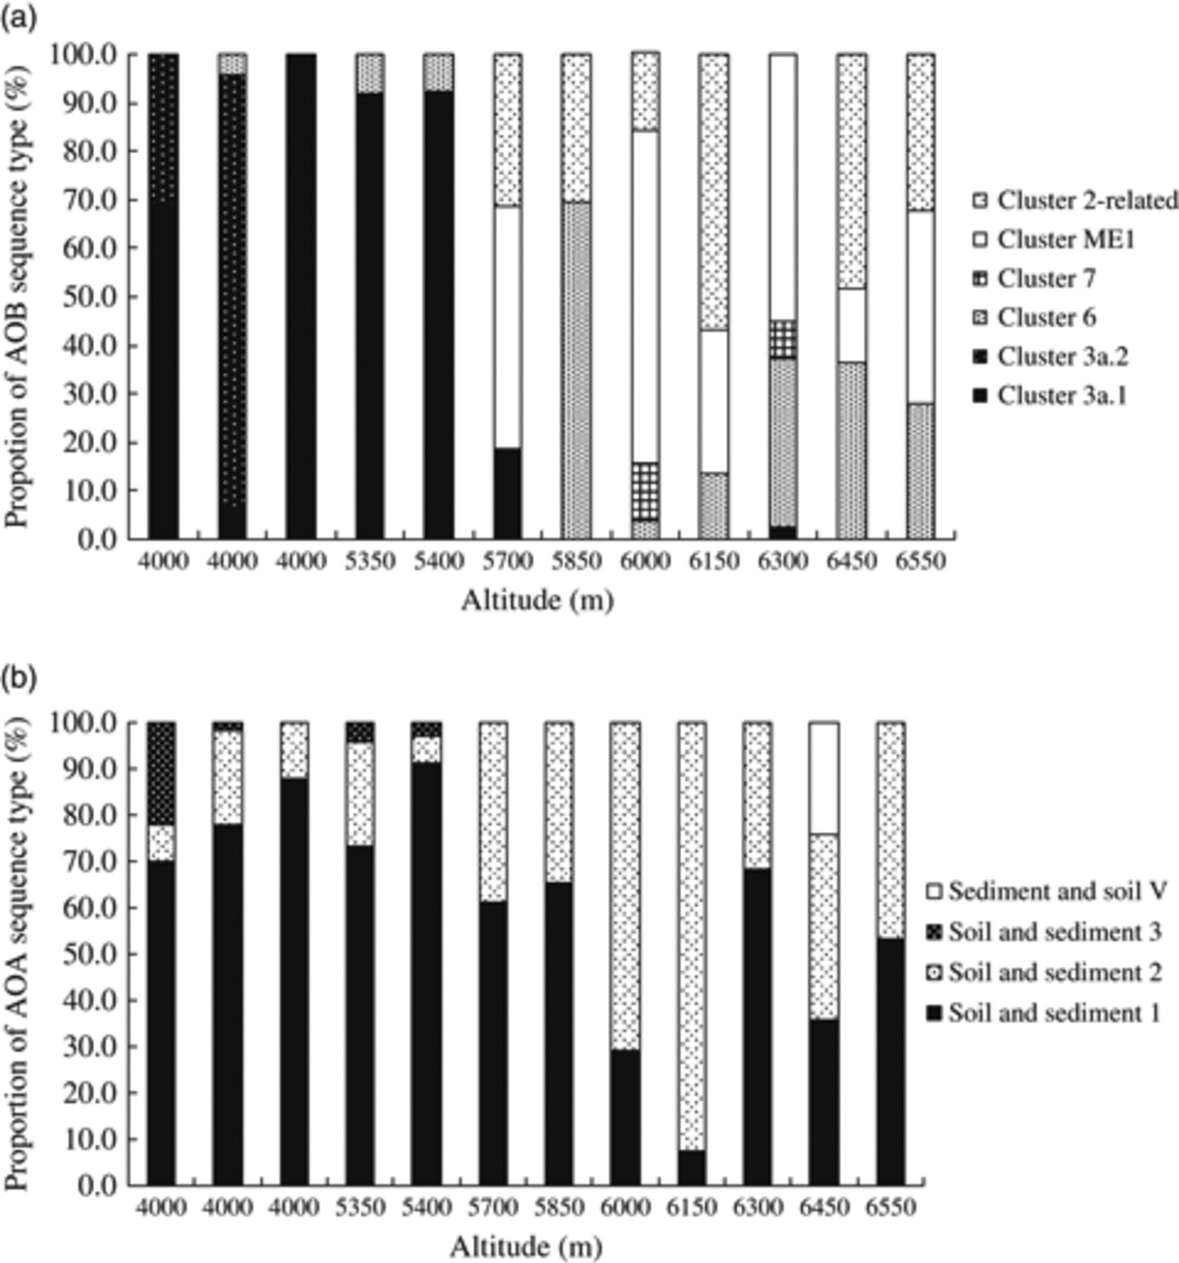
5 Proportions of bacterial amoA (a) and archaeal amoA (b) gene clone types representing various clusters in ...
Notes:
5 Proportions of bacterial amoA (a) and archaeal amoA (b) gene clone types representing various clusters in soils from Mount Everest, on the Tibetan Plateau.
Unless provided in the caption above, the following copyright applies to the content of this slide: © 2009 Federation of European Microbiological Societies. Published by Blackwell Publishing Ltd. All rights reserved

