Slide 1
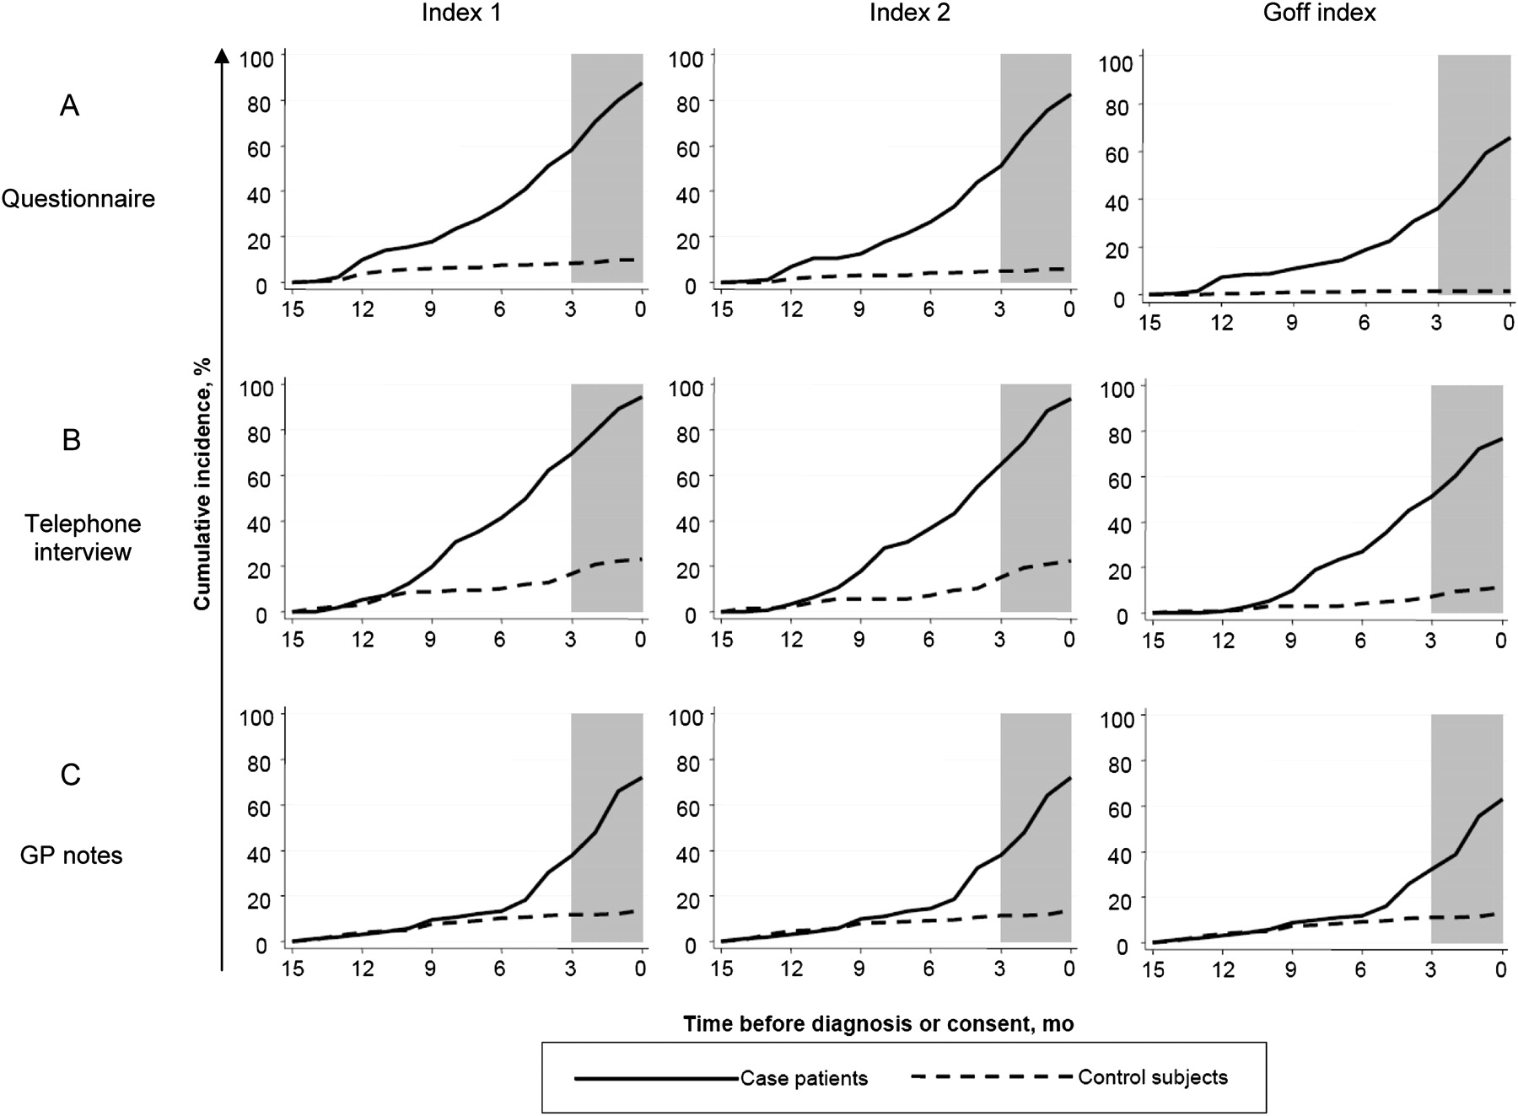
Figure 1 The cumulative incidence of positive indices among case patients and control subjects throughout 0–14 months ...
Notes:
Figure 1 The cumulative incidence of positive indices among case patients and control subjects throughout 0–14 months before diagnosis for each data source. The 3 months before diagnosis are shaded to demarcate the period during which women are already in, or about to enter, the referral system. The shaded areas indicate a peri-diagnostic period when investigations specific to the diagnostic work-up for ovarian cancer were likely to already be underway. A ) Data from 191 case patients and 268 control subjects were analyzed for the questionnaire; B ) data from 111 case patients and 125 control subjects were analyzed for the telephone interview; and C) data from 171 case patients and 227 control subjects were analyzed for the general practitioner (GP) notes.
Unless provided in the caption above, the following copyright applies to the content of this slide: © The Author 2012. Published by Oxford University Press.

